Slide 1
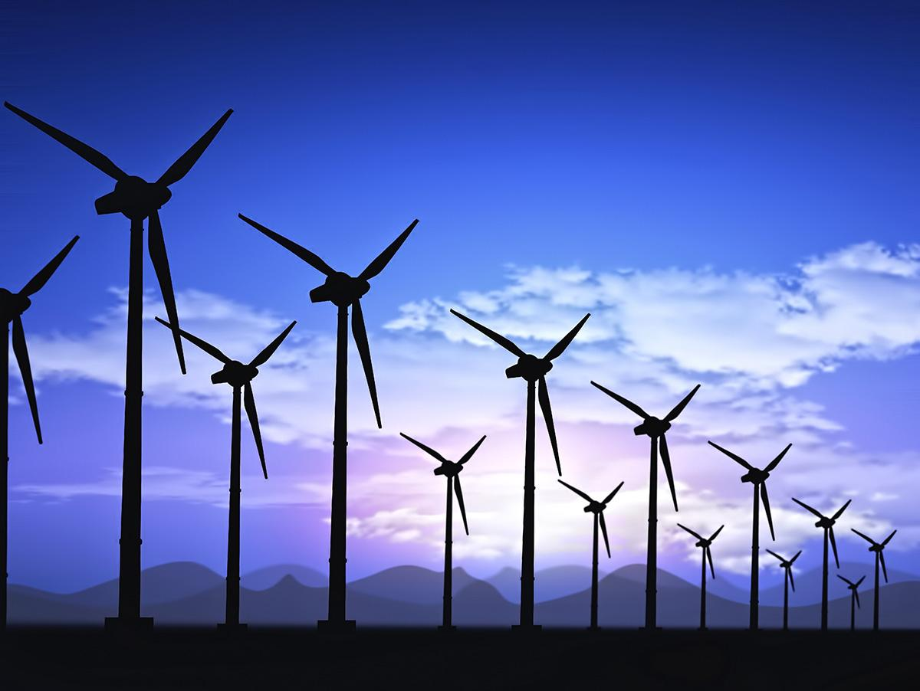
Positive and Negative Evaluations of Wind Power
Taylor Hubiak, Emily Royce, Christian Killino, Hannah Miller

Slide 2
Overview
Intro to Wind
Analysis 1: The benefits of wind power
Analysis 2: The cons of wind power
What we think

Slide 3
The Power of Wind
Engineers are exploring possibilities of creating “direct-drive” generators that operate at lower rotational speeds. This eliminates the gear box (heaviest and most expensive) part of the wind turbine.
This would make wind turbines more affordable and slightly lighter.
Accounts for ~2.5% of total electricity, but is growing at a rate of 25% per year.
Since 1980, prices of wind turbines decreased by 80%
  Technological advances → reduce in cost
Can replace solar panels on large properties
Energy from 1 turbine creates as much energy as 1,000s of solar panels

Slide 4
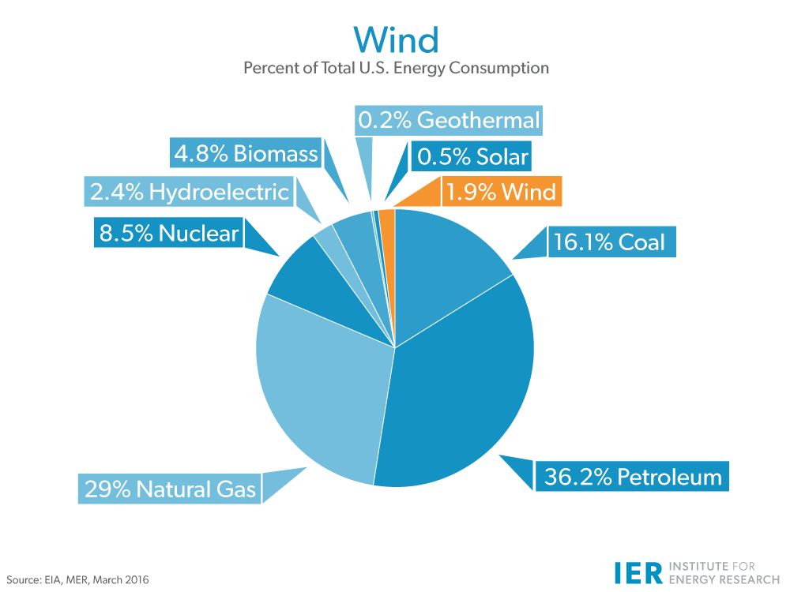
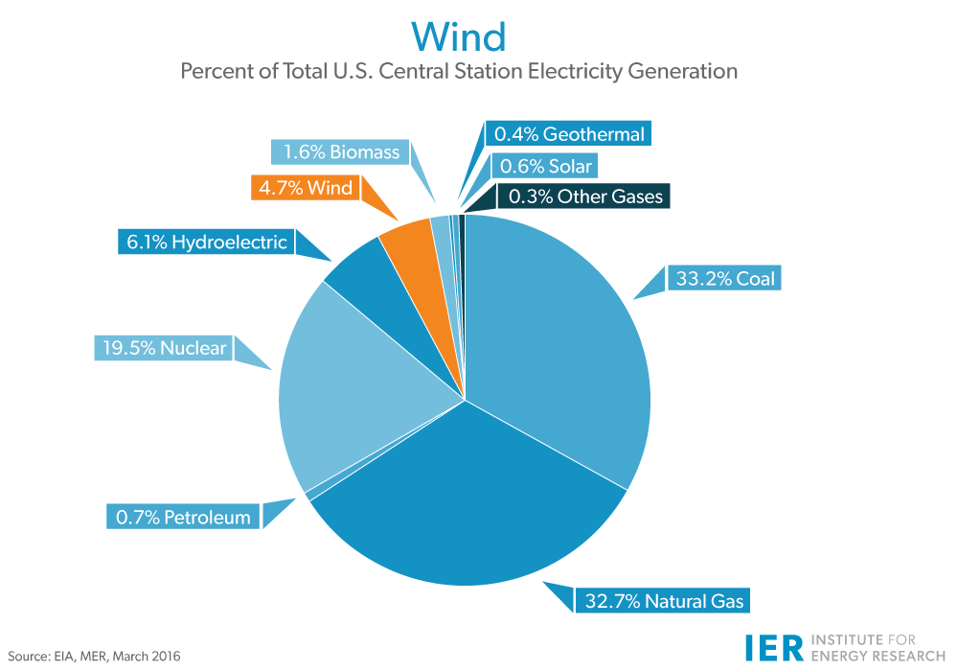
Notes:
https://www.instituteforenergyresearch.org/?encyclopedia=wind

Slide 5
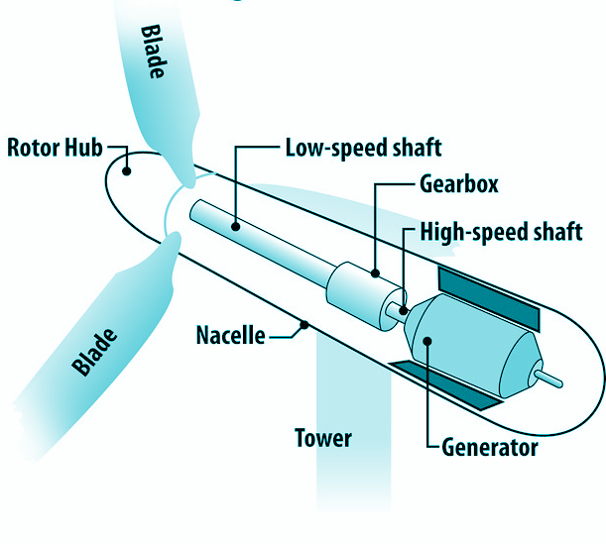
How Turbines Work
Propelled by two or three propeller-like blades around a rotor. Current blades are about 116 ft long each while the tower holding up is ~200 ft.
Rotor connected to a main shaft that spins a generator to create electricity
Blades turn the low-speed shaft at ~30-60 rpm
A gear box is connected to the low-speed shaft that increases the speed of the rpms to 1,000-1,800 rpms-- rotational speed required by generators to produce electricity
Anemometer- measures wind speed, keeps blades from spinning at a speed higher than 55 MPH.
A brake is used as an emergency shut off , and a controller prevents wind from propelling the blades at damaging speeds.

Slide 6
Scientific Perspective: Pros
Clean fuel source
Does not emit pollutants
Has no radioactive waste
Contains enough power potential to produce 20-times the amount of human energy needs
Minimally invasive to wildlife habitats and take us a very small amount of space
Renewable indefinitely

Slide 7
Economic Perspective: Pros
Cost-effective
Creates jobs
Wind turbines built on existing farms or ranches
  Benefits rural economy
  Farmers and ranchers can continue to work on the land
Has the ability to free US from figurative economic bondage of fossil fuels
“The U.S. wind sector employed more than 100,000 workers in 2016, and wind turbine technician is one of the fastest-growing American jobs of the decade.”

Slide 8
Scientific Perspective: Cons
Variable resource-energy-- only produced when wind is blowing
Turbines impact animal habitats
  Large areas cleared out → loss of natural vegetation
  Flying animals can be injured or killed by the 116 foot long blades
Construction/maintenance of turbines causes erosion
Wind farms produce a large amount of sound-- foreign to rural areas
  Animals and humans impacted

Slide 9
Economic Perspective: Cons
Coal and oil are more profitable in current system
Turbines not most profitable use of land
  Example-farming more profitable
High initial investment to build turbines
  Higher than fossil fuel generators- $1.3- $4 million more
Large wind farms mostly located in rural areas, far away from cities where the energy is needed
~146 days to generate more electricity than what was used to create the turbine itself

Slide 10
We think….
Wind can become a reliable source of energy in the future once the technology becomes more efficient, more affordable, and less variable. Until then we will continually rely on the traditional nonrenewable resources like coal and petroleum.

Slide 11
Resources
https://www.energy.gov/eere/wind/advantages-and-challenges-wind-energy
http://large.stanford.edu/courses/2014/ph240/lloyd2/
https://energyinformative.org/wind-energy-pros-and-cons/
windustry.org

