Slide 1
War on Coal
Laura Bayzick, John Luna, Nick Kubala, Christian Coassolo

Slide 2
Overview
Introduction
Analysis #1
Analysis #2
Conclusion
Summary

Slide 3
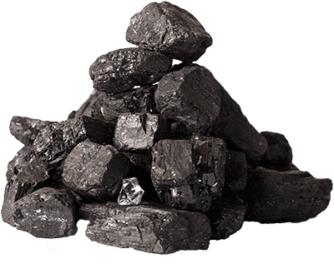
Introduction - The War On Coal
The War on Coal is a term first started by the coal industry and the people who support it.
They believe that the Obama administration passed strict regulations on the production of coal in order to make the use of coal uneconomical.
Notes:
A phrase used by the coal industry and its supporters to describe what they claim is an effort by the Obama administration to impose stringent regulations on coal power in the United States and thereby make such power uneconomical. (https://en.wikipedia.org/wiki/War_on_coal)
Major goal of taking action to better the environment was to reduce carbon emissions that the U.S. was giving off into the atmosphere. To do this, there would be strict emission laws put into place which took some companies out of business and had others get energy from non-fossil fuel sources such as solar, wind, water or nuclear.
Biggest proponent of the War on coal is money. It is cheap to use coal, expensive to use renewable energy sources. For the big businesses, cheap is better than expensive.

Slide 4
Introduction - The War On Coal
The strict emission laws put in place by the Obama administration caused some coal companies to go out of business and coal power stations to close.
With the coal companies closing, they were replaced by other cleaner forms of energy such as solar, wind, hydropower or nuclear or with natural gas
A large driving factor in this debate in money since it is cheaper to produce coal than it is any other renewable energy source which would make it much more appealing to big business

Slide 5

Analysis #1 - The War on Coal did not happen
Was there ever a war on coal in the first place?
Where was this war fought?
Who were the combatants?
What effect did this have on the economy/environment and American people?

Slide 6

Analysis #1 - The War on Coal did not happen - Cont.
Statement saying that there was a “War on Coal” are misleading on several counts.
President Obama didn’t wage a “war on coal”.
There has never been any official documents that do state a declaration of War on Coal.
Changing times and consumer demand for energy from non-fossil fuel sources has been steadily rising.

Slide 7
Analysis #1 - The War on Coal did not happen - Cont.
Natural decline in the need in the coal industry:
For coal, mining jobs have crashed from a high of 800,000 workers in the 1920s to about 76,000 today.
Automation in coal mining and competition from other energy sources like natural gas and renewables have caused the sector’s decline; regulations have played only a small role.

Slide 8
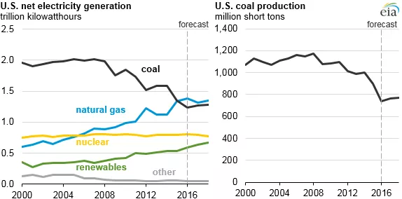
Analysis #1 - The War on Coal did not happen - Cont.
Coal production and its share of the electricity mix is falling too, largely coinciding with the shale gas boom.
Energy Information Administration

Slide 9
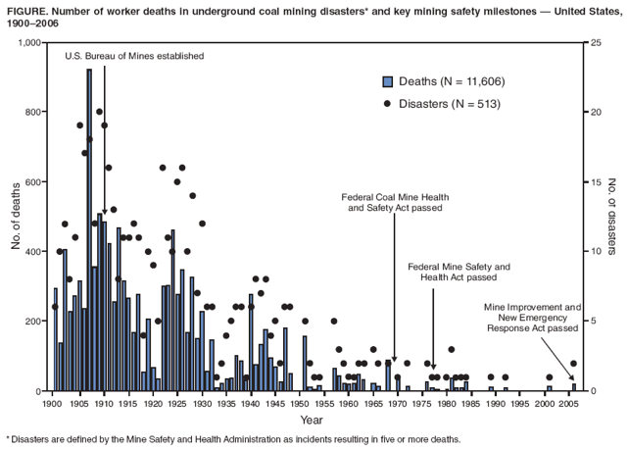
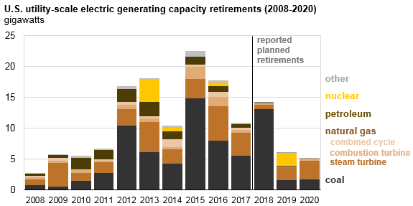
Analysis #2 - The War on Coal did happen
Coal for electricity production has dropped to 40% (2015) from 50% in 2005.
Coal related retirements have significantly dropped in the past 10 years.
Coal related deaths have decreased immensely since the early 1900’s.

Slide 10
Conclusion
As a group, we are split between if the war on coal actually happened and if it was good for our country. Some of us feel that there was a war on coal and it was positive for our country because there were efforts to go green by the Obama administration. Coal related deaths and retirements have dropped since the 1900s. Some of us feel that the war on coal did not happen and it was bad for our country. Coal is not a clean energy source and the war on coal was used as a distraction. Coal is being phased out for more efficient forms like natural gas or renewable forms.

Slide 11
Summary
Overview
Introduction
Analysis #1
Analysis #2
Conclusion

Slide 12
References
Grunwald, M., & Samuelsohn, D. (2015, May 27). Inside the war on coal. Retrieved from https://www.politico.com/agenda/story/2015/05/inside-war-on-coal-000002.
Stone, A. (2019, October 11). The War On Coal That Never Was. Retrieved from https://www.forbes.com/sites/andystone/2019/10/10/the-war-on-coal-that-never-was/#2d11ccf36921.

Slide 13


