Slide 1
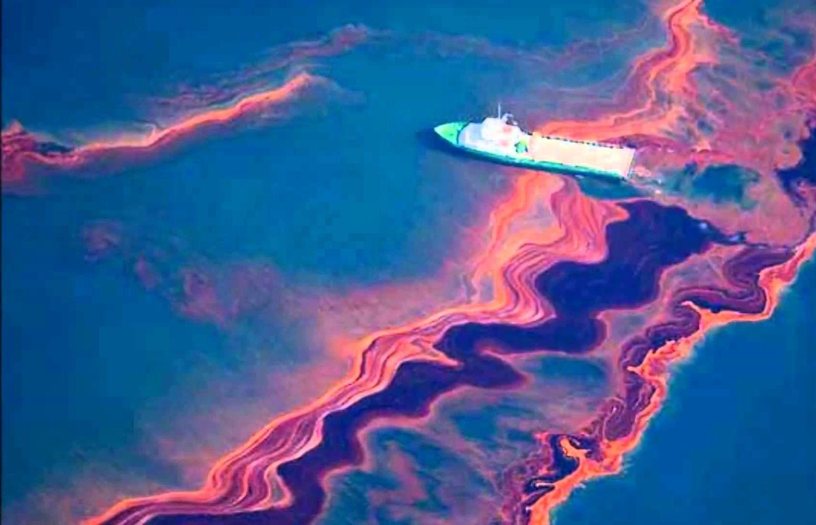
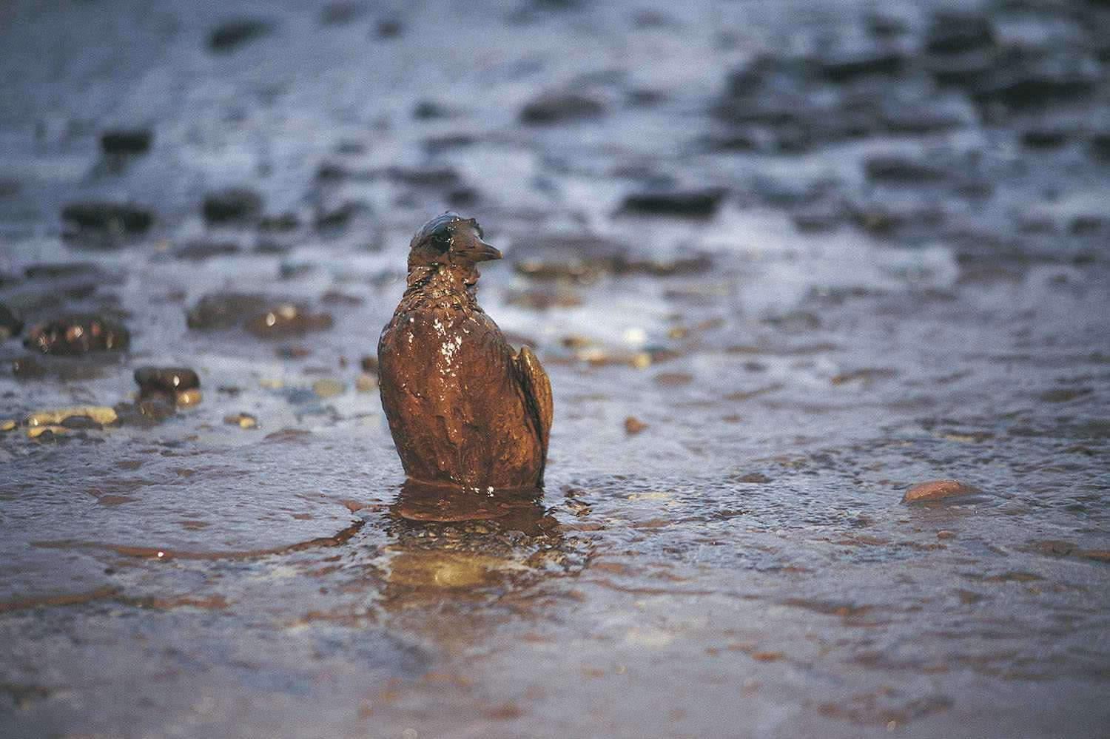
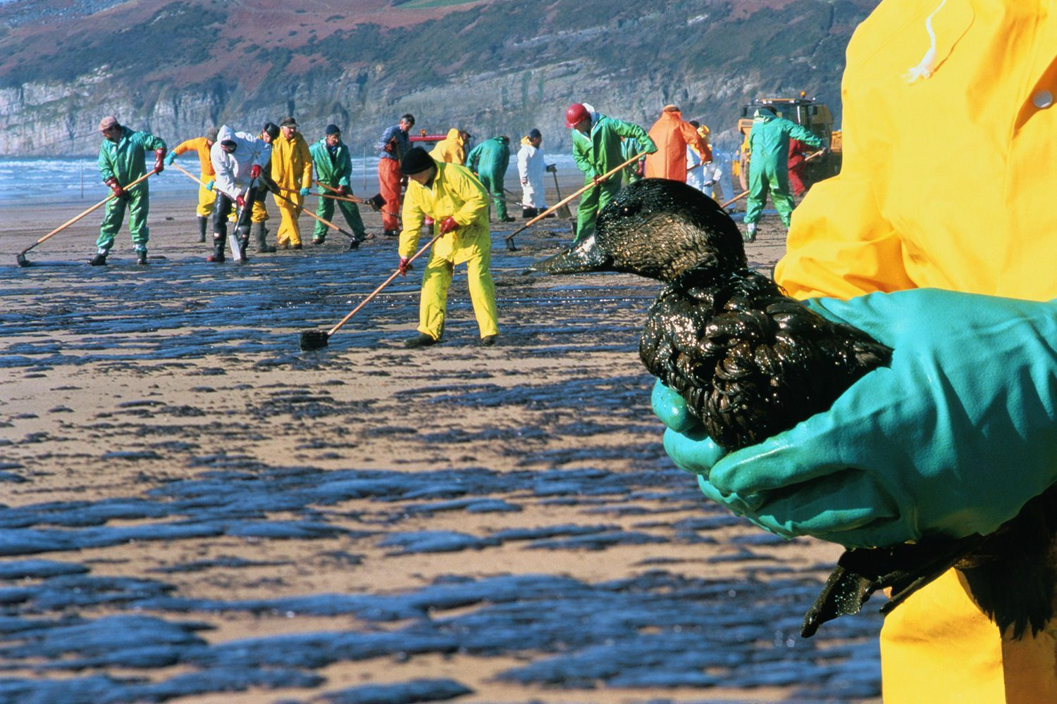
Oil Spills in Ocean: Finding diﬀerent ways of Shipping
By: Brianna Booths, Kellie Scott, and Bianka Melendez

Slide 2
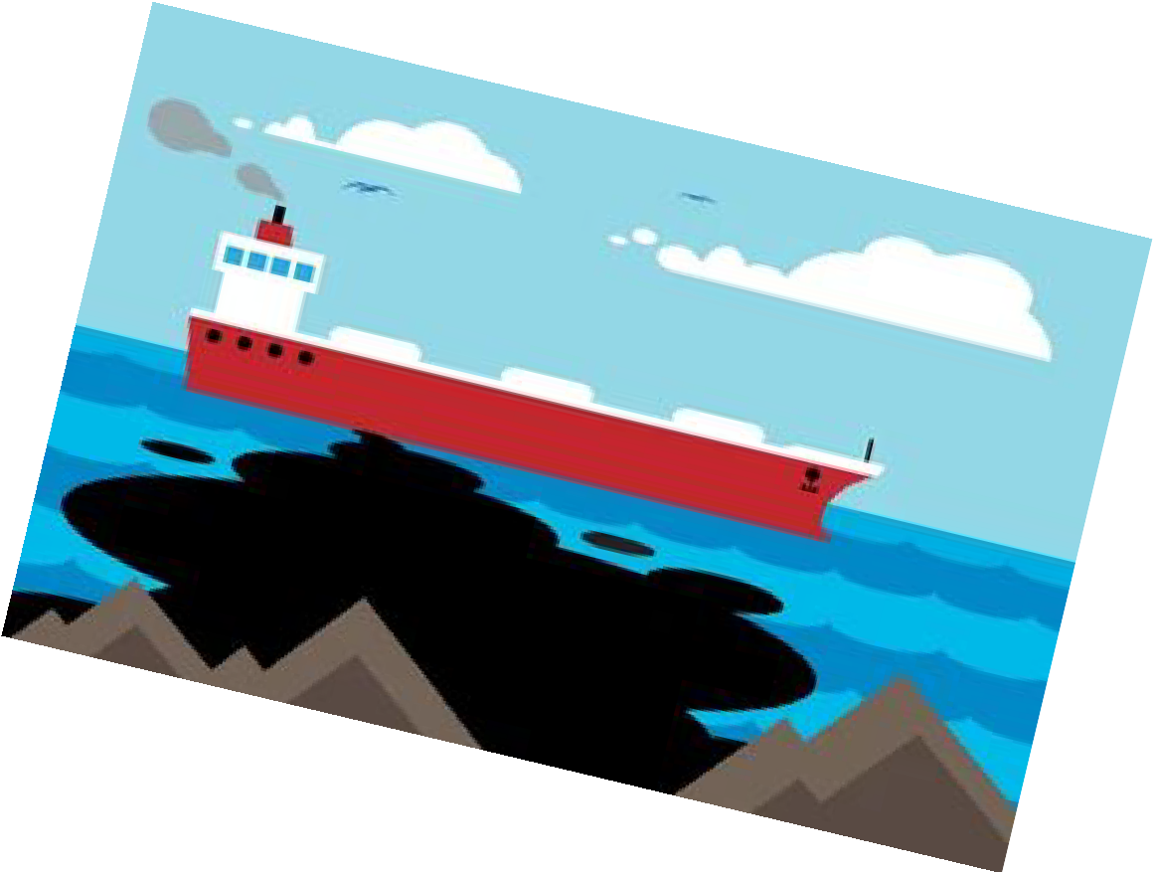
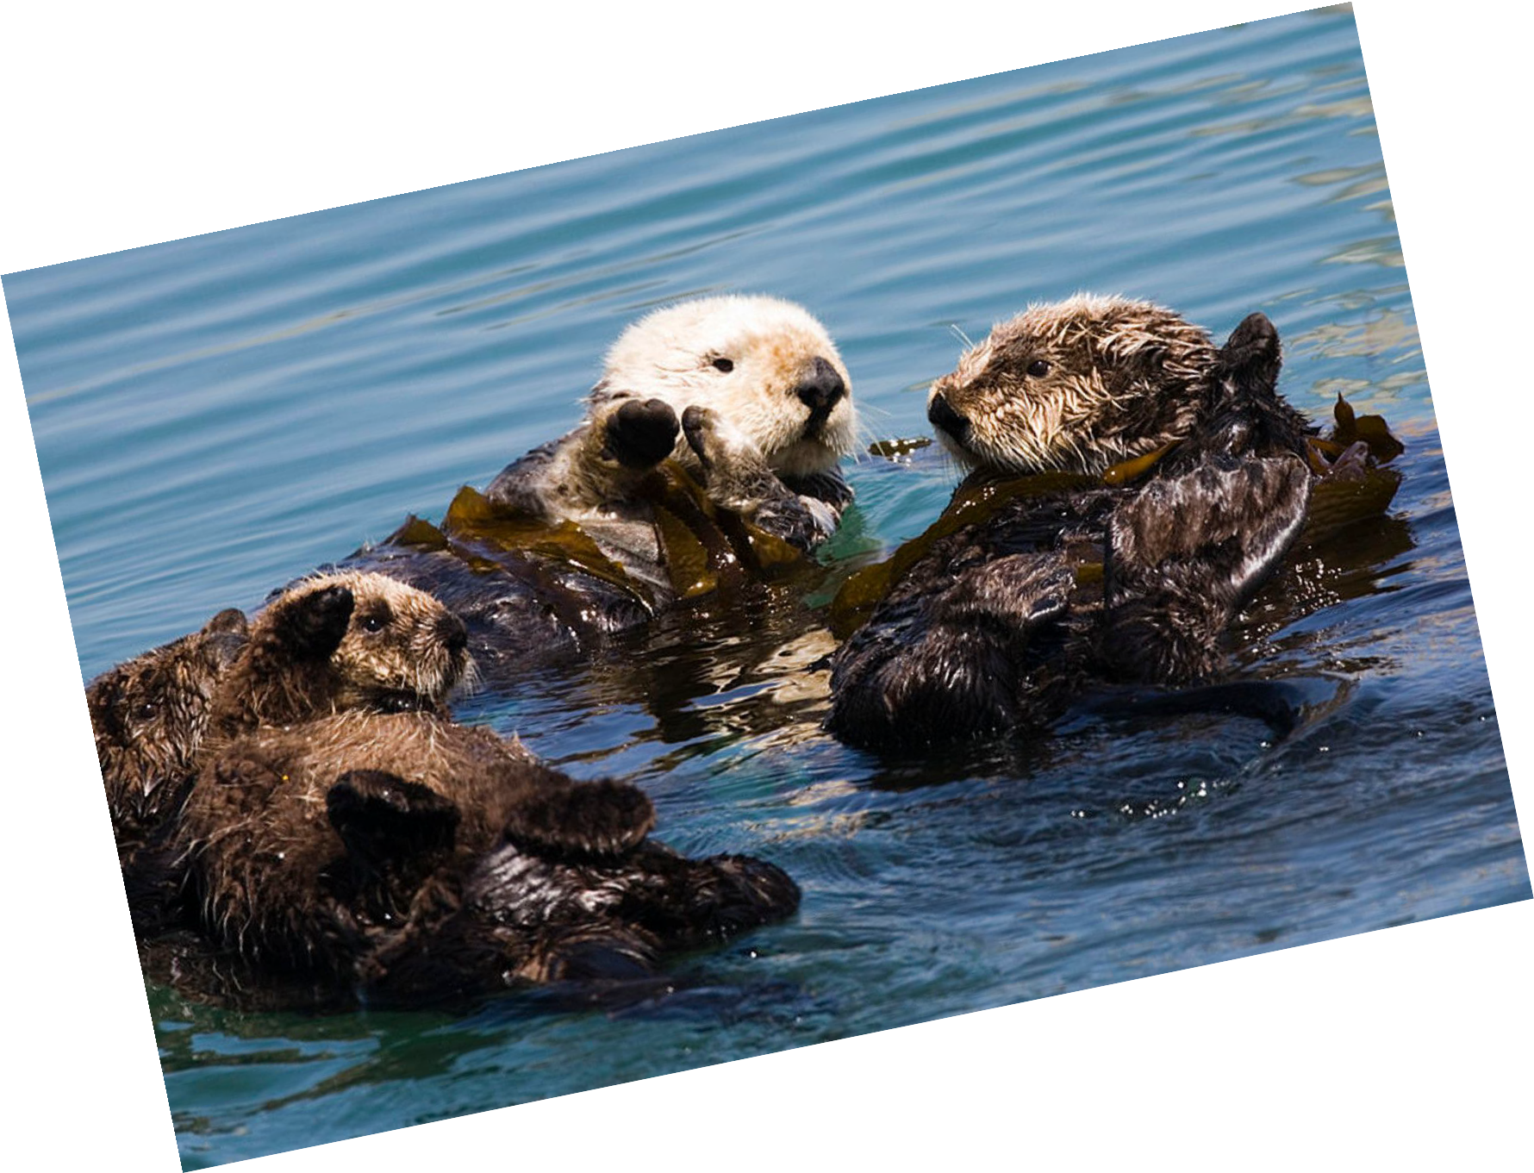
Layout of Presentation:
Random Facts and Deepwater Horizon
How oil spills aﬀect the environment?
Tanker Beneﬁts
Graphical Data about Tankers
History of Oil Pipelines
Solution to the problem: Pipelines
Advantages
Graphical Data about Oil Tankers
Disadvantages
Conclusion

Slide 3
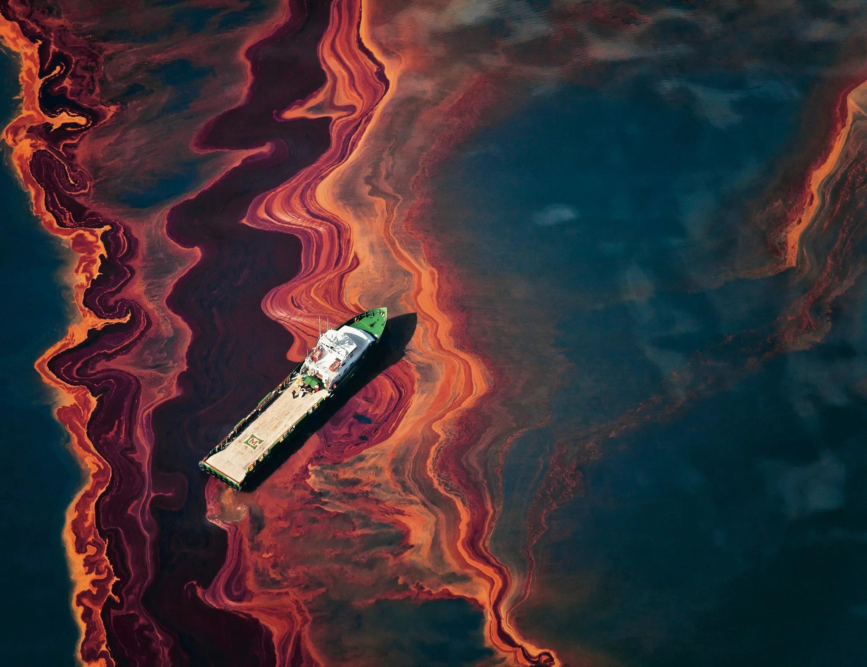
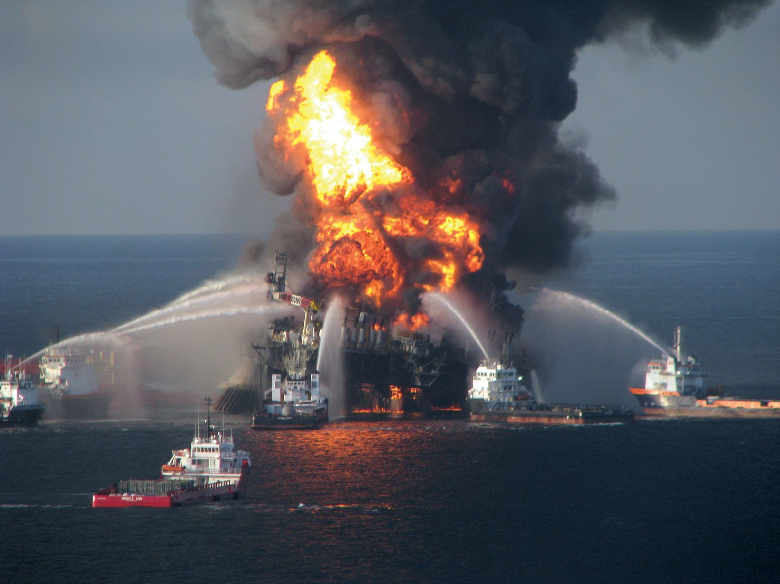
Random Fact and Deepwater Horizon:
Tankers and barges have spilt nearly six million tonnes of oil into the marine environment since 1970, with large spills (greater than 700 tonnes) responsible for most of the oil spilt into water bodies.
Deepwater Horizon (2010) is the largest oil spill with 134 million gallons of oil spilled into the ocean
We still haven’t been able to get all of the oil out of the ocean after that spill
This spill likely harmed or killed about 82,000 birds of 102 species; about 6,165 sea turtles; as many as 25,900 marine mammals; and a vast (but unknown) number of ﬁsh — from the great blueﬁn tuna to our nation's smallest seahorse — plus oysters, crabs, corals and other creatures.
→
Pictures are from the Deepwater Horizon Oil Spill
←

Slide 4
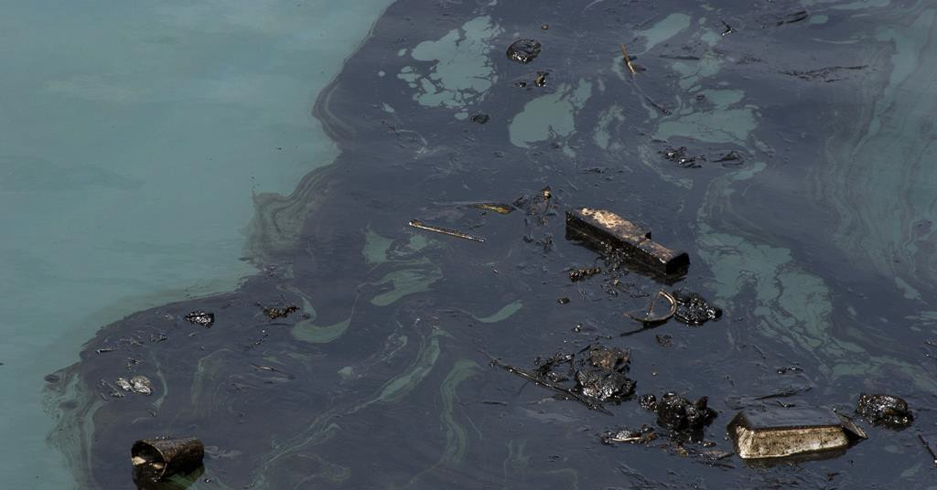
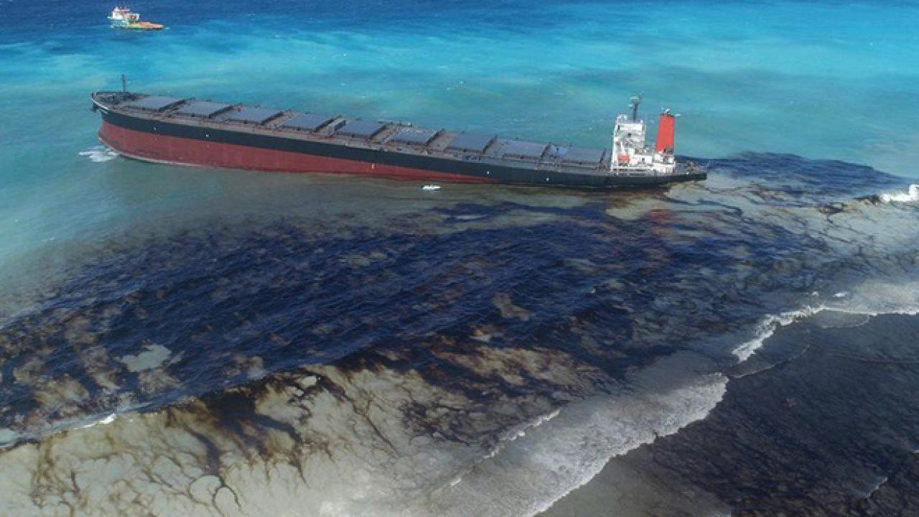
Oil Spills Eﬀects
An Oil Spill can aﬀect the ecosystem and surrounding area for years. It takes a very long time for the environment to recover 5-10 years.
It can cost billions of dollars to even begin to clean a spill. For example in the Deepwater Horizon disaster where it cost around $61.1 billion dollars.
Oil can sit on top of the water and spread maker it harder to clean, and fully get rid of. This thin oil on top on the water can also make it harder for the ecosystem in the water to receive sunlight.

Slide 5
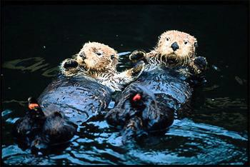
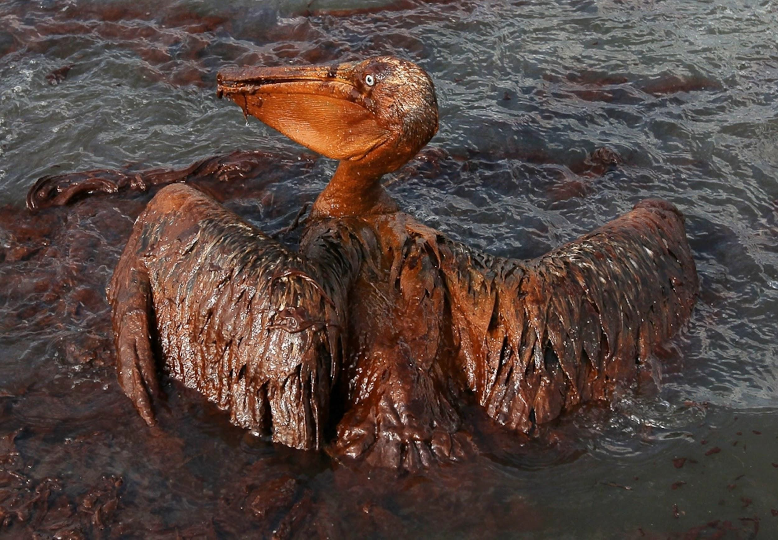
Oil Spill Eﬀects Cont.
If a human comes in contact with oil or even the fumes from oil it can cause a lot of physical and health damage such as, immune function, heart function, lung function, Neurological problems and so many more.
There are a lot of diﬀerent ways humans can get in contact with oil, eating ﬁsh, oil vapor and chemicals in the air, contaminated water.
Animals are also aﬀected by an oil spill. Some issues they face are, DNA complication, immune function, loss of egg production, and loss in insulation for bird wings.

Slide 6
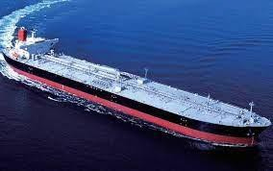
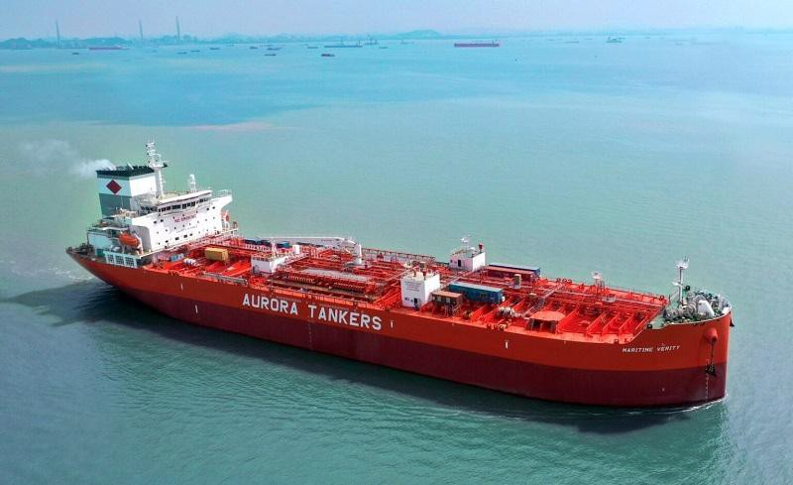
Tanker beneﬁts
Inexpensive when compared to Trucks and Railroad transport.
In the last decade there has been a 98% decrease in oil spills with the use of Tankers.
1 gallon of fuel moves one ton of oil.
Increase in jobs.

Slide 7
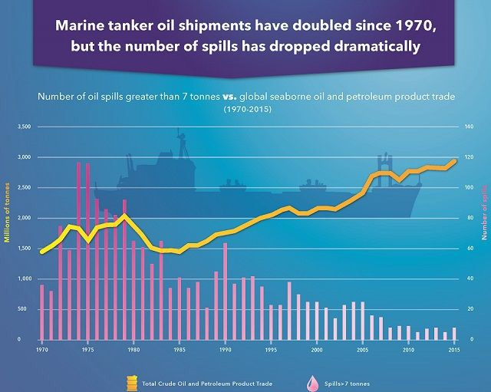
Graphical Data about Tankers
This graph shows that 1970-2015 when it comes to oil spills with tankers it has gone down dramatically.
Although there have been advancements in the construction and build of oil tankers this doesn’t guarantee that a potential leak could not happen.

Slide 8
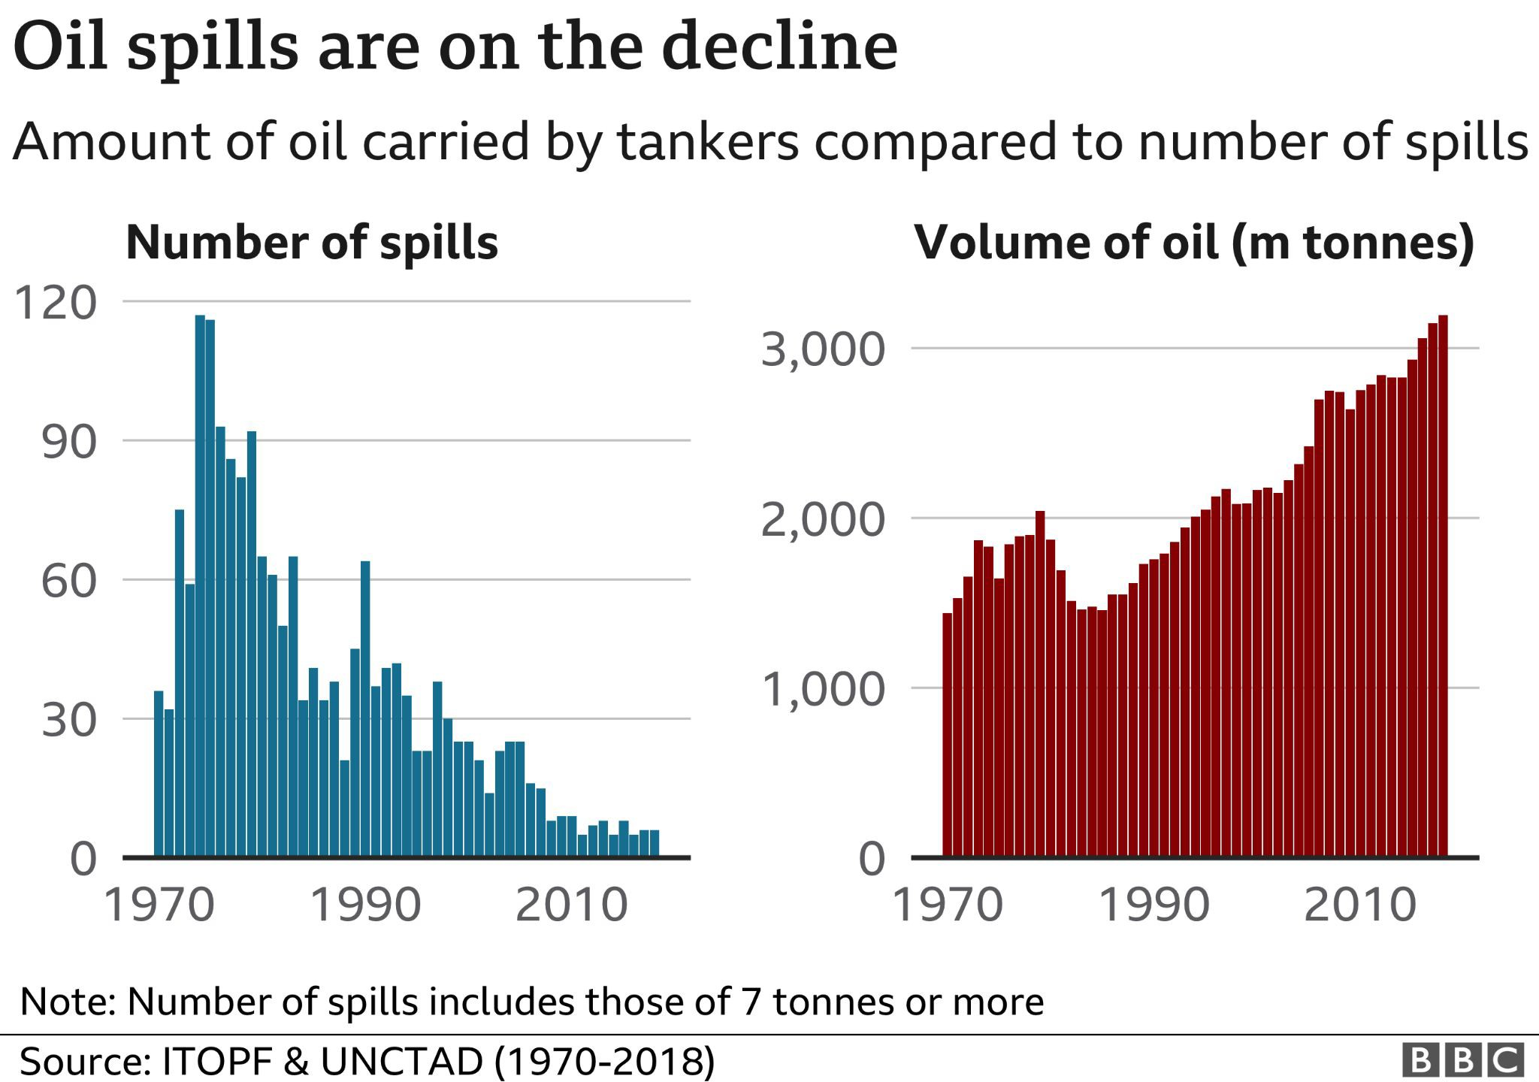
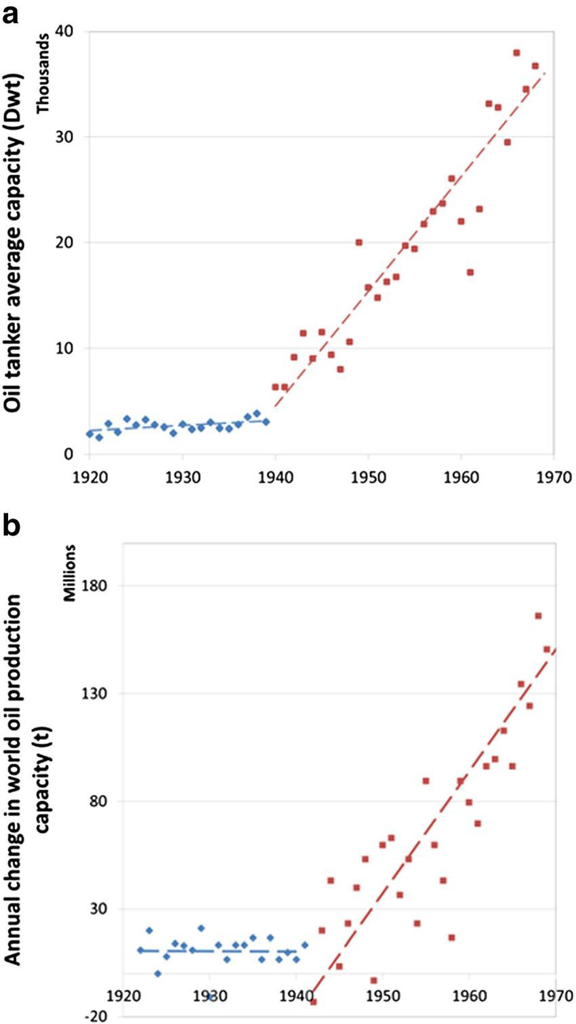
Graphical Data about Tankers
This graph shows that in 1920-1970 that the capacity of the amount of oil a tanker can hold has done up.
The largest oil tanker today has the
capacity to carry 2 million
→
barrels of oil
←
This graph shows that in 1970-2010 the number of spills has decreased but when a tanker does get a leak the amount of oil lost has gone up.
This is due to the oil capacity a tanker can hold has gone up. (Shown in the next graph)

Slide 9
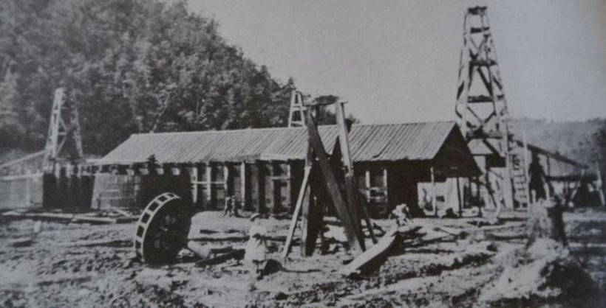
History of Oil Pipelines:
Oil pipelines have been around since the 1860s. The ﬁrst oil pipeline is widely believed to have been produced in 1862 at the well of Phillips No. 2 in Oil Creek Valley, Pa.
It was built out of two wooden boards combined to make a “V” shape (Clark, 2015).
Since then the United States has the most oil pipelines compared to other countries.
As of December 2020, there were 185 operational oil pipelines in the country and a further 34 under development (Sonnichsen, 2021).

Slide 10
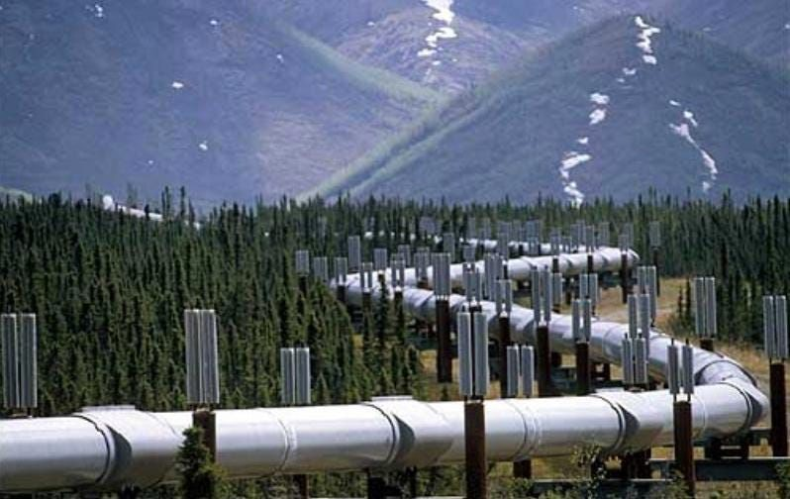
Solution to Problem: Pipelines
Advantages:
Oil also can be transported through them regardless of the weather:
Conversely, tankers should monitor the weather to decide if it is safe to go out into the ocean.
We are also reducing the cost of the transportation of oil from one location to the next:
Pipeline transportation generally is $5 a barrel (Conca).
According to “What Is The Cost of Shipping Oil by Tanker” tankers cost $40K-$70K per day for shipping.
We are preventing more fossil fuels from getting into the atmosphere:
Annually, ocean-crossing tankers emit about 125 million tons of CO2 into the atmosphere, as much as the home electricity consumption from 21 million U.S. residents (roughly the population of Florida) over the same time period
The shipping industry is responsible for a signiﬁcant proportion of the global climate change problem. In fact if global shipping were a country, it would be the sixth largest producer of greenhouse gas emissions (Oceana Europe).

Slide 11
Graphical Data about Oil Pipelines
This graph shows that since 1996 to 2007 that tank vessels/barges have a larger spill volume than pipelines.
Pipeline spill levels from 1990-2001 has dropped and it continuing to drop through 2007.
Oil pipelines getting a leak is rare

Slide 12
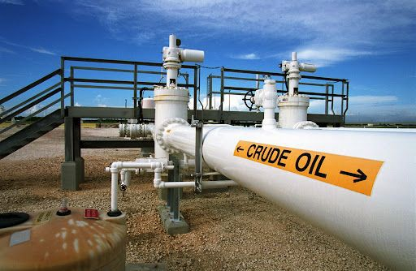
Solution to Problem: Pipelines
Disadvantages:
When you place a pipeline underground you cannot see whether or not a leak is present, and it cannot be repaired that easily.
Due to the fact that they are underground
Once the pipeline is constructed, it can only hold a certain capacity and cannot be increased.
According to the “Tip of the Mitt Watershed Council” pipelines can result in harm to human health and the environment, including injuries or fatalities to ﬁsh and wildlife, and contamination of drinking water supplies.
Constructing oil pipelines also requires a large ﬁnancial investment:
According to “Oil and Gas Pipeline Construction Costs” for proposed onshore US gas pipeline projects in 2015-16, the average cost was $7.65 million/mile.

Slide 13
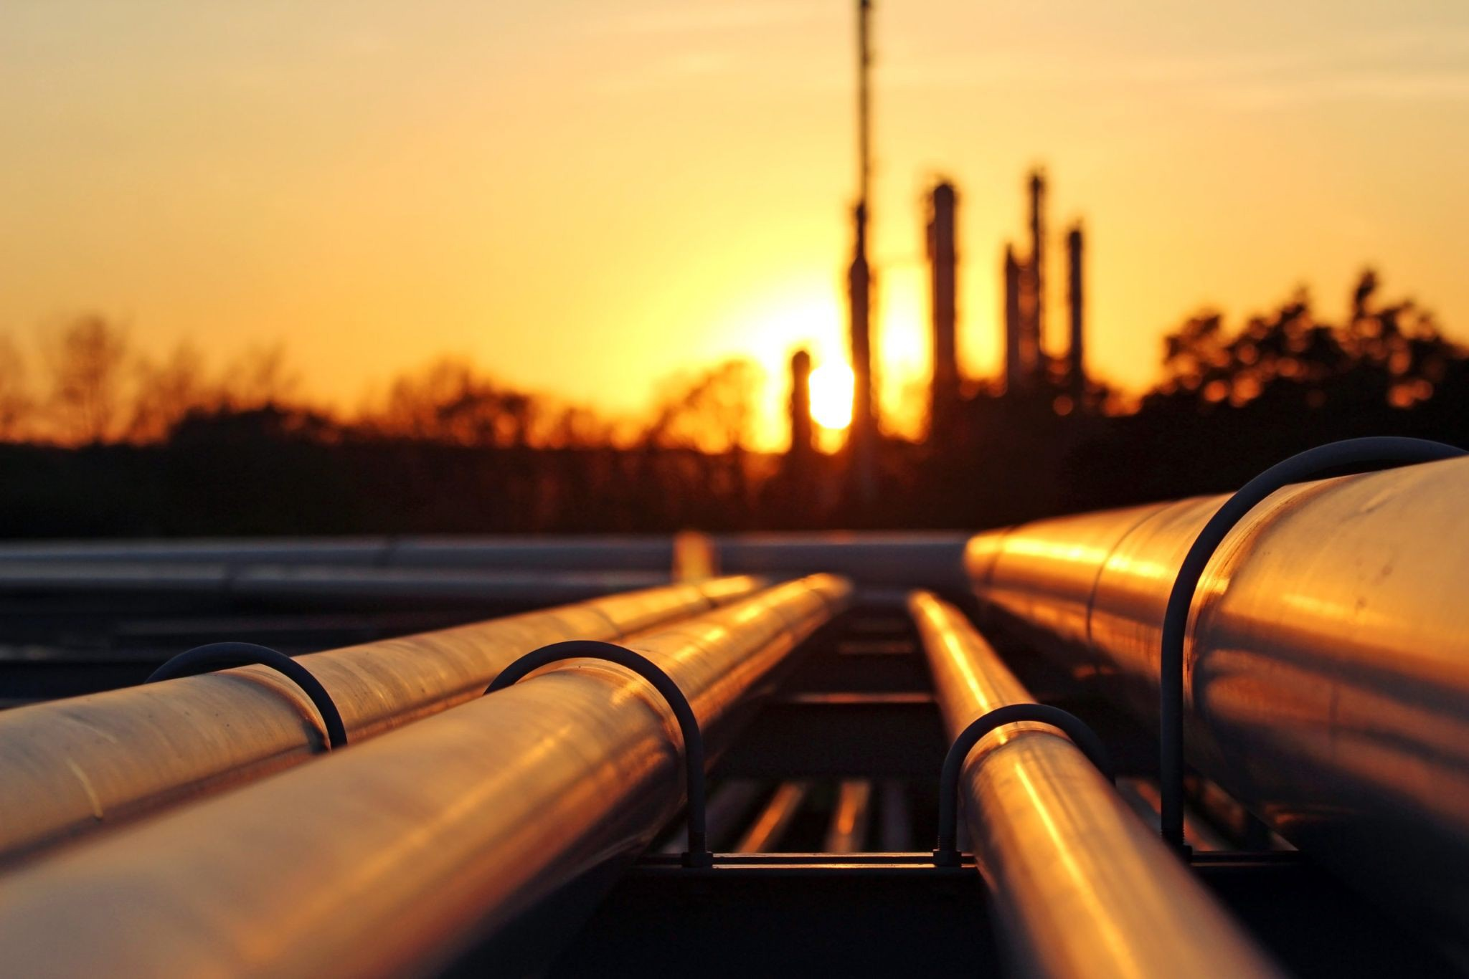
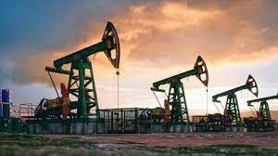
Conclusion
In our research we have seen both the outcomes of oil spills as well as the ways we can prevent
future spills. Also the beneﬁts of tankers for transporting oil. Due to the detrimental nature of oil spills on the environment and living organisms we found the most reliable and eﬃcient solution to the transportation of oil was pipelines. It can help save time, money, and the environment. If we switch to pipelines we are looking at a healthier and better tomorrow.

Slide 14
Works Cited:
A Deadly Toll.” Center for Biological Diversity, www.biologicaldiversity.org/programs /public_lands/energy/dirty_energy_development/oil_and_gas/gulf_oil_spill/a_deadly_toll.html.
“Advantages and Disadvantages of Pipelines in India!” Your Article Library, 17 Dec. 2013, www.yourarticlelibrary.com/india-2/advantages-and-disadvantages-of-pipelines-in-india/19743. Borunda, Alejandra. “As Oil Prices Crashed, Tankers Idled oﬀ California-Spewing Pollution for Weeks.” National Geographic, National Geographic, 3 May 2021,
www.nationalgeographic.com/science/article/coronavirus-oil-prices-crashed-tankers-idled-california-spewing-pollution.
Chang, S., Stone, J., Demes, K., & Piscitelli, M. (2014, May 9). “Consequences of oil spills: A review and framework for informing planning”. Ecology and Society. Retrieved December 2, 2021, from https://www.ecologyandsociety.org/vol19/iss2/art26/#oilspill.
Clark, Laura. “Oil Companies First Built Pipelines in the 1860s; They've Been Contested Ever Since.” Smithsonian.com, Smithsonian Institution, 12 Jan. 2015, www.smithsonianmag.com/smart-news/americas-ﬁrst-oil-pipelines-180953870/.
Conca, James. “Which Is Safer for Transporting Crude Oil: Rail, Truck, Pipeline or Boat?” Forbes, Forbes Magazine, 11 Oct. 2018, www.forbes.com/sites/jamesconca/2018/10/11/which-is-safer-for-transporting-crude-oil-rail-truck-pipeline-or-boat/?sh=f7c7e877b237.
“Crude Oil Transport by Ship in the Great Lakes.” Banner-Image-New, http://glslcrudeoiltransport.org/crude-oil-transport-by-ship-in-the-great-lakes/. “Factbox-Key Facts about Oil Spills.” Reuters, Thomson Reuters, 11 Nov. 2007, www.reuters.com/article/idUSB601823.
Heron, S. F. (2019, November 22). “How does an oil spill aﬀect the environment?” Sciencing. Retrieved December 2, 2021, from https://sciencing.com/oil-spill-aﬀect-environment-4616883.html. Keltner, Ty. “Oil Spill Prevention in Washington.” State of Washington Department of Ecology, ecology.wa.gov/Spills-Cleanup/Spills/Oil-spill-prevention.
Mufson, S. (2016, July 14). “BP's big bill for the world's largest oil spill reaches $61.6 billion”. The Washington Post. Retrieved December 2, 2021, from https://www.washingtonpost.com/business/economy/bps-big-bill-for-the-worlds-largest-oil-spill-now-reaches-616-billion/2016/07/14/7248cdaa-49f0-11e6-acbc-4d4870a079da_story.html.
Maritime Safety & Eﬃciency.” Energy API, https://www.api.org/oil-and-natural-gas/wells-to-consumer/transporting-oil-natural-gas/oil-tankers/maritime-safety-and-eﬃciency.

Slide 15
Works Cited Continued:
“Oil and Gas Pipeline Construction Costs.” Oil and Gas Pipeline Construction Costs, Global Energy Monitor, 1 May 2021, www.gem.wiki/Oil_and_Gas_Pipeline_Construction_Costs.
Oil spills. Oil spills | National Oceanic and Atmospheric Administration. (n.d.). Retrieved December 2, 2021, from https://www.noaa.gov/education/resource-collections/ocean-coasts/oil-spills. “Oil Spills: Impact on the Ocean.” Water Encyclopedia, www.waterencyclopedia.com/Oc-Po/Oil-Spills-Impact-on-the-Ocean.html.
“Permanent Steel Manufacturing .” Advantages and Disadvantages of Pipeline Transportation, 26 Feb. 2019, www.permanentsteel.com/newsshow/advantages-and-disadvantages-of-pipeline-transportation.html.
“Pipeline Risks.” Tip of the Mitt Watershed Council, www.watershedcouncil.org/pipeline-risks.html.
Schutes Author, Allison. “When It Comes to Oil and Fuel Spills, Prevention Is the Best Solution.” Ocean Conservancy, 10 May 2017, oceanconservancy.org/blog/2015/05/05/when-it-comes-to-oil-and-fuel-spills-prevention-is-the-best-solution/.
“Shipping Pollution.” Oceana Europe, europe.oceana.org/en/shipping-pollution-1.
STI Group - Industrial, Midstream & Fabrication Services. “Pipeline, Ship, or Rail: Diﬀerent Transport Methods for Oil and Gas.” STI Group - Industrial, Midstream & Fabrication Services, 18 Feb. 2016, https://setxind.com/midstream/pipeline-ship-rail-beneﬁts-needs-diﬀerent-oil-gas-transport-methods/.
Sonnichsen . “Oil Pipelines by Country and Status Worldwide 2020.” Statista, 21 Oct. 2021, www.statista.com/statistics/1131446/global-oil-pipelines-by-country-and-status/.
Tortoise. “Transporting Oil: Why Pipelines Still Rule.” Forbes, Forbes Magazine, 13 May 2016, www.forbes.com/sites/tortoiseinvest/2016/05/13/transporting-oil-why-pipelines-still-rule/?sh=70c134e412dc.
U.S. National Library of Medicine. (n.d.). “Fuel oil poisoning: Medlineplus medical encyclopedia”. MedlinePlus. Retrieved December 2, 2021, from https://medlineplus.gov/ency/article/002895.htm#:~:text=Swallowing%20such%20poisons%20can%20have,the%20substance%20is%20ﬁrst%20swallowed.
“What Is the Cost of Shipping Oil by Tanker.” Cost Finder, 3 Feb. 2019, cost-ﬁnder.com/what-is-the-cost-of-shipping-oil-by-tanker/.

Slide 16
Graphical Data Resources
“Canada: Tankers Safer than Pipelines, Rail.” The Maritime Executive, The Maritime Executive, 30 July 2017, www.maritime-executive.com/article/canada-tankers-safer-than-pipelines-rail.
Comparison of World New Annual Orders ... - Researchgate.net.
www.researchgate.net/ﬁgure/Comparison-of-World-New-Annual-Orders-between-2014-and-2015_ﬁg3_319948 189.
Harrington, Rebecca. “Here's How Much Oil Has Spilled from US Pipelines since 2010.” Business Insider, Business Insider, 15 Dec. 2016,
www.businessinsider.com/how-much-oil-spills-from-pipelines-us-america-natural-gas-2016-12.
Mwai, Peter. “Mauritius Oil Spill: Are Major Incidents Less Frequent?” BBC News, BBC, 13 Aug. 2020, www.bbc.com/news/world-53757747.

