Slide 1
Should Oil Companies Be Sued Over Climate Change?
By Sami Uggla, Jake Chittem, Alex Munoz, and Jeremie Hernandez

Slide 2
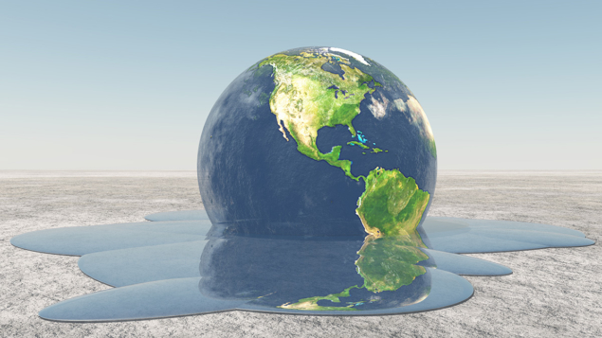
Background
The effects of climate change are already beginning to take place (temperature is increasing).
Climate change is one of the most hotly debated topics right now.
  Concepts in regard to climate change that are argued include how to keep the earth clean, how to protect the atmosphere, and what factors can cause the pollution of our environment and our atmosphere.

Slide 3
Introduction to the Topic
There are many factors that might lead to climate change. This includes emissions from cars, deforestation, and emissions of greenhouse gases. Oil companies are also contributing to the problem as well. One of the more recent debates that has come up in regards to climate change is whether or not oil companies should be sued for the damage that has already been done. Some people they should absolutely be sued and others believe they should not be.

Slide 4
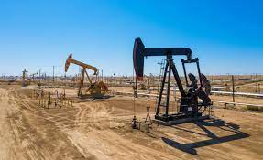
Oil
When it comes down to it, oil is very valuable and used for many things.
This includes:
  Powering our vehicles
  Heating our homes and buildings
  Helping to create electricity
  Diesel fuel
  Petroleum

Slide 5
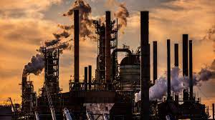
Why Oil Companies Should be Sued
Oil sold by U.S. companies is one of the major contributors to climate change.
  All of the fossil fuels used in our environment today are giving off toxins that pollute our air, water and atmosphere.
  Natural gas powers many U.S. grids and heats a majority of businesses and homes.

Slide 6
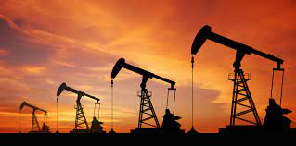
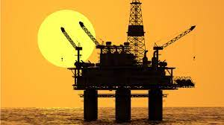
Why Oil Companies Should be Sued (Cont)
There are already numerous states that have many cases in this debate against oil companies.
  Oil companies are one of the biggest franchises in powering many houses, businesses and restaurants.
  However, they give many negative impacts including pollution which causes climate change. We have been seeing drastic changes to the planet with glaciers melting being one of the biggest problems.

Slide 7
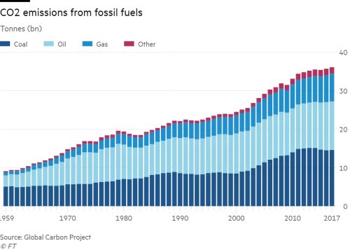
Why Oil Companies Should be Sued (Cont)
We are seeing drastic changes to our country and and even on a global level.
  Midwestern states have seen rises in temperature faster than National and Global Averages
  The changes in precipitation have made it very difficult to farm and also causes floods in peoples homes.

Slide 8
Counter argument
Some might argue that oil companies should NOT be sued
The oil companies (including Exxon and Shell) are angry about the lawsuits.
Some argue that there are other industries that are more at fault for climate change.
  This includes the transportation industry.
  Another argument is that burning coal is more harmful than oil

Slide 9
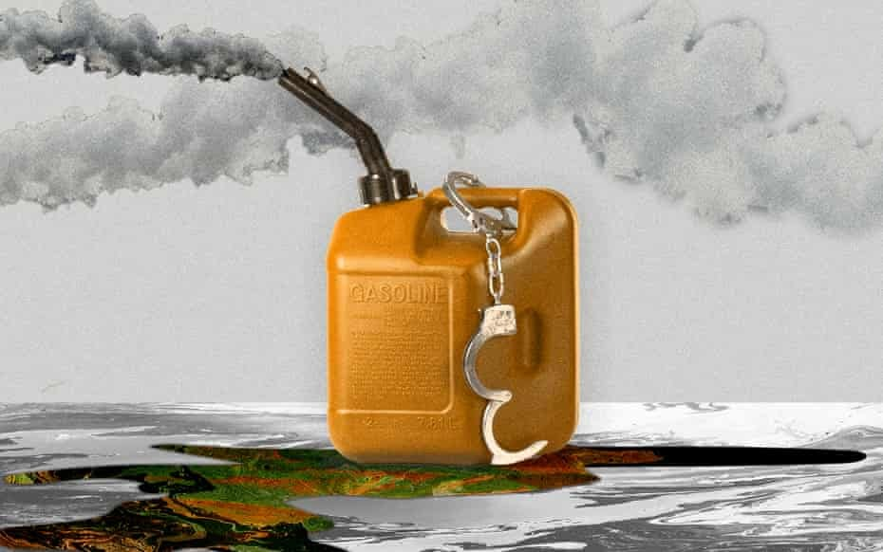
The truth behind oil companies
For years big oil companies have kept many dirty secrets from the world and now they may pay the price. Many oil companies are facing major lawsuits due to damage caused by fossil fuels.
Oil companies have affected and impacted many people's lives and communities across the world, oil companies tried to cover up what they knew would happen all along.

Slide 10
Oil damage
Many coastal areas are having hard times to keep sea levels steady
Midwestern states like Minnesota is dealing with mega rain, these are events in which 6 Inches of rain downpours and the numbers are rising, this event is destroying crops and homes.
Fishing is even becoming scarce Due to the heating of water

Slide 11
Electricity is the future
I believe by 2050 the world will be 80% electric and 20 % oil, I understand the world needs oil and it will never be 0% oil at least not for a while, because we just don’t have advanced enough technology but the world needs a huge shift in energy supply and demand, we need to get away from fossil fuels and look into low carbon, that is only a reachable goal if we convince companies the are willing to go low carbon and instead of excluding them.

Slide 12
Conclusion
Sadly, oil companies are the most reckless and don't care about the consequences of burning fossil fuels. As long as they get their money and continue to profit, they will continue burning fossil fuels. Oil companies are among the biggest contributors to climate change and pollution. They should be sued for all the damage they are doing to the Earth, because instead of coming up with solutions, they are only making it worse.

Slide 13
Sources
https://theappeal.org/the-lab/explainers/the-climate-change-lawsuits-against-big-oil-explained/
https://www.theguardian.com/environment/2021/jun/30/climate-crimes-oil-and-gas-environment

