Slide 1
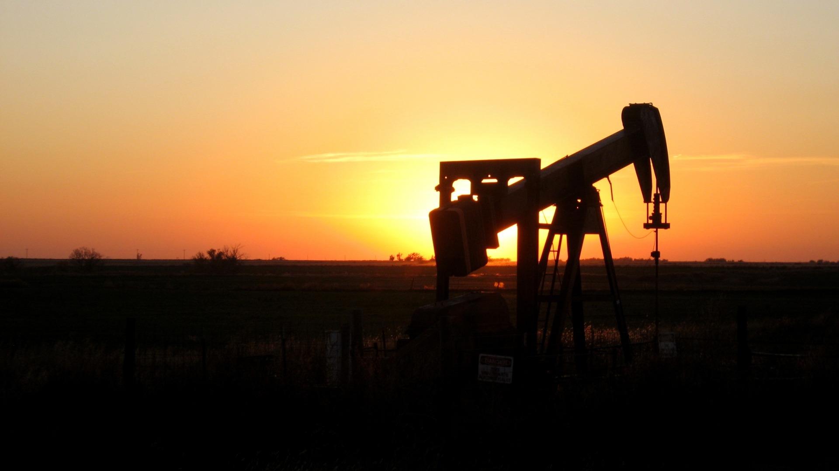
Should States be Allowed to Sue Energy Companies for Damages caused by Climate Change?
Carolee Pierce, Anthony Scarfuro,
Anna-Rebekah Virgo, and Jennifer Boch
Dr. Klemow
BIO/EES 105
November 18th, 2020

Slide 2
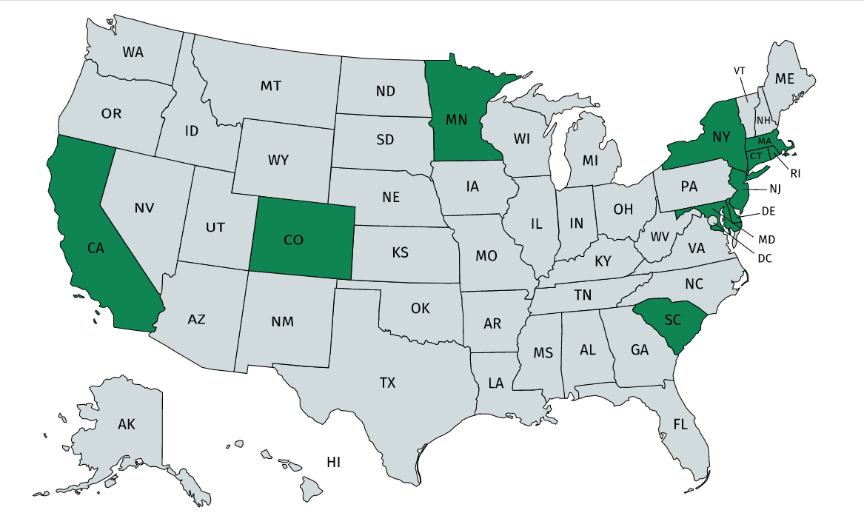
Introduction
2 BILLION DOLLARS! spent on lobbying against climate change legislation (Brulle, 2018)
Maybe the courts can help where the legislative failed
Over a dozen climate change cases across 11 states
SHOULD THIS BE HAPPENING? IS IT BENEFICIAL OR A WASTE OF TIME?
Map of U.S States that have court cases against energy companies as shown in green

Slide 3
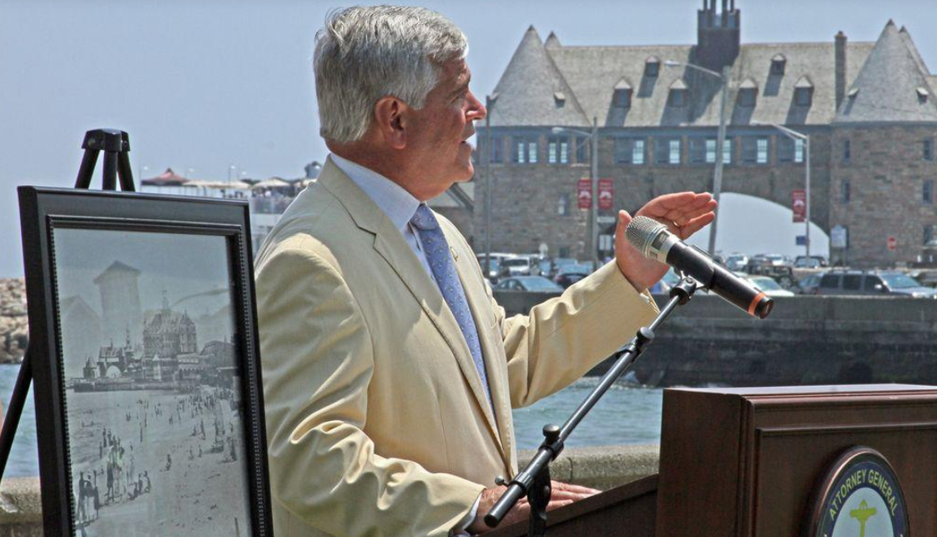
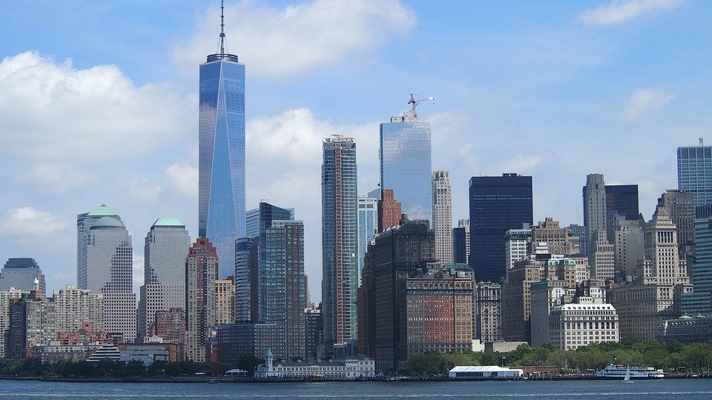
Analysis of Pro
Fossil fuel companies have “violated the public’s trust” (NYU State Energy and Environmental Law School 2020)
Help obtain financial compensation for damages caused by climate change effects
  wildfires, storm damage, and flooding from rising sea-levels
Raise awareness for climate change
  Maybe influence companies to update their industry practices
  Long-term effects?
Rhode Island Attorney General Peter Kilmartin announcing lawsuit in 2018, one of the first states to file against energy companies over climate change (Top)
NYC also filed a lawsuit in 2018 (Bottom)

Slide 4


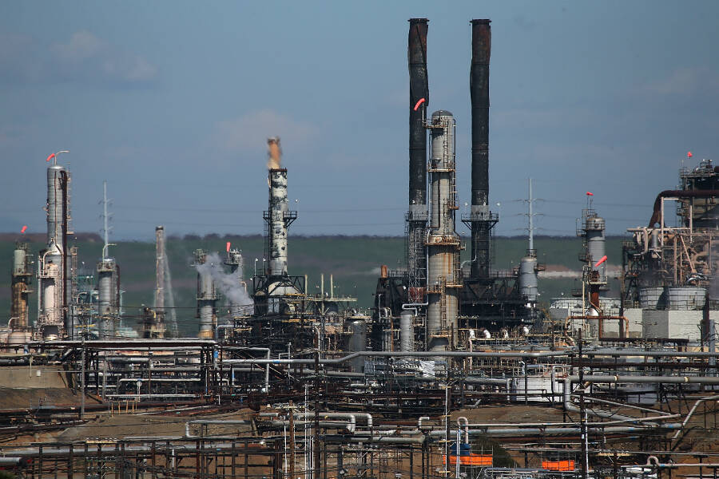
Analysis of Con
Who is responsible for climate change?
  Everyone has some responsibility
  Energy argues specific responsibility cannot be proven in court
This is a waste of time and resources (including tax revenue)
  Could use these resources elsewhere
  Such as funding developing alternatives
Chevron refinery near San Francisco Bay

Slide 5
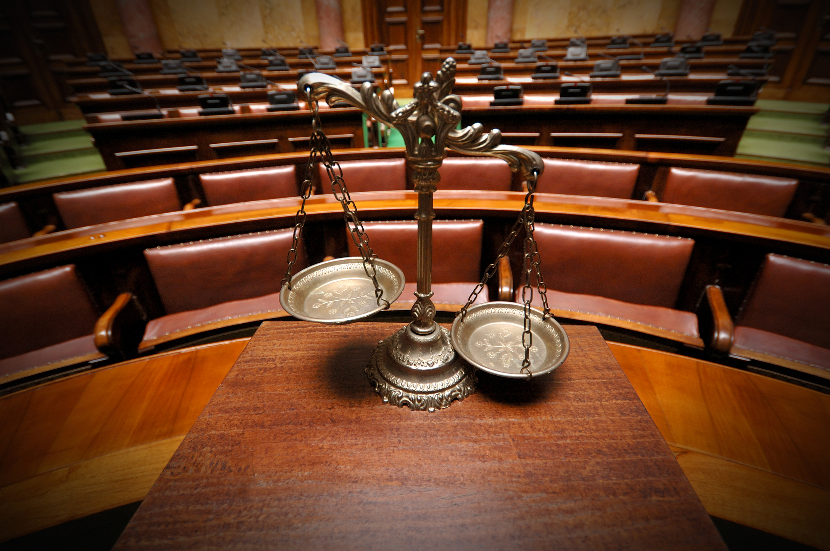


Conclusion
It is reasonable to sue these energy companies
  Especially if they knew the damaging consequences of their products/services
States and cities are the victims of environmental degradation and of climate change directly caused by these companies
  They deserve to be granted a trial
VS.

Slide 6
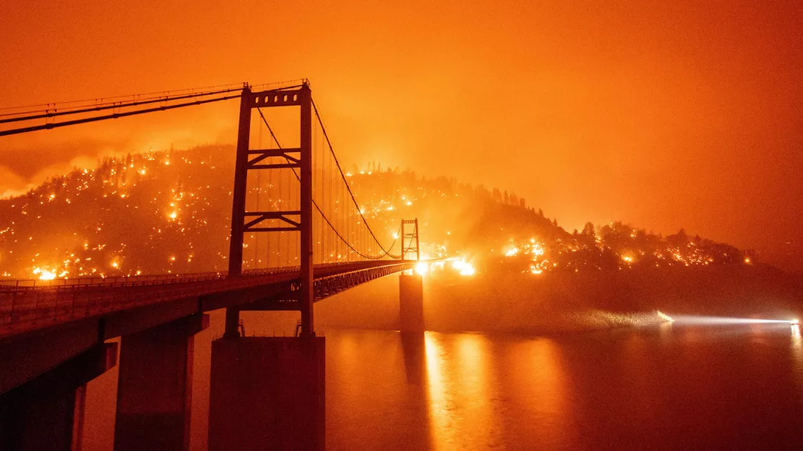
Where would we be if the 2 BILLION DOLLARS spent on lobbying was spent on alternatives and solutions, rather than preventing legislation that would protect our environment and prevent further climate catastrophe?

Slide 7
References used in Research
Brulle, R. J. (2018). The Climate Lobby: A Sectoral Analysis of Lobbying Spending on Climate Change in the USA, 2000 to 2016. Climatic Change, 149(3-4), 289–303. https://doi.org/10.1007/s10584-018-2241-z.
Grandoni, D. (2020, September 15). States and cities scramble to sue oil companies over climate change. The Washington Post. https://www.washingtonpost.com/climate-environment/2020/09/14/states-cities-scramble-sue-oil-companies-over-climate-change/.
Hasemyer, D., Bruggers, J., Tigue, K., Weisbrod, K., Kusnetz, N., Gearino, D., … Berwyn, B. (2020, September 16). Fives States Have Filed Climate Change Lawsuits, Seeking Damages From Big Oil and Gas. InsideClimate News. https://insideclimatenews.org/news/14092020/climate-change-lawsuit-connecticut-deleware.
NYU State Energy and Environmental Law School. (2020). State Suits Against Oil Companies. State Suits Against Oil Companies. NYU Impact Center. https://www.law.nyu.edu/centers/state-impact/issues/climate-action/suits-against-oil-companies.
Stohr, G. (2019, October 23). Supreme Court allows states to sue oil companies over climate change. World Oil. https://www.worldoil.com/news/2019/10/23/supreme-court-allows-states-to-sue-oil-companies-over-climate-change.

