Slide 1
Solar Power: Our Energy Future or False Promise?
By: Karma Collier, Natalie Hernandez, Phil Navarrete, and Eric Walsh

Slide 2
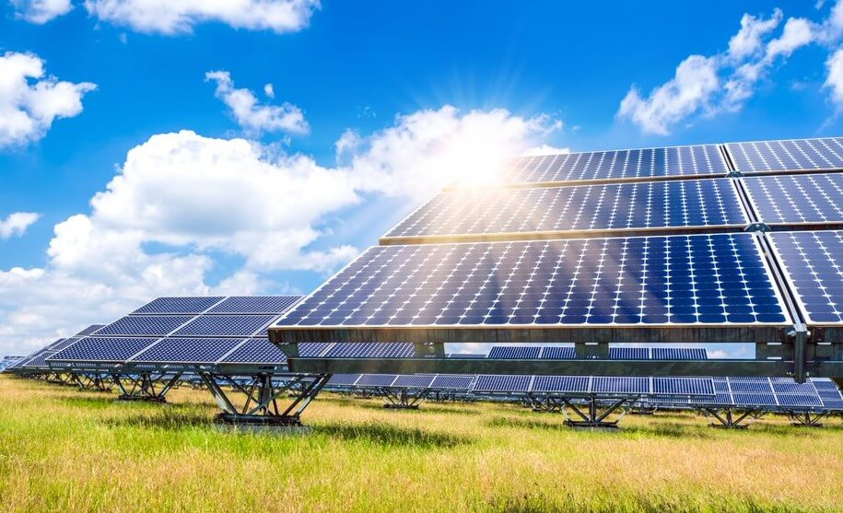
Solar Power: A Definition
According to the Solar Energy Industries Association Solar Energy is energy that is produced by the sun which is then converted into thermal or electrical energy.
Solar energy is a fairly versatile energy source as it can be used to power many processes such as water heating, providing electricity that can be used for lighting, and can power objects such as solar furnaces.
In terms of energy consumption in the United States, solar energy only makes up about 1%.
https://blog.technavio.com/blog/top-10-solar-energy-companies

Slide 3
Solar Power: A Controversy
While solar power initially seems like a great source of energy and possibly the next best solution to our energy issues, there are still many issues for why Solar energy is not a cure-all.
Many people view Solar Power as a great energy source as it is renewable and it doesn’t have the same negative effect on the environment that burning fossil fuels does.
However, many people push back against the transition to Solar energy as it is not as sustainable and consistently reliable as fuel sources such as coal and petroleum are.
This two sides are constantly debating to determine whether solar energy can be the next standard of energy or if we should stay with the energy sources we have now.

Slide 4
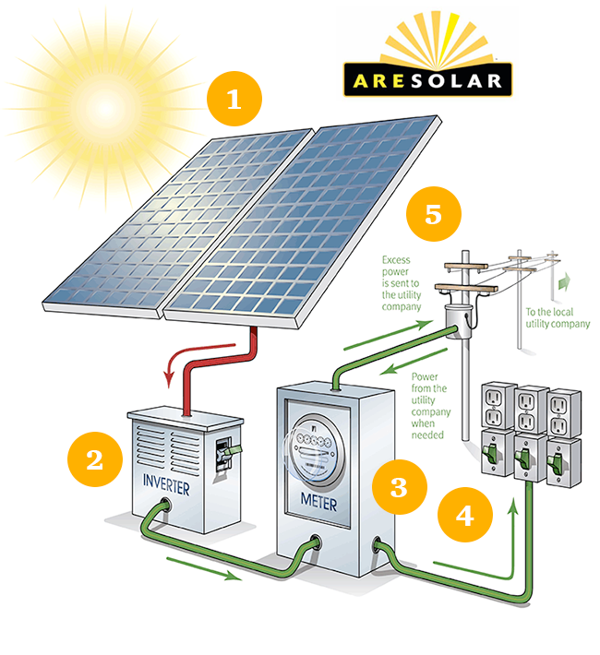
How Solar Works
Solar modules: Solar modules mounted on the roof or grounds of your property convert sunlight into DC power.
Inverter: An inverter (power converter) transforms the DC power from solar modules to AC. This power keeps your appliances up and running.
Electrical panel: The power from the inverter travels to your electrical service panel and distributes it the electrical devices in your home.
Utility meter: When your solar power system generates excess power, it flows into the grid through a utility meter. This will cause your meter to run backwards, thus gaining you a credit with the utility company.
Utility grid: The utility grid automatically provides electricity when needed – at night and during the day, when your demand exceeds your solar production.
Net metering: Net metering legislation states that the utility company must credit retail rate to your account, for all the clean energy you generate and share with the grid
https://aresolar.com/how-solar-works/

Slide 5
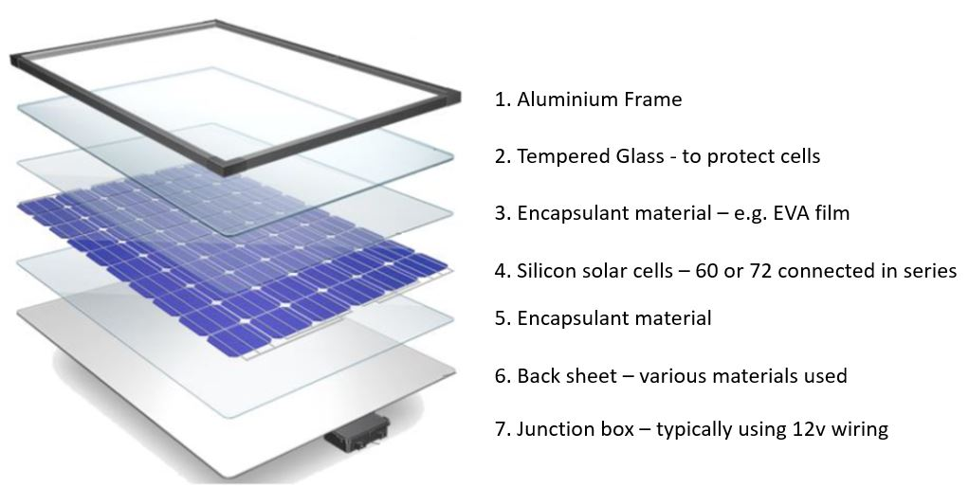
Generation to Generation
1st Gen (1883) - The first solar panel was made of Selenium to produce the solar cells
2nd Gen (1953) - The next solar panel was made of Silicon to produce the solar cells
Dr. Elliot Berman, helped make the solar panels more cost effective by using lesser grade of silicon and packaging the cells with more cost-effective materials. (1970s)
3rd Gen (2016) - Ultra-slim, flexible solar cells that are only 1.3 microns thick. Produce more than 400 X as much watts/LB
Current - Ongoing efforts to make the “perovskite” solar cell. Crystalline material could ultimately replace silicon in solar panels and reduce costs using simpler production methods.
https://www.cleanenergyreviews.info/blog/solar-panel-components-construction

Slide 6
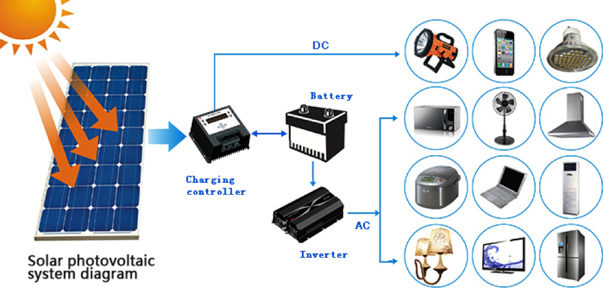
How Solar is Used
Solar Electricity - One of the more common uses, function of putting solar panels on a roof and gaining energy from the sun to consume electricity for day to day appliances (can also integrate batteries for backup use)
Solar Water Heating - By using solar panels and have the energy transfer to a water heater for home water use or swimming pools.
Solar Heating - Powering radiant floors or pairing with a Forced Hot Air system to heat a home.
Solar Ventilation - Solar attic fans can reduce the burden of your HVAC by helping to cool you home
Solar Lighting - Can be found everywhere from home, landscaping and security lights to road signs and street lights
Portable Solar - Portable solar PV chargers can also be integrated into phones. Researchers in Japan have even developed lightweight, water-resistant solar cells that could someday be sewed into clothing to power our devices
Solar Transportation - Existing applications including buses, trains, airplanes, and race cars
https://www.sunpowersource.com/ask-about-solar-energy/

Slide 7

Environmental Impacts
Using and generating solar energy is not associated with global warming emissions
Other stages such as the manufacturing of materials and transportation, installation, maintenance, and decommissioning and dismantlement does have an impact on global warming emissions. (still relatively small compared to others)
An estimate for life-cycle emissions for solar energy is about .08 -.2 LBS of carbon dioxide, equivalent per kilowatt-hour (Union of Concerned Scientists, 2013)
Compared to life cycle emission rates for natural gas (.6-2 LBS of CO2E/kWh) and Coal (1.4-3.6 LBS of CO2E/kWh) (Union of Concerned Scientists, 2013)
https://kubyenergy.ca/blog/the-positive-and-negative-environmental-impacts-of-solar-panels

Slide 8
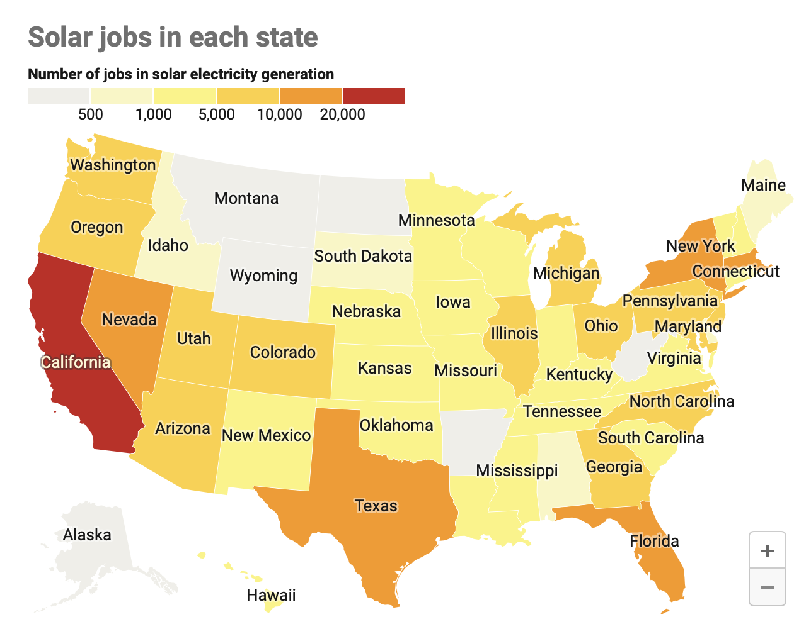
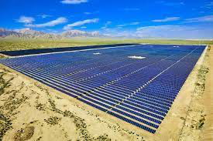
Solar power as a Social Vehicle
Job Creation
  Building and operating solar energy systems creates numerous jobs
  Nationwide: around 344,000 new jobs generated by late 2019 and is projected to increase to 3 million by 2050
Human and Environmental Health
  Solar energy emits little pollution into the atmosphere
  Much cleaner than burning fossil fuels and fracking
    Reduction of harmful greenhouse gases and air pollution
  Large-scale solar plants range from 3.5 to 10 acres per Megawatt
    Impacts native habitats
  PV cells contain harmful chemicals in which leaks can be harmful to the environment (US Energy Information Administration)
Less Oil Dependency
  US depends on oil from foreign nations
  Reduction in imported oil would lower international trade
  Makes the US closer to becoming energy independent
https://yaleclimateconnections.org/2021/04/wind-and-solar-energy-are-job-creators-which-states-are-taking-advantage/
https://www.clean-energy-ideas.com/solar/solar-energy/environmental-impacts-of-solar-energy/

Slide 9
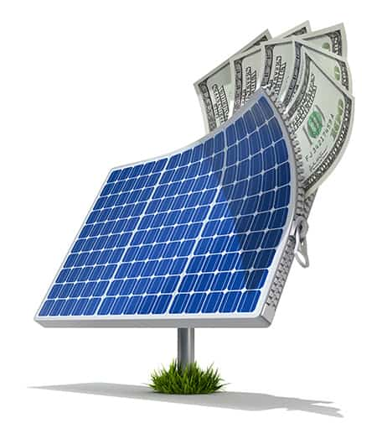
Solar Power in the Economy
Reiteration of Job Creation
  In 2015, solar power was 31% of all new generated electricity, continually generating many job opportunities as well. Jobs in solar energy fields provide “competitive wages” (Sekaric) from a low median of $21 per hour to $29 per hour depending on the job, offering a good living wage to families of workers.
  “American solar jobs have increased 167% over the past decade, which is five times faster than the overall job growth rate in the U.S. economy” (Energy.gov).
Multiple forms: Self-sufficient or company based
  Offer a self sufficient method for profit as option for homeowners
    Benefit is self-sufficiency with profit. Drawback is subsides required for sensible investment.
  Another option of relying on investment in Stirling engine
    Benefit is higher potential return rate. Drawback is “pragmatic limitations” (Banoni).
Produce both electricity and heat
  3 forms: 1) Low temperature solar thermal, 2) solar electric or photovoltaic (PV), and 3) high-temperature solar thermal energy (Timmons).
https://goingsolar.com/top-7-economic-benefits-of-installing-solar-panels-solar-savings/

Slide 10
Solar Power in Politics
The idea of using Solar Power, just like any issue in politics, is intensely debated. Many different people and parties have various opinions on how the country should move forward in terms of how we use our energy and through what form the energy we use is gotten. However, it seems to be the case that both Democrats and Republicans share some common ground on the issue. While both parties may not be supporting solar power for the same reasons it is important to note that each party seems to be leaning towards supporting a transition to solar power.

Slide 11
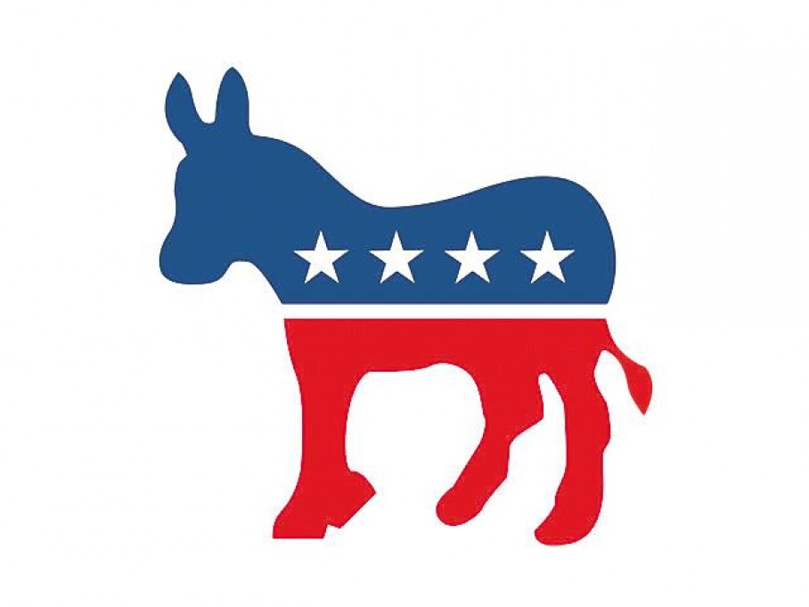
Democratic View on Solar Power
Over Republicans, Democrats are the main group that have been pushing for the transition from fossil fuels to solar energy. According to a survey conducted by the Pew Research Center, whose results were reported this year, about 93% of Democrats are in support of expanding our reliance on solar power. The primary reasoning for this stance from a Democratic point of view is that the transition from fossil fuels to renewable sources such as wind and solar power will be much better in the long run for the environment.
http://clipart-library.com/clipart/6ipLk8dpT.htm
Notes:
Picture Credit: http://clipart-library.com/clipart/6ipLk8dpT.htm

Slide 12

Republican View on Solar Power
While Democrats are the main group that has been pushing for a transition to solar energy, a percentage of Republicans have also wanted to see a push towards solar energy usage. According to the Pew Research Center survey, about 73% of Republicans want to see an increase in our reliance on solar energy. While this number is down from 84% in 2020, it is still no small number that shows that both Democrats and Republicans both want solar power in some form. However, the main difference comes in the reason for why each party wants more reliance on solar energy. While the Democrats would rather have solar energy since it is good for the environment, Republicans tend to support it because it is beneficial to the economy and has a more reasonable cost compared to other energy sources.
https://commons.wikimedia.org/wiki/File:Republicanlogo.svg
Notes:
Picture Credit: https://commons.wikimedia.org/wiki/File:Republicanlogo.svg

Slide 13
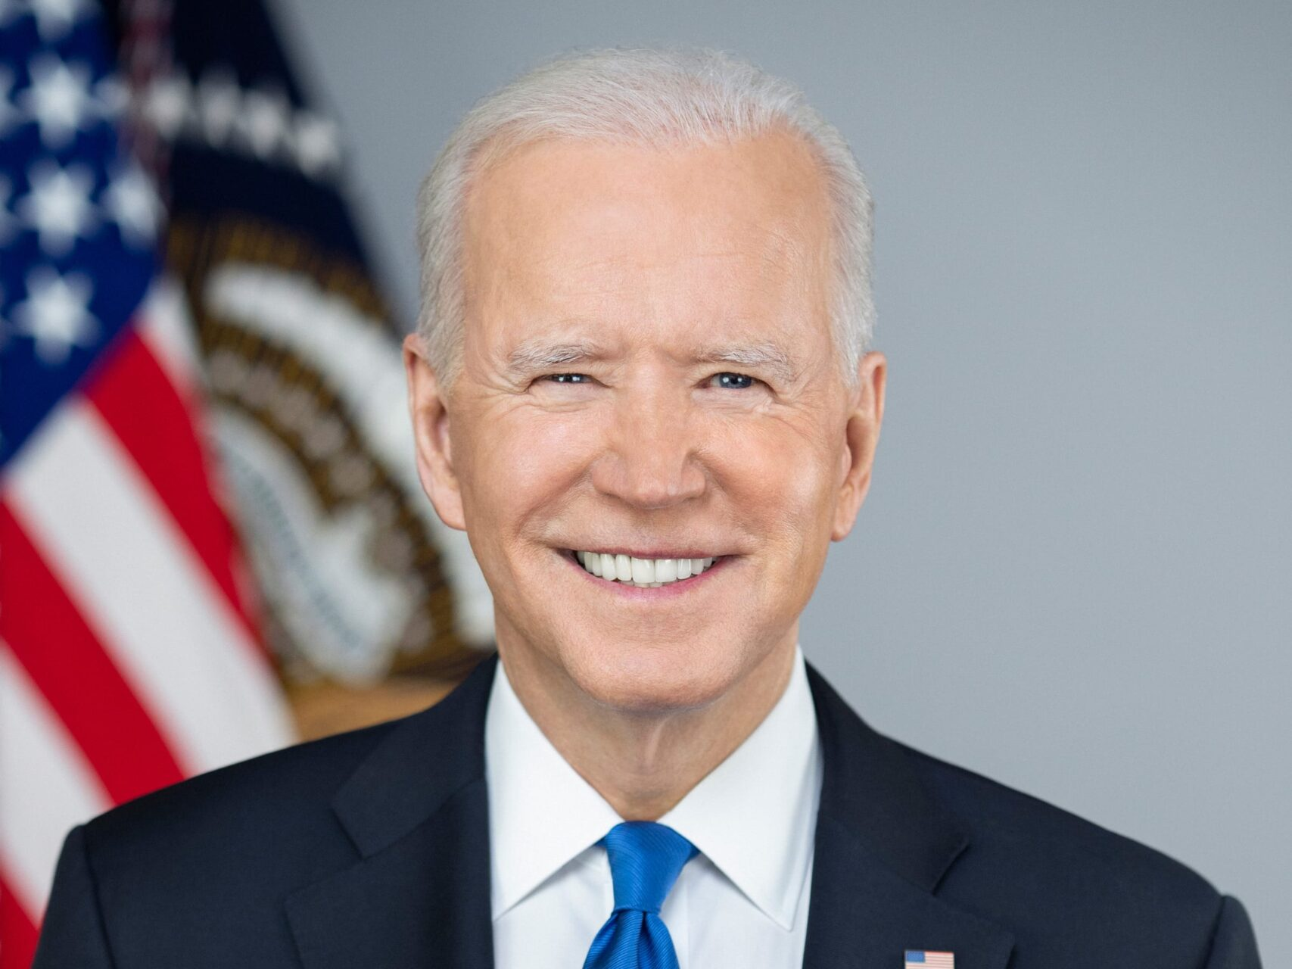
President Biden’s policies on Solar Power
One important aspect to look at when talking about any form of energy is the policies and ideas that our government is trying to put into place. In terms of President Biden, he is trying to make great strides in increasing our nation's reliance on solar energy. According to a fact sheet provided by the White House, President Biden has brought up the idea of investing in the Bipartisan Infrastructure Deal and the Build Back Better Agenda. President Biden hopes that investing in these areas will serve to create jobs in the field of solar power and that we can increase our reliance on renewable sources of energy in the near future. As President Biden attempts to reach a state of the U.S moving to “clean energy”, solar power will continue to be a large component in reaching his end goal.
https://whitehouse.gov/administration/president-biden/
Notes:
Picture Source: https://whitehouse.gov/administration/president-biden/

Slide 14
The Drawbacks to Solar Energy
While it may seem like solar energy has a lot of reasons to become the main energy source that we transition to in the future, there is no perfect energy source. This means that just like any other source of energy, solar energy will have drawbacks. As discussed, solar energy will have some benefits on the economy in forms of job creation. However, there are some downsides when we look at the average citizen and their ability to support a solar economy. The equipment needed to sustain solar energy is not cheap. According to Energysage, the average cost of a solar panel installation in 2021 is about $20,474. This is not an easy cost for many people to cover, which would make it much more difficult to transition to solar energy. There is also the issue of political support. While it can be seen that there is much political support for solar energy, it seems like political support may be dwindling in certain areas. While the survey conducted by the Pew Research Center showed that there was high support from both Democrats and Republicans for solar energy, Republican support dropped from 84% to 73% in the span of one year (2019-2020). This shows that Republican support for solar energy is dropping. If this trend continues, then political separation may be a roadblock on the path to the transition to solar energy.

Slide 15
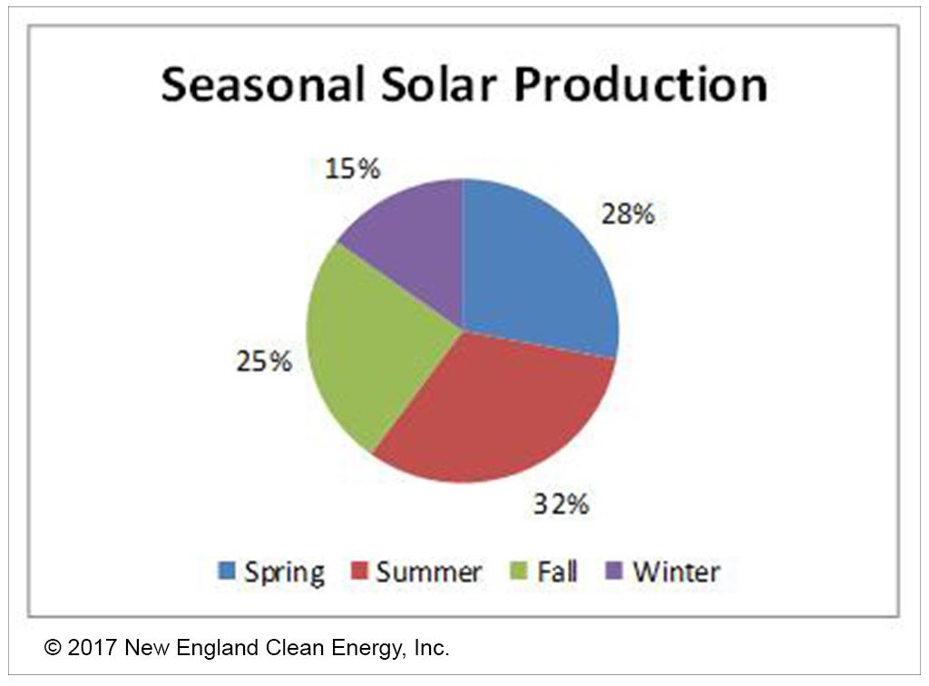
Closing thoughts
Not perfect, but possible
  No energy source is entirely perfect. Everyway that we can obtain energy has benefits and drawbacks
  Highly possible that solar power could grow to becoming a commonly used source of energy
Transferring to any new energy source can be difficult
  As reiterated, no energy source is perfect
    It may take a long time for people to become accepting of change and it will require environmental dependence.
Transferring to solar power has already began in some places
  It is already starting to be utilized by some people
    Some people are very active in typing to assist the acceptance of solar energy use and it is inspiring technological advancements.
Our belief for solar power in the future lies somewhere in between the two sides.
  We think that it has a chance of being very successful as an energy form in the future but it will also take a lot of time and patience to reach that point
https://newenglandcleanenergy.com/energymiser/2017/10/10/why-october-is-a-trick-not-treat-for-solar/

Slide 16
Works Cited
About solar energy. SEIA. (n.d.). Retrieved December 10, 2021, from https://www.seia.org/initiatives/about-solar-energy.
Banoni, V. A., Arnone, A., Fondeur, M., Hodge, A., Offner, J. P., & Phillips, J. K. (2012, April 23). The Place of Solar Power: An Economic Analysis of Concentrated and Distributed Solar Power. Chemistry Central Journal. Retrieved December 10, 2021, from https://www.ncbi.nlm.nih.gov/pmc/articles/PMC3332255/.
Clearway Community Solar. (2008, February 18). The Evolution of Solar Panels. Clearwaycommunitysolar. Retrieved December 10, 2021, from https://www.clearwaycommunitysolar.com/blog/understanding-community-solar/evolution-solar-panels/
Freedom Solar Power. (2018, June 12). 7 Uses of Solar Energy. Freedomsolarpower. Retrieved December 10, 2021, from https://freedomsolarpower.com/blog/7-uses-of-solar-energy

Slide 17
Works Cited (Cont.)
Kennedy, B., & Spencer, A. (2021, June 8). Most Americans support expanding solar and wind energy, but Republican support has dropped. Pew Research Center. Retrieved December 10, 2021, from https://www.pewresearch.org/fact-tank/2021/06/08/most-americans-support-expanding-solar-and-wind-energy-but-republican-support-has-dropped/.
Kirk, K. (2021, July 15). Wind and solar energy are job creators. which states are taking advantage? " Yale climate connections. Yale Climate Connections. Retrieved December 10, 2021, from https://yaleclimateconnections.org/2021/04/wind-and-solar-energy-are-job-creators-which-states-are-taking-advantage
Marsh, J. (2021, November 26). How much do solar panels cost in 2021?: Energysage. Solar News. Retrieved December 11, 2021, from https://news.energysage.com/how-much-does-the-average-solar-panel-installation-cost-in-the-u-s/.
Office of Energy Efficiency and Renewable Energy: U.S. Department of Energy. (2021). Solar Energy in the United States. Energy.Gov. Retrieved December 10, 2021, from https://www.energy.gov/eere/solar/solar-energy-united-states.

Slide 18
Works Cited (Cont.)
Republicans and Democrats differ in their primary reasons for supporting renewable energy. Yale Program on Climate Change Communication. (2020, April 13). Retrieved December 10, 2021, from https://climatecommunication.yale.edu/publications/republicans-and-democrats-differ-in-their-primary-reasons-for-supporting-renewable-energy/.
Sekaric, L. (2016, January 13). Solar Energy Jobs Outpace U.S. Economy. Energy.Gov. U.S. Department Of Energy. Retrieved December 10, 2021, from https://www.energy.gov/articles/solar-energy-jobs-outpace-us-economy
Tali, D. (2019, July 26). Negative effects of solar energy. Sciencing. Retrieved December 10, 2021, from https://sciencing.com/negative-effects-solar-energy-6325659.html.
The United States Government. (2021, August 17). Fact sheet: Bipartisan Infrastructure Deal and build back better agenda present Bright Future for solar power, good jobs, and more affordable energy. The White House. Retrieved December 10, 2021, from https://www.whitehouse.gov/briefing-room/statements-releases/2021/08/17/fact-sheet-bipartisan-infrastructure-deal-and-build-back-better-agenda-present-bright-future-for-solar-power-good-jobs-and-more-affordable-energy/.

Slide 19
Works Cited (Cont.)
Timmons, D., Harris, J. M., & Roach, B. (2014). The Economics of Renewable Energy - Boston University. Global Development and Environmental Institute. Retrieved December 10, 2021, from https://www.bu.edu/eci/files/2019/06/RenewableEnergyEcon.pdf.
Union of Concerned Scientists. (2013, March 5). Environmental Impacts of Solar Power. UCSUSA. Retrieved December 10, 2021, from https://www.ucsusa.org/resources/environmental-impacts-solar-power
Union of Concerned Scientists. (2013, March 5). Environmental Impacts of Solar Power. UCSUSA. Retrieved December 10, 2021, from https://www.ucsusa.org/resources/environmental-impacts-solar-power
U.S. Energy Information Administration - EIA - independent statistics and analysis. Solar energy and the environment - U.S. Energy Information Administration (EIA). (n.d.). Retrieved December 12, 2021, from https://www.eia.gov/energyexplained/solar/solar-energy-and-the-environment.php

