Slide 1
Solar power: Our energy future or false promise?
Ariel Reed, Jordan Jones, Sarah Pavlick, and Cole Sotack

Slide 2
What is Solar Power?
Defined as “the technology used to harness the sun’s energy and make it useable”
Can be done in multiple ways:
  Photovoltaic cells (solar panels) are made of different types of silicon that lose electrons when hit by the sun, which go through wires to power electronics and cycle back to the cell.
  Thermal generation uses flat panels to reflect light into a central tower that heats water into steam, or parabolic (U-shaped) panels that heat water flowing through tubes to create energy from steam.
  Passive solar technology includes skylights and large windows to heat and light buildings.

Slide 3
History of Solar Power
Solar energy has been used by people for thousands of years for heating, cooking, preserving food, and many other tasks.
1767: The first solar oven was created by a Swiss scientist, and later used by an explorer to cook food in South Africa.
1839: The photovoltaic effect (an increase in electricity generation when exposed to light) was discovered by Edmond Becquerel, a French scientist
1954: The first silicon PV cell was created at Bell Labs with 4% efficiency
Since then, scientists around the world have greatly improved the efficiency and availability of solar generators, and their breakthroughs will continue in the future.

Slide 4
Benefits
Sustainable
  The advantage of solar energy is that it is a sustainable alternative to fossil fuels. While fossil fuels have an expiration date that may be fast approaching, the sun is likely to be around for at least a few billion years.
Low Environmental Impact
  Solar energy has a substantially reduced impact on the environment compared to fossil fuels. Its greenhouse gas emissions are inconsequential as the technology does not require any fuel combustion.
Solar power helps to slow/stop global warming
  Global warming threatens the survival of human society, as well as the survival of countless species.

Slide 5
Drawbacks
Intermittency
  One of the biggest problems that solar energy technology poses is that energy is only generated while the sun is shining. That means nighttime and overcast days can interrupt the supply.
Land Use
  Another concern is that solar energy may take up a significant amount of land and cause land degradation or habitat loss for wildlife.
An Environmental Downside
  The one environmental downside to solar technology is that it contains many of the same hazardous materials as electronics. As solar becomes a more popular energy, the problem of disposing the hazardous waste becomes an additional challenge.

Slide 6
Are Solar Panels Efficient?
Some solar panels convert 22% of their available energy into electrical power.
  This is an actually amazing number if you consider the fact that people are paying a lot of their electricity bills every month.
  The solar panels are made of solar cells. A cell is a small disk of a semiconductor like silicon.
  They are attached by wire to a circuit. As light strikes the semiconductor, light is converted into electricity that flows through the circuit.
  As soon as the light is removed, the solar cell stops producing power.

Slide 7
Solar Power Efficiency cont.
A solar pool heating system uses the sun’s radiant energy to heat your water.
  The water is directed to the collectors, rising from the bottom to the top.
  As it gradually rises, it’s heated by the natural energy and then returned to your pool.
  This cycle continues until your pool water reaches the desired temperature.
  You can enjoy an added 10-13° to your water without any extra costs or air pollution!

Slide 8
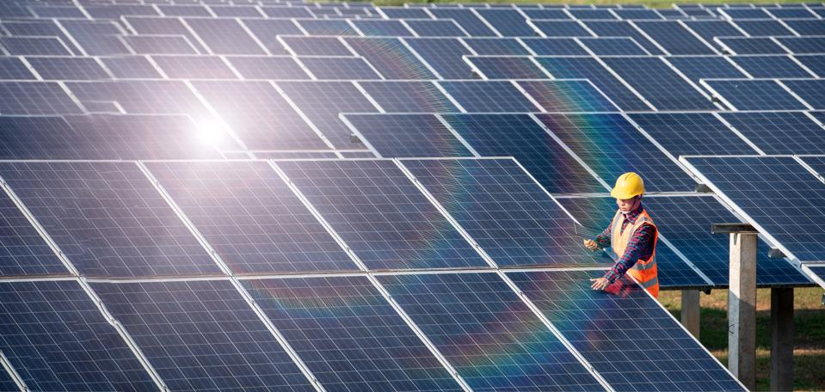
The future of this industry
Projected Usage
  According to the US Energy Information Administration (EIA) Solar energy is on track to produce more than 1,600 Billion Kilowatt hours by 2050.
  Starting in 2020 it is projected that over 2,000 units will be installed annually in residential, utility, and non-residential structures.
New Designs
  To harness higher amounts of power from the sun, new designs are being introduced while also being paired with high density energy storage options to help reduce energy waste.
  Elon Musk, creator of Tesla and SpaceX, has started branching into the solar energy field and has released a new solar option called solar roofs which replace all the shingles on your roof with shingle sized solar panels. These help to utilize the full space given of someone's house.

Slide 9
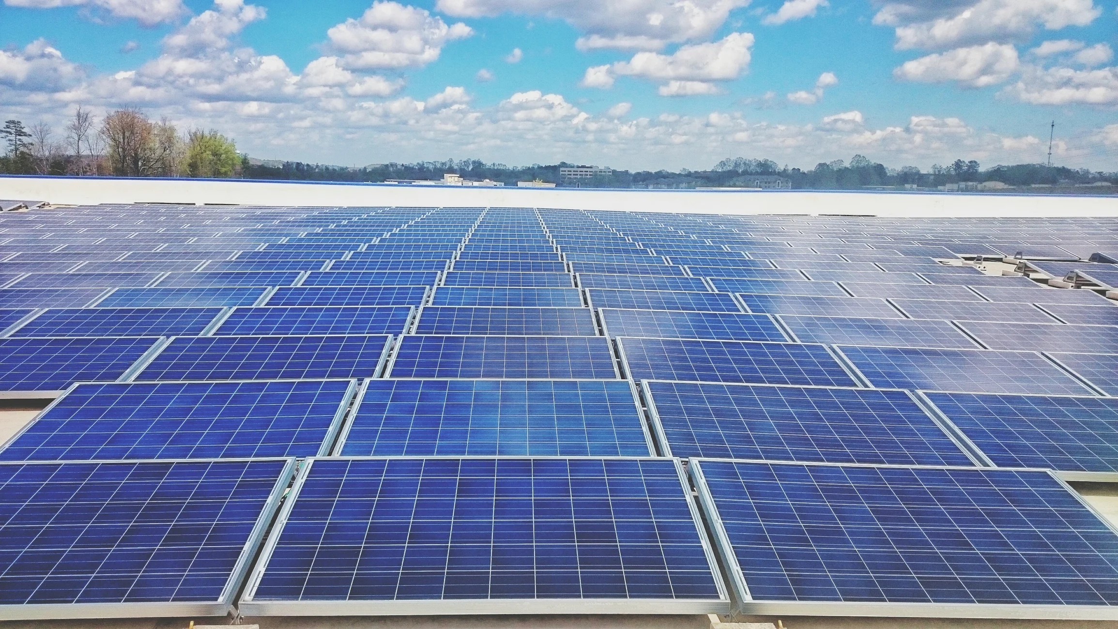
The future of this industry cont.
Possibilities
  Solar has the ability to be the dedicated source of power for all of China if properly implemented.
  Mixed with energy storage the size of factories we, could have giga batteries for all the energy not being used instantaneously.
Goals
  The goals of the Solar Energy Technologies Office (SETO) are to develop the technologies and knowledge base needed to continue the sweeping cost reductions seen throughout the industry since 2010, to improve the ability of solar energy to integrate into the country’s electric grid, and to combine solar technologies with storage, efficiency, and other value-adding technologies that allow solar to contribute to enhanced grid reliability and resiliency.

Slide 10
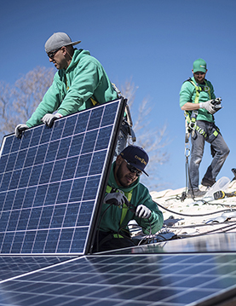
Solar Power Controversy
Cost of Installing
  The cost of installing a residential or commercial solar energy system has declined rapidly in recent years
Solar Users
  Solar users say the technology saves them money by allowing them to generate their own electrical power and helps protect the environment by reducing demand on conventional coal- and natural gas-burning power plants.
Solar Energy Growth
  Solar energy has been growing rapidly.
Solar Power Argument
  People argue that the rapid growth in solar power threatens the financial stability of the power grid and that solar users should pay to help maintain the vast system of poles, wires and transformers

Slide 11
Viewpoint 1
Solar energy saves money
The main costs associated with solar power are for installation and physically maintaining the structures
The cost to install solar panels is decreasing as technology improves
One-time costs cannot be changed by a company after some amount of months/years
Solar Power Saves Money at Home
Saves money by reducing your electricity bill by cutting down the amount of energy you use
Solar panels give you the ability to save money by creating a natural source of energy that has the ability to power your home and heat your pool.
Solar panels are long-lasting and require little upkeep

Slide 12
Solar Power Estimates by State
STATE | AVERAGE PRICE (6 KW SOLAR SYSTEM) | AVERAGE ELECTRICITY RATE PER STATE ($/KWH) | 20-YEAR SAVINGS
Arizona | $11,100 | $0.1278 | $21,572
California | $13,054 | $0.2047 | $39,277
Colorado | $13,852 | $0.1213 | $17,157
Florida | $11,944 | $0.1171 | $17,993
Massachusetts | $13,764 | $0.2324 | $45,648
Maryland | $13,187 | $0.1322 | $20,610
New Jersey | $12,388 | $0.1593 | $28,337
New York | $13,720 | $0.1733 | $30,584
Texas | $12,476 | $0.1230 | $18,968
Washington | $11,899 | $0.0967 | $12,822

Slide 13
Viewpoint 2
Solar power costs more in the long run
Installing solar panels is still very expensive
Power is not guaranteed all the time, so backup sources of power may be needed in addition to solar, which raises costs
Widespread solar use can threaten the current power grid and its financial stability

Slide 14
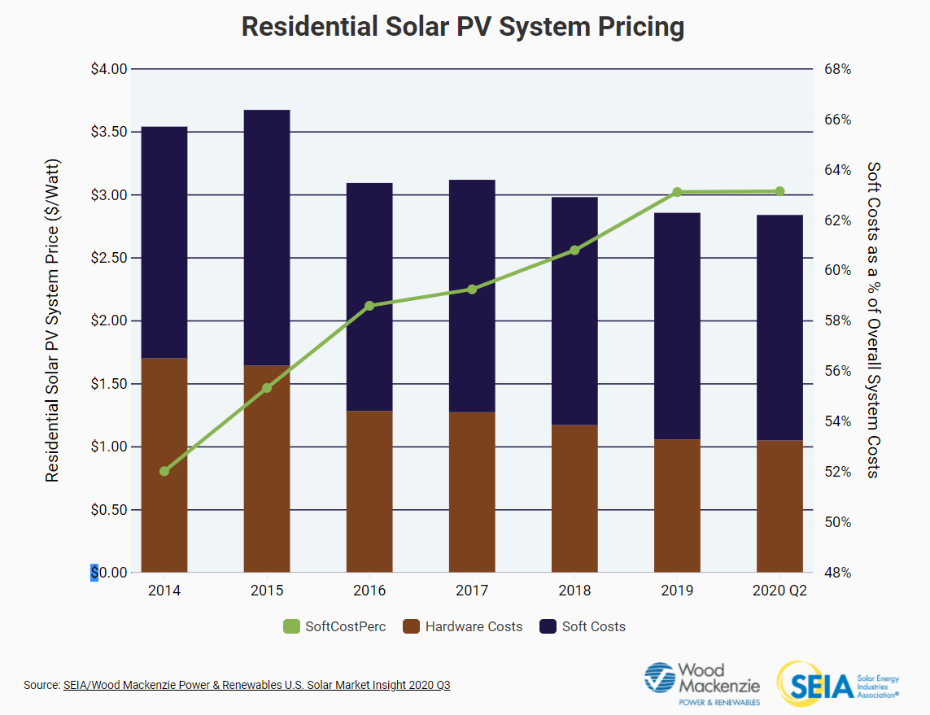
Solar Energy System Costs

Slide 15
Solar Power Costs Vs. Politics
Solar power is set to make huge strides due to its cost competitiveness, even without the stimulus that has been promised by Joe Biden.
If President Trump is somehow re-elected he is expected to continue with the reduction of the main support for the solar power, the investment tax credit, which is set to fall progressively from 30 per cent on new solar projects up until 2019 to 10 per cent by 2023.
  Solar power has such a low cost of energy, many people believe we will be see ageing US plants continue to be replaced by solar, wind and gas

Slide 16
Conclusion
Solar panels and solar panel systems will save you money and bring a return on your investment in no time.
  Rising property values, lowered utility costs and the federal tax credit all ease the upfront costs of installing solar panels.
  Since the price of energy isn’t dropping, investing in solar energy is the smart move to save money, with the added bonus of shrinking your carbon footprint!
The sun is a powerful source that can help our planet by giving us clean, reusable energy to power our world.
  The use of this energy is free, does not create pollution, and if used wisely can help us become less dependent on other more costly and damaging forms of power.

Slide 17
References
National Renewable Energy Laboratory. Solar Energy Basics. https://www.nrel.gov/research/re-solar.html. Accessed 13 Nov. 2020.
U.S. Energy Information Department, “Solar Explained - U.S. Energy Information Administration (EIA).” https://www.eia.gov/energyexplained/solar/. Accessed 13 Nov. 2020.
“Solar Power Information and Facts.” National Geographic. https://www.nationalgeographic.com/environment/global-warming/solar-power/. Accessed 13 Nov. 2020.
U.S. Department of Energy, “The History of Solar.”
https://www1.eere.energy.gov/solar/pdfs/solar_timeline.pdf. Accessed 13 Nov. 2020.

Slide 18
References
“Do Solar Panels Save Money?” UMA Solar, 21 Apr. 2020, www.umasolar.com/blog/do-solar-panels-save-money/.
Fellows, University of Houston Energy. “The Solar Net Metering Controversy: Who Pays For Energy Subsidies?” Forbes, Forbes Magazine, 16 Mar. 2016, www.forbes.com/sites/uhenergy/2016/03/16/the-solar-net-metering-controversy-who-pays-for-energy-subsidies/?sh=25923ce66fd2.
Macdonald-Smith, Angela. “Costs Predicted to Overcome Politics for US Solar Power.” Australian Financial Review, 4 Nov. 2020, www.afr.com/companies/energy/costs-predicted-to-overcome-politics-for-us-solar-power-20201104-p56bcg.
Merchant, Emma Foehringer. “Trump Moves to Increase Solar Import Tariffs, Kill Bifacial Exemption.” Greentech Media, Greentech Media, 20 Oct. 2020, www.greentechmedia.com/articles/read/presidential-proclamation-to-increase-extend-section-201-tariffs.
Sepco. “Solar Power Advantages and Disadvantages.” Commercial Solar Powered LED Lighting, www.sepco-solarlighting.com/blog/bid/115086/solar-power-advantages-and-disadvantages.

