Slide 1
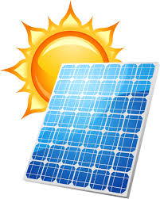
Solar Power: Our Energy Future or False Promise?
Group 8: Justin St. Hill, Michael Osayi, Gwen MacConnell, and Kayleigh Evans

Slide 2

Introduction: What is solar power?
Solar power is the conversion of energy from sunlight to a direct use or electrical generation.
https://www.youtube.com/watch?v=NLO9w963Aj0

Slide 3
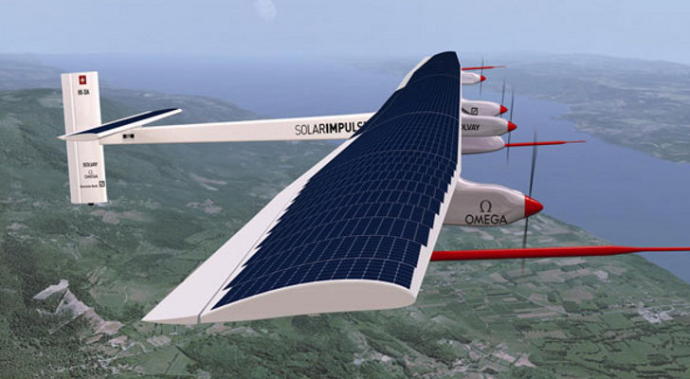
Background & Timeline
Discovered by French physicist Edmond Becquerel after exposing a cell made of metal electrodes to sunlight, noting that it produced more electricity.
In 1953, scientists Daryl Chapin, Calvin Fuller and Gerald Pearson are responsible for the solar powers we’re familiar with today by creating the photovoltaic cell (PV). Using this technology, they were able to fully power an electrical device for the first time (although it was only for several hours).
In 1956, solar panels were available commercially, although thFirstey went for a whopping $300 for a 1 watt solar cell. Eventually, in the 1970’s, prices began to drop down to about $20 per watt.
Today, solar power is used to power cars, homes and many other things (even a plane).
The Solar Impulse 2 ->
https://bgr.com/2015/06/29/solar-impulse-2-flight-across-pacific/

Slide 4
Overview of Controversy
SIDE 1
Argument for solar power
SIDE 2
Argument against the use of solar power

Slide 5
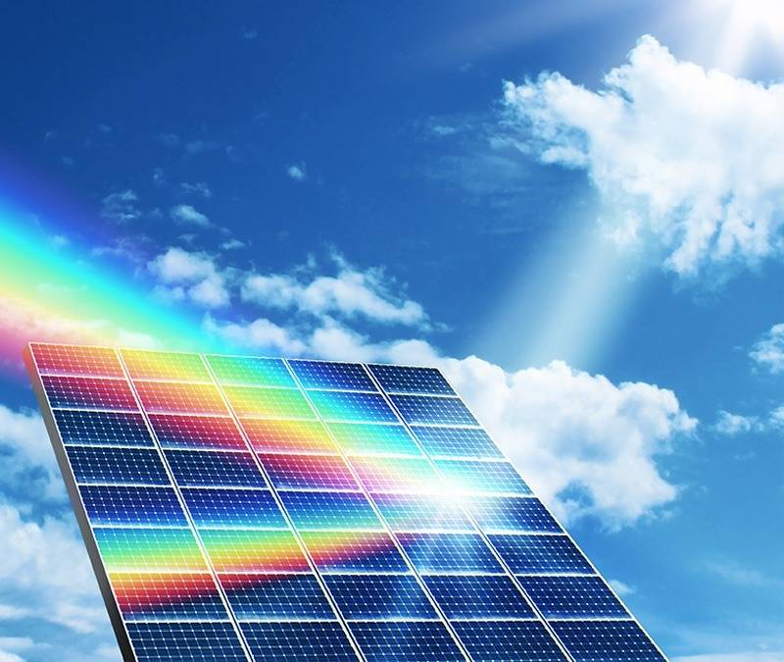
The Affirmative: Renewability
The sun provides a long-term energy source (5 billion years)
The sun shines on all parts of the globe making solar power global
Ability to work when partly cloudy

Slide 6
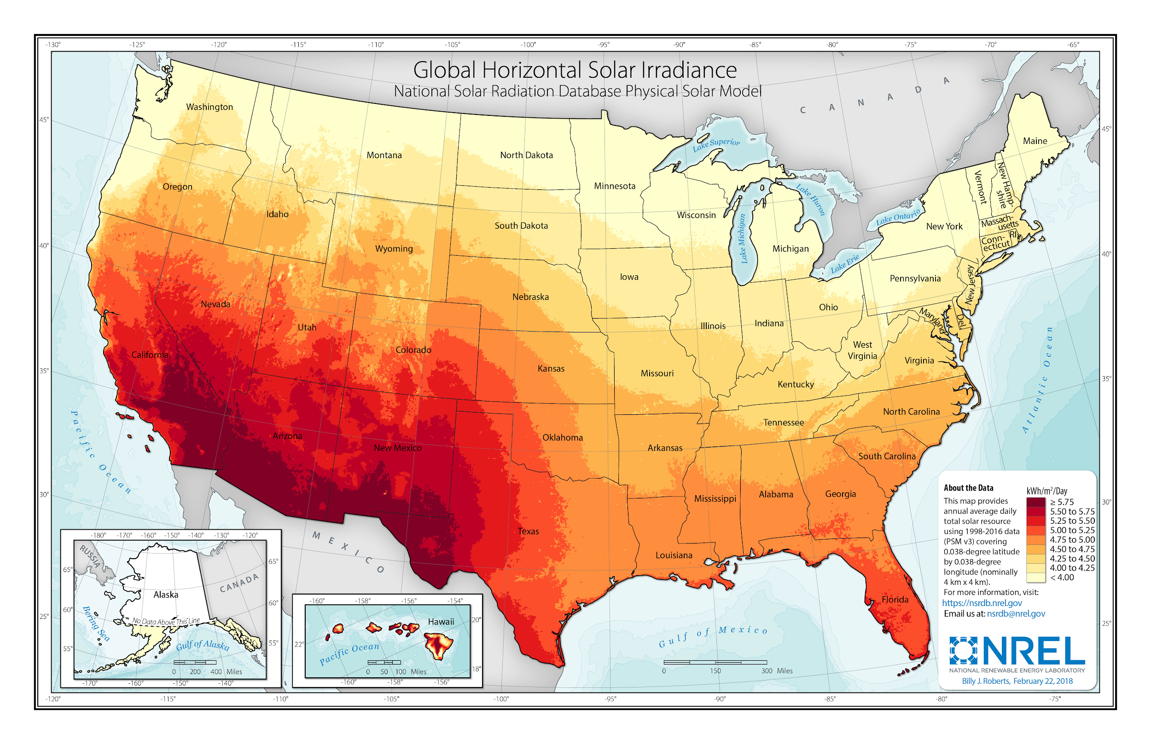
This map shows the concentration of potential solar power as a resource and solar photovoltaics in the US.
Map from NREL:
National Renewable Energy Laboratory

Slide 7
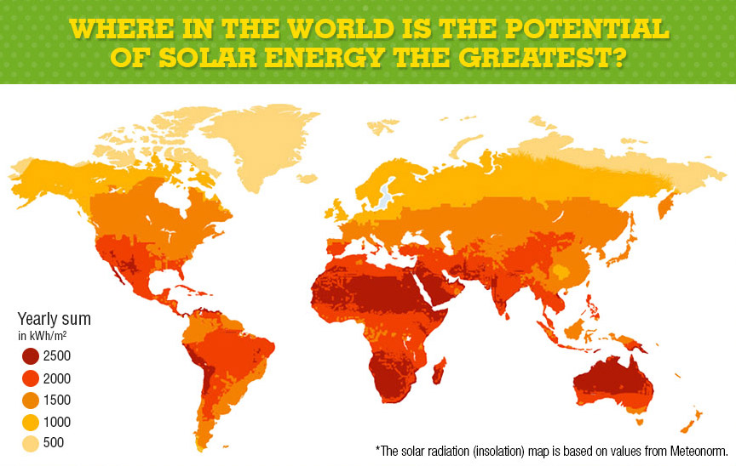
Graph is based on values from Meteonorm. Meteonorm is a solar radiation data source and the standard database in relation to solar energy.
The Green Empire 2016

Slide 8
Follow-up to the World Energy Map
Solar radiation is dependent upon cloud coverage and the angle of the sun
More potential solar energy is close to the equator
Solar Flux: rays hitting per kilowatt hour

Slide 9
Solar Energy Compared to the Demand
There are about 3850 ZJ (zettajoules) available in total. The worldwide energy consumption is about 0.50 ZJ.
This means that we have enough solar radiation to fit our consumption needs!

Slide 10
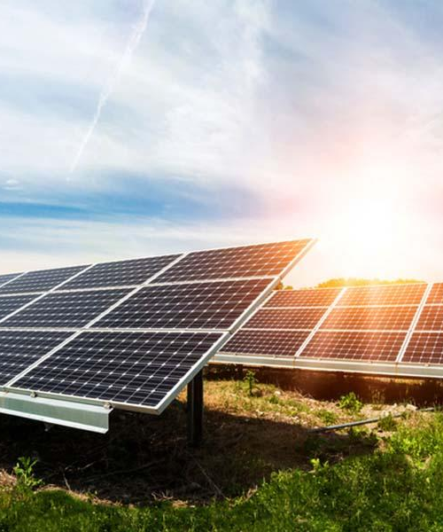
Electricity and Cost
Creates return investment
Potential to be one of the most efficient energy sources
Wide range of electrical uses.
Conversion rates of electricity are growing by the year.

Slide 11
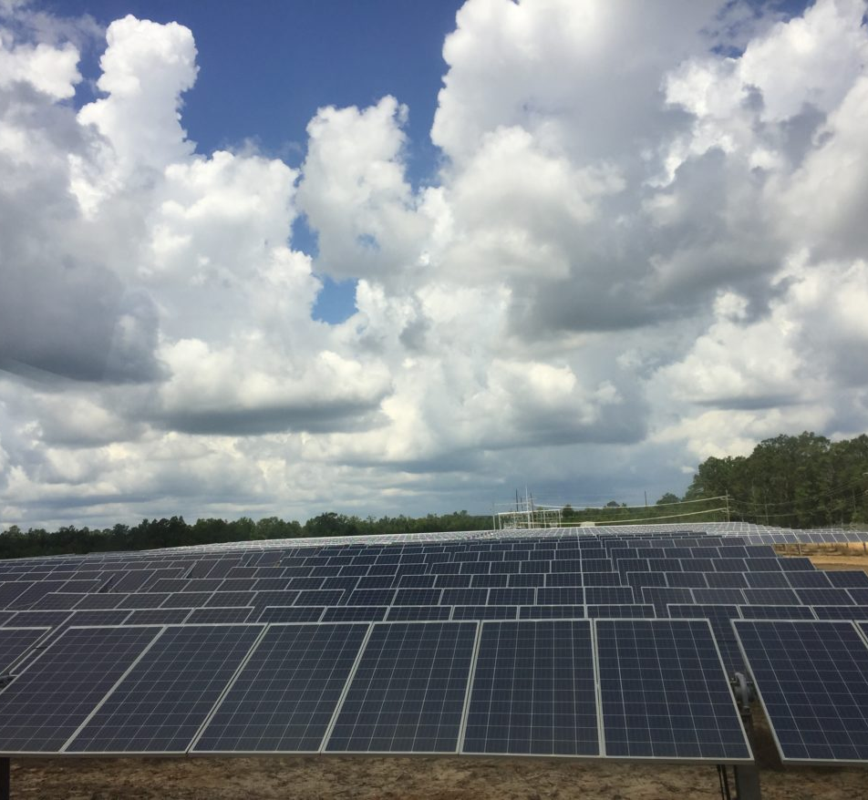
Clean
Little to no noise pollution generated after installation
Cuts down on pollution caused by other forms of energy - such as non-renewables
Drastically produces less greenhouse gas than the other forms

Slide 12
Side 2
The argument AGAINST using solar power.

Slide 13

Case against Solar Power 1
Cost - Initial
The # 1 thing people have against solar power is how much it costs
Popular brand Tesla began to dip their foot in the solar energy conversation.
They developed SolarGlass, which is solar panels built into roof tiles that provides direct power to your home
The cost for system was estimated to be about $21.25 per square foot
This is significantly more expensive than typical roofing.
However, solar panels are an investment, at first the prices will be staggering, but over time they will pay for themselves and some by the reduction in electricity costs alone.

Slide 14
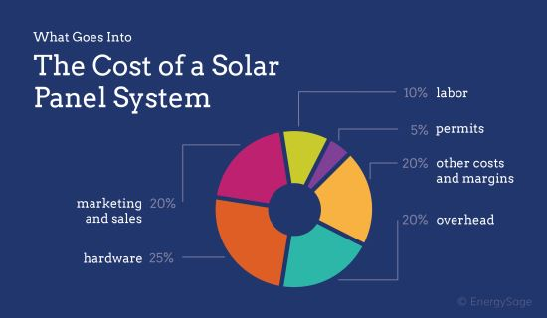
Construction Cost : Solar Panels
EnergySage is an online solar financing marketplace

Slide 15
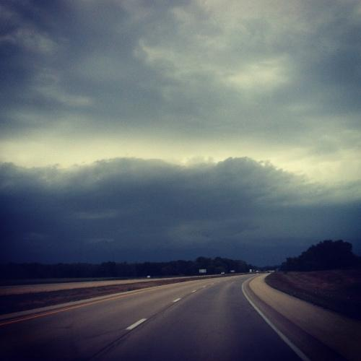
Case against Solar Power 2
Weather
The next case against solar panels would be the fact that weather is unpredictable.
If it is overcast or dark outside you’re not going to be generating nearly enough power to be sufficient.
This reason is why solar energy should be combined with other forms of renewable, or in necessary circumstances, non-renewable energy.
Solar power is a great form of unlimited energy that could cut down on everybody's usage of fossil fuels

Slide 16
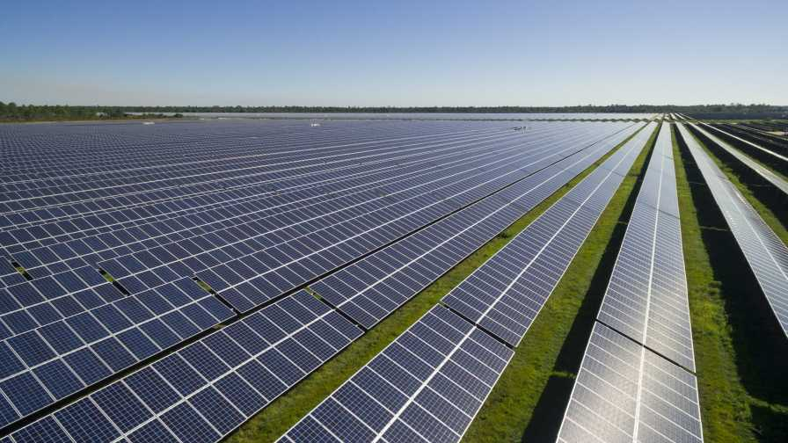
Case against Solar Power 3
Land Pollution
Another case against solar power would be the amount of space that would be required to be reserved in order to make solar panel fields, etc.
This could be minimized or eliminated all together by simple innovation
Innovations such as what Tesla has done with the SolarRoof
or even implementation of solar panels into skyscrapers.
Skyscrapers upper floors have direct access to sunlight and could avoid all forms of cloud coverage.

Slide 17
Removal of Solar Panels and Energy Storage Challenges
Another downside to solar panels is how hard it is to dispose of them, as they are made with materials such as sulfuric acid, phosphine gas, cadmium, lead and chromium.
It can be extremely difficult to recycle them.
Solar power uses batteries to store the energy that can leak chemicals

Slide 18
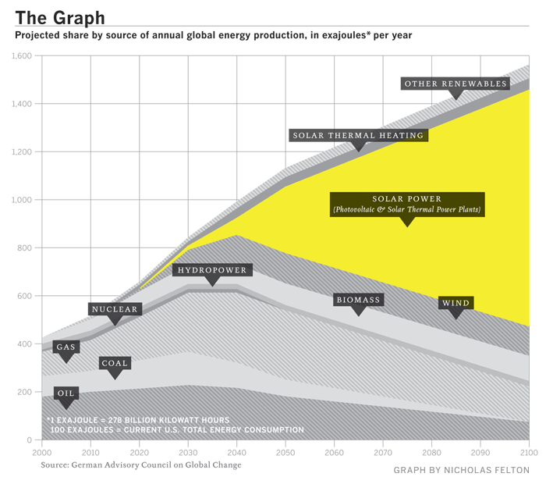
Graph of Future Predictions for Solar Power Usage

Slide 19
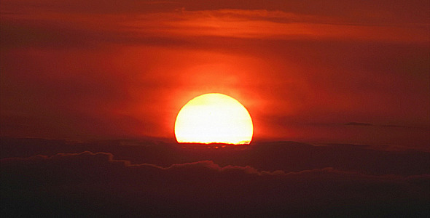
Where does our group stand?
Our group believes that if the efficiency of solar power can be increased then it serves as a powerful potential energy medium for the future.

Slide 20
References
https://www.angieslist.com/articles/how-much-does-roof-replacement-cost.htm
https://www.google.com/amp/s/www.theverge.com/platform/amp/2019/10/25/20932831/tesla-new-solar-glass-roof-elon-musk-version-three
“Solar Energy | A Student’s Guide To Global Climate Change” 5 Sept. 2017 https://archive.epa.gov/climatechange/kids/solutions/technologies/solar.html
“History of Solar Energy: Who Invented Solar Panels” 24 Oct. 2018 https://www.vivintsolar.com/blog/history-of-solar-energy
Aggarwal, Vikram. “Why Are Solar Panels So Expensive?: EnergySage.” Solar News, EnergySage, 9 Sept. 2019, https://news.energysage.com/understanding-the-cost-of-a-solar-panel-system/. - Image
“Solar Maps.” NREL.gov, https://www.nrel.gov/gis/solar.html.
National Geographic. “What is Solar Power?” Youtube, 28 September 2017, https://www.youtube.com/watch?v=NLO9w963Aj0
TheGreenEmpire. “TheGreenEmpire.” The Green Empire, 11 Apr. 2016, https://thegreenempire.net/solar-panels-powering-homes-and-helping-the-environment/.

Slide 21
References (Cont.)
C, Victoria “The History of Solar Power” https://bgr.com/2015/06/29/solar-impulse-2-flight-across-pacific 29 June, 2017
Richardson, Luke “History of Solar Energy: Timeline and Invention of Solar Panels” 3 May, 2018 https://news.energysage.com/the-history-and-invention-of-solar-panel-technology/

