Slide 1

















Pebble Mine
Pebble Mine

Slide 2


What is the Pebble Mine?
-Located in Alaska near Lake Iliamna and Lake Clark
-Sitting on the world's largest known gold deposit in the world
-Potential hundreds of billions of dollars worth of metals Located at the headwaters of the world’s most productive
salmon rivers
(Pebble Mine, 2010)
2

Slide 3
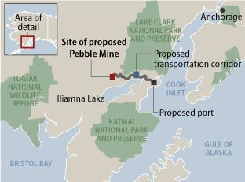

Map of Proposed Pebble Mine
3

Slide 5



Pebble Mine Controversy
- The Pebble Mine contains massive value, but faces problems in actually being mined due to…
Possible Clean Water Act Violations
EPA Regulations
Lawsuits against conservative groups
Failure to find new investors
5

Slide 6



Pebble Mine Controversy (Today)
Questions of whether the mine conformed to the Clean Water Act Standards in the Bristol Bay Area.
-The conflict was later resolved and the mine was found to fit the standards.
The EPA regulations that pertained to the King Salmon population.
-Was later proved that the Pebble Mine would not affect the fishes.
6

Slide 7



Pebble Mine Controversy (Today)
The mining company faced many legal battles against conservation groups such as, the Renewable Resource coalition where the company settled out in court for illegally purchasing confidential information.
Legal complications caused investors to drop out of the project.
-Resulted in the inability to fund the project.
7

Slide 8

Analysis of Viewpoint #1
(Environmental Concerns)

Slide 9



Perspectives
Perspective 1: The Pebble Partnership company argues that the project’s overall benefits will outweigh the potential environmental risks.
Perspective 2: Alaska’s community wants to prevent the Pebble Mine project in fear of potential environmental harm.
9

Slide 10

Findings Based on Research and Data
(Environmental Concerns)

Slide 11
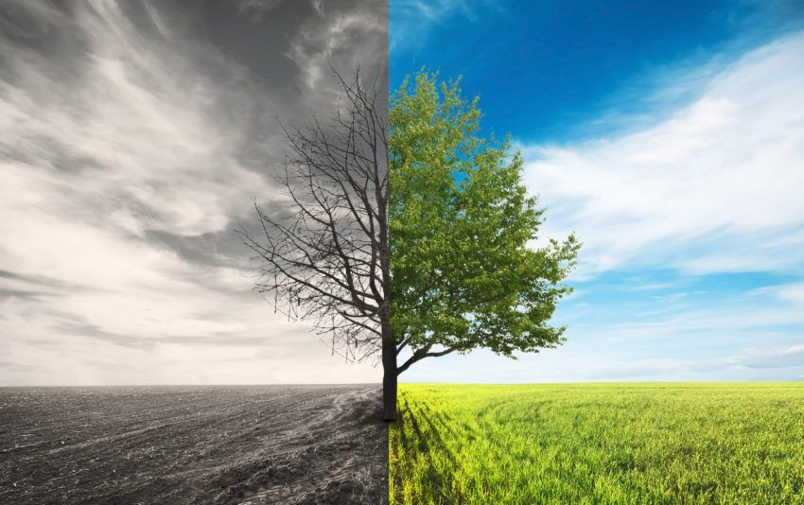


Environmental Disadvantages
The Pebble Mine could potentially...
-Destroy more than 80 miles of streams and 3,500 acres of wetlands.
-Create a toxic pit lake filled with 61 billion gallons of polluted mine water.
-Pollution of water would decrease the population of King Salmon fish (one of Alaska’s main food sources).
11

Slide 12
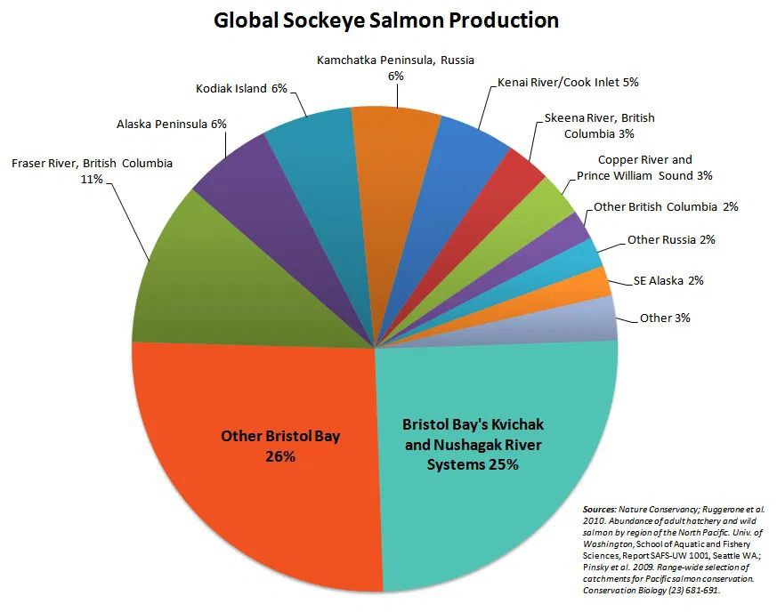
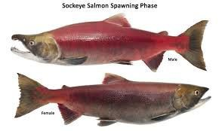
The Bristol Bay has the highest production of Sockeye Salmon.
Any potential damage to the Bay could hurt negatively impact the natural environment.
12

Slide 13



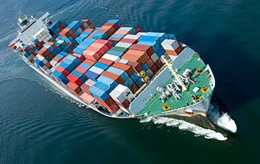
Environmental Advantages
The installation of pipelines under Alaska’s largest lake would…
-Create a Barge system
-A Barge System would provide Alaska’s community a new and inexpensive way of transporting resources.
-A Barge System would help conserve energy within the lake.
13

Slide 14


Final Statement: Environmental Concerns
Many of the mentioned environmental risks have not been proven as accurate.
With that being said, until proved to be accurate, the Pebble Mine project is seen as more beneficial than harmful.
14

Slide 15


Analysis of Viewpoint #2
(Employment & Economy)

Slide 16
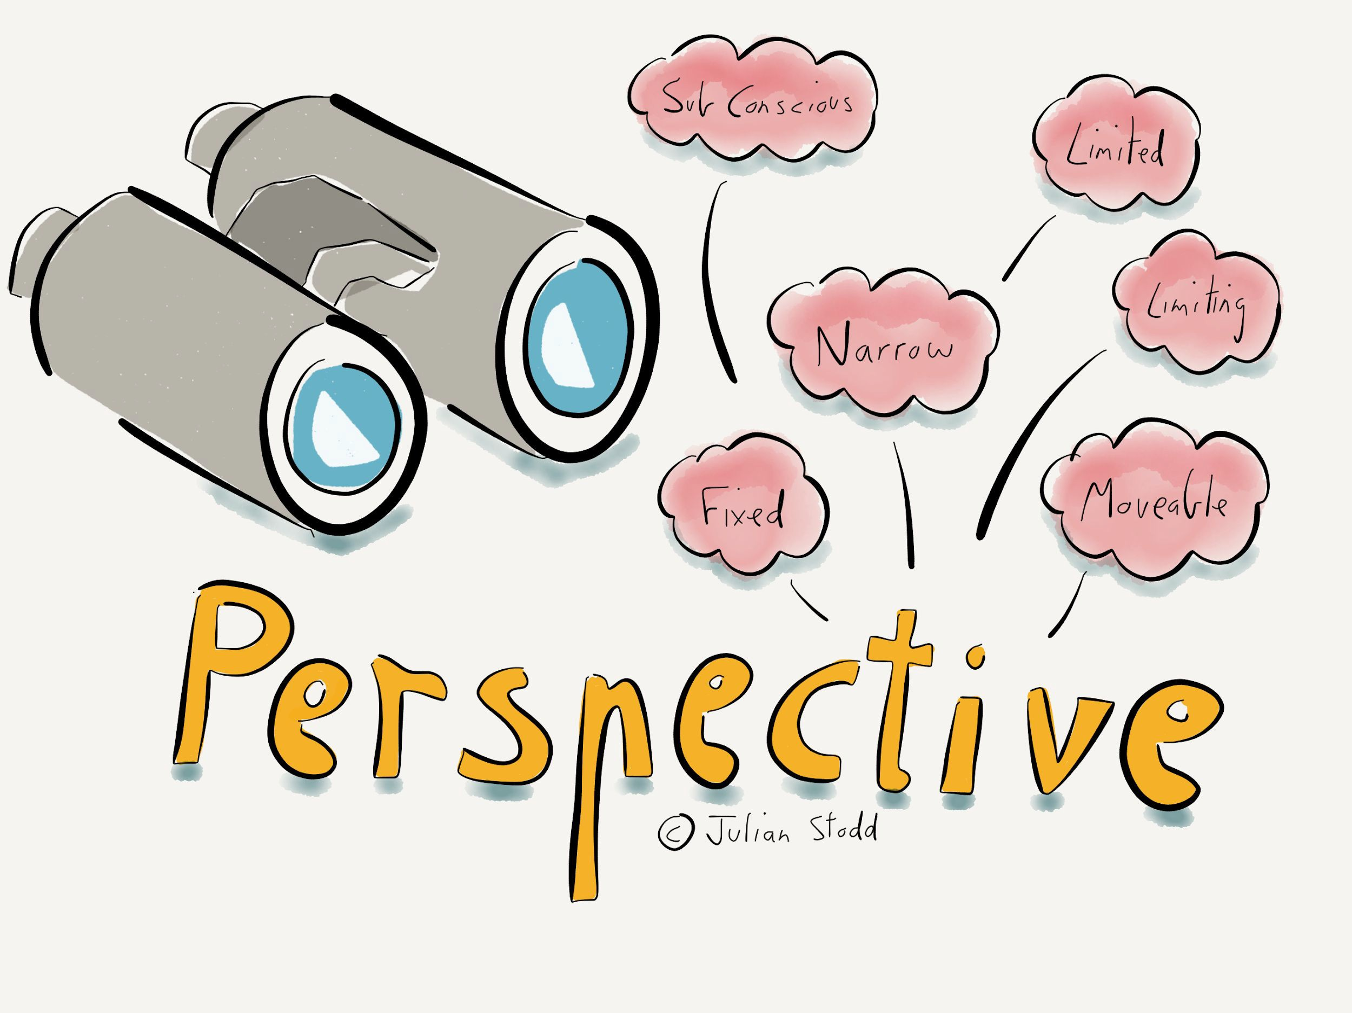


Perspectives
Perspective 1: The community of Alaska believes that the Pebble Mine will hurt their economy.
Perspective 2: The Pebble Partnership company believes that the Pebble Mine project would boost Alaska’s economy.
16

Slide 17

Findings Based on Research and Data
(Employment & Economy)

Slide 18



Employment & Economic Beneﬁts
-The Pebble Mine contains greater than $300 million worth of recoverable metals.
-If the mine was constructed, its metals would be exported to smelters.
-Revenue would go into mine operation, taxes, and paying off initial liabilities.
18

Slide 19

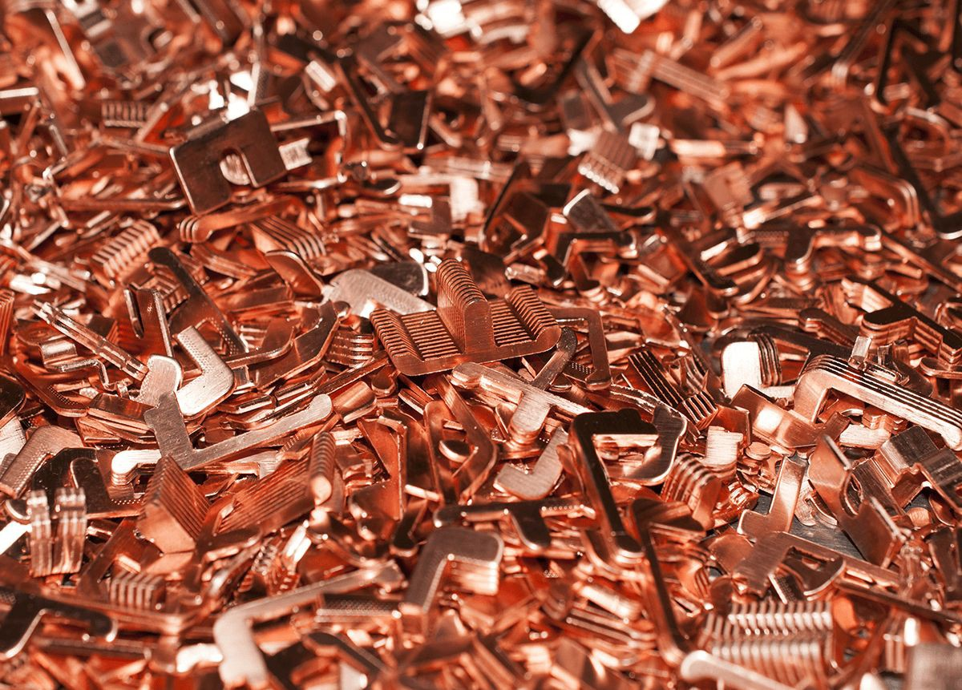




Continued
-Copper is a critical metal and the Pebble Mine could increase copper production by 20%.
-Over 29 year period, mine could create up to 16,000 jobs and generate $1 billion in government revenue.
-Metal mining generates less taxes than oil and gas extraction - so money would be saved.
-Estimated that the Pebble Mine would pay up to $11.5 billion in natural resource taxes over its lifetime.
19

Slide 20
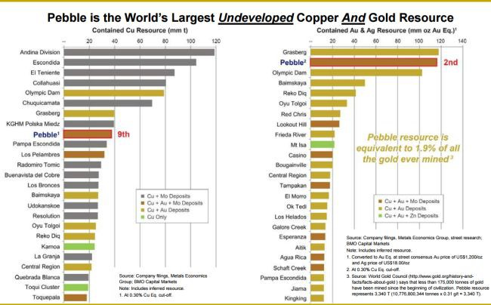

Slide 21




Employment & Economics Disadvantages
Depending on workforce origin (in-state vs out-state) and spending habits, income could either help Alaska’s economy or hurt it.
Payments to vendors (machinery, operation of ocean-going ships, etc.) would leave the state immediately since such vendors are not located within Alaska.
Out of state vending jobs would not benefit locals of Alaska.
21

Slide 22


Final Statement : Employment & The Economy
The Pebble Mine project won’t initially create much job opportunity for Alaska’s economy. However, the economy still benefits from the taxation of the project.
Overall, our research favors the Pebble Mine project and sees it as being more beneficial to Alaska’s economy than harmful.
22

Slide 23
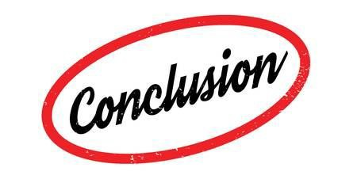


Conclusion (How We Feel?)
Although there is some potential environmental damage that could happen from this project, we believe that the Pebble Partnership company should be able to mine the Bristol Bay location.
We came to this consensus for the following reasons:
It is already known that most projects have potential environmental risks
Research proves that the value of resources that could be pulled from the mine, outweigh the potential risks
The mine meets all regulation standards (Clean Water Act, EPA, Fishery, ETC.)
23

Slide 24


Citations
Pebble Mine (Copper/Gold Prospect). (2010, May 5). Retrieved October 31, 2019, from http://groundtruthtrekking.org/Issues/MetalsMining/pebble-mine-gold-copper-prospect-alaska.html.
(2019, May 29). Retrieved October 31, 2019, from https://www.youtube.com/watch?v=y9K7Ecd14FM.
Monahan, Phil. “U.S. Army Corps of Engineers Releases Draft Environmental Impact Study on Pebble Mine.” Orvis News, 22 Feb. 2019 news.orvis.com
24

