Slide 1
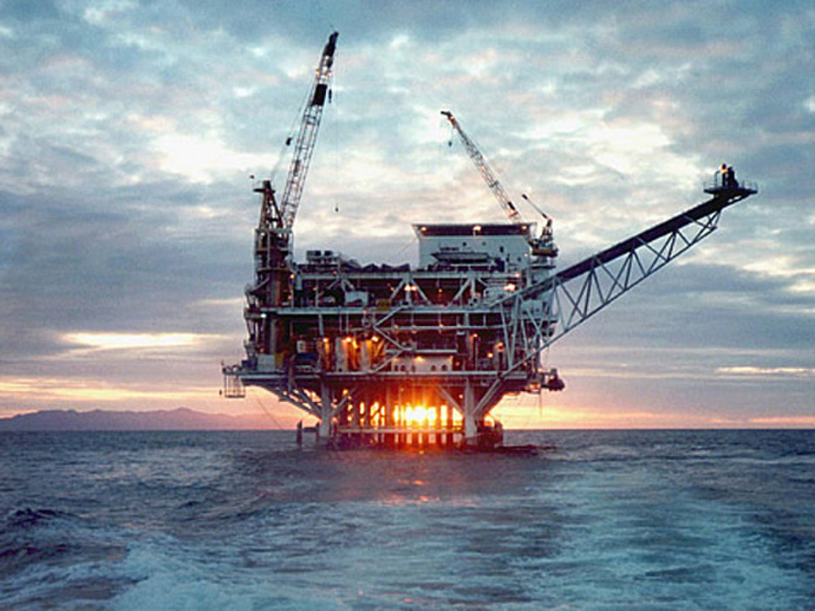
Is Offshore Drilling too Risky?
By
Boosalis, Chow, Clarke & DiMarsico

Slide 2
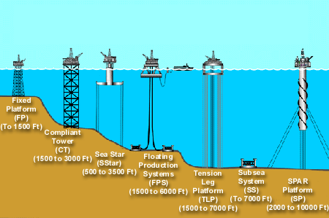
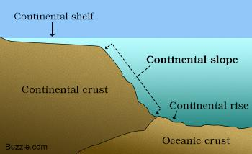
What is Offshore Drilling
A drilling operation done beneath the seabed from an oil rig in order to draw out oil and gas
Continental Shelf
The North Sea, Gulf of Mexico, California
1891, Great lake St. Mary, Ohio

Slide 3


Benefits
Economic benefits
  Foreign Oil
  Oil prices
  $$$
Job opportunities
  800,000+ by 2035
Aquatic shelter

Slide 4
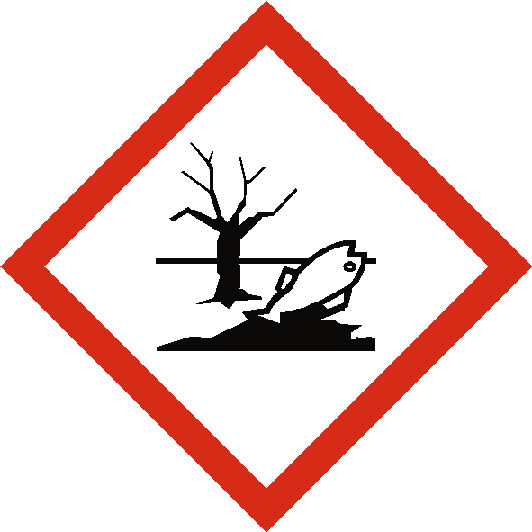
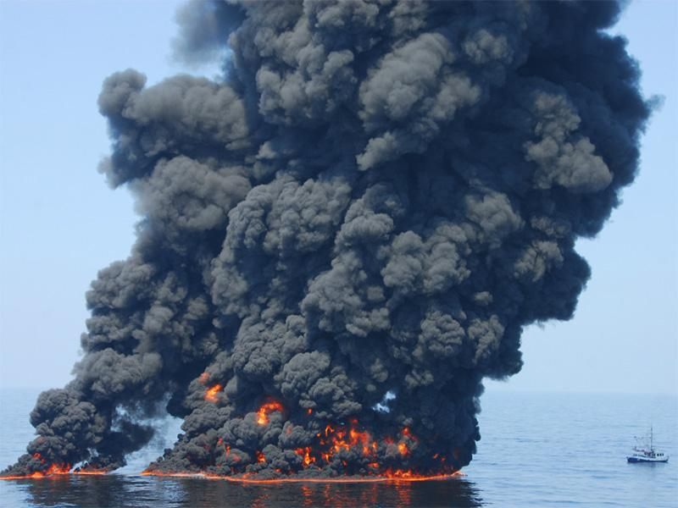


Risks
Dangerous to environment
Harmful to human health
Air pollution
Expensive

Slide 5
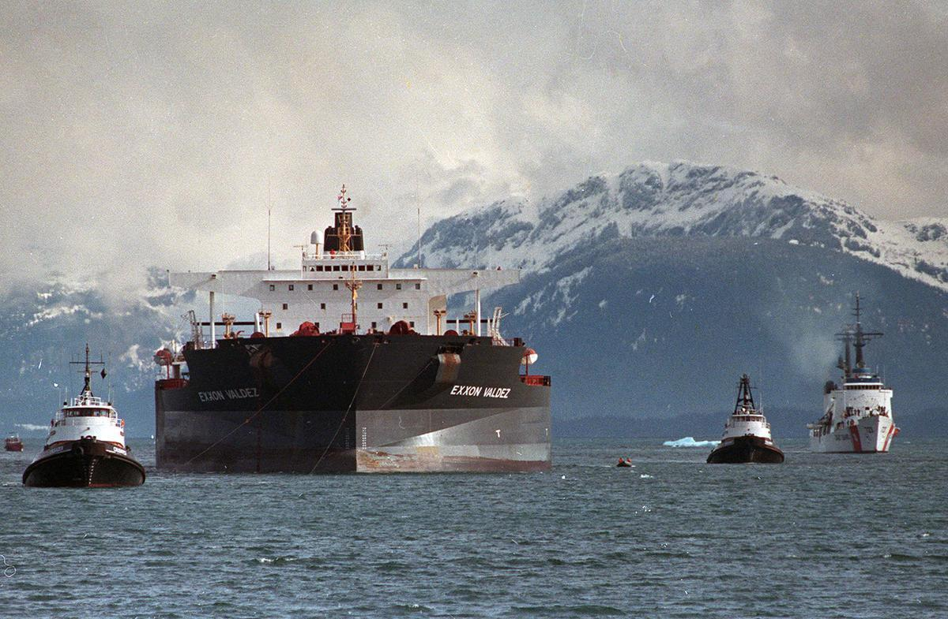
1989 Exxon Valdez
The Exxon spill was a devastating oil spill that occurred on the coast of Alaska in 1989. This spill along with the BP was catastrophic, studies show that in 2007 that 26000 gallons of oil were still trapped along the beaches and coastlines of Alaska.
The casualties among animals surrounding these lands were close to the millions
250-500 thousand seabirds, thousands of sea otters, harbor seals, 2 dozen killer whales are being said to have been affected by this oil spill. Millions on millions of salmon and herring eggs were destroyed. Other than the loss of billions of dollars there was also a major impact on wildlife that will cost more to clean up as well.
more than 1,000 miles of coastline were fouled, and hundreds of thousands of animals perished. Exxon ended up paying billions in cleanup costs and fines, and remains tied up in court cases to this day.

Slide 6
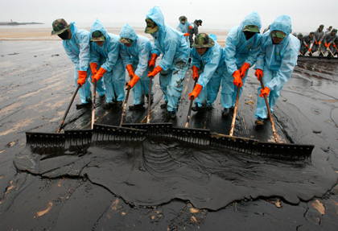
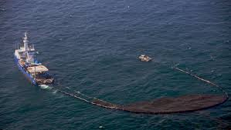
Clean up
Though the typical oil drilling rig generates about 60 million dollars a year the costs of the cleanup surpasses those profits.
When BP suffered their oil spill in 2010 the cost of their spill was nearly 61.6 billion dollars.
Exxon suffered theirs in 1989
The reasons to the cost are due to all the necessary procedures needed to clean to oceans and coastlines as quick as possible to minimize damages and loss of marine life around the area. In order to clean up such a massive spill you need equipment such as skimming ships, floating oil containment booms, oil boom fence, oil dispersant spray systems, and many other biological methods.

Slide 7
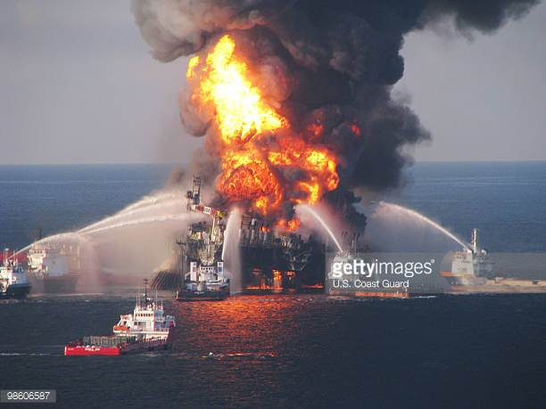
BP Oil Spill
April 10th, 2010
Gulf of Mexico
Deepwater Horizon Rig
Killed 11 people and injured 115 crew members
Oil flowed for 87 days, spread across 16,000 miles
Aquatic ecosystems destroyed (Coral)
Widespread extinction
Domino effect
Worst oil spill in the history of the United States
https://www.youtube.com/watch?v=A0XvAdwFW8Q

Slide 8
Environmental Impacts
Drilling Muds
- used to cool drill bit and pipes
- releases toxic chemicals to marine life
Produced Water
- fluid trapped underground that is brought up with oil and water
- 20 percent of waste associated with offshore drilling
- has an oil content of 30-40 parts per million
- nearly 2 billion gallons of produced water released into the Cook
Inlet in Alaska each year contain about 70,000 gallons of oil

Slide 9
Environmental Impacts continued.
Exploration
- firing air guns which send a strong shock across the seabed to find
offshore oil
- decreases fish catch, damage the hearing capacity of various marine
species and may lead to marine mammals being stranded
Offshore Oil Rigs
- attract seabirds at night due to their lighting and flaring
- bird mortality has been associated with physical collisions with the
rigs/ incineration from flares and oil leaks
- higher levels of mercury are found in Gulf of Mexico fish
- black carbon is created which contributes to climate change

Slide 10
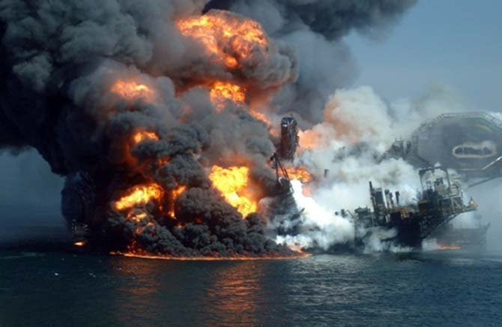
Human Casualties
The CDC has tracked the human casualty data and determined that between 2003-2010, over 128 people have died working on offshore rigs.
The average fatality rate for US offshore drilling is 2.8 deaths per 100,000 workers.
In the Deepwater Horizon Explosion, it was believed that 11 people were killed in the explosion.

Slide 11
Costs
The cost on average to build an offshore rig compared to a land rig is about 15 to 20 times more.
The price of offshore drilling is approximately $650 million
The least expensive offshore rigs are typically around $200 million
The big five oil companies (ExxonMobile, BP, Shell, Chevron and ConocoPhillips.)
The cost of cleaning up the mess made made by oil spills is well over the amount that offshore drilling makes in profits.
The approximate cost cleanup in social terms is well over $68 billion, $670 per gallon of oil spilled

Slide 12

President Trump
President Trump is all for offshore drilling
President Trump has been a huge supporter on the fossil fuel movement.
He believes that America should be the dominant force of energy in the world. He doesn’t care how we do it, he just cares that we become the dominant force.
He recently signed an executive order for the expansion of offshore drilling and this obviously raised alarms for wildlife preservations and animal rights activists.
He believes that the renewed production of offshore drilling will create new jobs and create billions of dollars of revenue.

Slide 13
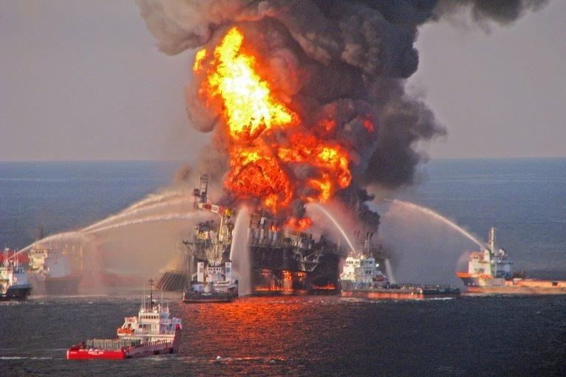
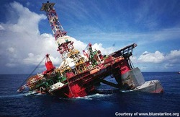
Our Thoughts
We believe that the risk of offshore drilling is far too dangerous as the reward of such a venture is coupled with the possible damage it may cause. The cost of offshore drilling is quite expensive. The dangers in offshore drilling is also a cause for concern as in multiple occasions, there are accidents and spills which will cost even more to clean up.

Slide 14
References
NYLN.com. “7 Most Notable Pros and Cons of Offshore Drilling.” NYLN.org, 16 July 2015, nyln.org/7-most-notable-pros-and-cons-of-offshore-drilling.
Times-Picayune, David Hammer The. “5 key human errors, colossal mechanical failure led to fatal Gulf oil rig blowout.” NOLA.com, 5 Sept. 2010, www.nola.com/news/gulf-oil-spill/index.ssf/2010/09/5_key_human_errors_colossal_me.html.
Rott, Nathan, and Merrit Kennedy. “Trump Signs Executive Order On Offshore Drilling And Marine Sanctuaries.” NPR, NPR, 27 Apr. 2017, www.npr.org/sections/thetwo-way/2017/04/27/525959808/trump-to-sign-executive-order-on-offshore-drilling-and-marine-sanctuaries.

