Slide 1
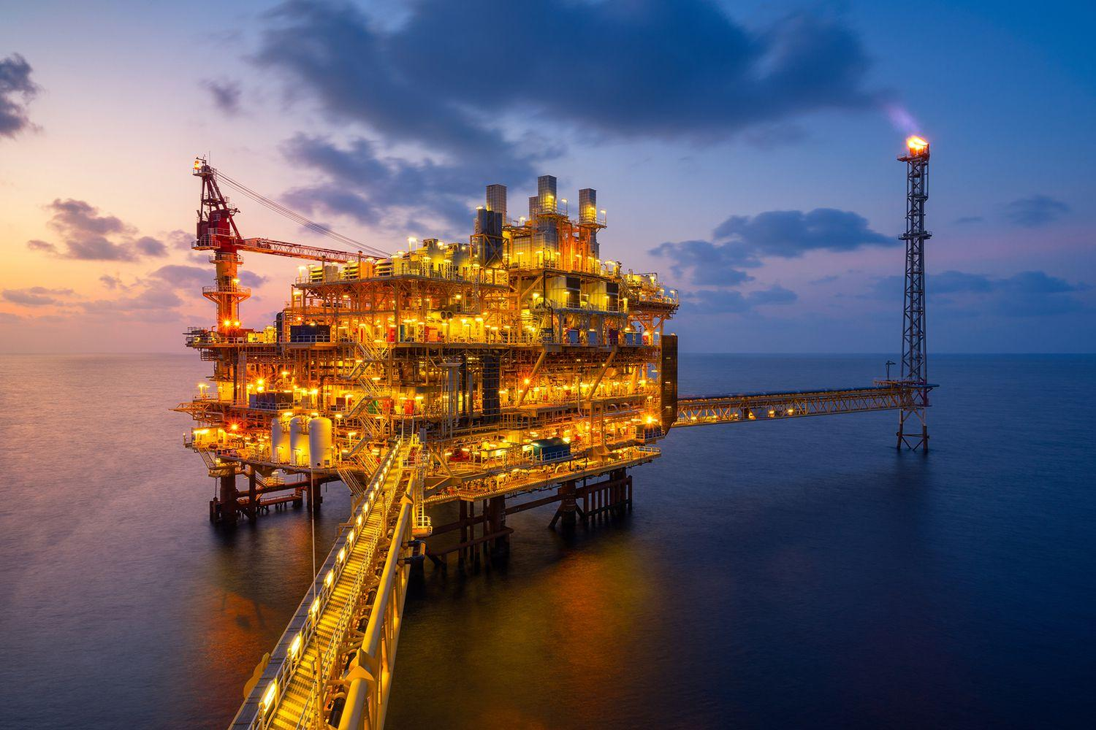
Dangers of Offshore Drilling
By: Felicia Clark and Jacob Dragon

Slide 2
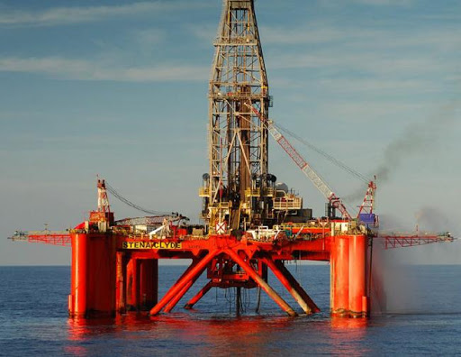
What is Offshore Drilling?
Offshore drilling is the process of extracting petroleum from reserves located beneath the Earth’s oceans
Nearly all offshore oil and natural gas leasing and development activity currently occurs in the central and western Gulf of Mexico

Slide 3
Where did it start?
The first offshore oil well was drilled in 1897 at the end of a wharf, 300 feet off the coast of Summerland, California by a businessman named Henry L. Williams
Major petroleum company drilled the first “over water” oil well in 1911, paving the way for future offshore drilling
The jack up rig had been introduced in the 1950’s
At the end of WWII the offshore drilling industry began to quickly rise in popularity

Slide 4
Most Common Types of Offshore Drilling
Drilling Barges
mostly utilized for shallow water drilling in calm water conditions
Drilling equipment is placed onto the barges’ decks and towed to the site by tugs
Anchors hold the barges in the position where drilling is to be carried out.
Jack-up rigs
Self-contained drilling structures similar to the drilling barges only to the exception that these massive structures are positioned onto the site by lowering and rooting their three or four giant legs on the seafloor.
Drill Ships
Ultra-deepwater drilling capability and easy mobility.
Adapted to provide complete offshore drilling solutions to the clients across the globe.
Equipped with exhaustive mooring and positioning systems and are able to propel from one well to another without outside assistance.

Slide 5
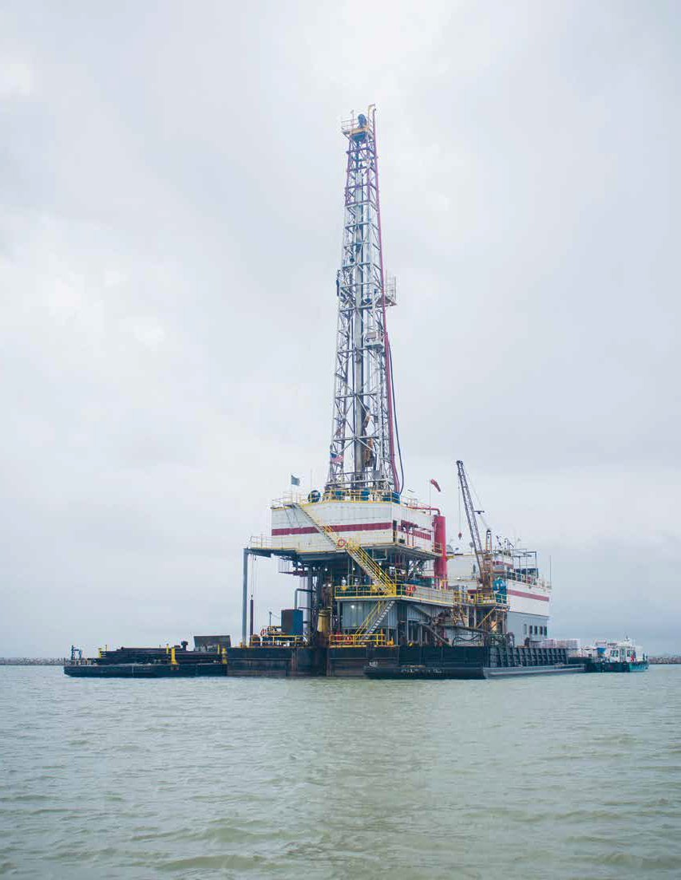
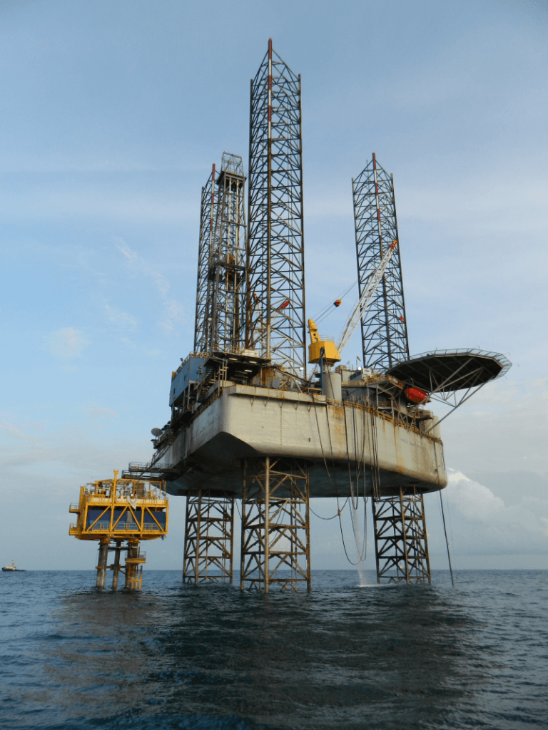
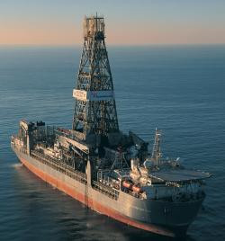
Drilling Barges
Jack-up Rigs
Drill Ships

Slide 6
Why is it Needed?
Offshore drilling has increased in popularity as a result of the large amount of oil and other petroleum products used worldwide each day
To meet the very high and increasing demand for fossil fuels, petroleum companies are faced with the task of searching in more remote locations to discover new reserves
A large amount of the oil and natural gas reserves around the globe are located beneath water

Slide 7
Environmental Impacts
Oil spills
  Because of offshore drilling there are nearly 157,000 barrels of oil spilled into the ocean every year
Toxic pollution
  Offshore drilling releases volatile organic compounds, greenhouse gases, and other air pollutants.
A major risk to all animals and nature
  Any type of oil spill could cause poison and or death to all wildlife living in, around, or off of the water it spills in

Slide 8
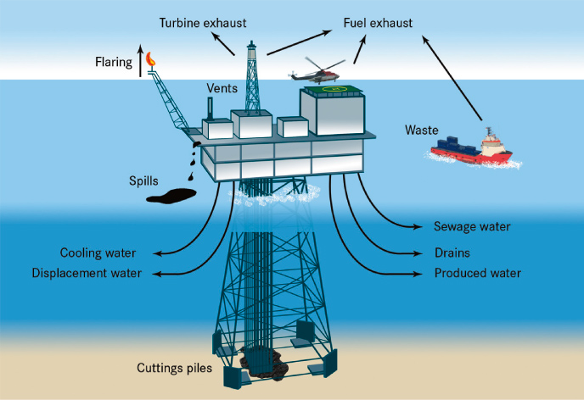

Slide 9
Impacts on our Local Economy
Puts industries at risk
  When offshore drilling is introduced into a region, it jeopardizes commercial fishing, recreation, and tourist economies
  The jobs brought in by oil companies will not replace the jobs lost by the effects of offshore drilling.
  The impact will be felt for generations.
Creates military concerns
  The military is one of offshore drilling industry’s major employers
  Oil production off the Atlantic coast has raised concerns from the Department of Defense because of potential conflicts with military operations

Slide 10
Impacts on climate change
Heavier rainfall and more intense storms, due in part to climate change, lead to more polluted runoff, threatening the progress made so far in reducing pollution to the Bay.
Warmer waters hold less dissolved oxygen, exacerbating fish-killing dead zones and contributing to algal blooms.
Temperature changes affect key species like eelgrass and striped bass, impacting not only the species themselves but the commercial fisheries that are integral to the region’s economy.
Sea level rise is already threatening communities around the Bay, from Annapolis to Hampton Roads to the Eastern Shore to Tangier Island.

Slide 11
Drilling Accidents
Piper Alpha(1988)-Due to gas leakage from one of the condensate pipes at the platform, it produced more than 300,000 barrels of crude a day, killing 167 people and becoming the deadliest offshore oil rig accident in history
The Usumacinta Jack-up disaster(2007)-Due to a storm with winds of 130km/h and up to 8m of waves created an oscillating movement causing a collision with the PEMEX-operated Kab-101 platform in the Bay of Campeche, it claimed 22 lives
Deepwater Horizon(2010)-Due to an explosion of natural gas this oil rig eventually capsized and released millions of gallons of oil into the Gulf of Mexico.

Slide 12
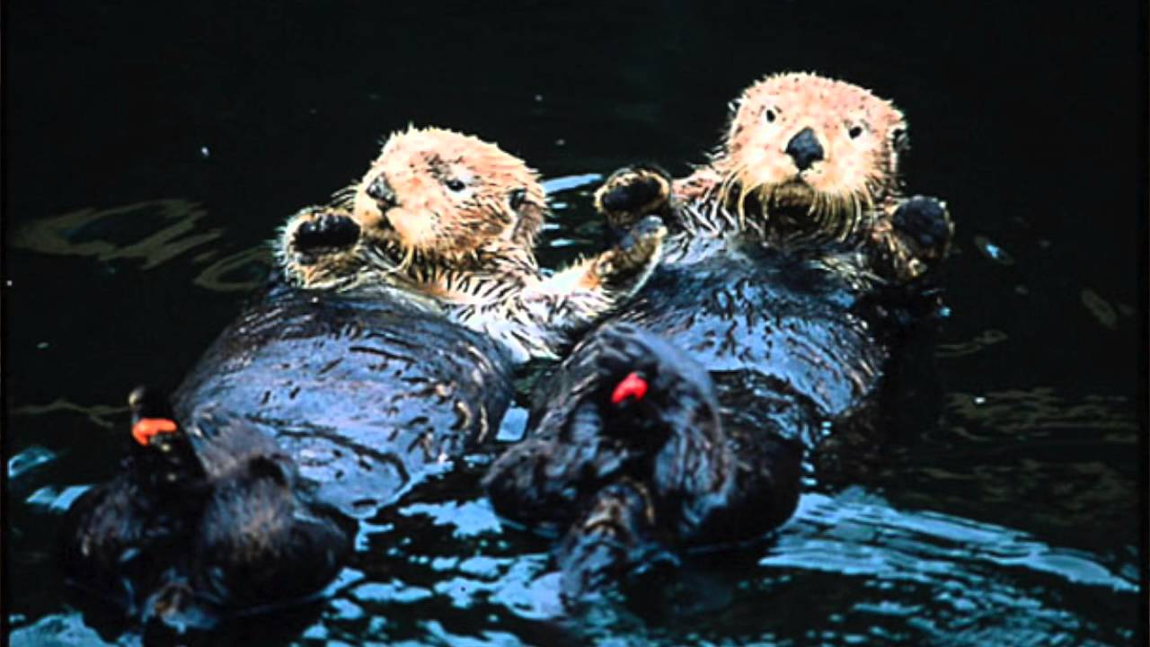
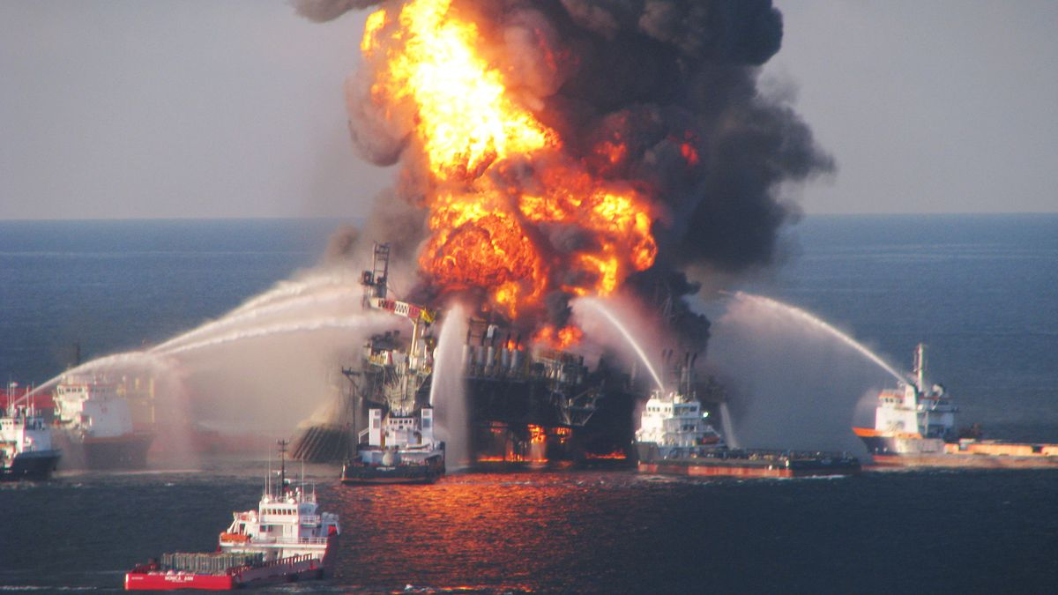
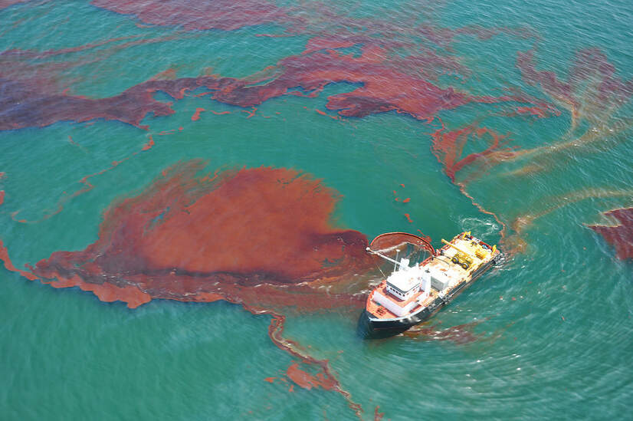
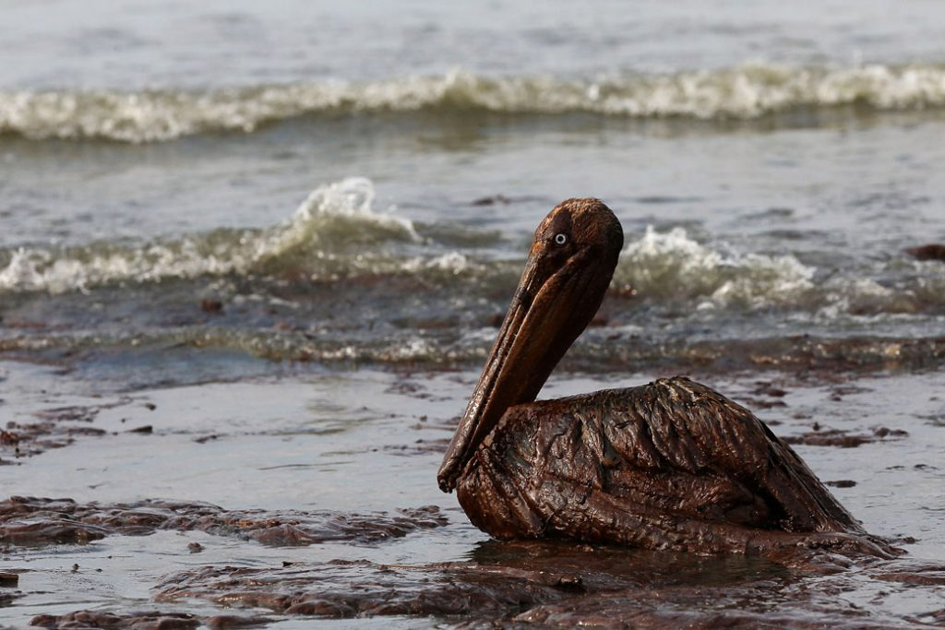

Slide 13
Reasons to Support Offshore Drilling
Self sufficiency
  With the millions of barrels of oil needed to supply the growing market, the U.S. import petroleum from OPEC conglomerates. This does not only cost money but basically, the country is at the mercy of its supplier
Supply increase
  Being a commodity that relies on supply and demand, the price of oil will increase or decrease depending on the availability of petroleum products. When there is sufficient or abundant supply, consumers can enjoy reduced oil prices as well as other products that use oil
More jobs
  The more ongoing drilling activities, the bigger is the need for people to fill in positions. These local jobs not only boost the economies of communities but also the economy of the country
Industrilazional boost
  With investors spending for offshore drilling, jobs will be created and there is a big chance that poor countries can also become industrialized powers like other First World countries

Slide 14
Reasons to be Against Offshore Drilling
Pollution
  Offshore drilling contributes to air pollution and increased carbon emissions. This will have an effect on global warming in a negative way
Environmental hazards
  Offshore drilling accidents and oil spills cause a lot of harm not only to the environment and the people but most especially to marine life, coral reefs and birds that also rely on the sea for food
Worker endangerment
  If accidents happen in a bigger scale, it will be difficult to transport victims to safety. Moreover, they are also exposed to harsh conditions such as extreme heat and cold as well as storms
Expensive
  Offshore drilling involves a large amount of money when putting up the rig into place, if the country does not have enough resources to fund for the drilling it needs investors who will gain much of the money, and cleaning oil spills and treatment is very expensive

Slide 15

Biden’s Stance in the 2020 Election
Would phase out fossil fuels to address a climate crisis
Promises to spend $2 trillion on a clean energy transition to wean the nation off fossil fuels, which could begin an orderly shift away from oil and gas production

Slide 16

Trump’s Stance in the 2020 Election
Promises to continue expanding drilling and production
The Trump administration has enacted policies that have likely made it cheaper to drill

Slide 17
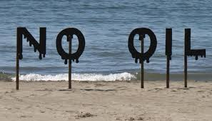
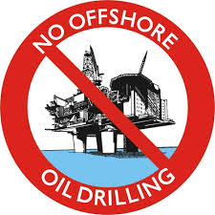
Our Position
As a group we have collectively decided to be against offshore drilling for the following reasons:
  The pollution that offshore drilling causes
  The environmental harm it has on the animals and nature living in, around, or off of the ocean
  The negative effect it has on climate change
  The danger it puts their employees in

Slide 18
What you can do to Stop Offshore Drilling
Encourage comments to engage legal action
Support state legislation
Plan and participate in local events
Show the Federal Administration that Businesses Oppose Oil Drilling
Sign petitions
Donate money to keep the oceans clean
Visit: https://www.nrdc.org/stop-offshore-drilling

Slide 19
Works Cited
Kusnetz, Nicholas, et al. “Biden Could Reduce the Nation's Production of Oil and Gas, but Probably Not as Much as Many Hope.” InsideClimate News, 5 Oct. 2020, insideclimatenews.org/news/01102020/biden-trump-oil-output-2020-election-public-lands.
Miller, Brandon. “9 Prominent Pros and Cons of Offshore Drilling.” Green Garage, 14 Jan. 2017, greengarageblog.org/9-prominent-pros-and-cons-of-offshore-drilling.
“Offshore Drilling.” Chesapeake Bay Foundation, www.cbf.org/issues/offshore-drilling/.
“Offshore Drilling.” Offshore Drilling - Energy Education, energyeducation.ca/encyclopedia/Offshore_drilling.
“Offshore Petroleum History.” American Oil & Gas Historical Society, 9 Nov. 2020, www.aoghs.org/offshore-history/offshore-oil-history/.
Singh, Bikram, et al. “Types Of Mobile Offshore Drilling Units (MODU).” Marine Insight, 11 Oct. 2019, www.marineinsight.com/offshore/basics-of-offshore-drilling-types-of-mobile-drilling-units/.
“U.S. Energy Information Administration - EIA - Independent Statistics and Analysis.” Offshore Oil and Gas in Depth - U.S. Energy Information Administration (EIA), www.eia.gov/energyexplained/oil-and-petroleum-products/offshore-oil-and-gas-in-depth.php.

