Slide 1
Does nuclear power have a future in the US if we can't identify a central waste deposit?
Shawn Cottee, Bradley Anacreon, Mia Walker, Jack Bauer
BIO/EES/EGY 105 Dr. Klemow

Slide 2
Nuclear power has been an increasingly used form of energy within the United States and around the World. While it is the most reliable energy source, and has no greenhouse gas emissions, the waste that it produces is potentially extremely harmful to humans.

Slide 3
What is Nuclear Power?

Slide 4
Nuclear power is the use of nuclear reactions in the form of fission, which is used to heat up water being used as a coolant for the nuclear fuel rods, generating steam to power turbines and create electrical energy.

Slide 5
History of Nuclear Power

Slide 6
Atomic radiation, change and nuclear fission were mainly developed from 1895 to 1945
  Much of the development was done in the last 6 years of that time span
  In those 6 years, most of the development was focused on creating an atomic bomb
  After 1945, the attention switched over to being able to store and use this power for energy
  Since 1956, the field’s main focus has been “the technological evolution of reliable nuclear power plants”
There have been three major nuclear reactor meltdowns
  Three-Mile Island in Pennsylvania
  Chernobyl in Ukraine
  Fukushima in Japan

Slide 7
Pro-Nuclear Power Opinions

Slide 8
Varying pro-nuclear power sources said the following about nuclear energy:
It is the energy of the future since it does not emit carbon, the wastes have the potential to be recycled, and it has the highest energy density out of all of the different forms of energy.
Only the upfront costs of nuclear power are expensive. To reduce this cost, smaller reactors can be built. This also shortens the time it takes to build the reactor. Maintenance and operation cost are a lot lower than other forms of energy.
In relation to waste:
  Nuclear waste is currently put into dry caskets and stored for around 5 years. If this time was extended, and the waste had designated spots to go to, this would be a good alternative to how we currently handle waste management
  The current methods of storage is not the best, and can be improved through additional cooling time, monitored aging fuel, alternatives to current Yucca Mountain storage.
  Nuclear waste has been managed for six decades without significant environmental release
    Radioactivity diminished over time, and high level waste is reused as reactor fuel

Slide 9
In relation to nuclear waste (continued)
  Nuclear power plants have a low environmental footprint
    Save people from pollution-related deaths
  Radiation naturally occurs
    Dangerous in high doses, but most nuclear meltdowns have given off less radiation than medical tools we use today such as x-rays
    The Nuclear power industry is responsible for <0.1% of radiation that people are exposed to daily
    Coal releases more radioactivity with fly ash
      People use fly ash to extract uranium when uranium ore supply is low
    All of the used nuclear fuel produced by the U.S over the last 60 years could fit on a football field around the 10 yard mark
In regards to nuclear meltdowns:
  There have been 3 major nuclear meltdowns, and many studies have shown that these accidents are less destructive than over major industrial accidents
  X-rays give off 6x the radiation than the initial blast of Three-Mile Island
  At Chernobyl, 3 decades later around only 6 thousand cases of increased thyroid cancer have occured

Slide 10
In regards to nuclear meltdowns (continued):
  Worst accident examples from other forms of energy:
    In Bhopal, India, pesticide plant leak of methyl isocyanate gas
    3,800 died immediately, thousands were sick
  In Henan province, China, a failure of a major hydroelectric dam in a typhoon caused 26,000 people to drown
  Chernobyl death rate is 9x lower than death rate from liquefied gas, 47x lower than from hydroelectric stations
  Nuclear waste is now a political problem, and no longer a technological one
    Fukushima resulted in no major public exposure or deaths from radiation due to how well the reactor was built
  Meltdowns due to natural disasters can be prevented if engineers put into account what natural disasters occur within the area
    Example: Making the power plant materials able to withstand earthquakes

Slide 11
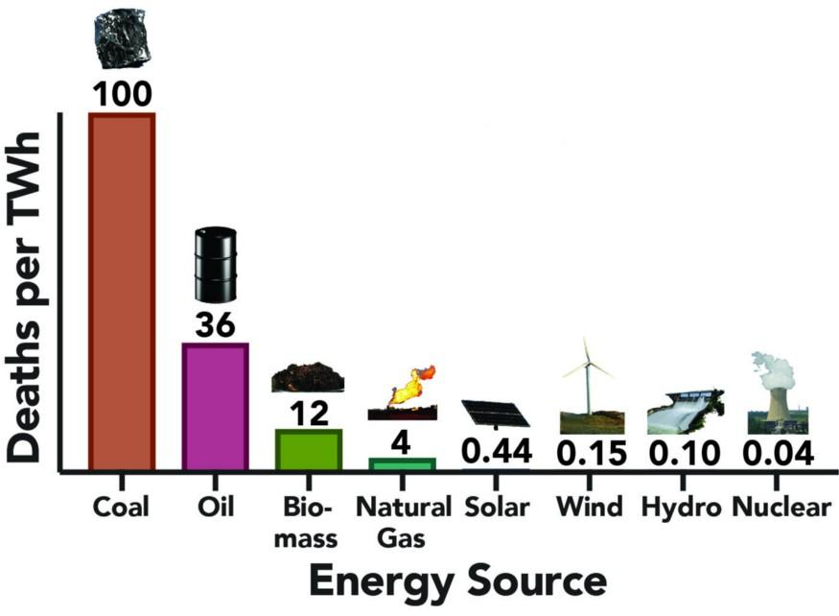
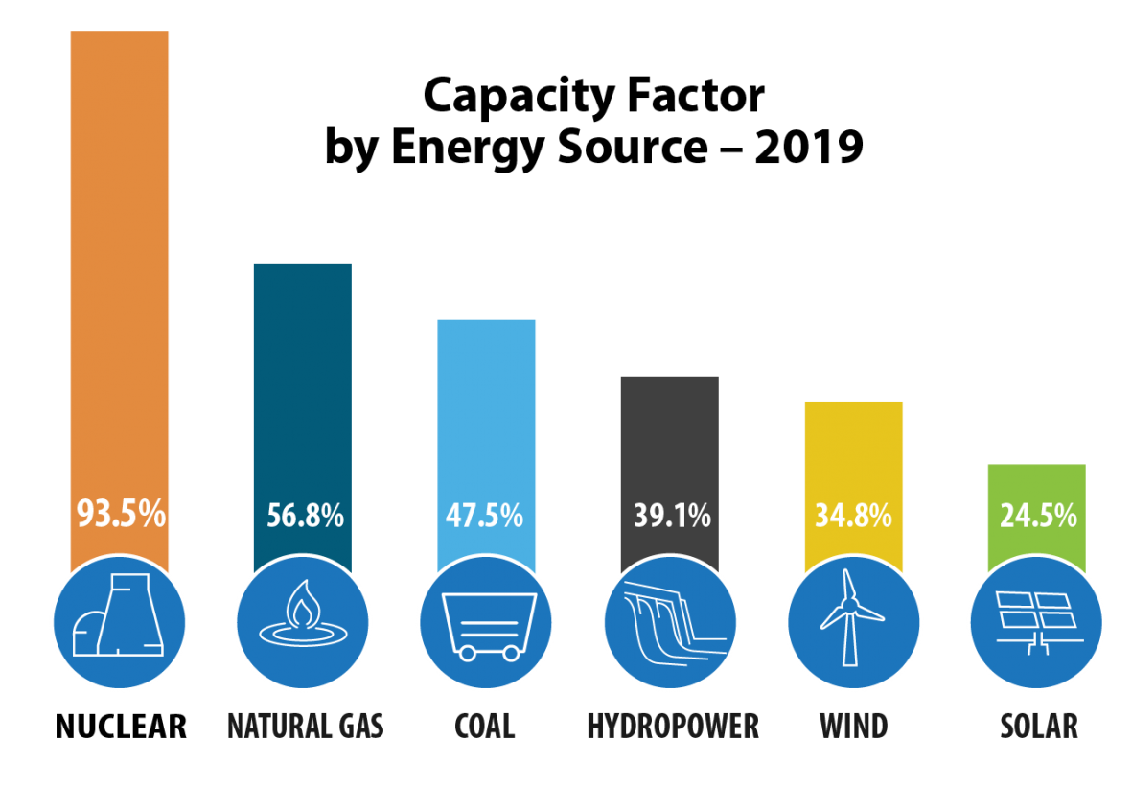
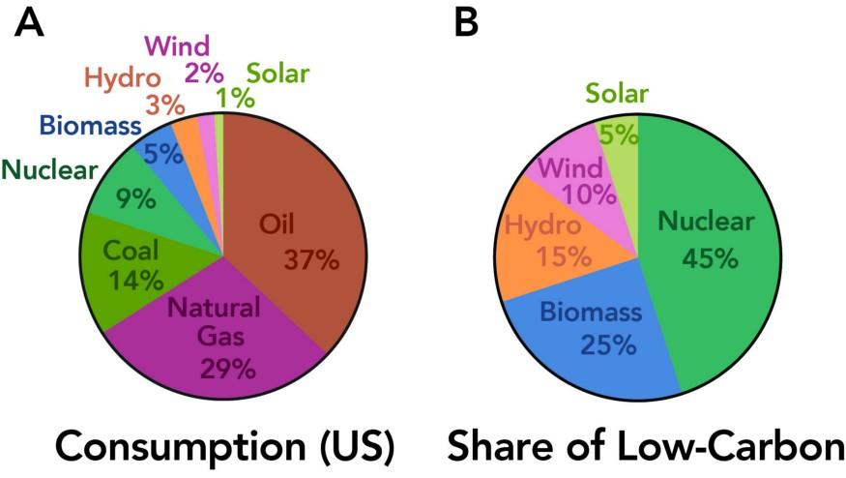
Graphs and Data

Slide 12
Capacity Factor by Energy Source chart
  Out of all of the different fuels, nuclear power has the highest energy capacity.
  Energy capacity factor is defined as “The net capacity factor is the unitless ratio of an actual electrical energy output over a given period of time to the maximum possible electrical energy output over that period.” (wikipedia, base definition)
Deaths per TWh Per Energy Source chart
  Coal has the most deaths per terawatt-hour, while oil is in second
  Nuclear power has the least deaths per terawatt-hour
Energy Consumption VS Carbon Emissions chart
  The United States consumers high Carbon emission fuels mostly
    37% of consumption is oil, 29% natural gas, 14% coal, and the remaining 20% is renewables
  The fuel that the most low-carbon is nuclear fuel, at 45%
    The remaining fuels that are low-carbon include biomass, hydro, wind and solar respectively

Slide 13
Con-Nuclear Power Opinions

Slide 14
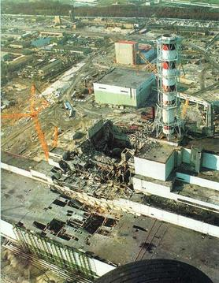
Nuclear power plants are very expensive to open up and to build
  As of 2008 an estimated price to start up a nuclear power plant cost 9 billion us dollars, additional funds are expended as nuclear waste management is expensive
Nuclear power can be very dangerous if not managed correctly
  Radiation leaks can be very harmful to surrounding areas and can contaminate groundwater dn the habitat, causing the area to be a red zone for hundreds of years
  Nuclear plant accidents in the past such as Chernobyl, 3 mile island, and Fukushima
    These are prime examples of what can go wrong if there isn't proper management of the plant and its procedures
    The most notable nuclear plant disaster is chernobyl which resulted in an estimated 10,000 deaths from short and long term effects from radiation poisoning

Slide 15
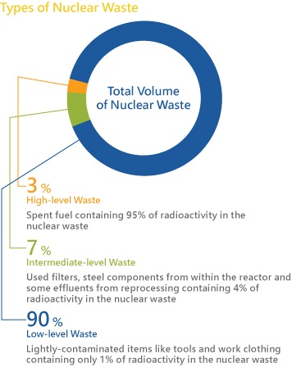
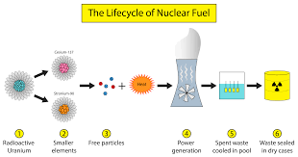
Graphs and Data

Slide 16
The process in which nuclear fission occurs involves the extraction of uranium which can have a negative effect on the environment if not disposed correctly
Radioactive waste rock can leave behind radioactive particles, causes erosion, and even pollutes nearby sources of water.
Radioactive waste is determined by 3 levels according to its risk to the environment
  Low level waste is generated from hospitals and industry, as well as the nuclear fuel cycle
  It comprises paper, rags, tools, clothing, filters, etc., which contain small amounts of mostly short-lived radioactivity
  Intermediate level waste typically comprises resins, chemical sludges, and metal fuel cladding, as well as contaminated materials from reactor decommissioning
  High level waste arises from the 'burning' of uranium fuel in a nuclear reactor
  HLW contains the fission products and transuranic elements generated in the reactor core and has to be managed and disposed properly so that it can have no effect on the surrounding environment

Slide 17
Conclusion

Slide 18
Nuclear power has its negative and positive sides, but even when looking at radioactivity, cancer, and deaths, nuclear power is safer than other fuels currently used such as coal. With downsides such as costs and nuclear meltdowns, putting our attention into developing the technology further through better waste management techniques, such as specific areas being used for waste management, depth differentiation between different types of radioactive waste, and development of smaller reactors or producing nuclear power on a consumer scale could help decrease those worries. All in all, Nuclear power is the energy source of the future.

Slide 19
Sources

Slide 20
History/About Nuclear Power:
https://www.world-nuclear.org/information-library/current-and-future-generation/outline-history-of-nuclear-energy.aspx
https://www.livescience.com/39961-chernobyl.html
Pro-Nuclear Power Opinions:
http://energy.mit.edu/news/why-we-still-need-nuclear-power/
https://www.world-nuclear.org/information-library/current-and-future-generation/the-nuclear-debate.aspx
https://e360.yale.edu/features/why-nuclear-power-must-be-part-of-the-energy-solution-environmentalists-climate
https://www.energy.gov/ne/articles/nuclear-power-most-reliable-energy-source-and-its-not-even-close
https://www.energy.gov/ne/articles/3-reasons-why-nuclear-clean-and-sustainable
https://www.realclearenergy.org/articles/2020/08/10/nuclear_energy_is_almost_here_501542.html
https://towardsdatascience.com/a-case-for-nuclear-bridging-the-route-to-renewables-with-low-carbon-energy-f0ad069a37ce
Con-Nuclear Power Opinions:
www.world-nuclear.org/information-library/nuclear-fuel-cycle/nuclear-wastes/radioactive-waste-management.aspx
springpowerandgas.us/the-pros-cons-of-nuclear-energy-is-it-safe/

