Slide 1
Should we export Marcellus Gas to other countries?
Group 9: Kyle Medrow, Bryce Bernardine, Jamison Shaw & Taylor Coleman

Slide 2
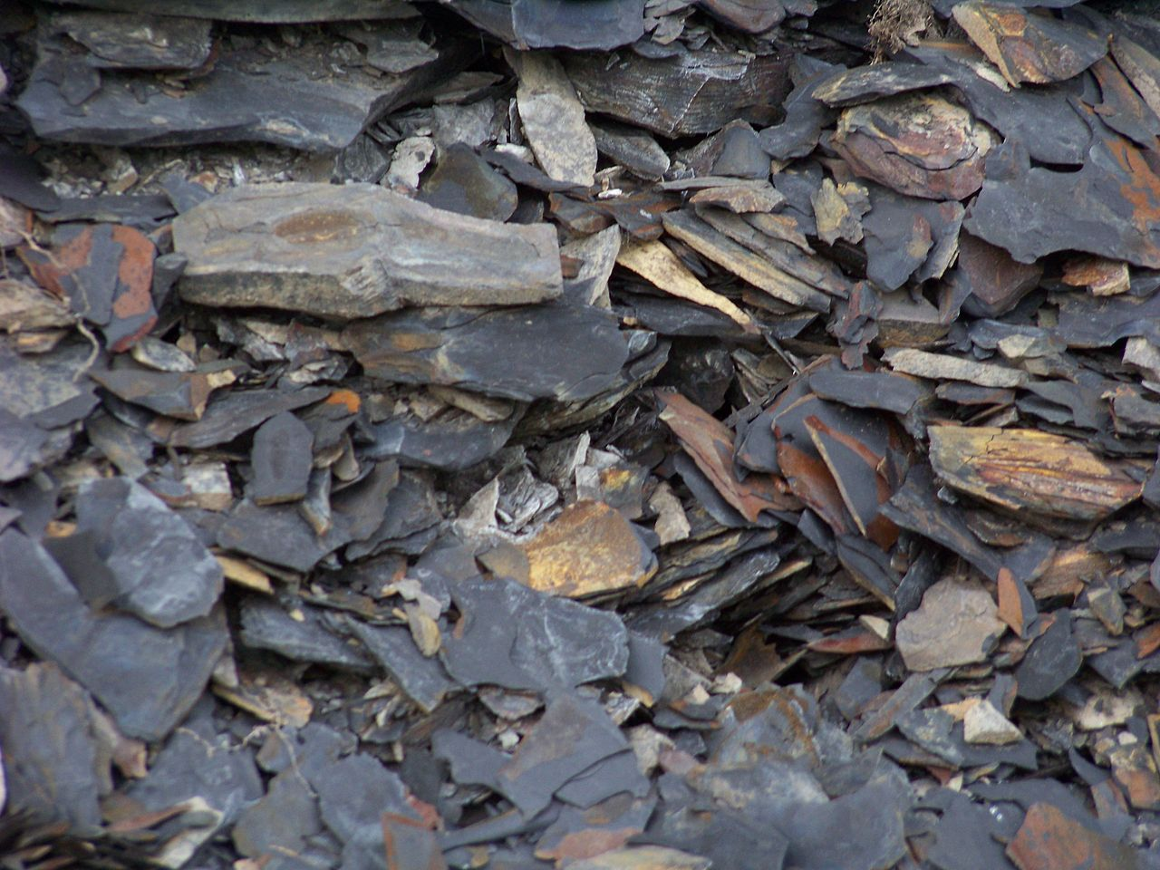
Introduction
Video
1st aspect of controversy
2nd aspect of controversy
Video
Questions
OVERVIEW

Slide 3
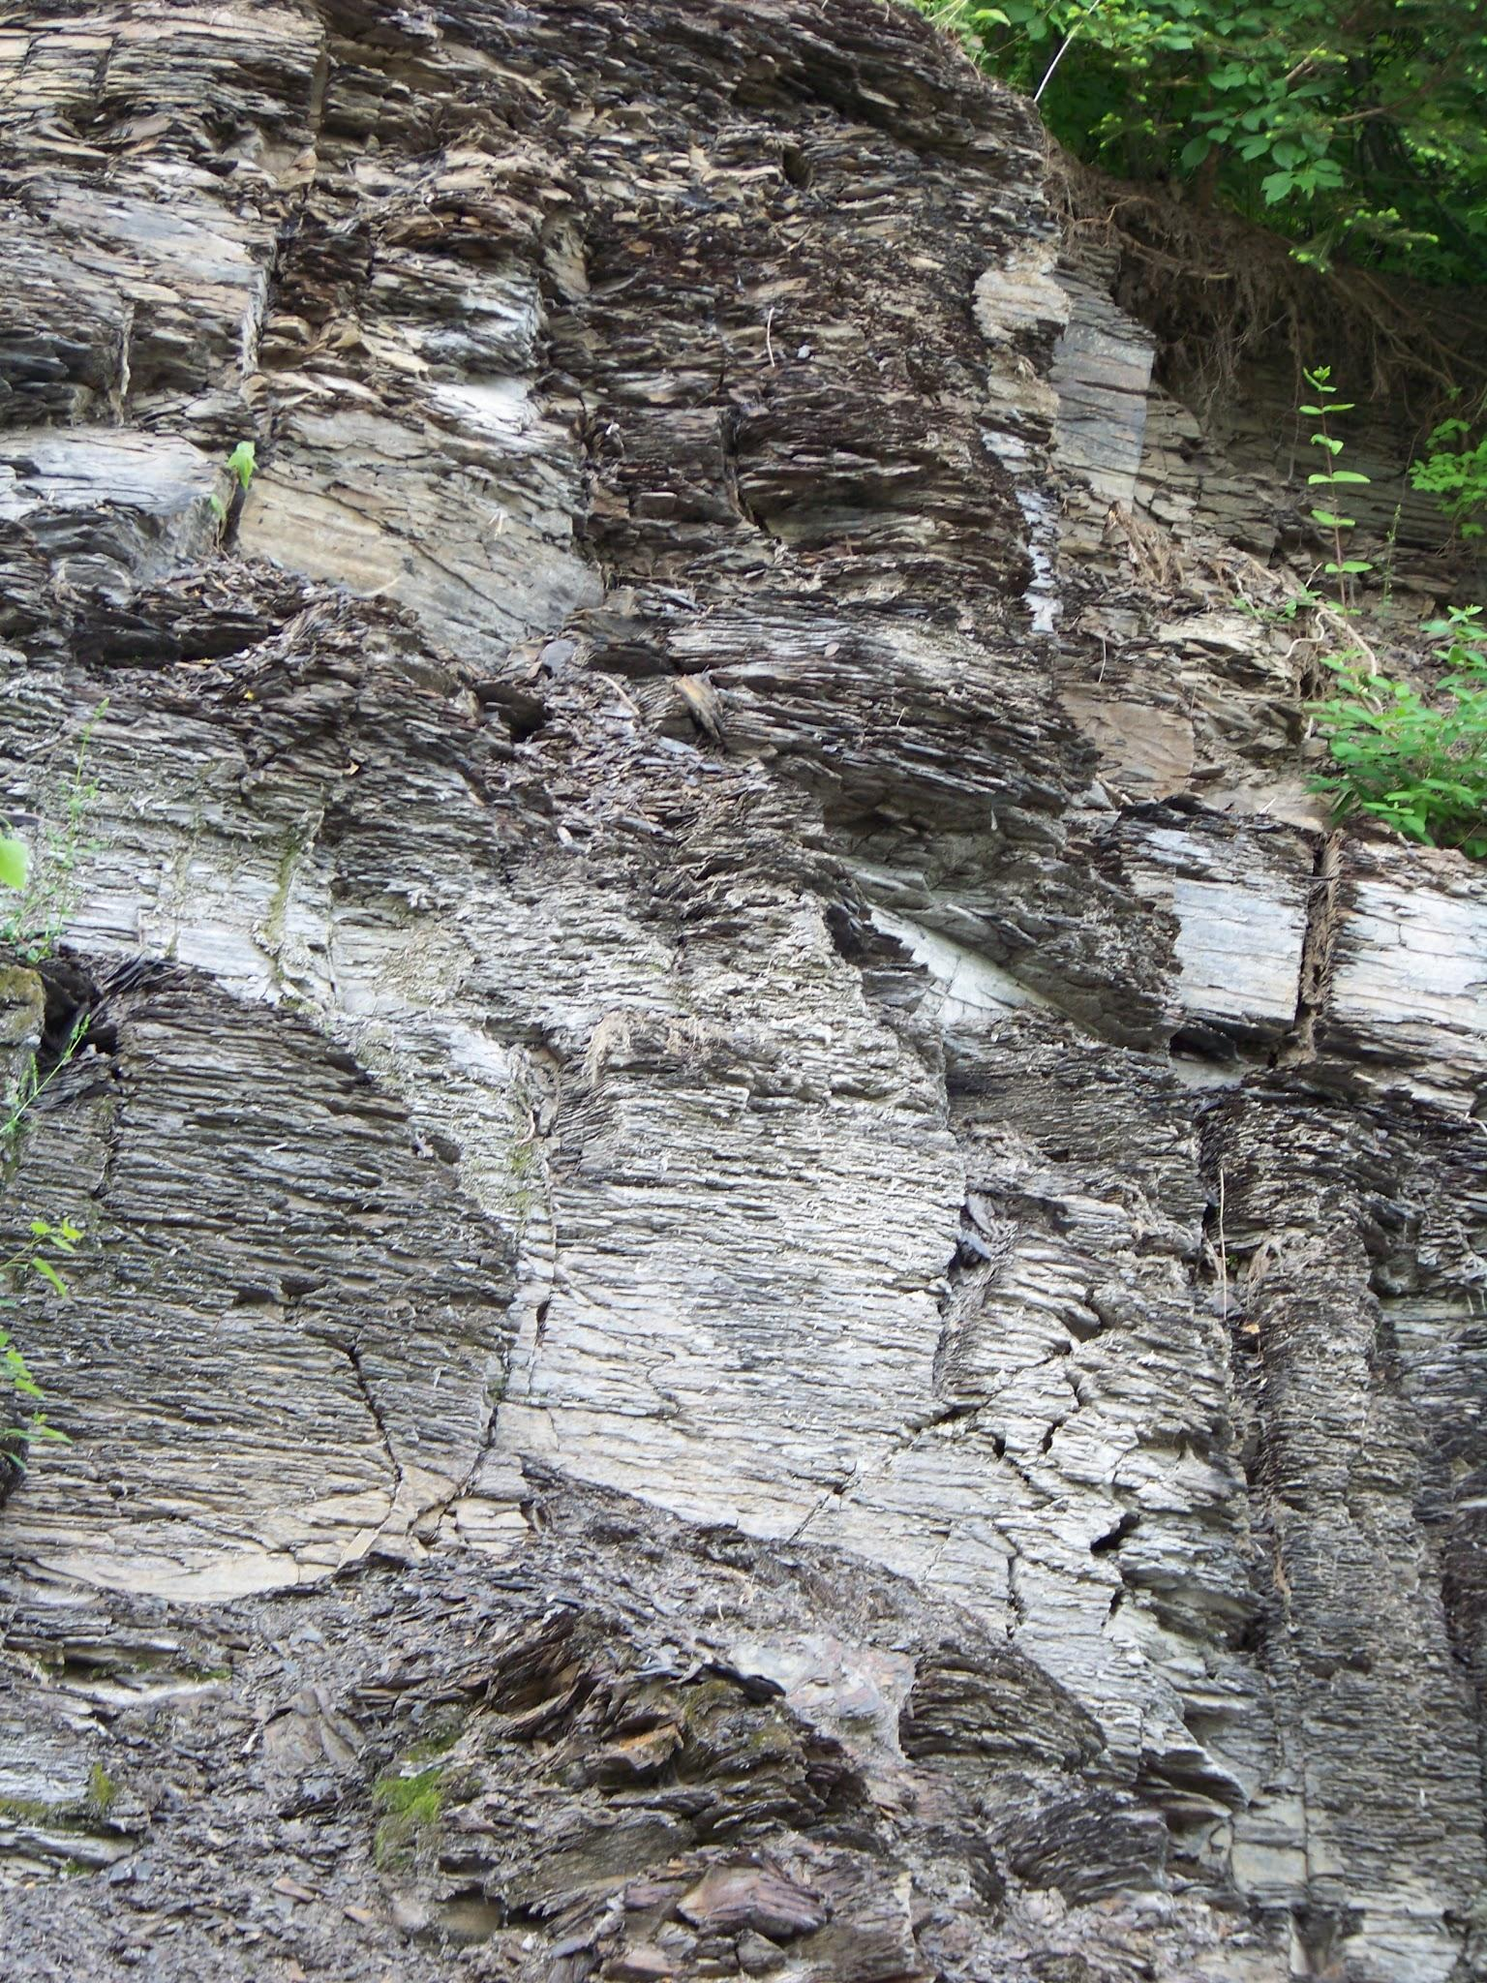
WHAT IS MARCELLUS SHALE GAS?
Marcellus Shale is a sedimentary rock buried thousands of feet beneath the earth’s surface
The rock can be found from upstate New York south through Pennsylvania to West Virginia and west to parts of Ohio
Named after a town in upstate New York, the rock itself is millions of years old, formed from mud and organic material

Slide 4
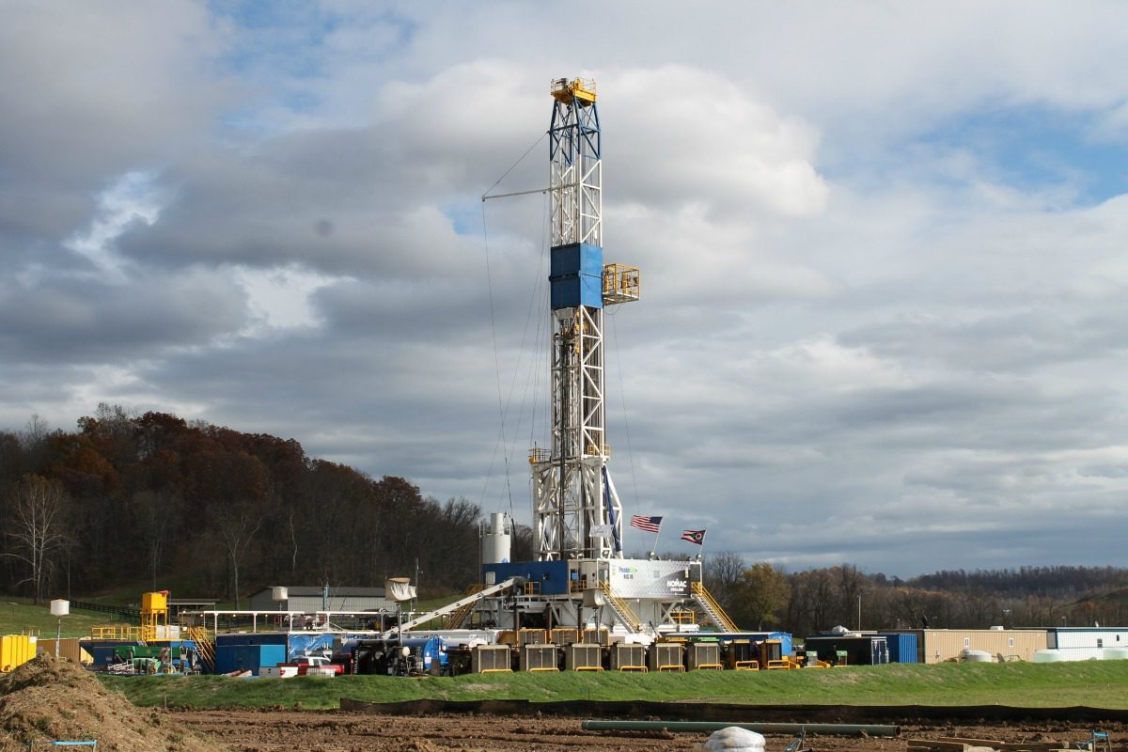
MARCELLUS SHALE
The Marcellus Shale formation might contain more than 500 trillion cubic feet of natural gas. Using some of the same horizontal drilling and hydraulic fracturing methods that had previously been applied in the Barnett Shale of Texas, perhaps 10% of that gas (50 trillion cubic feet) might be recoverable
  That volume of natural gas would be enough to supply the entire United States for about two years and have a wellhead value of about one trillion dollars
By early 2015, the Marcellus Shale was yielding about 14.4 billion cubic feet of natural gas per day. In addition, wells in the western part of the play, near the Pennsylvania-Ohio border and westward, were yielding valuable natural gas liquids and small amounts of oil. At that time the Marcellus was the source for over 36% of the shale gas produced in the United States and 18% of the total dry gas production of the United States

Slide 5
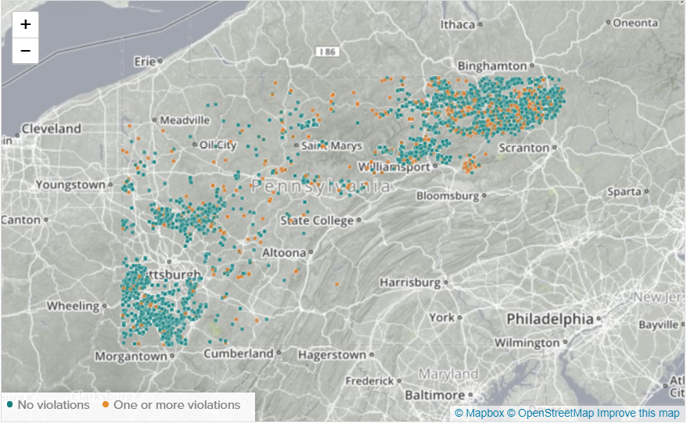
MARCELLUS SHALE
The most effective way to extract natural gas from marcellus shale is by using horizontal drilling and hydraulic fracturing
  Horizontal drilling can be described as first drilling vertically, then turn the bit horizontally and continue into the formation
  Hydraulic fracturing is the forcing open of fissures in subterranean rocks by introducing liquid at high pressure in order to force out and obtain natural gas
Location of shale plays in Pennsylvania and also indicating the wells with violations

Slide 6
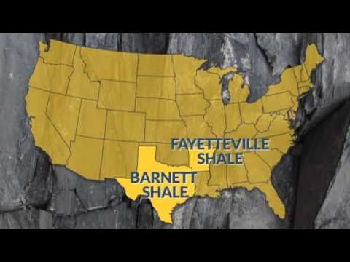
VIDEO RUNDOWN ON MARCELLUS SHALE
https://www.youtube.com/watch?v=g5QqidiEEHw

Slide 7
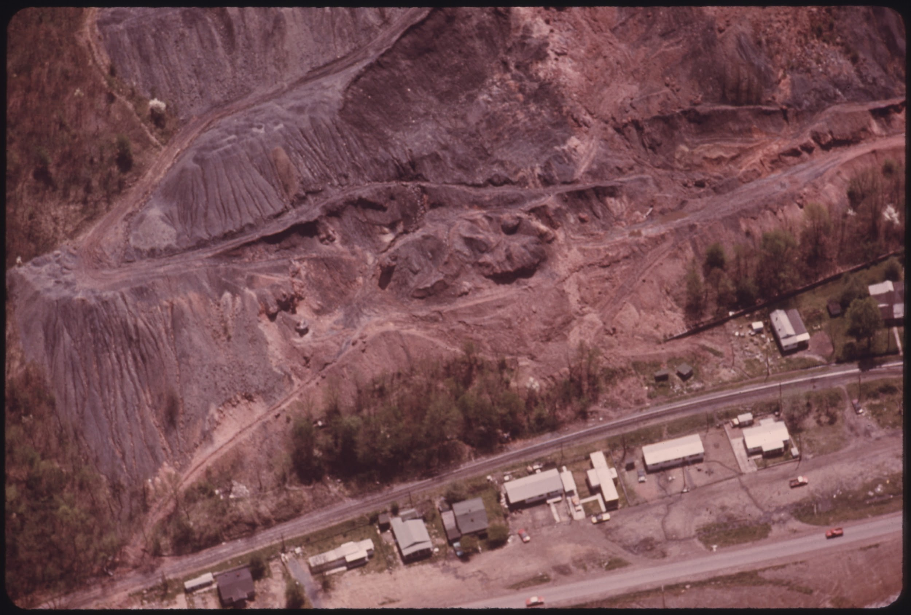
ASPECT OF
1:
Why we should drill Marcellus Shale
CONTROVERSY

Slide 8
Why we should drill the Marcellus Shale
Fracking is cleaner than burning coal to produce electricity
  As fracking becomes more widely used, nitrogen oxide and sulfur dioxide emissions have been reduced
Even though drilling could possibly cause issues in drinking water it is highly unlikely as the technology has improved
Drilling rigs are not permanent operations and as productivity of wells increase, more money can be made

Slide 9
The Economy
The boom in fracking has caused the prices of natural gas to be lowered by 47% prior to what it was in 2013
With the help of gas from the Marcellus Shale, the global population without electricity fell below 1 billion in 2017
“These barrels (of ethane) have to find a home,” McGinn said. “If we weren’t exporting ethane right now, they’d be giving it away for free.”
Companies are shipping the ethane to chemical plants in Europe, Brazil, India and China.
  These chemical plants make anything from plastic bottles to medicine

Slide 10
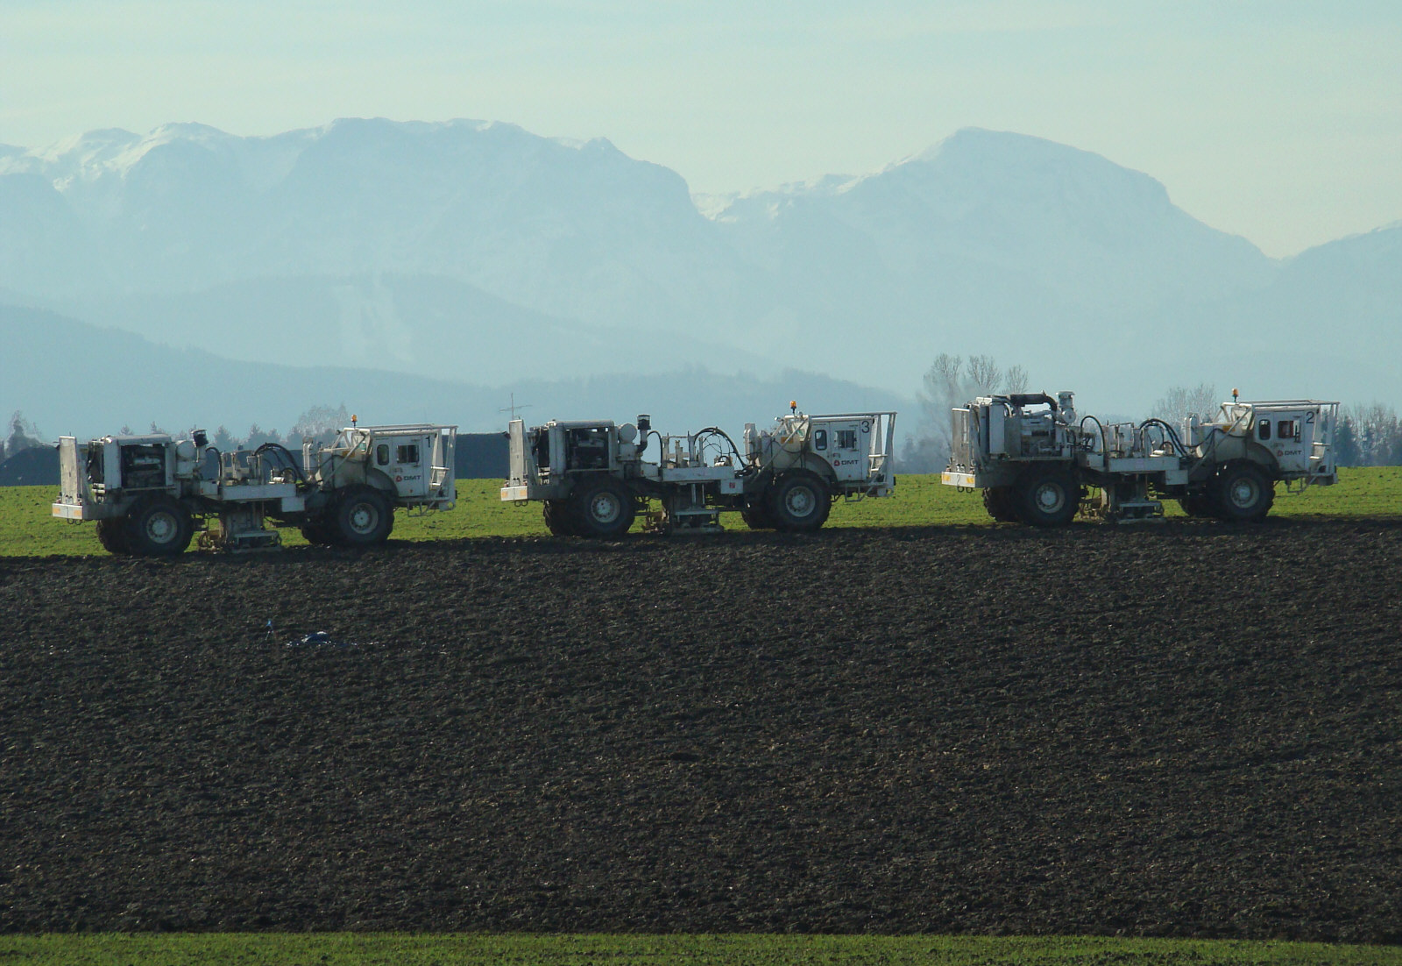
ASPECT OF
2:
Why we should not export Marcellus shale gas
CONTROVERSY

Slide 11
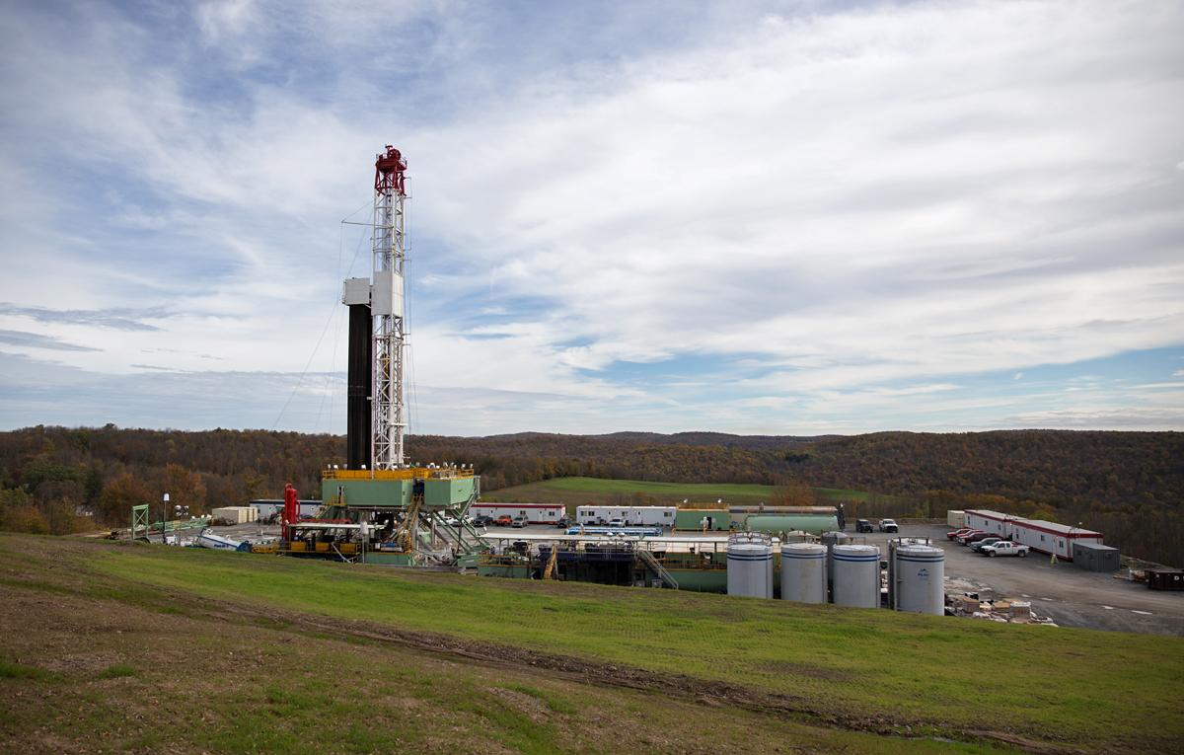
WHY WE SHOULD NOT EXPORT
MARCELLUS SHALE GAS
Exporting the gas has a greater impact on the source from the drilling
It affects the local people and the environment
Cost is NOT worth the Risk

Slide 12
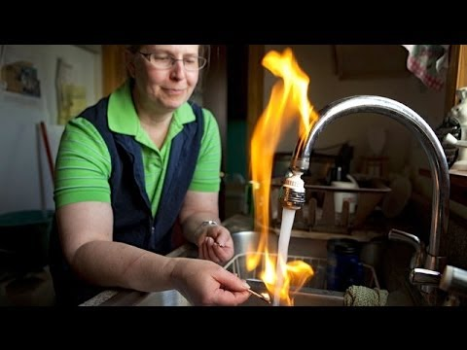
Marcellus Shale Gas Environmental Impacts
Water
Methane in Water
Loss of well water due to contamination
Land
Public parks & land become private
Large acres used for drilling
Affects local farming
Over land subsidence & Soil erosion
Air Pollution
Increase in Carbon footprint due to vehicle & truck traffic
Notes:
a single well blow out can have an affect more than a 1 mile radius

Slide 13
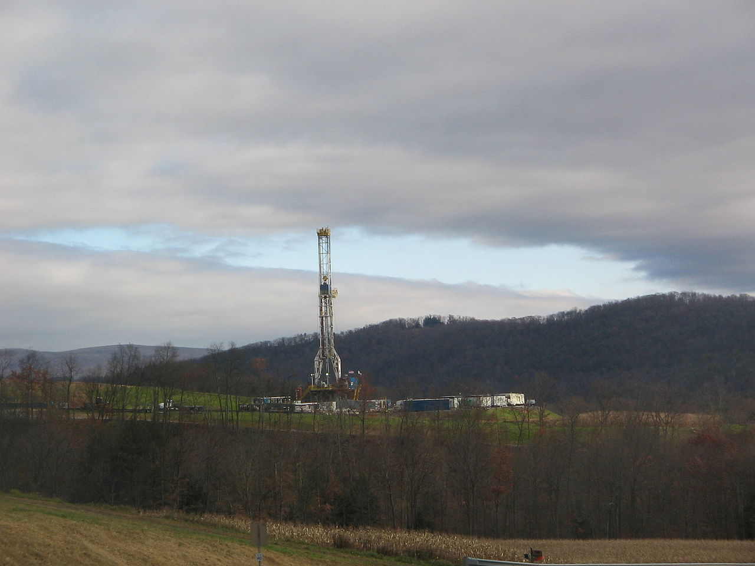
Video
https://ytcropper.com/cropped/g55de56b77c8751
* a virtual tour of the exploration of marcellus shale.

Slide 14
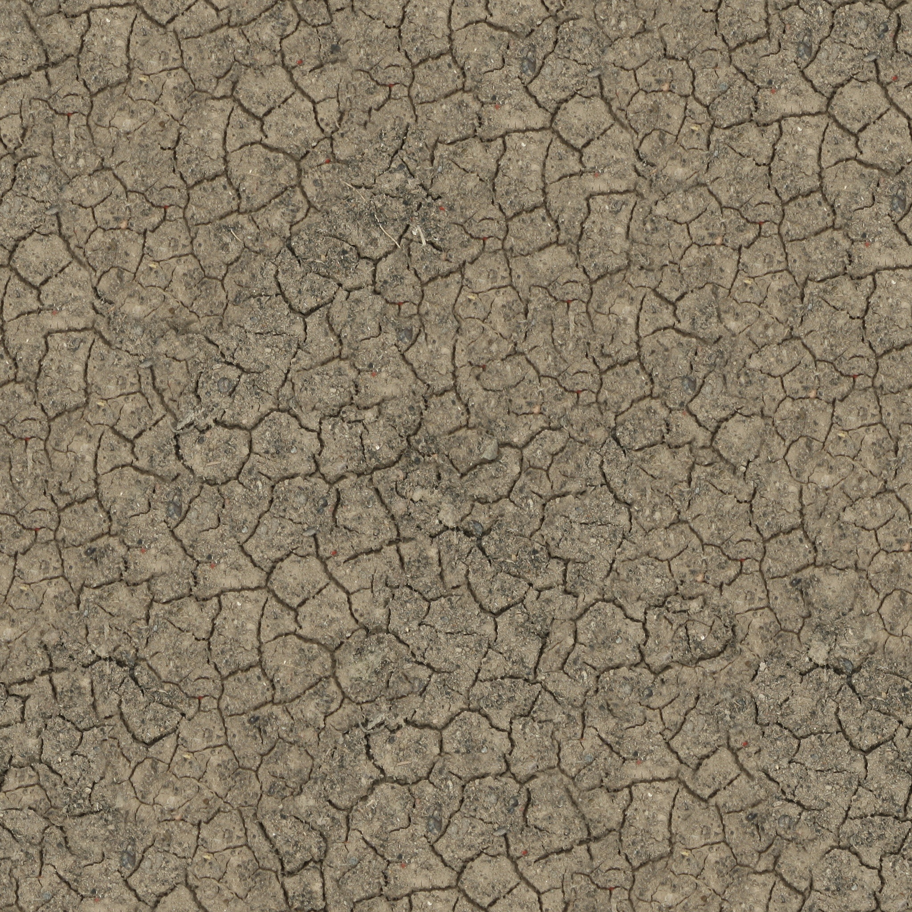
GROUP CONCLUSION:
We believe that exporting Marcellus shale gas to other countries isn’t worth the monetary gain that one would get from destroying communities/ ecosystems.
By destroying communities to gain access to the gas, people can suffer from the potential health impacts of air and water pollution associated with pulling gas from the ground.

Slide 15
References
https://www.brookings.edu/blog/brookings-now/2015/03/23/the-economic-benefits-of-fracking/
https://marcelluscoalition.org/2018/11/american-shale-gas-delivering-global-benefits/
https://stateimpact.npr.org/pennsylvania/2019/10/02/shale-gas-off-ramp-pa-s-fracking-boom-produces-a-glut-of-ethane-thats-helping-fuel-plastics-production-overseas/
https://marcelluscoalition.org/wp-content/uploads/2011/10/MSC_Fast_Facts_Large.pdf

Slide 16


The Marcellus Shale formation is thought to be the second largest natural gas field in the world
70% of all Marcellus related jobs are filled by Pennsylvanians
Marcellus producers have invested more than $411 million to build and repair Pennsylvania roads since 2008.
ANY
QUESTIONS?

