Slide 1
Hydropower Dam Reduction
By Allen Kokilananda, Keith Allen, Sabrina Lewis, and Lamont Brown

Slide 2
Topics
Overview of Hydro Power
Advantages of removal
Drawbacks of removal
Conclusion

Slide 3
1.Hydropower Introduction
The Basics

Slide 4
Hydropower or hydroelectricity refers to the conversion of energy from flowing water into electricity. It is considered a renewable energy source because the water cycle is constantly renewed by the sun. Historically, one of the first uses of hydro power was for mechanical milling, such as grinding grains.

Slide 5
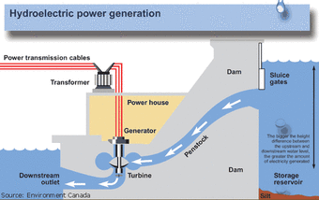
How Hydropower work
Notes:
Water from stream goes through the slice gate
Enter dame and then it spin the turbine that generate power

Slide 6
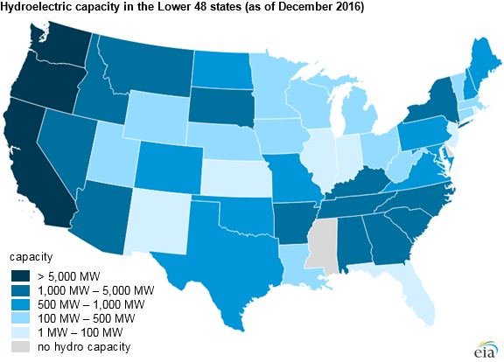
US Hydropower Graph
Notes:
Largest plants in the US Washington, California, and Oregon.
Mississippi has no Hydro capacity
Most Midwest States benefit from Hydropower

Slide 7

Takeaways
The advantages and disadvantages of hydropower dam removal

Slide 8
Advantages of hydropower dam removal
Environmental Consequences
Changed water flow impact fish interactions because fish habitats depend on physical factors.
Expensive
Building power plants are expensive and take about 4-7 years to be built.
Notes:
Physical Factors that fish habitats depend on: water level, water velocity (rate at which water is flowing downstream), shelter opportunities for various species of fishes with different needs, and access to food
Why waste money now practically to make something that will not be able to produce energy as efficiently as others?

Slide 9
Disadvantages of Hydropower
Purpose
Many hydropower dams do not serve the purpose they were built to provide.
Droughts
Electricity generation and the price of energy is directly related to how much water is available.
Limited Reservoirs
Many reservoirs have already been used up for hydroelectric power plants.
Notes:
Reserviors also produce water borne illnesses such as malaria, the most common. And they also help trigger earthquakes.
Renewable energy has progressed so much in recent years that

Slide 10
Why we want to remove hydropower dams
Restore flows and natural sediment
By removing hydropower dams ecosystems will go back to its natural state.
Eliminate safety risks
These dams change the temperature of the water which can harm aquatic habitats.
Save money
Since most dams are owned by the U.S. government our taxpayer money could now be put towards a better cause.
Notes:
Sediment is a naturally occurring material that is broken down by processes of weathering and erosion, in this case it is transported by water but the dam is preventing it from happening because it is an artificial dam humans put that interferes with nature.

Slide 11
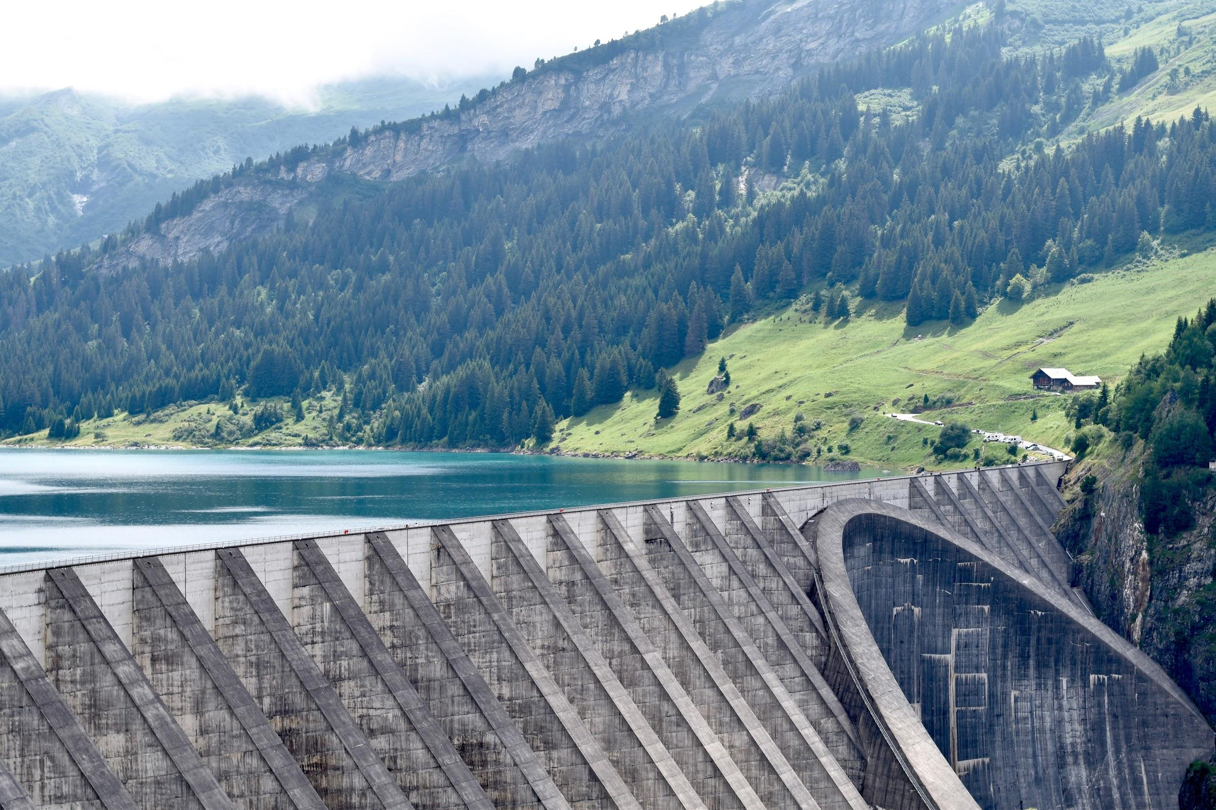
Advantages of Hydropower Dams: The Argument Against Removal

Slide 12
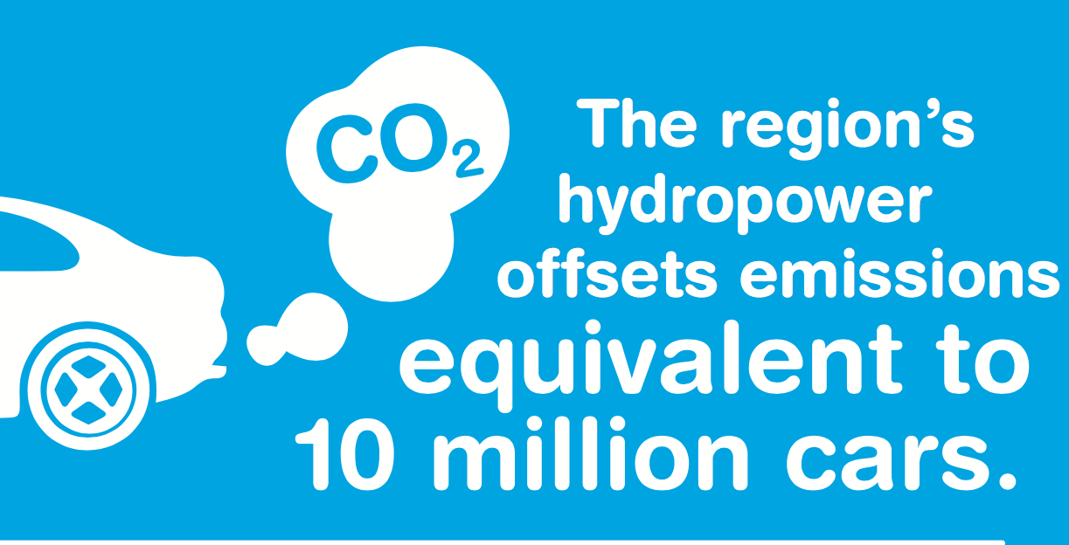
Environmental Benefits
Hydropower is both clean and renewable
  Over the past few decades, awareness of pollution and the dangers of non-renewable energy have become more prevalent in mainstream media
  Many people are reluctant to reduce hydropower dams simply because they are a source of renewable energy
  Hydropower is often used to supplement less reliable renewable energy sources like wind power and solar power, and offers far more flexibility and reliability.
Bpa.gov: about the NW region

Slide 13

Economic Benefits
Hydropower dams have a low operating cost, and are used in ways that minimize the price of electricity for consumers
Unlike fossil fuel plants, hydropower dams are sheltered from the rising costs associated with non-renewable resources
Many different types of jobs are created for operating and maintaining the plant
Jobs are also created the irrigation control offered by the reservoir, so more farmland is available for farmers to expand, and more food can be produced within the united states
Bpa.gov: about the NW region

Slide 14
Conclusion
Hydropower dams are expensive and the removal of them will not only positively impact taxpayers but will give the ecosystem a chance to restore natural habitats and better the environment.
The majority of the group agrees that hydropower dams should be removed

Slide 15
Sources
“Benefits of Hydropower.” Energy Institute, https://www.energy.gov/eere/water/benefits-hydropower
“Dams & Earthquakes.” Seismology Research Centre, https://www.src.com.au/earthquakes/seismology-101/dams-earthquakes/.
“Economic Benefits of Hydropower.” Army Corp. of Engineers: Institute for Water Resources, 2017, https://www.bpa.gov/Hydroflowshere/Pages/Economic-Benefits.aspx
“Hydropower: Economic Impact.” Value to the Nation, Civil Works, 2017, https://www.iwr.usace.army.mil/Missions/Value-to-the-Nation/Hydropower/Hydropower-Economic-Impact/
“Problems With Big Dams.” International Rivers, https://www.internationalrivers.org/problems-with-big-dams.
Slides by: Slide Carnival

