Slide 1
Health Risks of High Tension Power lines
By: Nick Leverentz, Samuel Meehan, Vincent Werner, Breanna Ebisch

Slide 2
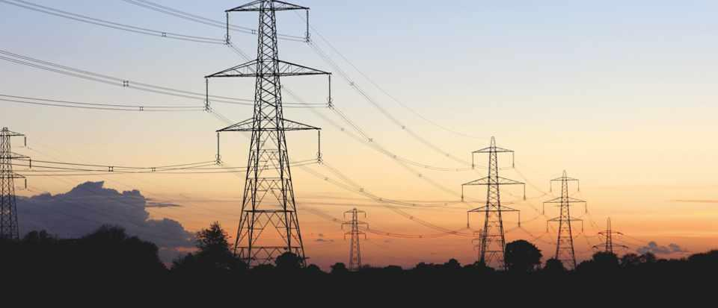
Overview
Intro
High Tension Power Lines do cause health issues.
High Tension Power Lines don’t cause health issues.
Our viewpoint
Summary
https://www.sciencefocus.com/science/why-do-high-voltage-power-lines-crackle-and-hiss/

Slide 3
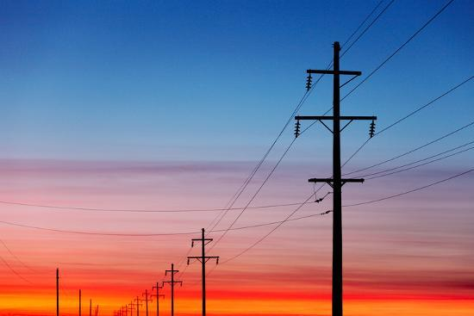
Introduction
First concerns came around in 1979
  People thought that children who lived near High Tension Power Lines were more likely to be diagnosed with Leukemia
  Due to these concerns, Congress authorized a national program in electric and magnetic field research in 1992
    This program was called EMF-RAPID (Electric and Magnetic Fields Research and Public Information Dissemination)
https://www.art.com/products/p48207862991-sa-i10826830/todd-klassy-a-silhouette-of-high-voltage-power-lines-against-a-dramatic-and-colorful-sky-at-sunrise-or-sunset.htm?upi=Q1A1J9V0

Slide 4
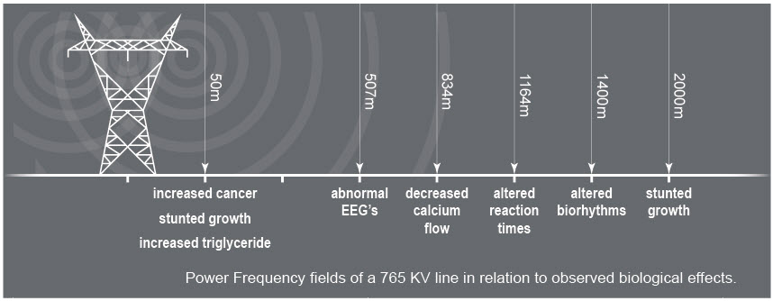
High tension power lines do cause health issues
With EMF ( Electro Magnetic Fields) being very overwhelming near power lines it does increase the risk of abnormal health issues
Within 50 meters: Increased risk of cancer, potential stunted growth
Within 500 meters: Abnormal EEG’s, ( Electroencephalogram ) - used to evaluate electrical activity in the brain
Within 800 meters: Decreased calcium flow
Within 1000 meters- Altered biorythms
https://www.safespaceprotection.com/emf-health-risks/emf-health-effects/power-lines/

Slide 5
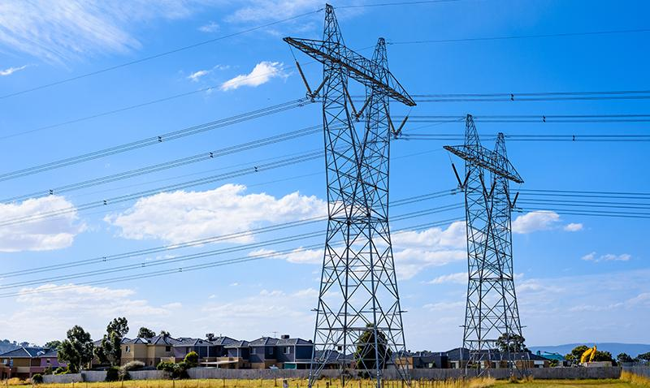
High tension power lines don’t cause health issues
In 1995, the American Physical Society (APS) addressed the concern on EMF and the health effects of High Tension Power Lines
  They found that there was no consistent evidence that showed a relation between cancer and High Tension Power Lines
In 2002, The World Health Organization (WHO) published a 339 page report on how electrical and magnetic fields might affect our health
  They found that there was little evidence to prove that mutations in cells could happen due to ELF
https://www.arpansa.gov.au/understanding-radiation/radiation-sources/more-radiation-sources/measuring-magnetic-fields

Slide 6
Our viewpoint
As a group, we believe that high tension power lines do cause health issues, specifically various form of cancer.
Several studies have proved that radiation of any kind can lead to cancer.
Multiple cases of health issues and cancer from areas close to high tension power have surfaced over the last few decades.
Products are available that prevent some of the effects from the EMF of high tension power lines.

Slide 7
Summary
Intro
High tension power lines do cause health issues
High tension power lines don’t cause health issues
Our viewpoint

Slide 8

Questions?

Slide 9
Works Cited
https://www.safespaceprotection.com/emf-health-risks/emf-health-effects/power-lines/
https://hps.org/hpspublications/articles/powerlines.html
https://www.forbes.com/sites/stevensalzberg/2014/09/01/do-high-voltage-power-lines-cause-cancer/#41073ac96497

