Slide 1
EGY 101 Final
By: Salvatore Purpura, Rocky Dibernardo, and Katarina Johnson

Slide 2
Research Topic
Should the government support energy companies if they are financially suffering from the pandemic?

Slide 3
Our Standpoint and Why
We believe that the government should support energy companies that are financially impacted by the pandemic. The government should support the companies by offering them grants and reductions on their taxes. Due to the lack of workers and supplies, support from the government is necessary for these companies to survive.

Slide 4
Reasons Why Energy Companies Need To Remain Open
Energy companies need to remain open during the pandemic for many reasons, some of them include:
Hospitals, medical firms, and law enforcement facilities heavily rely on the energy companies to provide electricity and other forms of energy to operate.
People rely on consistent energy provided by energy companies to survive. This includes gas and electricity that is required to cook and use heating within their homes.
Companies rely on energy to deliver their goods and receive materials. Without the energy companies would have a severe lack in supplies for their consumers.

Slide 5

Energy Issue 1 - A Decrease In Workforce
Due to the pandemic many industries have lost a majority of their workers. The energy industry is one of the industries that this has become a big problem for. A large number of the workforce is crucial to the continuous operation of any energy business and the production of safe, and reliable delivery of power, gas, and water. This being said, energy companies are struggling to keep up with energy demands due to the decrease in their amount of workers.

Slide 6
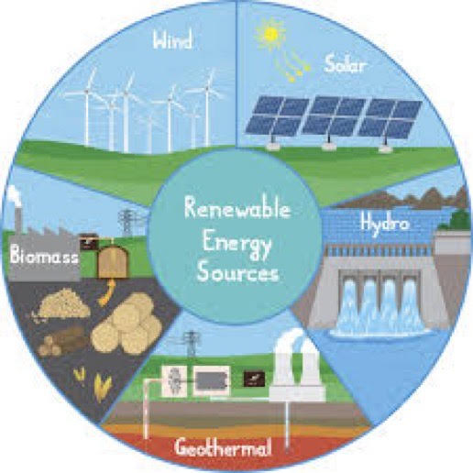
Energy Issue 2 - A Lack Of Supplies
Regulated utilities are mandated to have access to adequate supplies of parts, components, equipment and materials for emergencies. Due to the pandemic these utilities are encountering shortages in critical supplies needed to produce energy. This is because productions of the supplies produced in countries highly affected by COVID-19 have been greatly constrained because of laws placed on traveling and a lack of workers to make what is needed.

Slide 7
Energy Issue 3 - A Lack Of Financial Income
Many business have closed their doors during the COVID-19 pandemic. This being said, they are consuming less energy than they were prior to the pandemic. This has greatly decreased the amount of money energy companies are making from their customers due to the decrease in their energy consumption.

Slide 8
How Energy Companies Can Prevent Further Disaster
Companies should evaluate the short, medium, and long range effects that are caused by the pandemic. They should plan for any scenario that could happen ahead of time. Having a plan before a disaster happens could greatly decrease the chances of the situation getting worse
They should also limit the amount of company spending and plan future investments and purchases.

Slide 9
How The Government Can Help
There are many ways the government can assist the energy companies that are suffering from the pandemic. These solutions include:
  Reducing the amount of taxes energy companies owe during the duration of the pandemic.
  Offer energy companies grants in order to keep their businesses running during the pandemic.
  Temporarily suspend the obligation for companies to file for bankruptcy when it is due to \
COVID-19.
  Ease up on repayments owed by energy companies to help reduce their amount of debt.

Slide 10
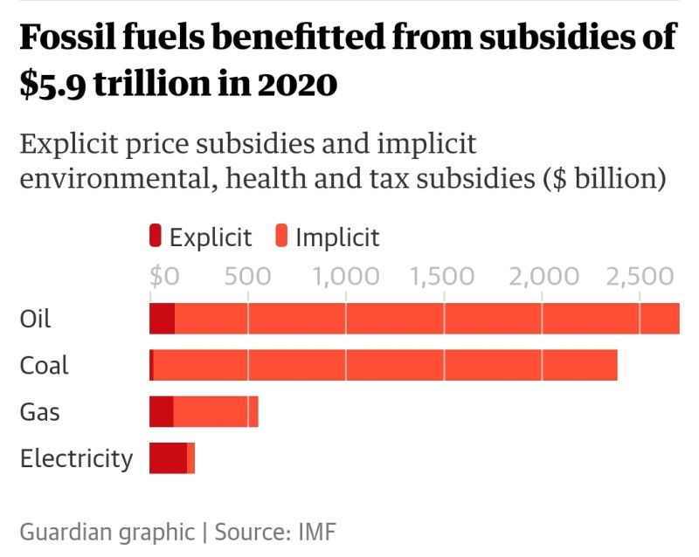
Graph Showing Government Subsidies Given to Energy Companies

Slide 11
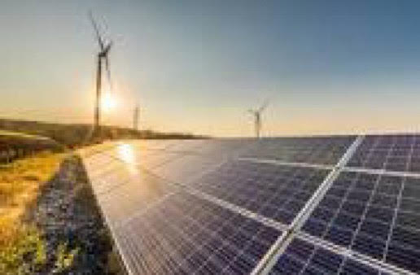
Why The Government Should Not Assist Energy Companies During The Pandemic
Oil and gas companies in the United States already benefit from millions of dollars in government subsidies and tax breaks every year; the money can be used for health packages and to aid small businesses instead.
In the past decade, fuel companies have spent more on stock buybacks and dividends than they have brought in with revenue, leading them a big debt burden.

Slide 12
Conclusion
In conclusion:
  We believe that the government should provide assistance to energy companies suffering from the pandemic.
  Energy companies are facing many difficulties since the pandemic, including a decrease in workforce, a lack of supply, and a lessoned income.
  Energy provided by these companies is necessary for the operation of hospitals, medical firms, and other important industries.
  Planning for future disasters can greatly decrease the effects of events such as the pandemic.
  The government can assist energy companies by providing financial assistance.

Slide 13
Thank You

Slide 14
Works Cited
“Covid-19 Hospital Data.” Centers for Disease Control and Prevention, Centers for Disease Control and Prevention, 19 Nov. 2021, https://www.cdc.gov/nchs/covid19/nhcs.htm.
“Supporting Businesses in Financial Distress to Avoid Insolvency during the COVID-19 Crisis.” OECD, https://www.oecd.org/coronavirus/policy-responses/supporting-businesses-in-financial-distress-to-avoid-insolvency-during-thecovid-19-crisis-b4154a8b/.
Hedden, Adrian. “Study Shows Billions of Government Relief Dollars to Oil and Gas amid Covid-19.” Argus, Carlsbad Current-Argus, 8 Oct. 2020, https://www.currentargus.com/story/news/local/2020/10/08/study-billions-government-relief-went-oil-and-gas-amid-covid-19/3623099001/.

Slide 15
Works Cited
IEA. “Covid-19 and Energy: Setting the Scene – Sustainable Recovery – Analysis.” IEA, https://www.iea.org/reports/sustainable-recovery/covid-19-and-energy-setting-the-scene#how-should-governments-respond.
PricewaterhouseCoopers. “Covid-19: What It Means for the Power and Utilities Industry.” PwC, https://www.pwc.com/us/en/industries/energy-utilities-mining/library/how-covid-19-is-impacting-power-and-utilities.html.
PricewaterhouseCoopers. “Energy Industry and Covid-19 (Coronavirus): Strategizing for the 'New Normal'.” PwC, https://www.pwc.com/gx/en/issues/crisis-solutions/covid-19/energy-utilities-resources-coronavirus.html.
Roberts, David. “Coronavirus Stimulus Money Will Be Wasted on Fossil Fuels.” Vox, Vox, 20 Apr. 2020, https://www.vox.com/2020/4/20/21224659/coronavirus-stimulus-money-oil-prices-fossil-fuels-bailout

