Slide 1
Should the U.S. Government Financially Support Energy Research?
If so, should funding support go to bolstering non-carbon alternatives, or into making carbon based alternatives cleaner?
Group 2 :
Matt Konikow
Allyson Sebolka
Amanda Eberle
Erin Schaepe

Slide 2
Overview
Introduction Statement
Department of Energy
  Roles and funding opportunities
Non-Based Carbon Alternatives
Carbon-based Alternatives
Why Support Non-Carbon Based?
Why Support Carbon-Based?
Which is statistically more beneficial?
Should the government financially support energy research?
Our conclusion

Slide 3
Introduction Statement
The written mission statement of the U.S. Department of Energy is “to ensure America’s security and prosperity by addressing its energy, environmental, and nuclear challenges through transformative science and technology solutions”.
The department of energy itself offers a plentiful amount of grants to those looking to start up businesses with energy related projects, those with proven technology trying to reach commercial scale, or those from smaller governments looking for resources for their energy projects.
The question that arises with such financial offers is if the money being put in is actually worth it. We question if the government should be supporting such energy research and if so, are we supporting the correct type of research?

Slide 4
Department of Energy (Roles/History)
Activated on October 1, 1977 and it brought together two programmatic traditions within the Federal Government.
  Defense responsibilities (Manhattan Project : atomic bomb)
  Energy related problems throughout the Federal Government
Emphasis and focus shifted over time.
  1970’s : energy development and regulation
  1980’s : nuclear weapons research, development, and production
  2000’s : ensuring nations security and prosperity
The Department now seeks to transform the nation’s energy system and secure leadership in clean energy technologies and pursue world-class science and engineering as a cornerstone of economic prosperity.

Slide 5
Department of Energy (Funding)
Resources for small businesses
Office of Science Funding Opportunities
Fossil Energy Funding
Loan Programs Office
Energy Efficiency and Renewables
ARPA-E Funding Opportunities
Nuclear Energy Funding
State Energy Program
Small Business Innovation Research
For more specific information you can visit https://www.energy.gov/energy-economy/funding-financing

Slide 6
Non-Carbon Based Alternatives (Renewable Resources)
Energy security, affordability, job creation, and future economic strategic positioning are common reasons used to justify government support in renewable resources.
The energy security argument says that investing in renewable resources that can be produced at home and doesn’t rely on fossil fuel markets will help to achieve greater security.
Cost effectiveness in reference to renewable technologies has increased overtime.
Looking long term, if we were to invest in renewable resources, we have the potential to be competitively positioned in future clean-energy technology markets.
Renewable options need a leg up in order to gain full social benefits they offer.

Slide 7
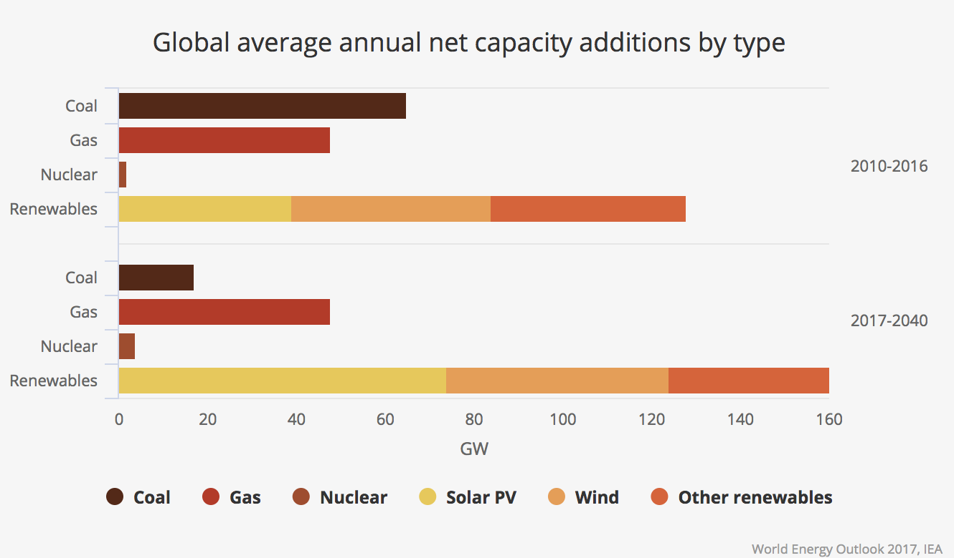

Slide 8
Carbon Based Alternatives
(Non-Renewable Resources)
Fossil fuels are the world's traditional energy sources and most of the world is built around using them.
The availability of natural gas has skyrocketed in recent years, driving down prices.
Improvements in fossil fuel technologies make it harder for the economics of renewables to stack up by themselves.
Fossil fuels are being unfairly favored despite negative external impacts.
New technologies are emerging that may allow fossil fuel use with less harmful effects to the environment.

Slide 9
Argument 1: Non-Carbon
Based Alternatives

Slide 10
Why Support Non-Carbon?
Less emissions into the atmosphere
  In 2017, emissions of carbon dioxide (CO2) by the U.S. electric power sector were 1,744 million metric tons
  Would slow down Global Climate Change
  Improve air purity
  Improve public health
Added jobs
  Scientists are paid to study and develop new energy forms
  Need laborers
Steady energy prices in the future
  Renewable energy provides affordable electricity currently
  Amid 2010 and 2017, the average price to install solar decreased more than 70%
  Amid 2009 and 2016, the cost of generating electricity based off of wind decreased 66%

Slide 11
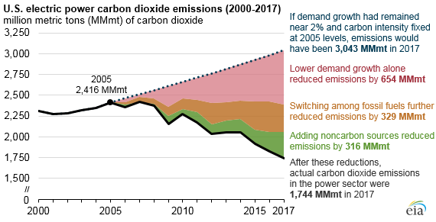

Slide 12
Argument 2:
Carbon Based Alternatives

Slide 13
Why Support Carbon Based Alternatives?
The Energy Policy Act of 1992 defines an alternative fuel as:
Biodiesel (B100)
Natural gas and liquid fuels domestically produced from natural gas
Propane (liquefied petroleum gas)
Hydrogen
Domestic coal is abundant and cheap
Power-Plants
  Fossil fuels generate vast quantities of power

Slide 14
Should the government financially support energy research?
Here are the Pros and Cons …
Pro: Many of the sources that were used to create this were government- funded institutions, meaning, without government funded institutions providing research and resources the public would be uninformed. Also, government funding has been a driving force in renewable energy research and production.
https://www.energy.gov/science-innovation/clean-energy
Cons: Energy research relies on tax dollars to survive, so we all have to pay a little bit into research.

Slide 15
Our conclusion...
We believe that the government should financially support funding into energy research.
We support the non-carbon based alternative standpoint
  Cost effective
  Greater security
  Added jobs
  Steady prices

Slide 16
Sources
https://www.energy.gov/energy-economy/funding-financing
http://sitn.hms.harvard.edu/flash/2012/energy-finance/
https://sciencing.com/renewable-vs-nonrenewable-energy-resources-12071170.html
https://www.eia.gov/tools/faqs/faq.php?id=77&t=11
http://www.nyc.gov/html/dot/downloads/pdf/alternativefuel.pdf
https://www.conserve-energy-future.com/pros-and-cons-of-fossil-fuels.php
https://www.ucsusa.org/clean-energy/renewable-energy/public-benefits-of-renewable-power#
https://www.eia.gov/todayinenergy/detail.php?id=37392

