Slide 1
Is Germany Really a Good Model for Renewable Energy?
By Courtney Corona, Nick Antolick, Jose Puello, and Matt Horwedel

Slide 2
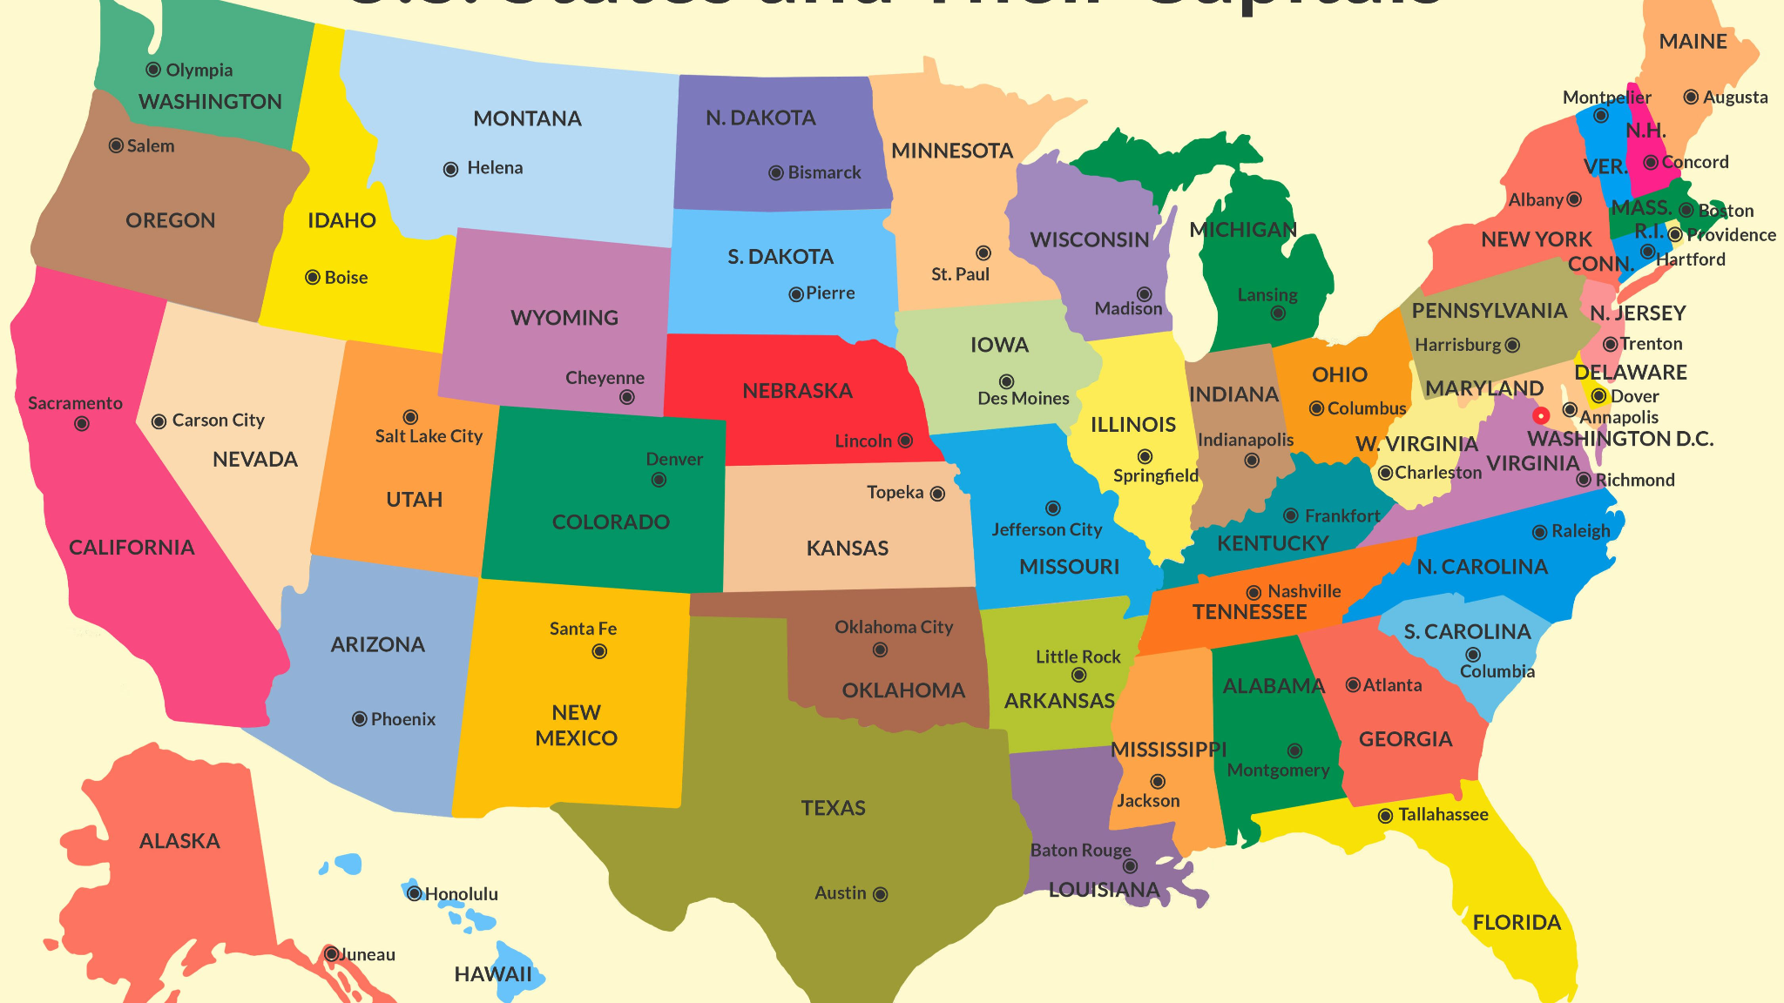
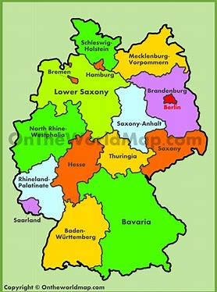
Introduction
The focus of our presentation is to:
  Explain the renewable energy models of both
  Germany and the United States
  Compare the renewable energy models of the two countries
  Answer the question of if we believe Germany is truly a good
model for renewable energy

Slide 3
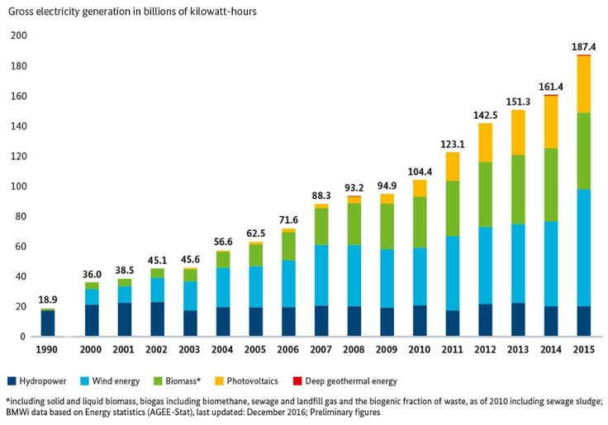
German Renewable Energy
Germany is one of the international leaders in renewable energy and environmental technologies
In 2019, 46% of the country’s electricity mix came from renewable energy sources (“Energy Resource Guide”)
In 2020, clean energy sources created as much
energy for the country as that of coal, gas, oil,
and nuclear power (Hockenos, 2021)
Germany is expected to increase their
renewable energy output to 65% by 2030

Slide 4
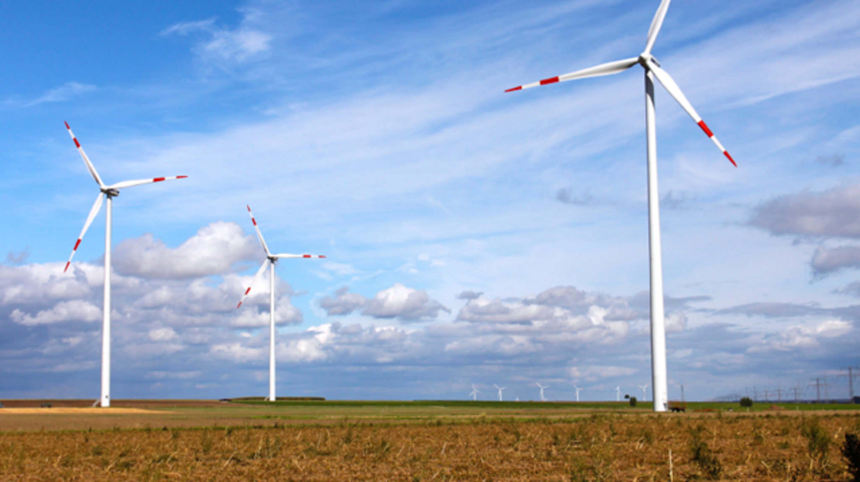
German Renewable Energy Jobs
Not only is the production of renewable
energy good for the environment, it also
creates jobs.
  In 2017, the renewable energy industry in
Germany employed 300,000 people and
these numbers are expected to grow
(“Energy Resource Guide”)

Slide 5
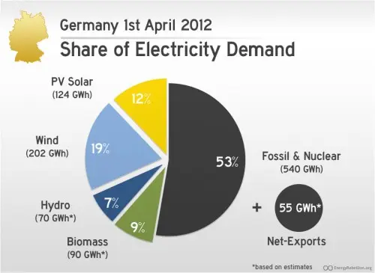
Renewable Energy Sources Act
Germany’s energy transition and the expansion of renewables is regulated by the Renewable Energy Sources Act (EEG) that
  This act came into force on April 1, 2000
  Regulates the purchasing and compensation
of energy which has been exclusively
produced from renewable sources
(“Energy Research Guide”).

Slide 6
Problems with the German Energy Model
Energy costs in Germany are much higher than other countries in the European Union; the median household pays 43 percent more on power bills than the EU average.
Renewable energy sources have not been able to close the gap left by the phasing out of coal and nuclear energy.
Because of this shortfall, Germany’s power grid is unstable.
Though Germany is leading Europe in reducing greenhouse gas emissions and producing clean energy, it is still very dependent on other countries for much of its energy needs. (Lohmann)

Slide 7
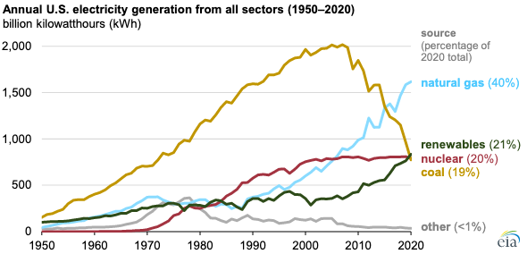
American Energy
The USA is the second highest consumer of energy in the world. Only beaten out by China
About 85% of our energy comes from petroleum, natural gas, and coal
However, we have started to show trends towards using more renewable energy
Renewable energy capacity surpassed 20% in 2018, and it has consistently risen year after year. With wind energy leading the way at 45% of that.
The U.S. also has plans to expand on this progress, with an increase of renewable energy to 42% from 2010-2020

Slide 8
Germany vs. The United States
German Energy usage is much cleaner than energy usage in the United States
  German citizens consume 29.79 barrels of oil per day per thousand people, while citizens of the United States consume 68.67 barrels per day per thousand people (NationMaster.com)
  Renewable energy sources account for 17-46% of energy production in Germany, while they account for only 10-15% of energy production in the United States (“Energy Resource Guide: Pew Research Center”).

Slide 9
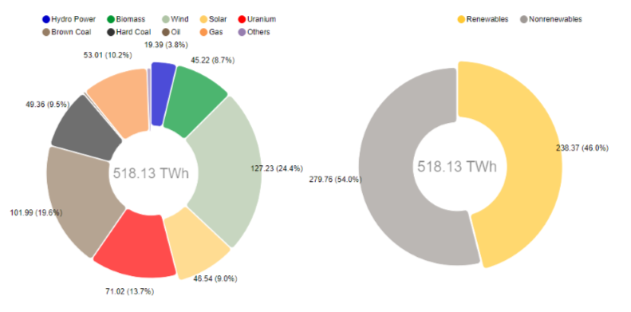
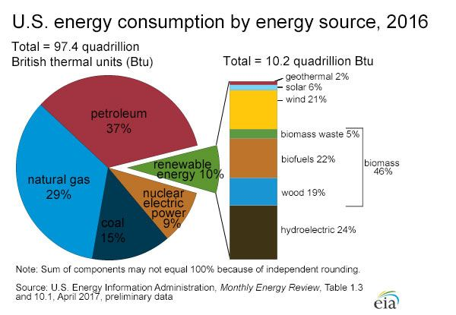
Germany vs. The United States
2019 Electricity Generation in Germany

Slide 10
Germany vs. The United States
Many experts want the United States to introduce energy policies like those in Germany, but they might not be economically viable.
  Due to its increasing dependence on clean energy, energy costs in Germany are higher than in the United States.
  Along with this, German politicians have a consensus on a clear policy direction, while politicians in the United States do not (Archer and Banks).

Slide 11
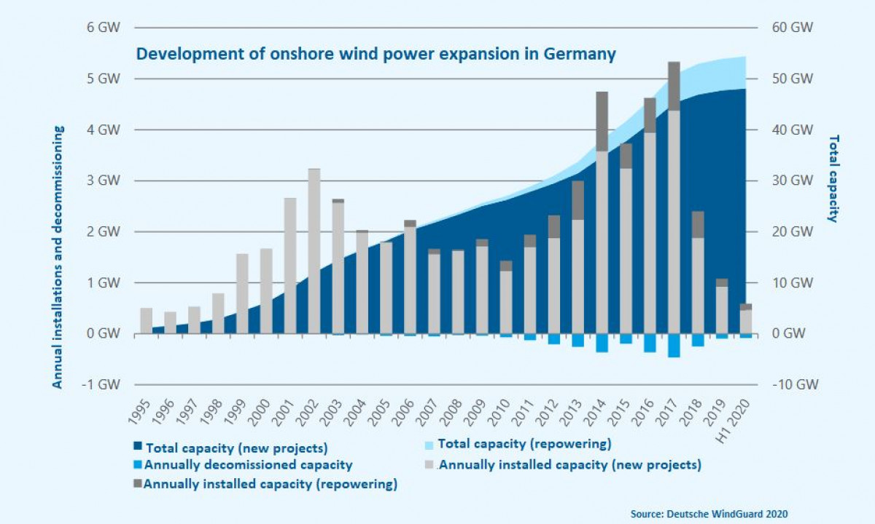
Future Plans
Germany is already looking forward to renewable energy for the future
Proposed a 45 billion dollar, eighteen-year plan to move away from coal
The country is looking forward to using only renewable energy by 2038

Slide 12
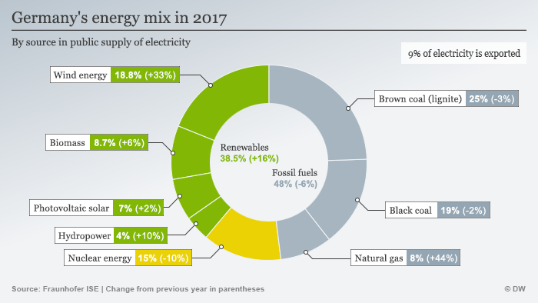
Future Plans
According to the International Renewable Energy Agency (IRENA), Germany already has over a couple thousand people working under this sector
New ideas are being used as blueprints for other countries to pursue renewable energy

Slide 13
Conclusion
Germany is a great model for reliance on renewable energy, and the United States should follow its example.
Germany has invested heavily in renewable energy, and in doing so they have made a positive environmental impact and employed thousands.
Germany has provided the rest of the world with a roadmap to a largely renewable energy sector.

Slide 14
Works Cited
Archer, Kathryn and John P. Banks. American and German Approaches to Energy-Climate
Policy. 11 June 2014. The Brookings Institution. Web. 3 December 2021.
https://www.brookings.edu/articles/american-and-german-approaches-to-energy-climate
policy/
DeSilver, D. (2020, January 15). Renewable energy is growing fast in the U.S., but fossil
fuels still dominate. Pew Research Center. https://www.pewresearch.org/fact-tank/2020/01/15/renewable-energy-is-gro wing-fast-in-the-u-s-but-fossil-fuels-still-dominate/
“Energy Resource Guide - Germany - Renewable Energy.” International Trade Administration |
Trade.gov, https://www.trade.gov/energy-resource-guide-germany-renewable-energy.
Hockenos, Paul. “Is Germany Making Too Much Renewable Energy?” Foreign Policy, 10 Feb.
2021,https://foreignpolicy.com/2021/02/10/is-germany-making-too-much-renewable-energy/.
Latest Data Book Shows U.S. Renewable Capacity Surpassed 20% for First Time in 2018. (2020, February 18). News
NREL.https://www.nrel.gov/news/program/2020/latest-data-book-shows-us-rene
wable-capacity-surpassed-20-for-the-first-time-in-2018.html
Lohmann, Sarah. Germany Has a Math Problem, and It’s about to Get Worse. 2021. Johns Hopkins University. Web. 11 December 2021. https://www.aicgs.org/2021/09/germany-has-a-math-problem-and-its-about-to-get-worse/.

Slide 15
Works Cited
NationMaster.com. Energy Stats: compare key data on Germany & United States. 2021. Web. 3
December 2021.
<https://www.nationmaster.com/country-info/compare/Germany/United-States/Energy>.
Phelan, Matthew. “Germany Wants 65 Percent Renewable Energy by 2030. Here's The Wild
Plan.” Inverse, Inverse, 11 July 2018,
https://www.inverse.com/article/46873-germany-2030-green-energy-plans.
Renewables became the second-most prevalent U.S. electricity source in 2020 - Today in Energy
- U.S. Energy Information Administration (EIA). (2021, July 28). U.S. Energy
Information Administration. https://www.eia.gov/todayinenergy/detail.php?id=48896
The World Economic Forum. World Economic Forum. (n.d.). Retrieved December 3, 2021, from
https://www.weforum.org/.
Wood, Johnny. “This Is Germany's $45 Billion, 18-Year Plan to Move Away from Coal.” World
Economic Forum, 23 Jan. 2020,
https://www.weforum.org/agenda/2020/01/coal-lignite-germany-renewables-energy/.

