Slide 1
Is Germany really a good model for renewable energy?
Emily Cholin, Ben Mandell, Allyssa Olear & Jessica Smith

Slide 2
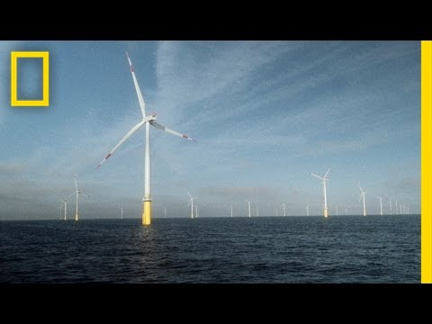
Intro to Germany’s Model:
Notes:
Ben: The video shows that the German ‘Energiewende’ was very successful in delivering a rapid increase in electricity generation from wind and solar PV. The flipside of this development was a substantial increase in end-user electricity prices. Our presentation will consider the different perspectives analyzing Germany’s model and take into account the economic and environmental impacts of the policies.

Slide 3
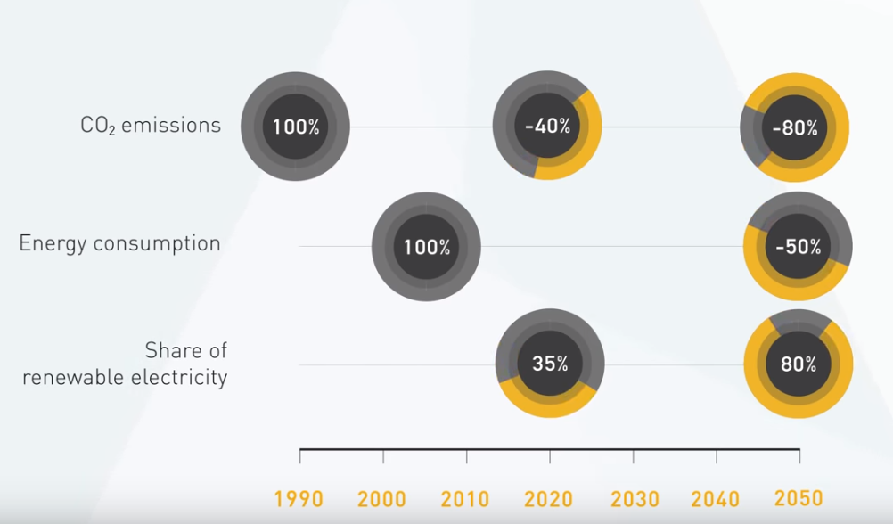
What is Germany’s renewable energy model?
Years of Policy Changes:
  2000- Renewable Energy Sources Act
  2010 (September) Energy Concept
  2014 Revision of Renewable Energy Sources Act
    Greatly reduced costs
    stipulated that new large-scale installations are responsible for marketing the electricity they generate (better integration into the electricity market)
    Slowed rise in electricity cost
    Goals: move away from nuclear power and utilize renewables through Energiewende
Notes:
Jessie: The Germany’s renewable energy model projects CO2 emissions to reduce by 40% in the year 2020, and an 80% total reduction by 2050. To achieve this, energy consumption will be reduced by 50% by 2050 and at least 80% of electricity will come from renewables, like offshore and onshore wind, in 2050. Thus fossil and nuclear power will be replaced with different forms of renewable energy that will become the predicted primary energy source. However, the economic impact felt by the average German citizen is rising as the nation has spent more than 36 billion euros on the project thus far. (Germany’s GDP is 3.677 trillion dollars from World Bank)

Slide 4
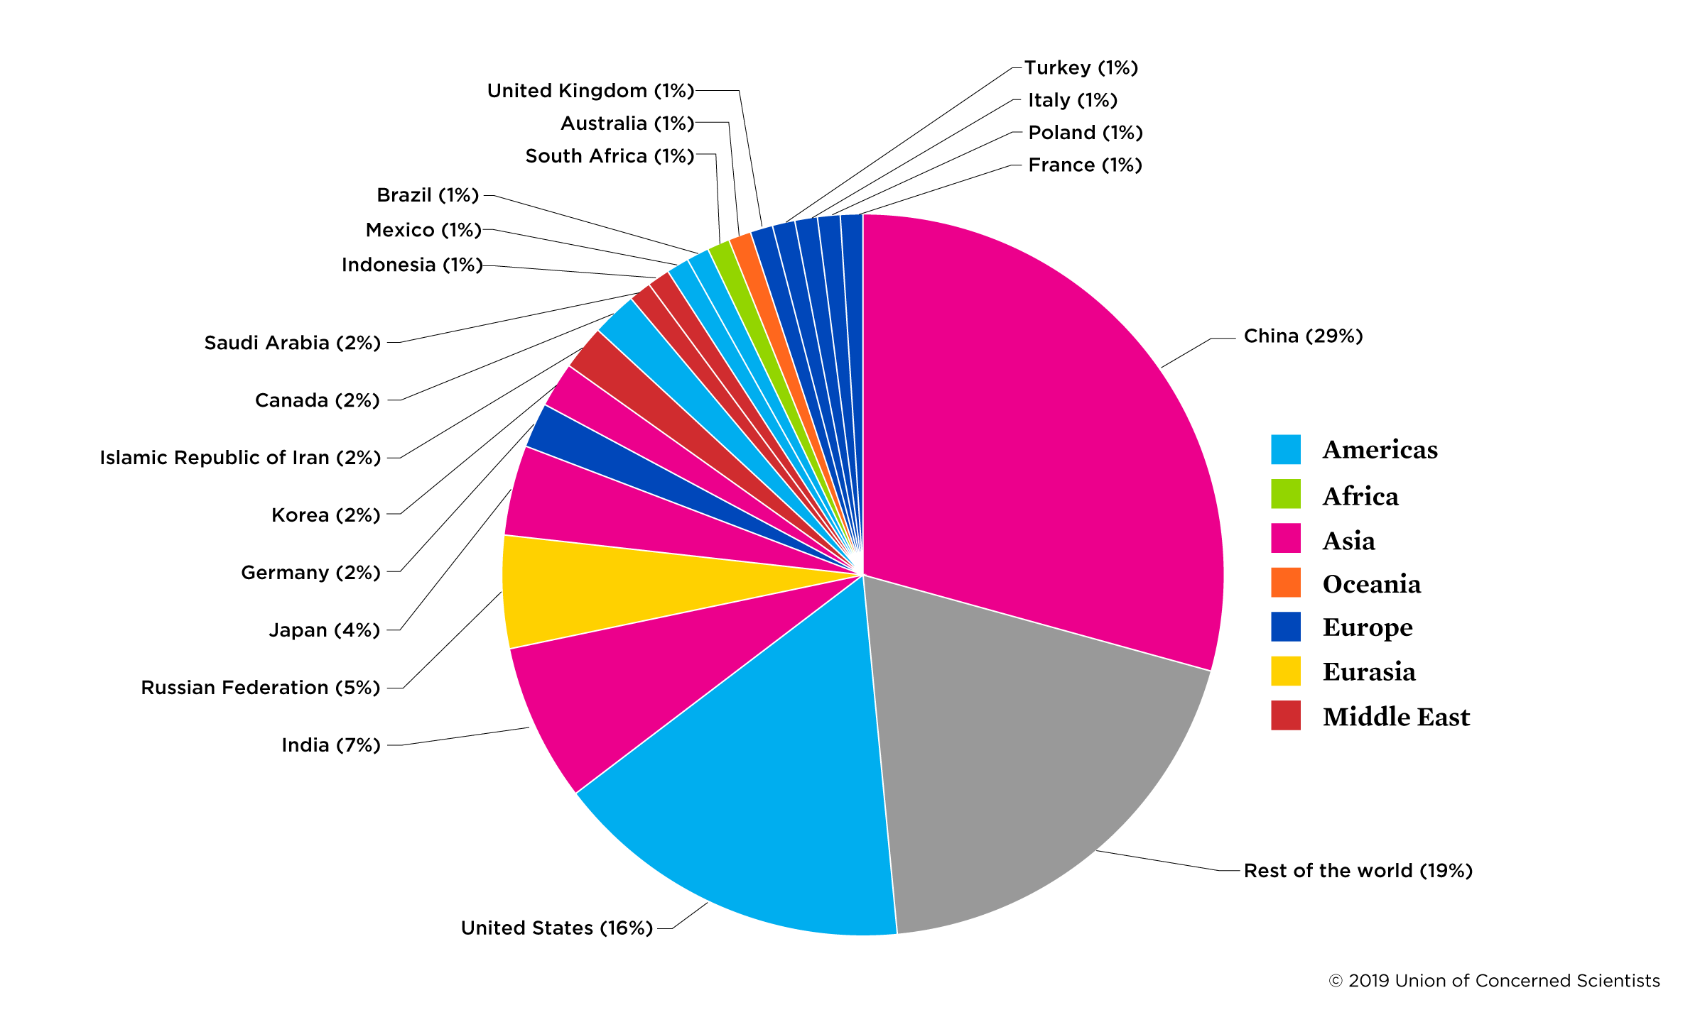
How Does Germany Compare?
CO2 Emissions 2019
According to the Union of Concerned Scientists, total CO2 emissions in 2019 are highest in Asia and the Americas
Germany accounts for 2% of current global emissions
Notes:
Allyssa: so far, in 2019 Asia, specifically China and the the Americas, specifically the US create most of the CO2 emissions. As shown in this graph, Germany accounts for 2% total emissions.

Slide 5
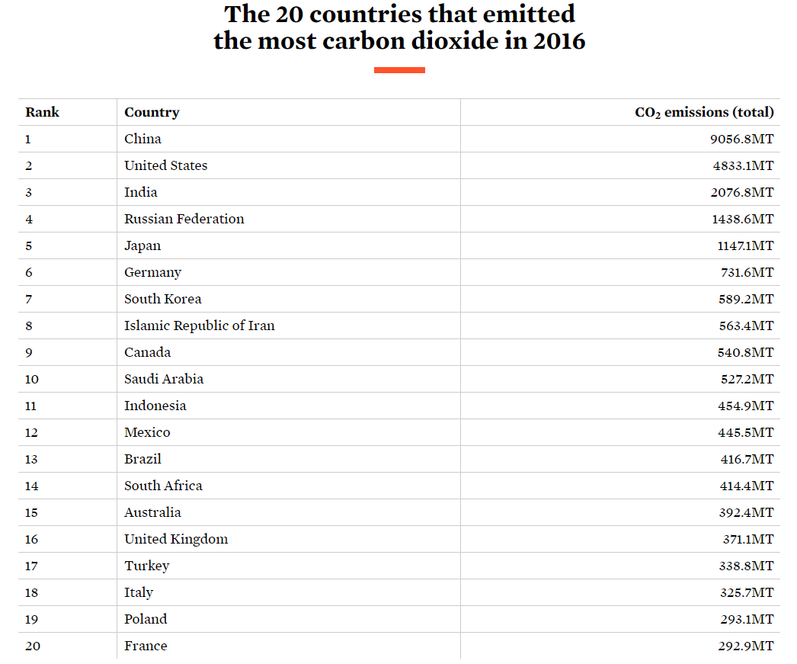
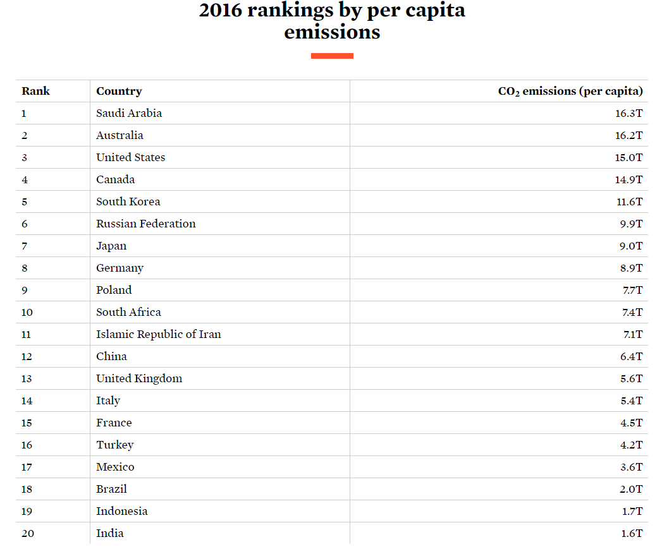
Total vs. Per Capita Emissions World-Wide
Notes:
Allyssa: As of 2016, Germany ranked 6th in the world for highest CO2 emissions. However, per capita, Germany’s emissions fell two spots lower, placing them at 8th for CO2 emissions. Another notable observation is the difference in consistency between total emissions and emissions per capita in developing/developed countries. For example, India, a developing country ranks third on world emissions, but is 20th per capita. One possible interpretation pertaining to the role of countries in the international community, is that the developed countries with the means must lead the world in sustainable energy due to lack of economic ability in underdeveloped countries.

Slide 6
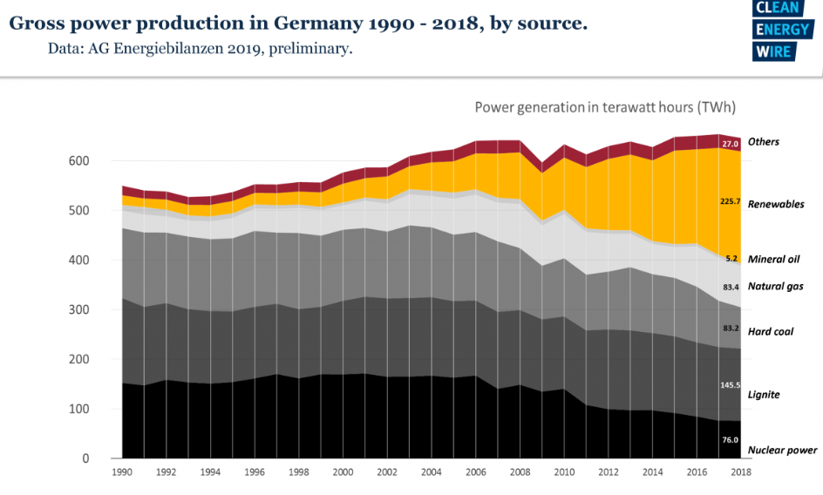
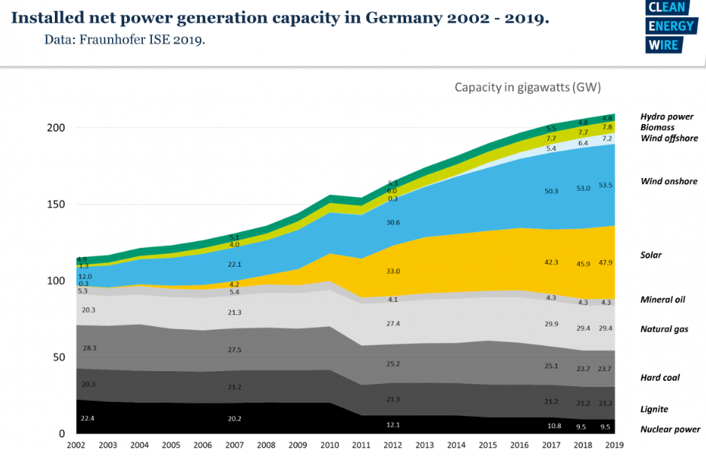
Notes:
Allyssa: As you can see from the top left graph, the renewable, gross power production in Germany has increased significantly since the introduction of Energiewende and other policies around 2008. The bottom right graph is important in showing how onshore wind and solar generation have increased dramatically since 2006, but that hard coal and lignite are still a large source of installed net power generation in Germany.

Slide 7
What are the different perspectives?
Opponents (Economists):
Germany had to delay its phase-out of coal, and would not meet its 2020 greenhouse gas reduction commitments.
Energiewende has cost Germany €32 billion ($36 billion) and opposition to renewables is growing in the German countryside.
Solar farms take 450 times more land than nuclear plants, and wind farms take 700 times more land than natural gas wells.
Germans will have spent $580 billion on renewables and related infrastructure by 2025.
Germany is the world’s leading producer of lignite.
Proponents (Conservationists):
In 2014, about 27% of Germany’s electricity came from renewable sources such as wind and solar power, 3x what it got a decade ago and more than twice what the United States gets today.
Despite Germany having Europe’s second highest consumer electricity prices, public support for Energiewende is at an impressive 92%.
Germany's renewable-energy surge has contributed to a 27% reduction in its greenhouse gas emissions.
Notes:
Jessie: Opponents of the Germany model are predominantly economists who believe it is a waste of money, waste of resources and ineffective in achieving its goals. Some of their evidence is that Germany was forced to acknowledge that it had to delay its phase-out of coal, and would not meet its 2020 greenhouse gas reduction commitments. #2: Energiewende has cost Germany roughly €32 billion ($36 billion) annually, and opposition to renewables is growing in the German countryside. #3: Solar farms take 450 times more land than nuclear plants, and wind farms take 700 times more land than natural gas wells in order to produce the same amount of energy. #4: Germans will have spent $580 billion on renewables and related infrastructure by 2025; and lastly #5: Germany is the world’s leading producer of lignite, thus a phase-out of coal would severely damage the German economy.
Now Proponents of the Germany model are conservationists who believe the model is achieving many of their goals and that with due time, all initiatives will be reached. Some of their evidence includes that about 27% of Germany’s electricity came from renewable sources such as wind and solar power in 2014, which is three times what it got a decade ago and more than twice what the United States gets today. #2: Despite Germany having Europe’s second highest consumer electricity prices, public support for Energiewende is at an impressive 92%. And lastly #3: Germany's renewable-energy surge has contributed to a 27% reduction in its greenhouse gas emissions already, which is on schedule to meet the model’s goal of 80% reduction by 2050.
Opponents information is found from the Forbes article, “The Reason Renewables Can't Power Modern Civilization Is Because They Were Never Meant To”.

Slide 8

Is one side being influenced by those with a financial stake in the outcome?
Yes (International Renewable Energy Agency)
  “Climate Premium”, Market Incentive Programme (MAP)
    Applicants with a solar heating system
    Wood pellet or firewood stove or geothermal energy probe
    Money received depends on size and quality of the system
Notes:
Emily: Yes! According to the International Renewable Energy Agency, Germany has a “Climate Premium.” The incentive is for citizens who have a solar heating system (with a wood pellet or firewood stove or geothermal energy probe), and the money that the household receives is dependant on the size and quality of the system within the house.

Slide 9
Do we favor one side? Why?
Pros:
Greenhouse gas emission reduction is occuring
Solar power development on residential homes will significantly decrease household electricity bills over time
Cons:
Economic strain on German citizen’s is growing, and CO2 emissions are behind their projected reduction goal
The immediate cost of installing solar power on residential homes is too great
Conclusion:
The Germany Model is great in theory but not a good model for renewable energy.
Notes:
Emily: For the Germany Model, it is clear that a significant reduction in greenhouse gas emissions is present; however the economic strain experienced by German citizens is growing each year. One can combat the economic strain by saying solar power development on residential homes can significantly decrease household’s electricity bill over time, yet the immediate cost of installing said solar power is too great to overlook. Thus, despite the great improvements in renewable energy use and projected reductions in greenhouse gases, we currently think the Germany model is great in theory but not a good model for renewable energy.

Slide 10
Is more research needed? What should the research include? Research to be conducted and funded by who?
Research should include:
  Continuous monitoring of Germany’s CO2 emissions, energy consumption and share of renewable energy.
  Measurements of Germany’s GDP and average household electricity expenses.
  Conducted by IRENA
In order for the Germany Model is become great in theory and practice:
  The costs and benefits need to be allocated in a fair and transparent way among all participants, especially households.
  Renewable energy capacity must expand in parallel with the timely development of the transmission and distribution networks.
  A stable regulatory system is necessary to ensure long-term finance to network operators.
  Close monitoring of Germany’s ability to meet electricity demand at peak times should continue.
Notes:
Ben: That’s not to say that the Germany Model can’t become a great model for renewable energy. More research is absolutely needed before anyone can write-off the model, which includes the continuous monitoring of Germany’s CO2 emissions, energy consumption and share of renewable energy and measurements of Germany’s GDP and average household electricity expenses. This can be conducted by current agencies like the International Energy Agency (IEA).
For the Germany Model to become great in practice, we must see the costs and benefits of the model be fair and transparent among all participants, including households as they bear the greatest economic strain. Renewable energy capacity must also increase with the development of transmission and distribution networks for the energy. The establishment of a regulatory system that routinely monitors the long-term finances of the model is a great start and lastly, agencies must closely monitor Germany’s ability to meet electricity demands.

Slide 11
Works Cited
“Each Country's Share of CO2 Emissions.” Union of Concerned Scientists, https://www.ucsusa.org/resources/each-countrys-share-co2-emissions.
Federal Ministry for Economics Affairs and Energy. “Renewable Energy.” BMWi, https://www.bmwi.de/Redaktion/EN/Dossier/renewable-energy.html.
Germany Trade & Invest (GTAI). “Germany’s Renewable Energy Revolution.” YouTube, 11 March 2015, https://www.youtube.com/watch?v=EvceQ0T80Zc.
National Geographic. “An Immersive Voyage Into Germany’s Energy Revolution.” YouTube, 17 Oct 2015, https://www.youtube.com/watch?v=W3ml_3ZfZk8.
“Global Engagement.” Germany, https://www.iea.org/countries/Germany/
“The promotion of Renewable Energies in Germany.” Renewable Energies Agency, 2019, https://www.unendlich-viel-energie.de/features/politics/the-promotion-of-renewable-energies-in-germany.
Shellenberger, M. (2019, June 3). “The Reason Renewables Can't Power Modern Civilization Is Because They Were Never Meant To”. Forbes. https://www.forbes.com/sites/michaelshellenberger/2019/05/06/the-reason-renewables-cant-power-modern-civilization-is-because-they-were-never-meant-to/#5cb191fea2b9.
Oroschakoff, Kalina. “Germany’s green energy shift is more fizzle than sizzle”. Politico. https://www.politico.eu/article/germany-climate-change-green-energy-shift-is-more-fizzle-than-sizzle/.
Notes:
Ben

