Slide 1
Health Impacts of Fracking for Natural Gas
EES 105

Slide 2
Essential Question: Are the health impacts of fracking for natural gas worse than for any other energy source?

Slide 3
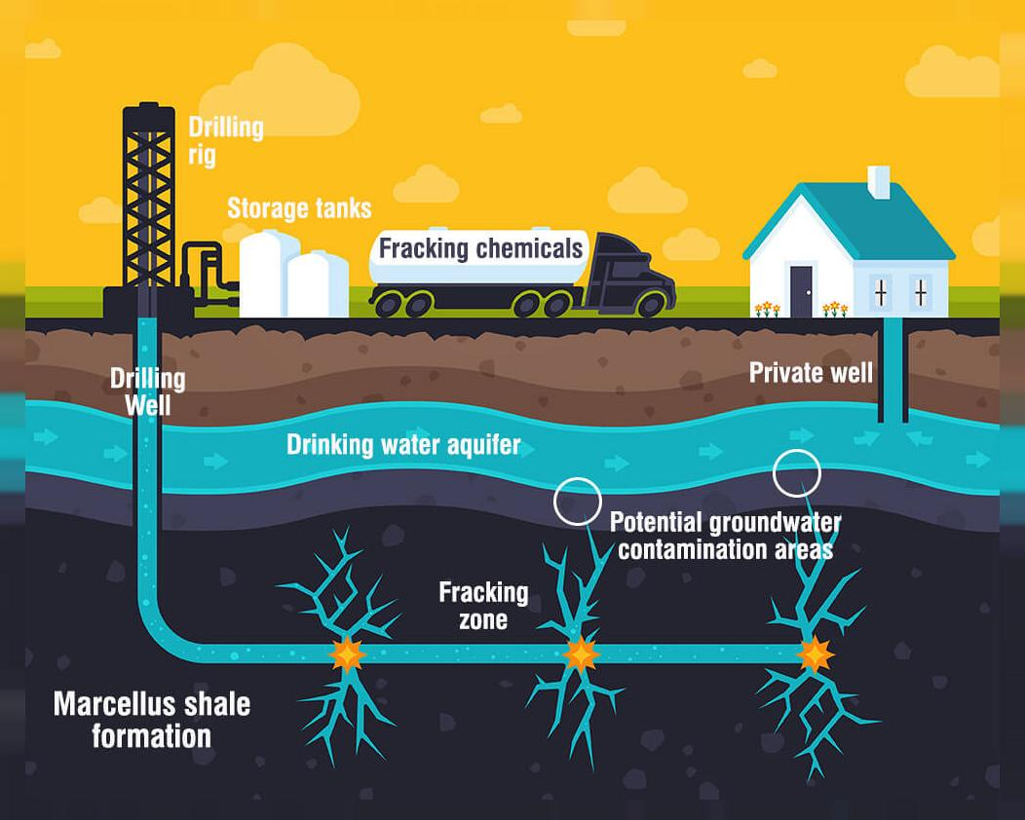
What is Fracking
Fracking is a method of oil drilling that has become very popular since the beginning of the millenium. Fracking is the process of injecting liquid at high pressure into subterranean rocks, boreholes, etc. so as to force open existing fissures and extract oil or gas.

Slide 4
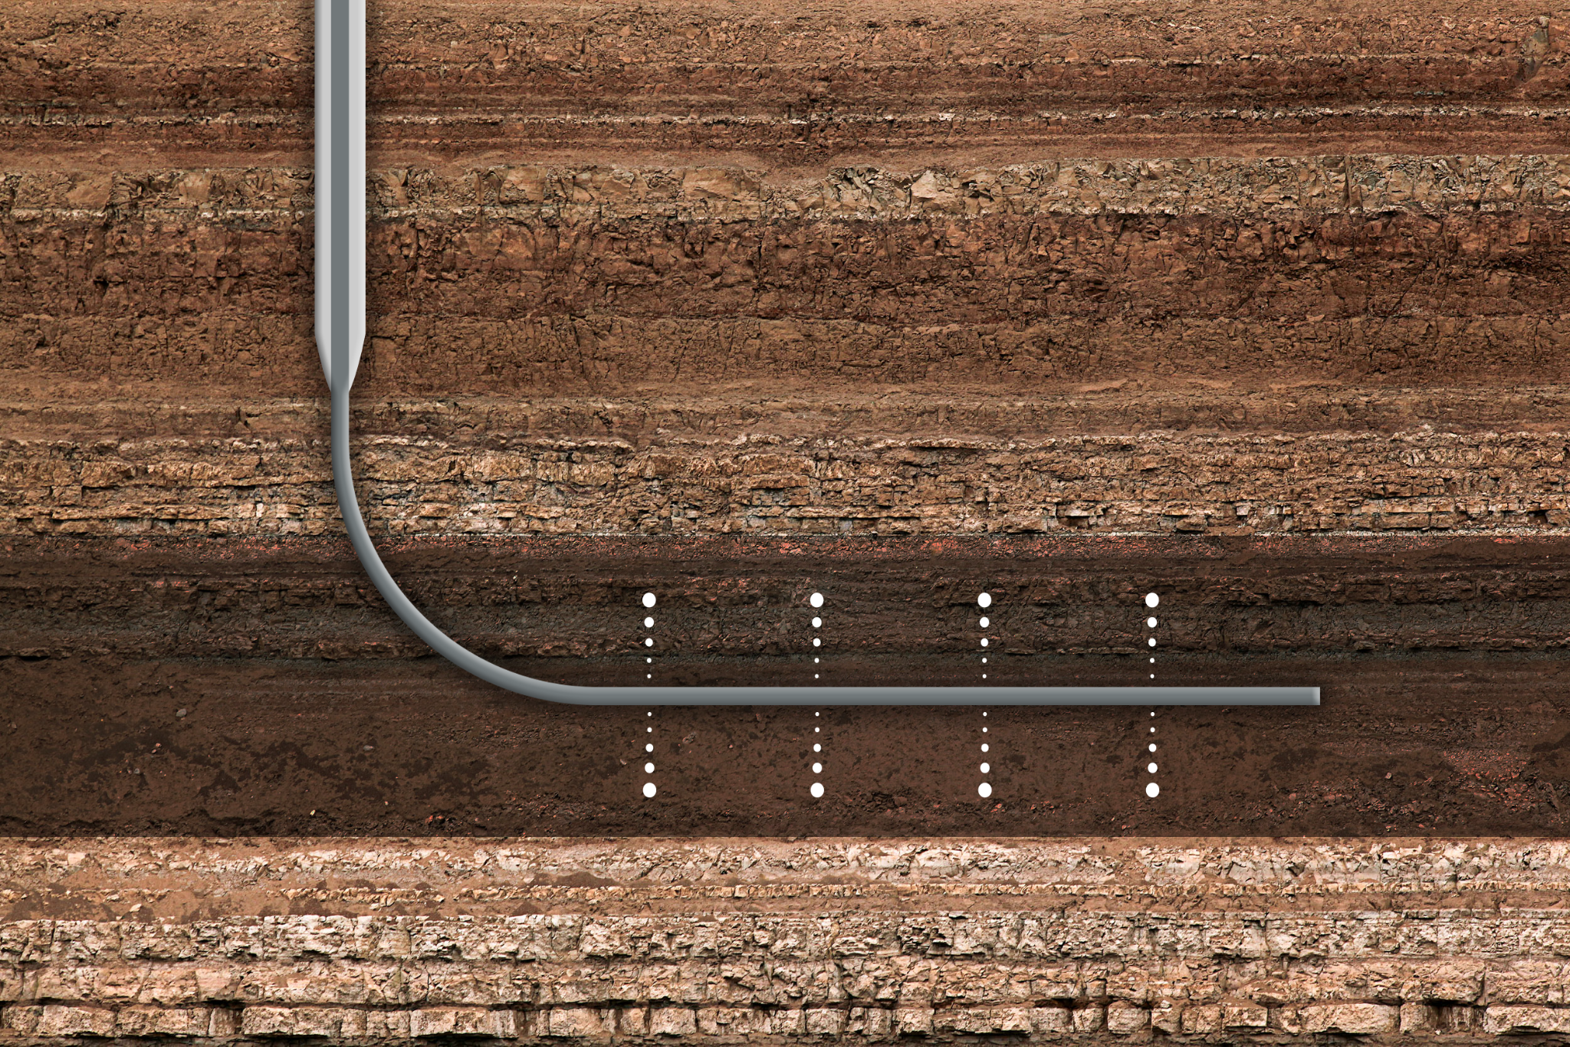
Boom of Fracking
When it was first introduced in 1862, it was done with many explosives being put into a well and then having water pumped through it in order to get the oil.
In the 1940s, explosives were replaced with high-pressured blasts of water. The convenience of no longer needing a ton of explosives made fracking much more attractive
Another advancement came at the turn of the century, which was one of the main reasons for the boom in the 2000s
Horizontal drilling, a technique that increases the productive potential of each well because it can reach more of the rock formation that contains the oil and gas. These two led to the boom of fracking as since, around 1,000,000 U.S. were drilled using fracking and one-third of them came after 2000.

Slide 5
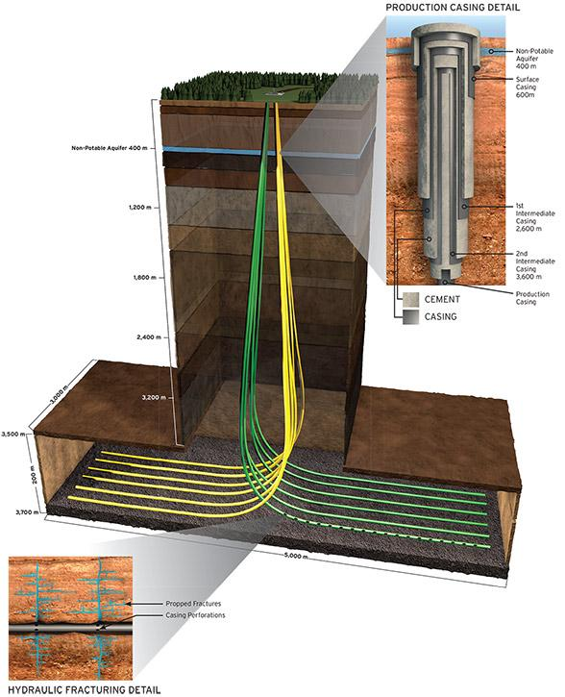
Well Construction
The wells are built with thick walls because there are natural water supplies nearby that they do not want to contaminate.
There can still be errors with wells but, in a 2013 report from the US EPA, it only reported 457 spills of any kind of slickwater, the water used in fracking containing thousands of chemicals. While any water leak is not good, these couple hundred were taken between 2006-2012, a six year period where tens of thousands of wells were used.
Only 21 states have fracking occurring within it and the number , while it is looking to grow, will not grow much as oil only occurs in a few states.

Slide 6
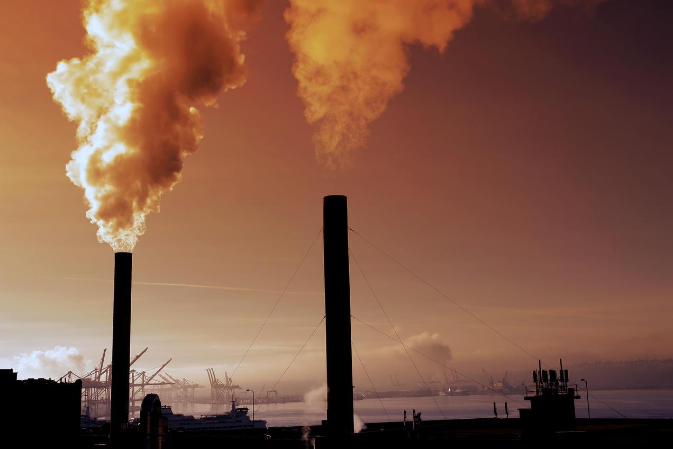
Air pollution
Fossil fuels are a part of the reason to blame for the problem of Global Warming that we have today
Methane and carbon dioxide from oil rigs and other methods of retrieval causes a lot of pollution
Fracking on the other hand has virtually no bad effects on the environment because of the low amounts of chemicals that need to be pumped out. A great majority of the bad chemicals are held in the water used and that helps maintain the quality of air.

Slide 7
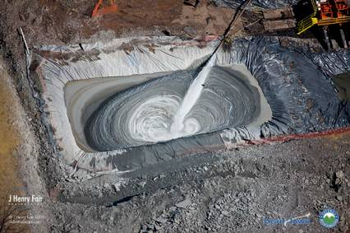
Slickwater
It is a combination of water, sand, and hundreds of different chemicals
  it is not able to be used by people or animals due to the high amounts of dangerous chemicals present
Once the water is used, it must be stored away in order to not contaminate other freshwater nearby. It can be sent for refinement, but many of the chemicals that are present cannot be taken out without a lot of work being done.
The main issue however is the storage of it. For the majority of the sources it is kept safe and away from freshwater in a place where it can be reused.
  As with anything however, there are the few that will just do the bare minimum with that slickwater and leave it in a pool away from the natural water but not in a palace where it could never be contaminated.

Slide 8

Conclusion
Nuclear is good as long as the plant does not blow up and leave everything within a 50 mile radius in ruins.
Coal has awful effects on the people mining it and the combustion of coal produces a significant amount of carbon dioxide..
Fracking is safe for people and is not the worst natural gas energy source.

