Slide 1
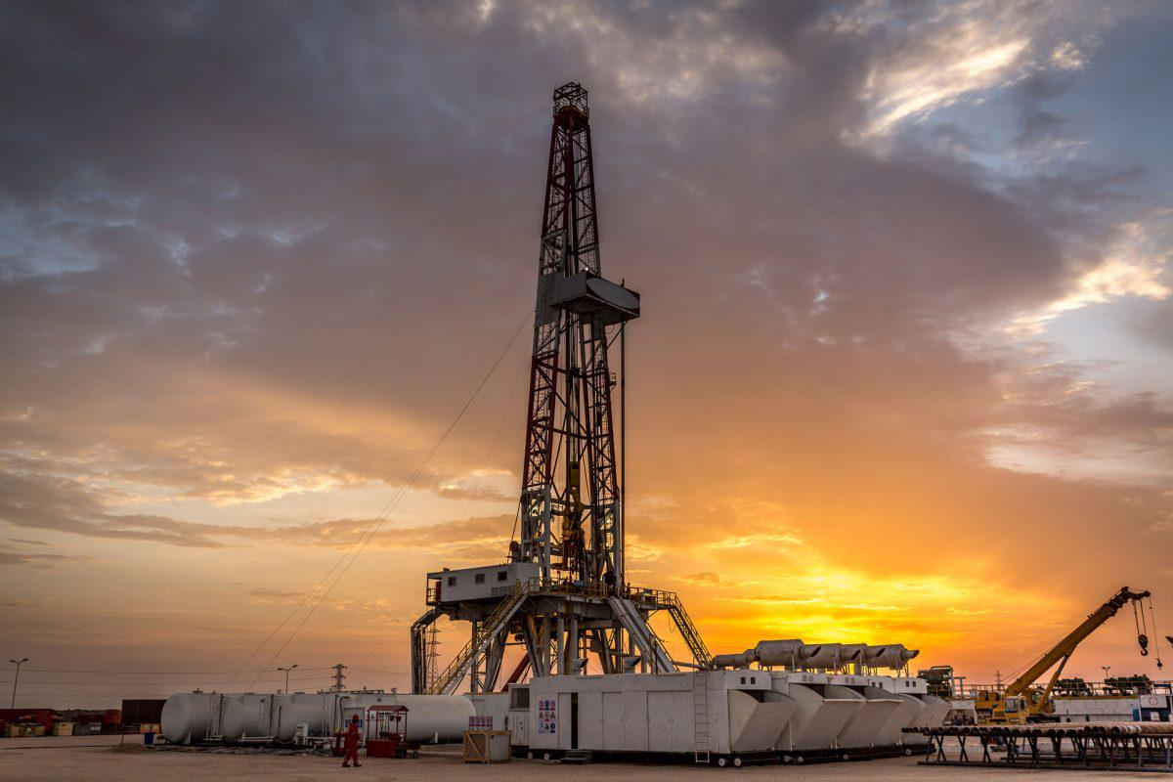
Does Fracking have Health Impacts?
Nick Kinzler, Ian Scott, Corey Repsher

Slide 2
What is Fracking / Hydraulic Fracturing?
“Involves the injection of a mixture of sand, water and chemicals into an oil or gas well at high pressures to fracture the shale rocks to release the natural gas inside”
Both an Environmental and Political Issue
Not a new technology
  Began in 1947 in Grant County, Kansas
  Used 1 million times in U.S. by 2002
  95% of wells drilled today are hydraulically fractured
  Accounts for more than 67% of all natural gas production

Slide 3
The Fracking Process
Wellbores are drilled thousands of feet deep into the Earth’s surface
Drilling begins vertically and then becomes angled horizontally
Pipes, aquifer, conductor, and cement casings are installed
Fluid is forced down wellbore under high pressure
Open crevices in rocks to liberate methane

Slide 4
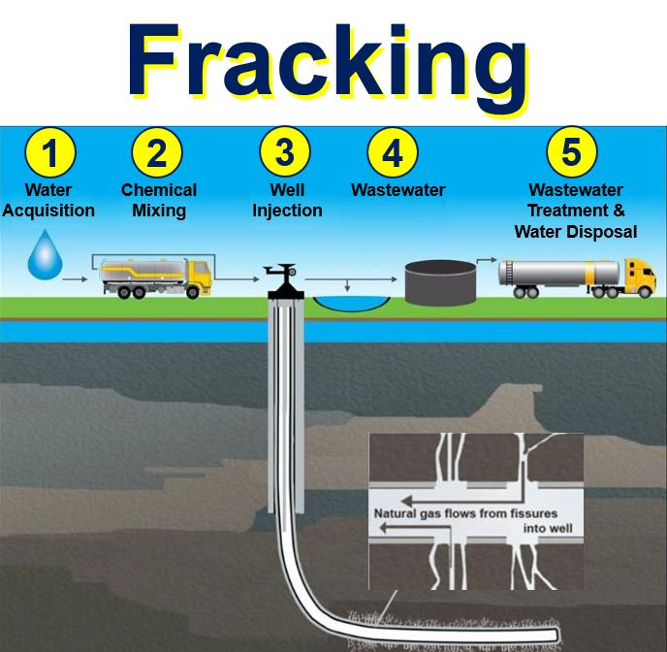
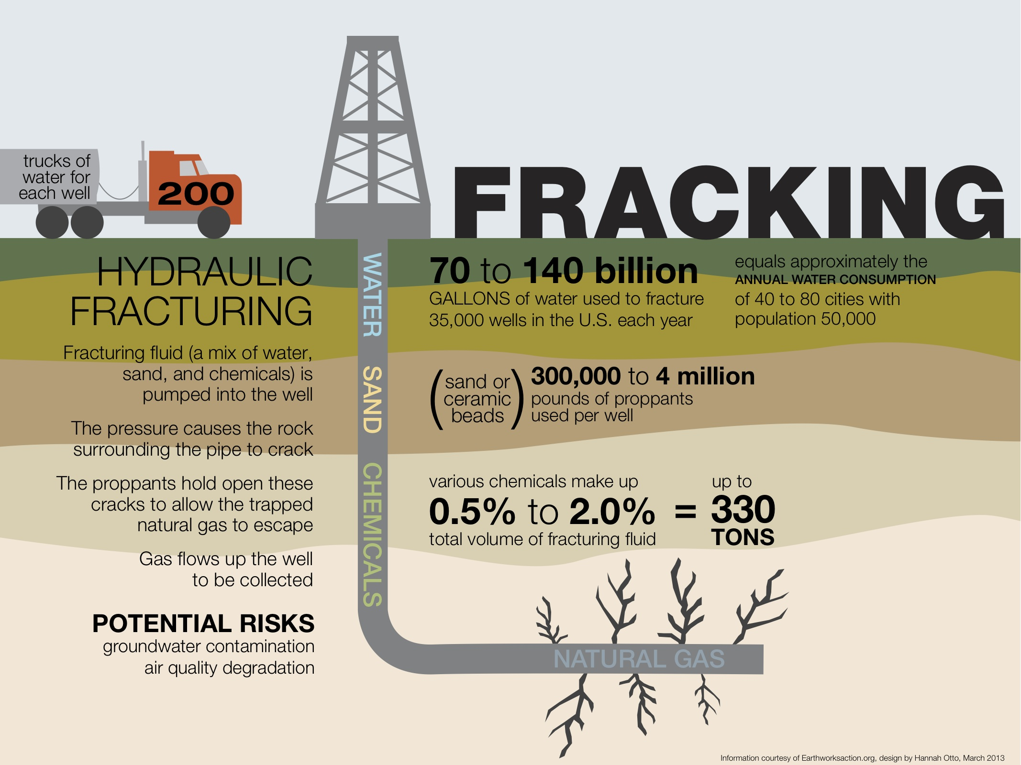
The Fracking Process (Con’t)

Slide 5
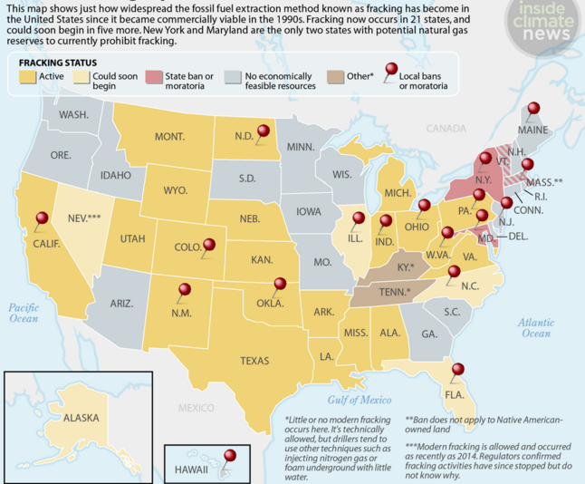
Where is Fracking Prevalent?
Fracking is very popular in the Midwest.
Pennsylvania has a large-scale market for Fracking.
However, more and more states are starting to consider placing bans on fracking.

Slide 6
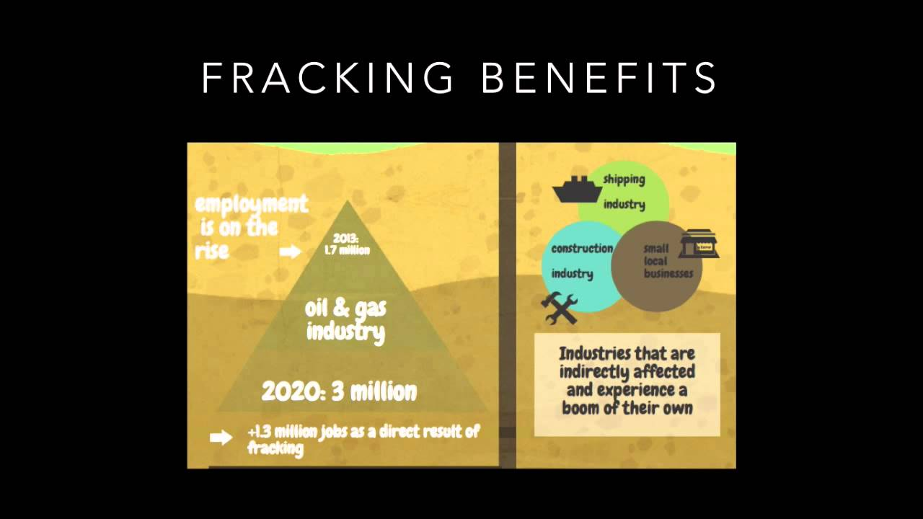
Benefits of Fracking
Access to more Gas and Oil
Smaller Reliance on other countries for Oil trade
Creation of Jobs

Slide 7
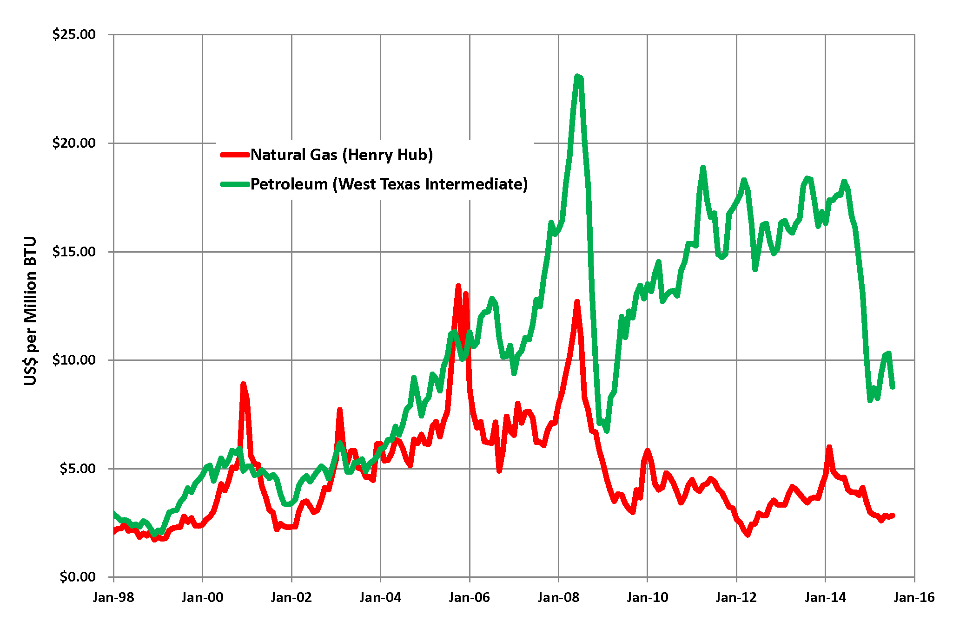
Access to more Gas and Oil
Allows for drilling thousands of feet deep into the ground
  Allows for more gas and oil to become readily available
Will have large scale effect on domestic gas prices
  The larger the abundance of natural gas, the cheaper it will be for consumers to buy

Slide 8
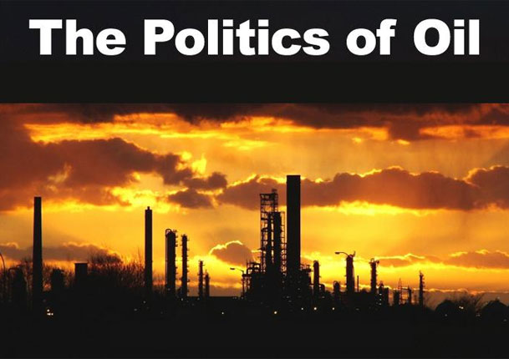
Decreased reliance on other countries for Oil
As a result of having more oil and natural gas available, the United States can slow trade negotiations with foreign nations for these two necessities
Political Tensions could be reduced for the United States as they would not be fiercely competing for fossil fuel trade

Slide 9
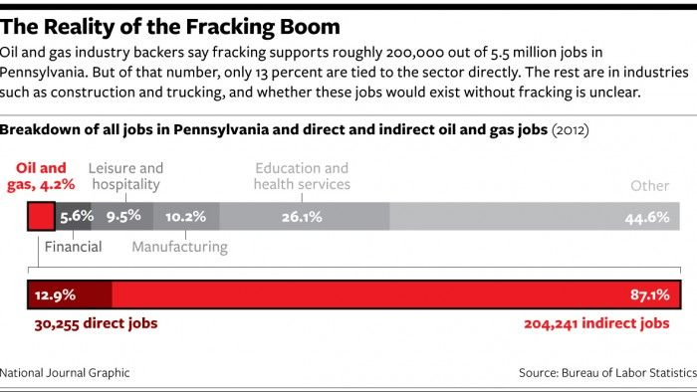
Creation of Jobs
If the production of natural gas increases, more employment opportunities will open up as production expands
  More shale deposits will need top be drilled for
From 2003 - 2012, there was a 67% rise in employment due to the increase of fracking technology

Slide 10
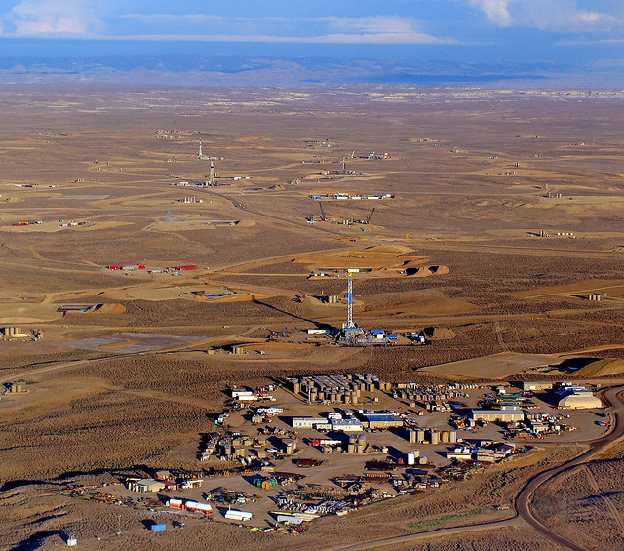
Negative Effects of Fracking
Water consumption
Wastewater disposal
Potential groundwater pollution
Habitat fragmentation
Potential surface water pollution
Air pollution
Health issues

Slide 11
Water Consumption
A single well requires between 4-6 million gallons of water
This water is generally taken from regional water bodies
There are proposals to use abandoned mine drainage
To help with the consumption in eastern Pennsylvania, each body of water is regulated by the Susquehanna River Basin Commision
  Fracking companies require permits for all withdrawals
  Permits will be denied if there is a drought
There is no similar agency in western Pennsylvania

Slide 12
Wastewater Disposal
Approximately 20-80% of injected water returns as flowback and produced water
There are high levels of salinity and radioactivity in the used water
All used water is stored in onsite holding tanks
There is now specialized water treatments
  This dirty water will be returned to the drillers once clean
  All brine is trucked to disposal site

Slide 13
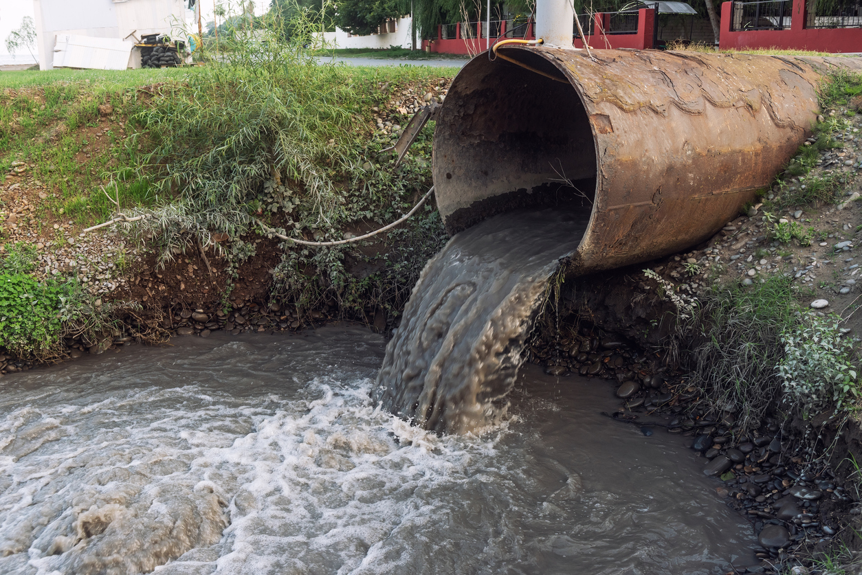
Groundwater Pollution
Fluids used for fracking consist of toxic substances
  Such as: salts, radioactivity, and methane
Studies indicate that there is methane leakage due to fracking and it sometimes appears very close to residential areas
If fracking is done in areas where rocks happens to have cracks, the gases can leak into groundwater and pollute it

Slide 14
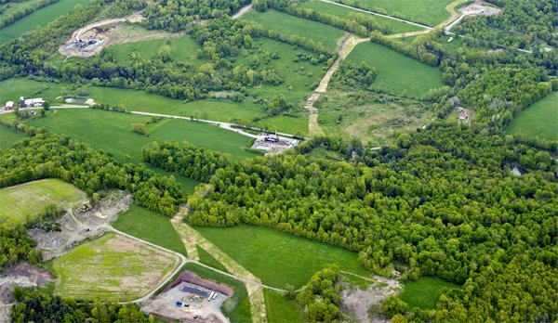
Habitat Fragmentation
When Hydraulic Fracturing machines are built they may split areas of land due to connection from one machine to the other
Animals will most likely be displaced from their habitats
This can also lead to some of the wildlife such as trees and grass in the surrounding areas to die off due to the chemicals used in the process

Slide 15
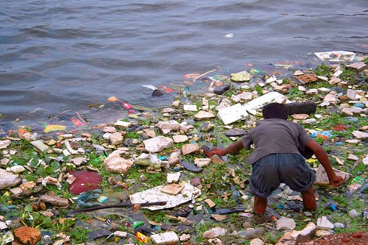
Potential Surface Water Pollution
There are spills from flowback
There are holding pond accidents
Release of wastewater into clean water sources
Wastewater shipping accidents
There is also poor erosion and sedimentation control measures

Slide 16
Air Pollution
During drilling Methane may escape and be considered “Fugitive Methane”
Due to methane escaping this causes issues with the O-Zone
  Methane is approximately 25 times stronger than carbon dioxide
Diesel Exhaust
  Carbon Monoxide, Nitrous Oxide, Sulfur Dioxide
BTEX
  Benzene, Toluene, Ethylbenzene, and Xylene

Slide 17
Health Issues
Some Hydraulic Fracturing chemicals are carcinogenic
There are suggested links to autism, respiratory, cardiovascular, neurological problems, and loss of taste and smell
  Most of this is not reliable or necessarily true, it is more based off of personal accounts not research
  Also people have reported miscarriages due to fracking
Conducted studies are pointing that mostly these health issues are epidemiological

Slide 18
Quality of Life
Hydraulic Fracturing leads to industrialization of rural landscape
Families can possibly be displaced
Water can become impure by the sapping of gasses through cracks in rocks
The long term effects are still up in the air because the field hasn't been around long enough for generational studies

Slide 19
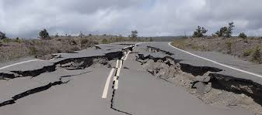
Earthquakes
Injection of wastewater into boreholes can trigger earthquakes
There is some concern saying that Hydraulic fracturing may cause seismic activity
A majority of this seismic activity is around or smaller than a magnitude of 1
Around 2% of Oklahoma’s earthquakes can be linked to fracking

Slide 20
How does Fracking compare to other sources of energy?
Fracking is one of the lesser efficient of the energy sources, it is close to being an energy sink
Compared to renewables of all kinds fracking is better suited to the existing infrastructure as a supplemental source of energy
Compared to fossil fuels it is not even close to being as extensive of an energy source
Also compared to fossil fuels it causes severe pollution and little to nothing to reduce the carbon emissions that it creates

Slide 21
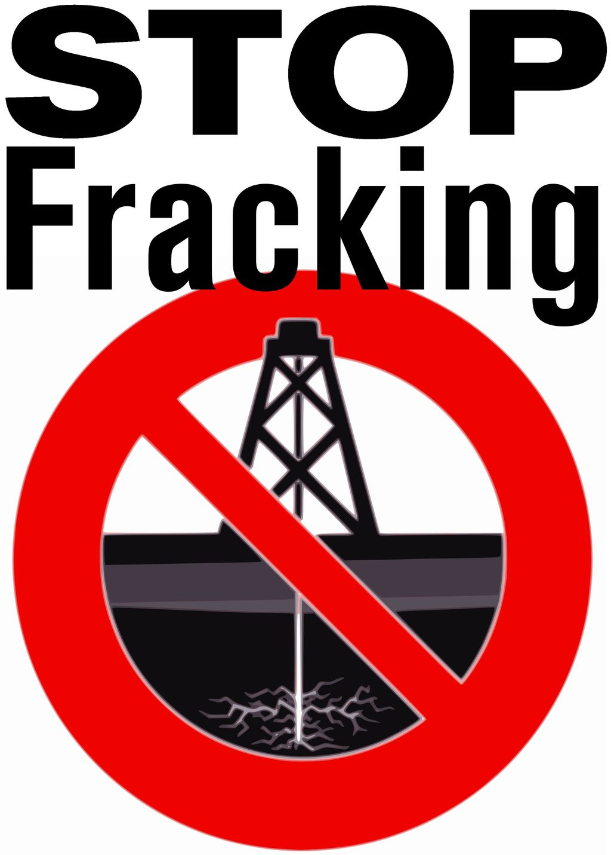
Opinion of Those who are AGAINST Fracking
Chemicals used in Fracking can lead to…
  Respiratory Problems
  Complications during Pregnancy
  Noise, stress, sleep deprivation
  Spills and Accidents
Millions of gallons of water are being used for a process that is impacting the health of many
  Also polluting the water!
There is not enough regulation by government / fracking companies

Slide 22
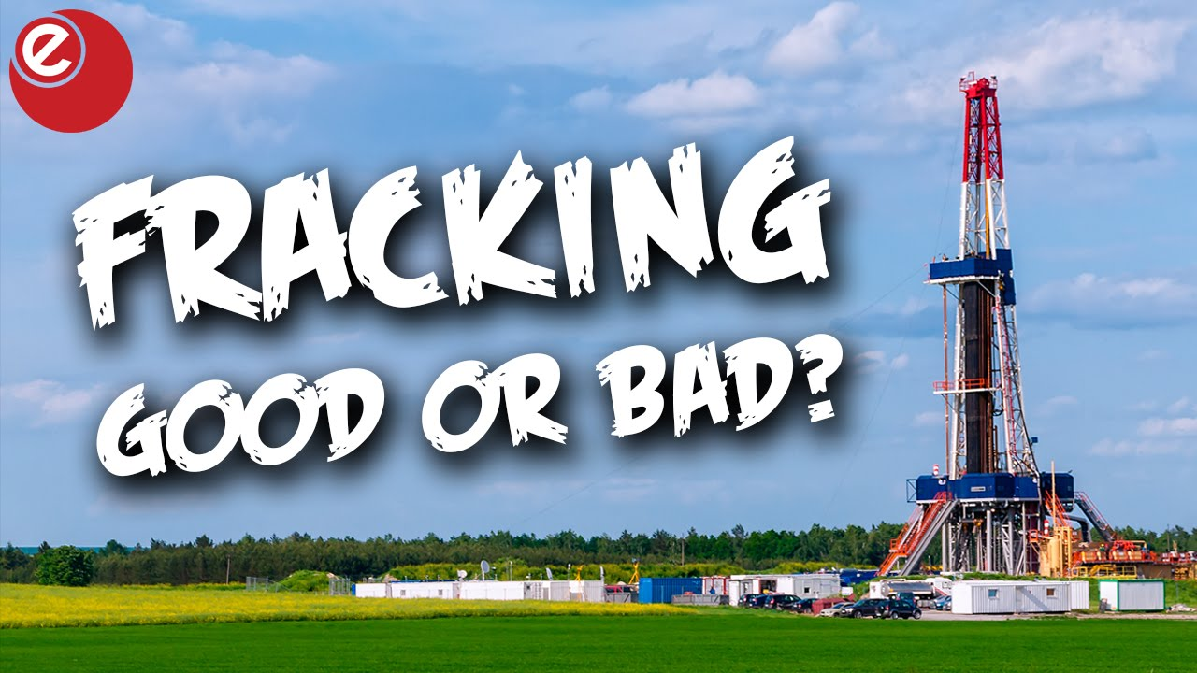
Our Opinion of Fracking
Hard to Determine if it is a viable option of energy
  No concrete evidence that the benefits of fracking outweigh the health and environmental damages it can cause
More Information should be made available to the general public
For now, it is an energy source that can be used to carry out our day to day operations
As more information comes out, fracking should be used with caution

Slide 23
References
Hinrichs, R., & Kleinbach, M. H. (2013). Energy: Its Use and the Environment. Brooks/Cole.
Klemow, K. M. Unconventional Natural Gas.
Rinkesh, A. (2016, December 25). Benefits and Dangers of Fracking. Conserve Energy Future.
https://www.conserve-energy-future.com/benefits-and-dangers-of-fracking.php.
Stone, J. (2017, February 23). Fracking Is Dangerous To Your Health -- Here's Why. Forbes.
https://www.forbes.com/sites/judystone/2017/02/23/fracking-is-dangerous-to-your-health-heres-why/?sh=7bc345115945.
U.S. Department of Health and Human Services. Hydraulic Fracturing & Health. National
Institute of Environmental Health Sciences. https://www.niehs.nih.gov/health/topics/agents/fracking/index.cfm.

