Slide 1
Electric Vehicles
Are they the future?
Presentation by Ashley Collura, Max Shaffer, Billy Berry, Jake Robel

Slide 2
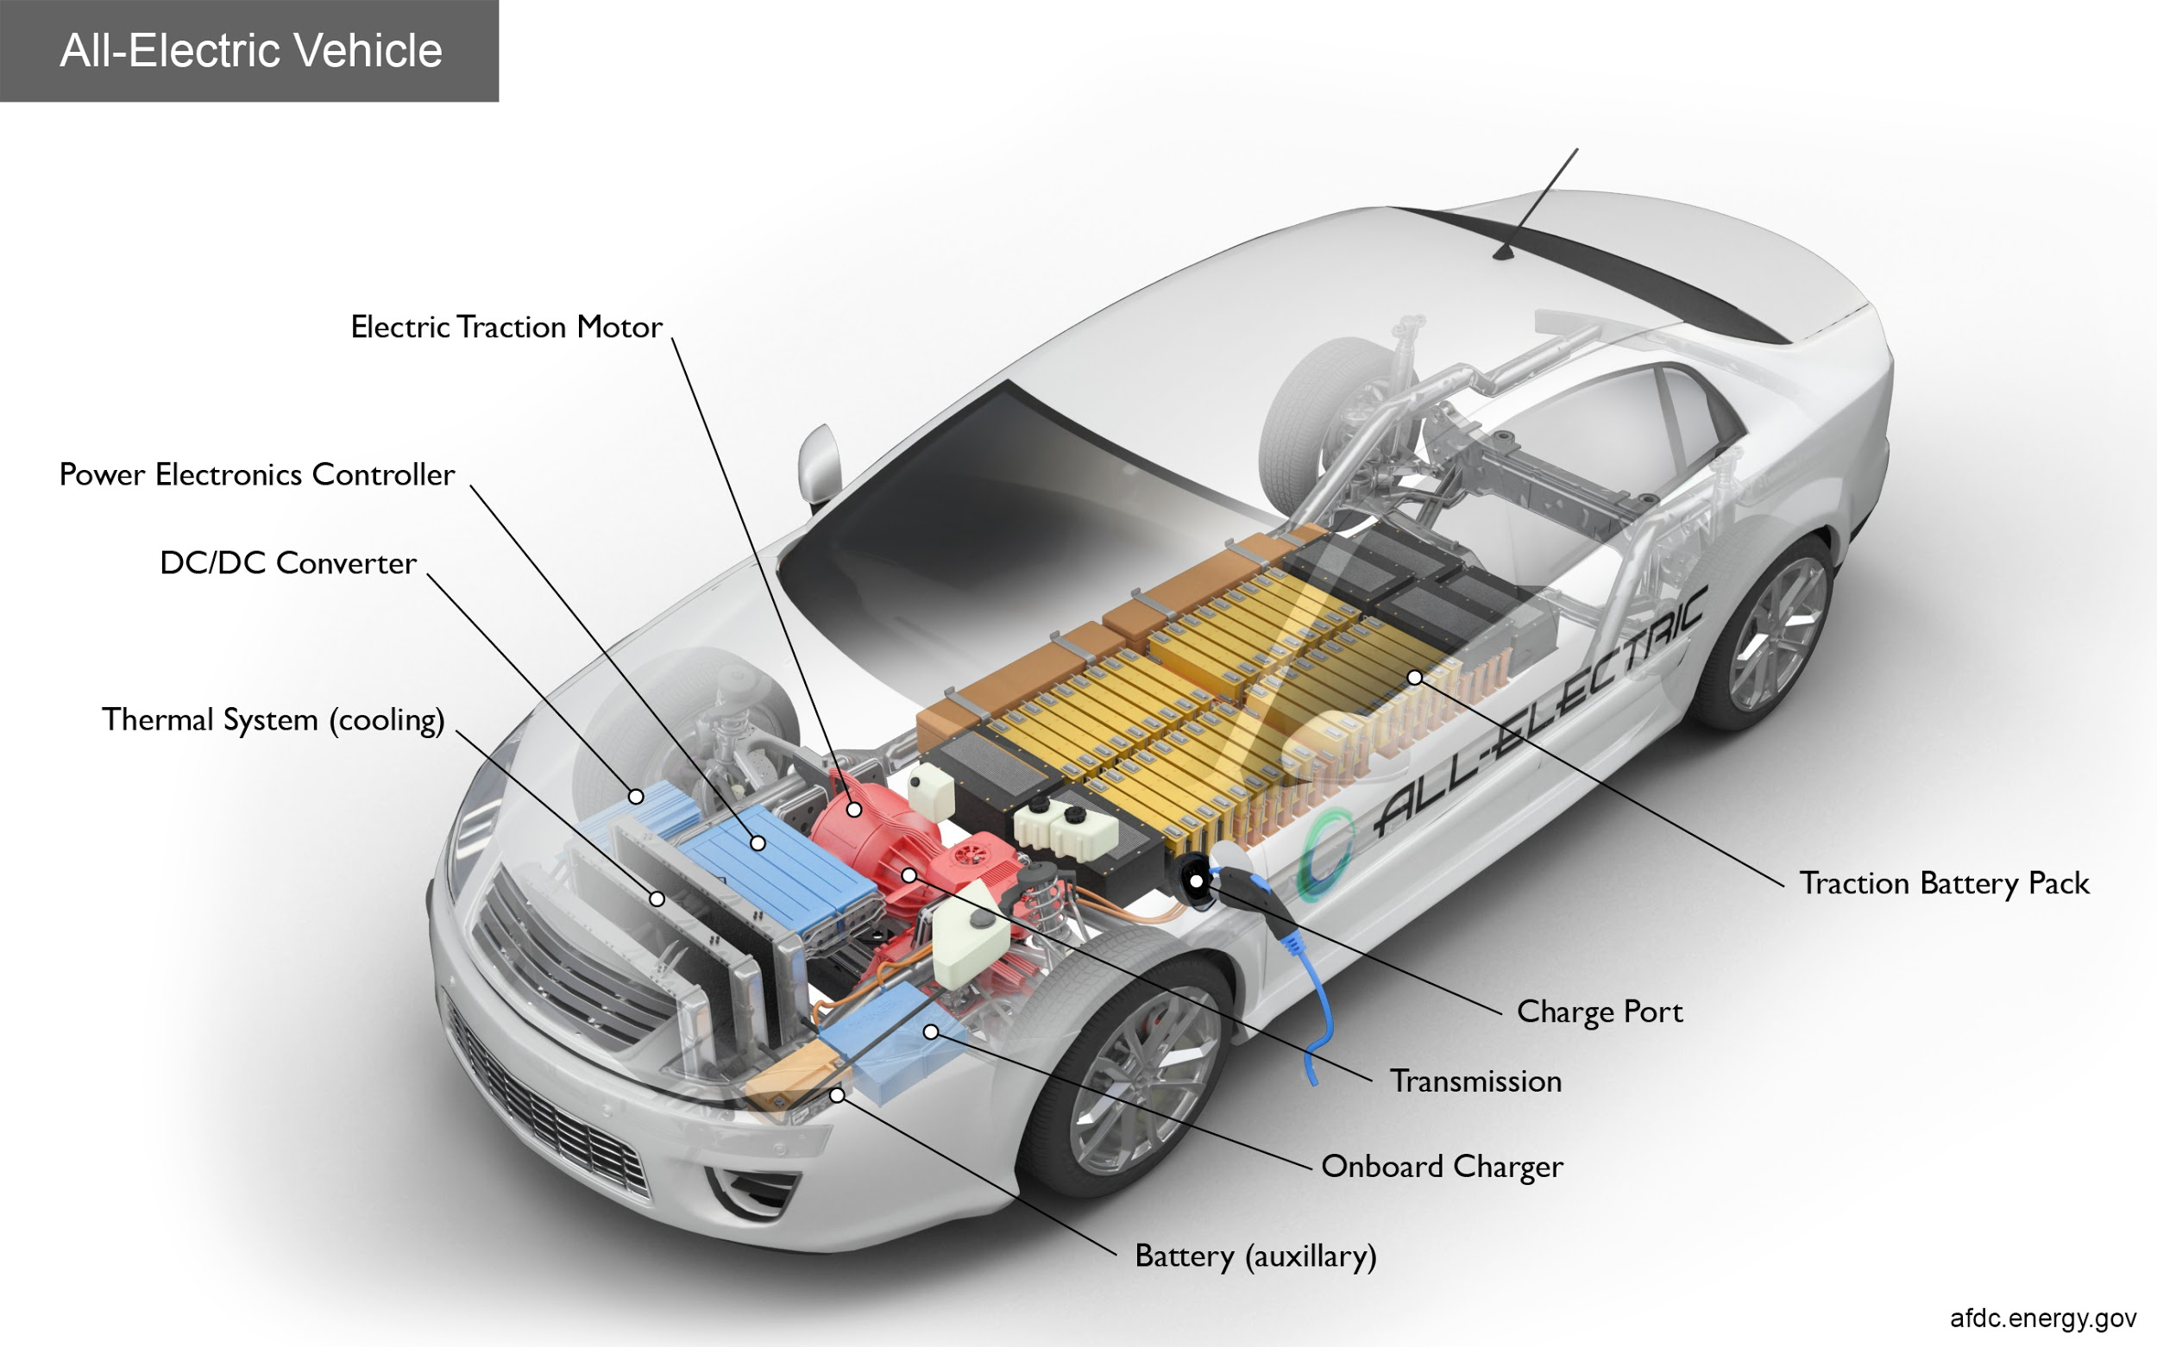
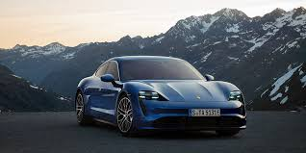
Overview
3 types of EV’s-Plug-in electric, Plug-in hybrid, and Hybrid electric
Regular cars burn gasoline to produce energy to turn a motor
Rather than energy from burning gasoline, electric cars use the electrical energy stored in a large rechargeable battery inside the car to power an electric motor
Like pumping gas, electric cars must be plugged in to store energy and recharged regularly

Slide 3
History of Electric Cars
First came to be in the mid-1800s from battery to electric motor.
There is no exact place but mainly in Hungary, the Netherlands and the United States.
First used in small scale cars.
First electric car in the U.S. was in 1890 created by William Morrison.
With the invention of the Model-T the electric cars became less and less popular since the Model-T was a lot cheaper.
Gasoline- $650.00 Electric- $1,750
Rebecca, Matulka. “The History of the Electric Car.” Energy.gov, September 15, 2014. https://www.energy.gov/articles/history-electric-car.

Slide 4
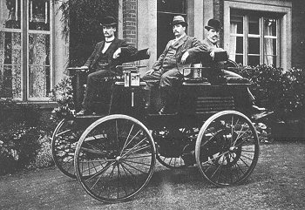
William Morrison’s Electric Vehicle
Rebecca, Matulka. “The History of the Electric Car.” Energy.gov, September 15, 2014. https://www.energy.gov/articles/history-electric-car.

Slide 5
Electric Cars in Today's Society
Climate concerns have driven the electric vehicle market to all time highs
China currently leads the world in the manufacturing of EVs
One million electric vehicles were on the road in the US in 2018 and is expected to hit 18 million by 2025
As of now, only 2.2% of vehicles worldwide are electric
70% of US drivers drive less than 60 miles a day, well within the range for electric cars
Growth in the industry is expected to be exponential
https://www.plugandplaytechcenter.com/resources/electric-car-innovation-how-electric-vehicles-are-changing-world/
https://policyadvice.net/insurance/insights/electric-car-statistics/

Slide 6






Electric Cars in Today’s Society
Today electric cars are making a comeback with multiple companies making their own cars. These include:
Tesla
Audi
Honda
Nissan
BMW
Chevrolet
Source: “Who Are The Top Electric Car Companies?” Enel X, 19 Oct. 2018, evcharging.enelx.com/news/blog/492-top-electric-cars.

Slide 7
Benefits of Electric Cars
Electric cars will use energy from the United States instead of overseas
Easy to charge anywhere because of the grid
  Don’t have to leave your house to get gas, can charge from home
Not having to pay for gas
  Cheaper in the long run
Low maintenance
Quiet
Helps reduce the emissions that contribute to climate change
EV’s have quick motor reactions, very responsive and good torque
  Smoother drives, and easier to handle
Uses less oil
“Electric Vehicle Benefits.” EnergyGov, 2019. https://www.energy.gov/eere/electricvehicles/electric-vehicle-benefits
Source: “Pros and Cons of Electric Cars.” EnergySage, January 17, 2019. https://www.energysage.com/electric-vehicles/101/pros-and-cons-electric-cars/.

Slide 8
Drawbacks of Electric Cars
Shorter range than gas-powered cars
  Gas cars can go you up to 400 miles (depending on the car)
  Full charged cars can take you at most 100 miles
Charging takes time
  Can take up to 20 hours to fully charge
Expensive to buy
  Battery packs, home charging stations
Not 100% green energy
Small variety of car models
Limited supply of lithium
Can be difficult to find a charging station depending on the area you’re at
Sources: “Pros and Cons of Electric Cars.” EnergySage, January 17, 2019. https://www.energysage.com/electric-vehicles/101/pros-and-cons-electric-cars/.
BARKENBUS, JACK. "Electric Vehicles: Climate Saviors, or Not?" Issues in Science and Technology 33, no. 2 (2017): 55-59.http://www.jstor.org/stable/24891965.

Slide 9
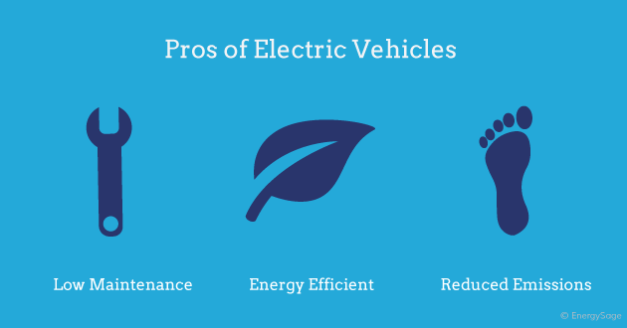
Pros
“Pros and Cons of Electric Cars.” EnergySage, January 17, 2019. https://www.energysage.com/electric-vehicles/101/pros-and-cons-electric-cars/.

Slide 10
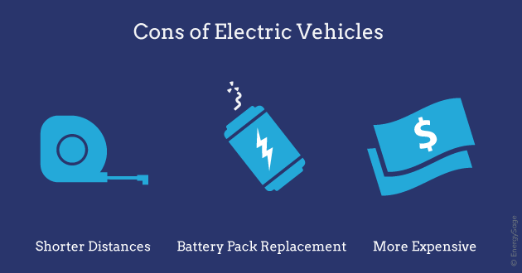
Cons
“Pros and Cons of Electric Cars.” EnergySage, January 17, 2019. https://www.energysage.com/electric-vehicles/101/pros-and-cons-electric-cars/.

Slide 11
Conclusion
Like many sources and consumers of energy there are major benefits and drawbacks. Electric cars have been a concept for almost two centuries and seem to be gaining more traction over the years, and with every year the technology is getting more and more advanced. With technology booming soon we can have recyclable batteries. Also with low maintenance, less carbon emission, and energy efficient electric cars are the way of the future.

