Slide 1
Are Electric Cars the Wave of the Future?
By Ally Joly, Tyson Araujo, and Brian Sacco

Slide 2
Overview
Introduction
Electric cars are the future
  Advantages
Electric Cars are NOT the future
  Disadvantages
Our Conclusion

Slide 3
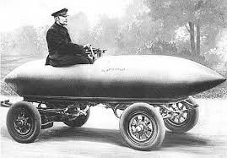
Introduction
Early models date back to 1830-1840
The “Miracle” of the Nineteenth century
  100km/hr
Different than Hybrid Electric Vehicles
Two types
  All-Electric
  Plug-in Hybrid

Slide 4
Viewpoint #1: Electric Cars (EV’s) ARE the Future

Slide 5
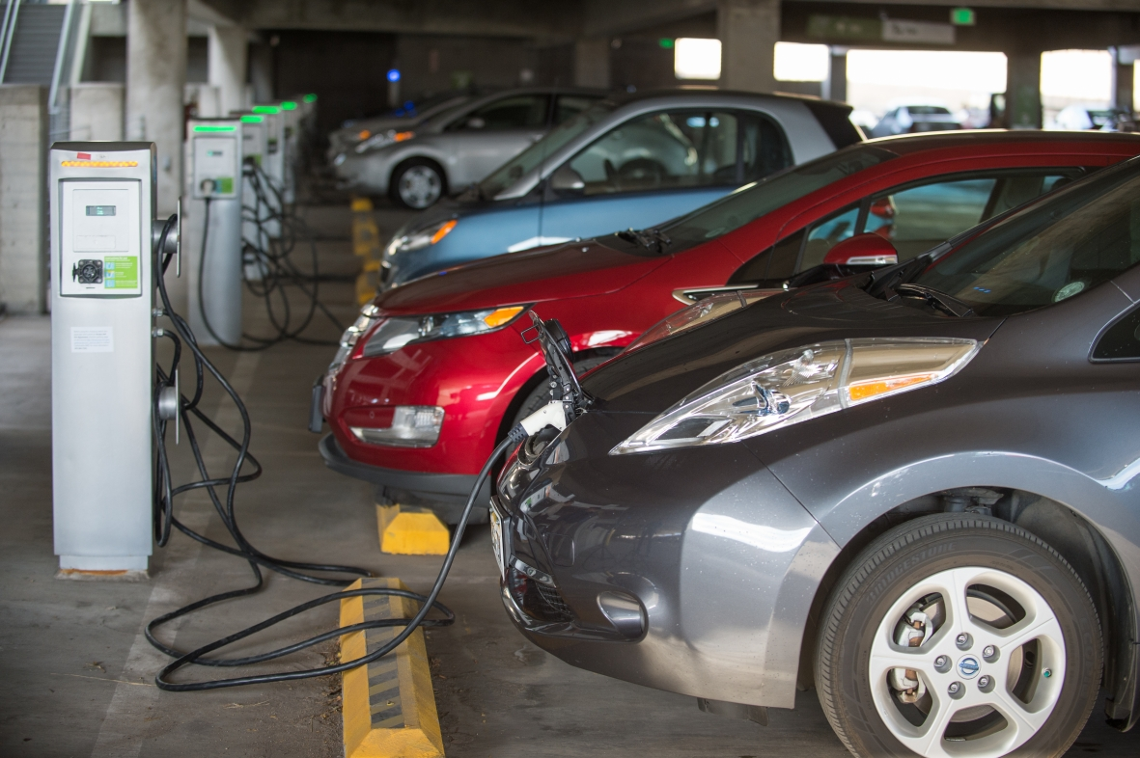
Advantages of Electric Cars
Connected, Fun, and Practical
Fueling benefits
  Electric Grid
  Variety of options
Greater Diversity of fuel choices
  9 Billion Barrels of petroleum
    ⅔ to transportation
Reduce Emissions
  Benefit Public Health
  Ecological

Slide 6
Advantages Continued:
Two General Categories of vehicle emissions
  Direct Vs Lifestyle
EV’s produce ZERO!! direct emissions
Produce less Lifestyle Emissions
Government Incentivization
Safety:
  All the same
  Specific battery standards
  Lower center of gravity
Less Maintenance

Slide 7
Battery Life:
Could be thought of as a disadvantage
Many beneficial steps
  Accessories
  Economy mode
  Planning
  Breaking
  Speed limit
All minor inconveniences, but pieces towards the big picture

Slide 8
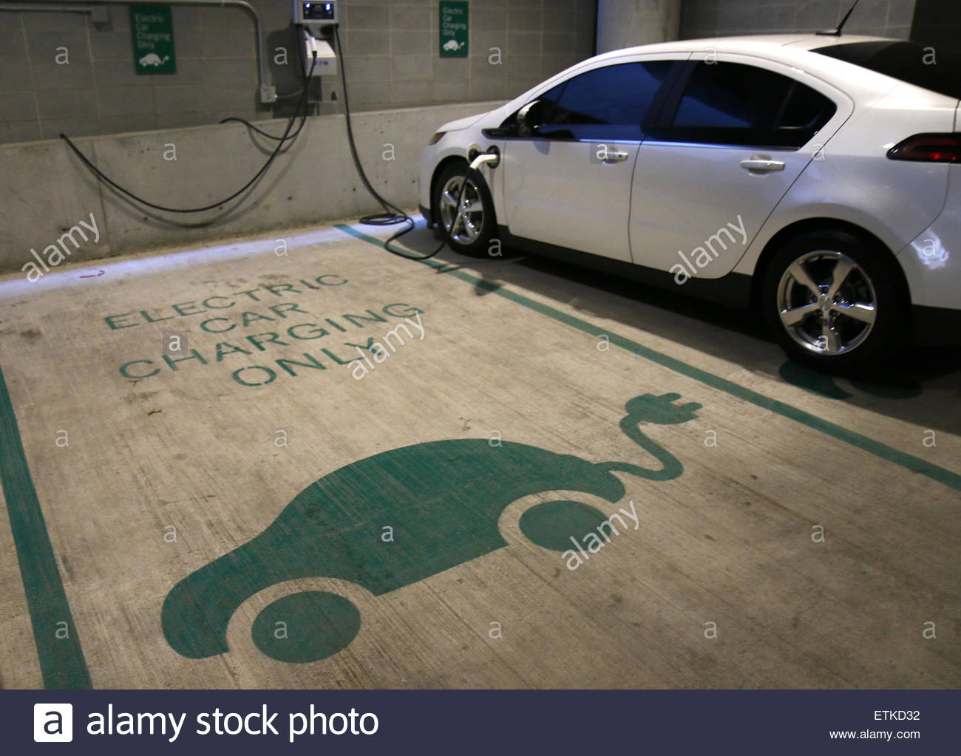
Intangibles
Feel good
Parking Spots
Quicker

Slide 9
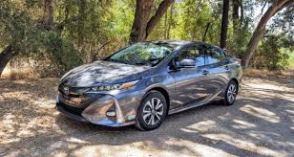
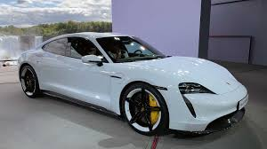
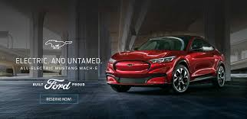
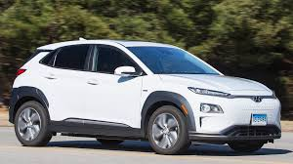
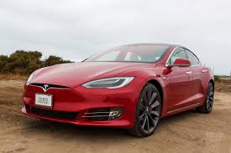
Can Look Very Cool:

Slide 10
Viewpoint #2: Electric Cars ARE Not the Future

Slide 11
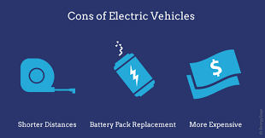
Disadvantages
Cold weather
Charging/fuel
  Have to add a charger to garage
Depreciation
  AAA estimates, Electric Cars lose $5,704 compared to $2,114
Used electric no federal state incentives
BATTERIES
  Manufacturing process
  Cheapest gas at night, but most “green” during the day

Slide 12
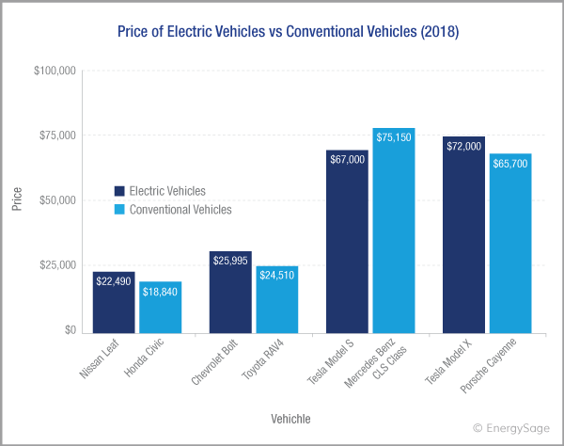
Intangibles
Away from the normal
Silent for pedestrians
Just easier

Slide 13
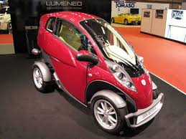
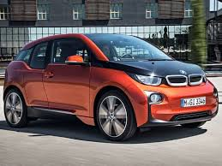
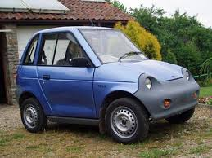
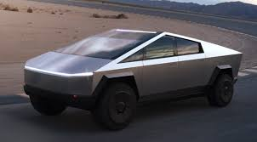
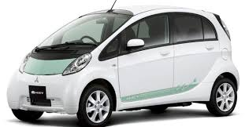
Can Look Ugly...

Slide 14
Our Conclusion:
They will play a large role!
How large the impact is complicated
  Economic, Political & Social Issues
Conventional Cars are not going away soon
Hybrid Cars will take over within coming decades
  Not suitable in all areas
Help socially change how we view clean energy

Slide 15
Questions??

Slide 16
References:
Riley, Chris. (2019, February 14). Dispelling The Disadvantages Of An Electric Car. Retrieved from AutoWise website: https://autowise.com/top-7-disadvantages-of-electric-cars/
Durbin, D.-A. (2018, February 7). Electric cars have benefits, but likely won’t save you money. Retrieved from Phys.org website: https://phys.org/news/2018-02-electric-cars-benefits-wont-money.html
‌Why electric cars are only as clean as their power supply. (2018, February 14). Retrieved from the Guardian website: https://www.theguardian.com/environment/2016/dec/08/electric-car-emissions-climate-change
Electric Vehicle Benefits. (2019). Retrieved from Energy.gov website: https://www.energy.gov/eere/electricvehicles/electric-vehicle-benefits
Gelmanova, Z. S. (2018). Electric Cars. Advantages and Disadvantages. Journal of Physics, 1015, 1–6.
‌

