Slide 1

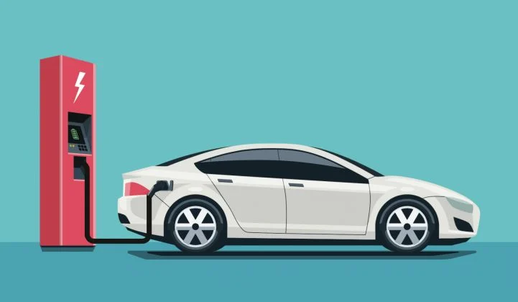

A Drive to the Future
Why Electric Cars are the Wave of the Future
A Team 12 Presentation

Slide 2
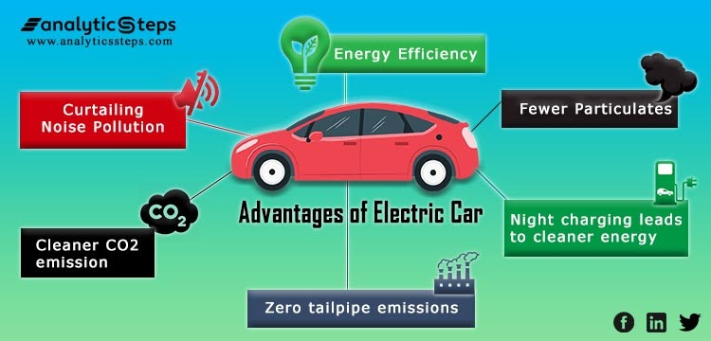
A Brief Look at What They can do...

Slide 3

Common Misconceptions about Electric Cars
⚡They are slow and cannot travel very far.
⚡Costly to purchase and to maintain.
⚡They are not better for the environment than gas powered cars.
⚡They use more electricity than we can generate.

Slide 4
The Power of Electric Cars
⚡Electric-powered cars are generally faster than gasoline-powered cars.
🗲Electric motors generate 100% of their torque instantaneously.
⚡On average, electric cars can go around 3oo miles before needing a charge, while the average gas-powered car can only go around 200 miles.
⚡Electric cars are more efficient at using the energy it holds.

Slide 5
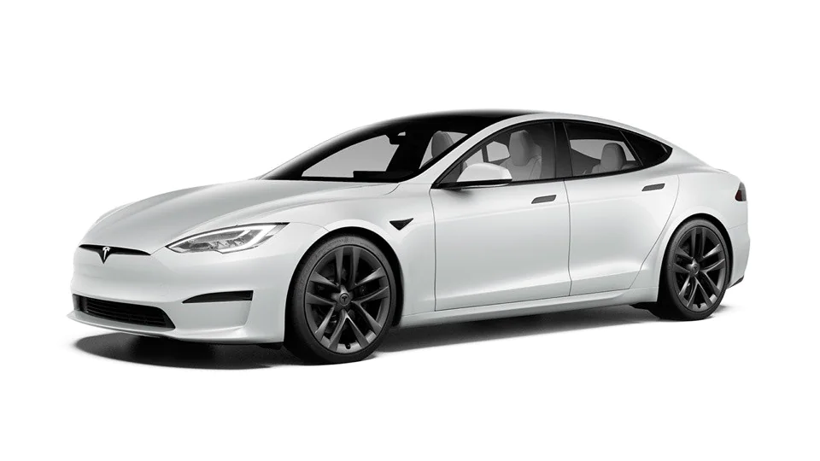
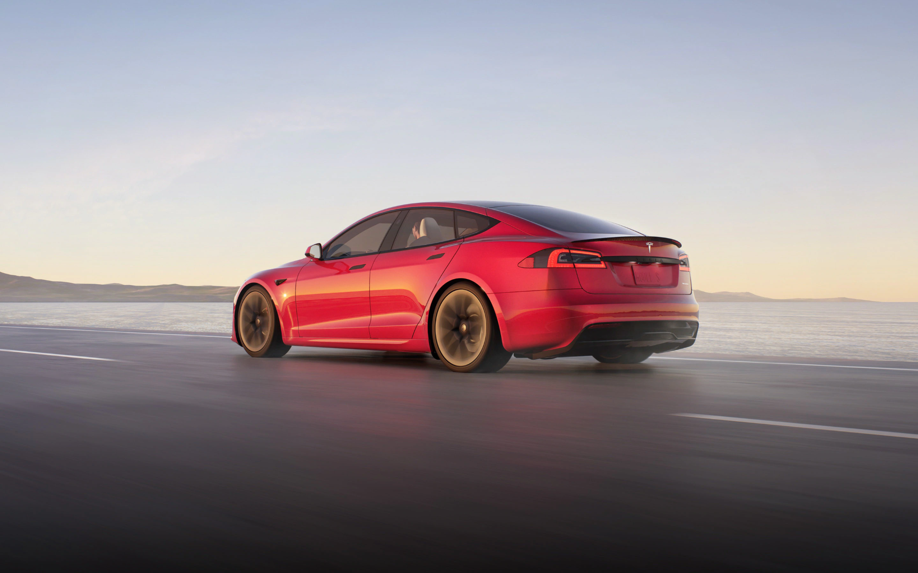
Tesla Model S
Can achieve 0mph-60mph in 2.5 seconds, which makes it nearly the fastest in the world.

Slide 6
The Long-Term Savings of Electric Cars
⚡On average, the initial purchase of electric cars are around $10,000 more than their gas-powered counterparts.
⚡Over a longer period of time, electric cars are cheaper because:
🗲Require less maintenance
🗲Price to fuel is much cheaper
🗲More efficient at using fuel
⚡Although this is a big jump, most electric cars are sold with a $5,000 t0 $7,500 cash rebate.

Slide 7
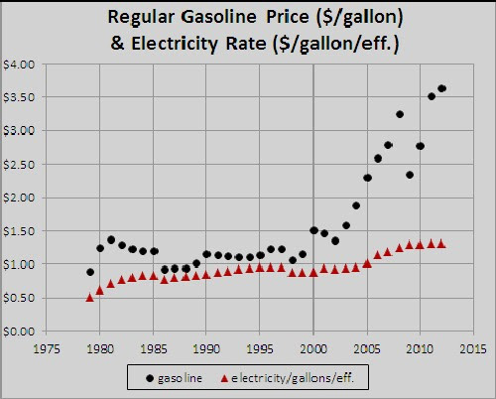

Slide 8


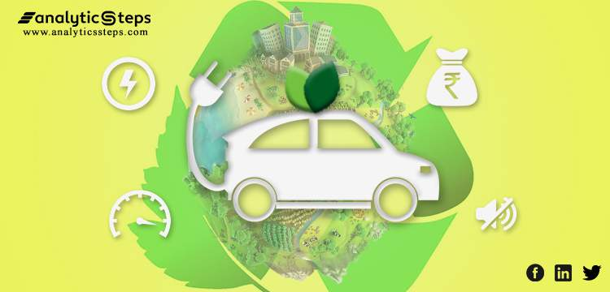

Electric Cars are the Color Green
⚡Electric cars will greatly reduce the amount of air pollution.
⚡On average, one gas-powered car will emit 4.6 metric tons of carbon dioxide per year.
⚡Car emission make up 29% of the total U.S. greenhouse gas emissions.
🗲Emissions can drop 17%-30% with the usage of electric cars.

Slide 9
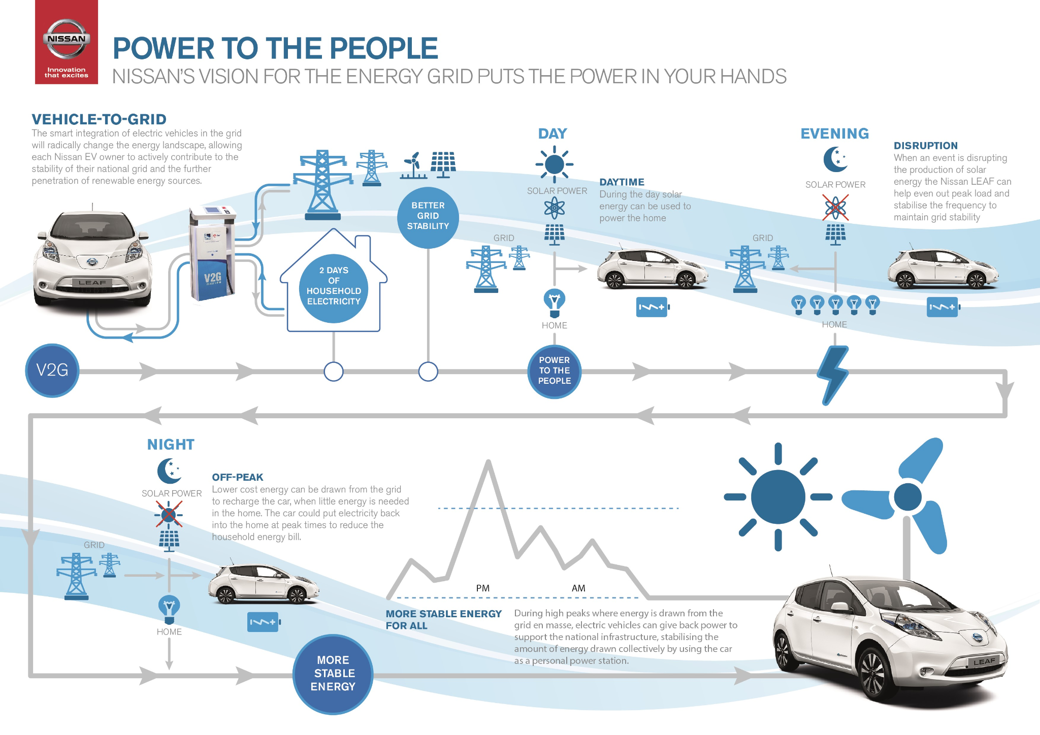
The Usage of Electricity by Electric Cars
⚡In 2020, about 4.01 trillion KWh of electricity was produced in the U.S.
⚡According to a study by Navigant Research, 1,000,ooo can be added on to the grid before there would need to be more electricity being produced.
⚡Using electric cars would allow for the U.S. to save gasoline for other purposes.

Slide 10




Other Uses for Gasoline...
⚡With the switch to electric, gasoline use can be focused on:
🗲Farming Equipment
🗲Aircraft Fuel
🗲Generators for Power
🗲Heating Homes

Slide 11


Reasons Against the Implementation Electric Cars
⚡Price (Economic Issue)
Electric cars have a sticker price that is $19,000 more than gasoline powered cars
Electric Cars are around $51,500 while Gasoline Cars are around $32,500
⚡Battery Life (Societal Issue)
Idea that the car will run out of battery and there will be no place to recharge
Idea that charging the battery takes an extended amount of time

Slide 12
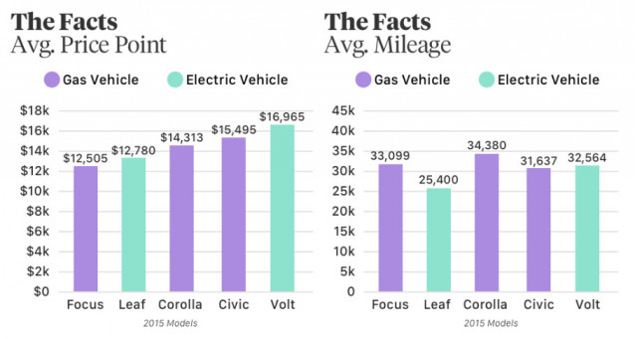
Sticker price consistently higher.

Slide 13
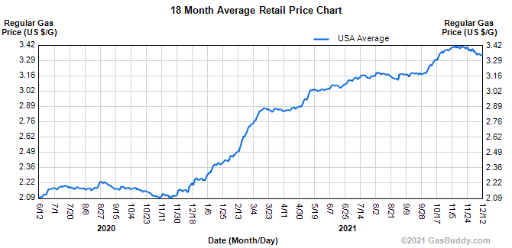
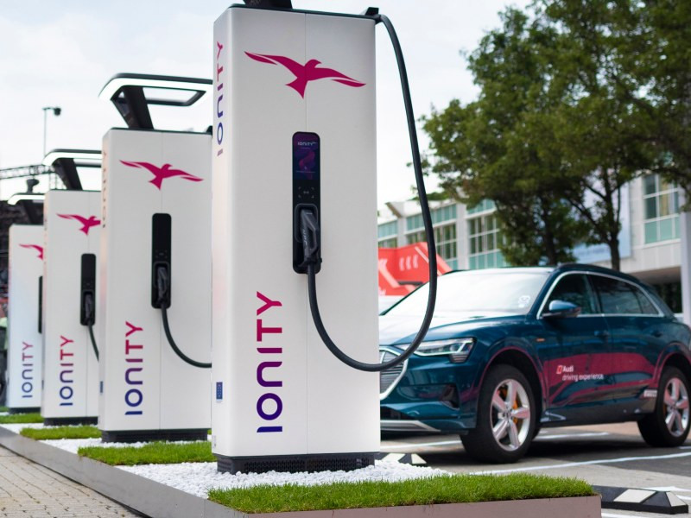
Reasons Why these Concerns are Unwarranted
⚡Price (Economic Issue)
While the sticker price is more expensive, the fuel is actually cheaper
Charging the car saves the individual around $14,500 over 15 years
⚡Battery Life (Societal Issue)
Current electric cars can travel up to 350 miles on one charge (similar to gas cars)
There are 44,000 charging stations throughout U.S. and apps to show locations
While charging time is a valid concern, companies are improving on this
However, most people charge while they are busy (sleeping, shopping, eating)

Slide 14
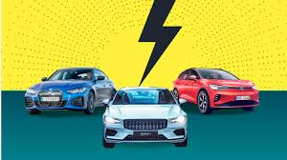
So, why should you switch to driving an electric car?

Slide 15



⚡They are more efficient than gas-powered cars.
⚡They are faster than gas-powered cars.
⚡Require less maintenance and the cost to purchase is not much higher.
⚡Price to power electric cars is lower than gas-powered cars.
⚡Reduce air pollution and greenhouse gas emissions into the air.
⚡Will not increase the need for electricity by a large margin.
⚡Gasoline can be saved for other gas-needy purposes.

Slide 16
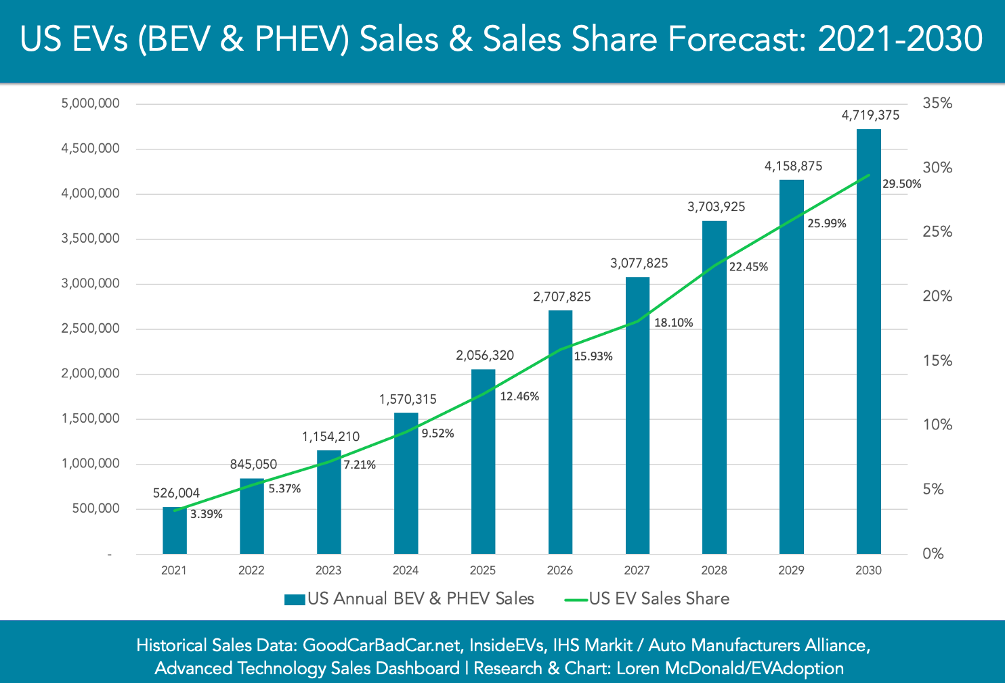
Electric cars are projected to be on the rise and provide a positive impact.

Slide 17
Join the drive towards the future!
Go Electric!

Slide 18
Sources
https://www.whatissmartenergy.org/electric-vehicles?gclid=Cj0KCQiAy4eNBhCaARIsAFDVtI2xV9LAKt1JuQ6fVO0o47oRMn7SG1Rbm8_H5oZWvJ_yEwkqKNjZ27saAlinEALw_wcB
https://www.myev.com/research/ev-101/10-common-electric-car-myths-busted
https://www.caranddriver.com/shopping-advice/a32494027/ev-vs-gas-cheaper-to-own/
https://www.andersoneconomicgroup.com/wp-content/uploads/2021/10/EVtransition_FuelingCostStudy_10-21-21.pdf
https://www.nytimes.com/interactive/2021/03/10/climate/electric-vehicle-fleet-turnover.html
https://www.sandicliffe.co.uk/blog/the-truth-about-torque-what-is-it-why-does-it-matter
https://www.epa.gov/greenvehicles/greenhouse-gas-emissions-typical-passenger-vehicle#:~:text=typical%20passenger%20vehicle%3F-,A%20typical%20passenger%20vehicle%20emits%20about%204.6%20metric%20tons%20of,8%2C887%20grams%20of%20CO2.
https://afdc.energy.gov/fuels/electricity_benefits.html
https://blinkcharging.com/fact-from-fiction-the-real-reason-why-consumers-dont-buy-electric-vehicles/?locale=en.
https://phev.ucdavis.edu/about/faq-phev/.
https://www.nrdc.org/stories/electric-vs-gas-it-cheaper-drive-ev.
https://www-proquest-com.wilkes.idm.oclc.org/intermediateredirectforezproxy/advanced
https://blog.evbox.com/eliminate-range-anxiety.

