Slide 1
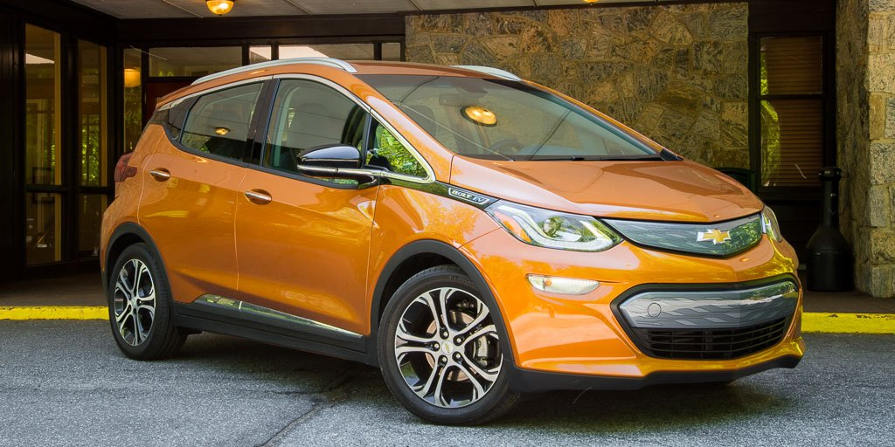
Electric Cars:
The Wave of the Future?
Figure 1. Electric Car (Paul, 2017).
By Dean Bowen, Marcy Ledvinka, Matt Maranca, & Alyson Tacury

Slide 2
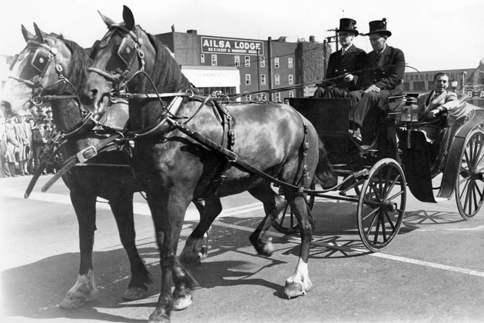

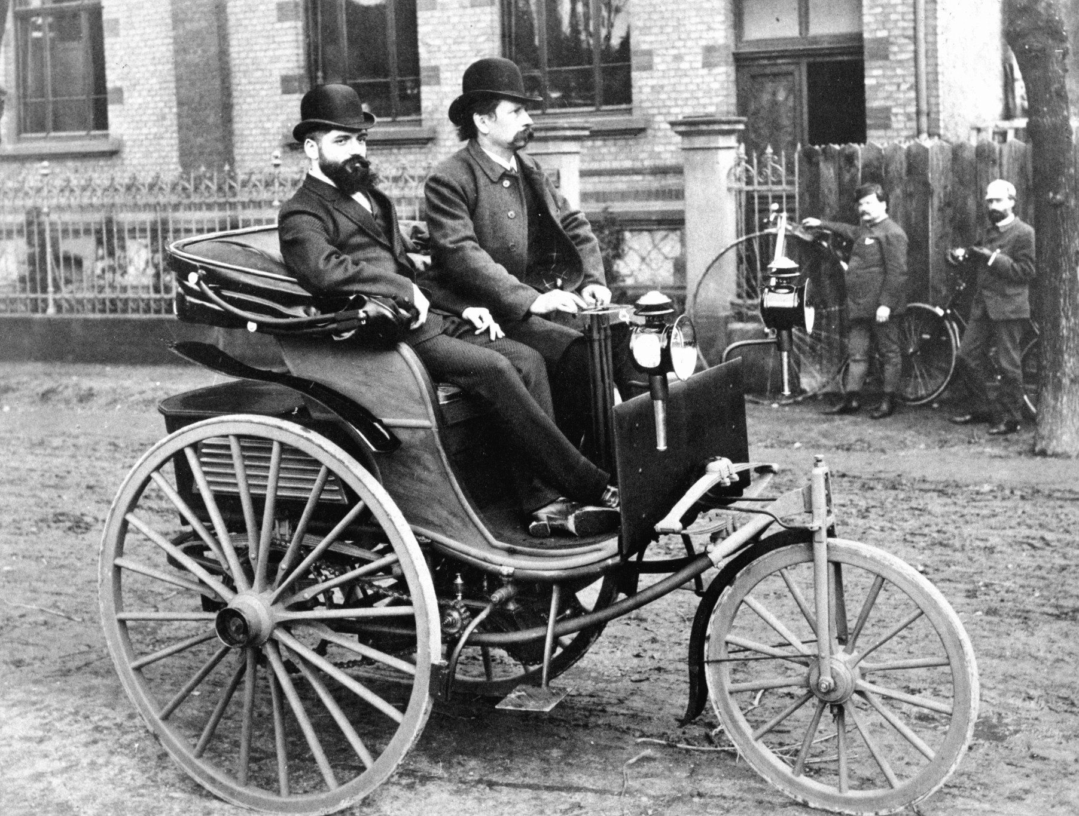
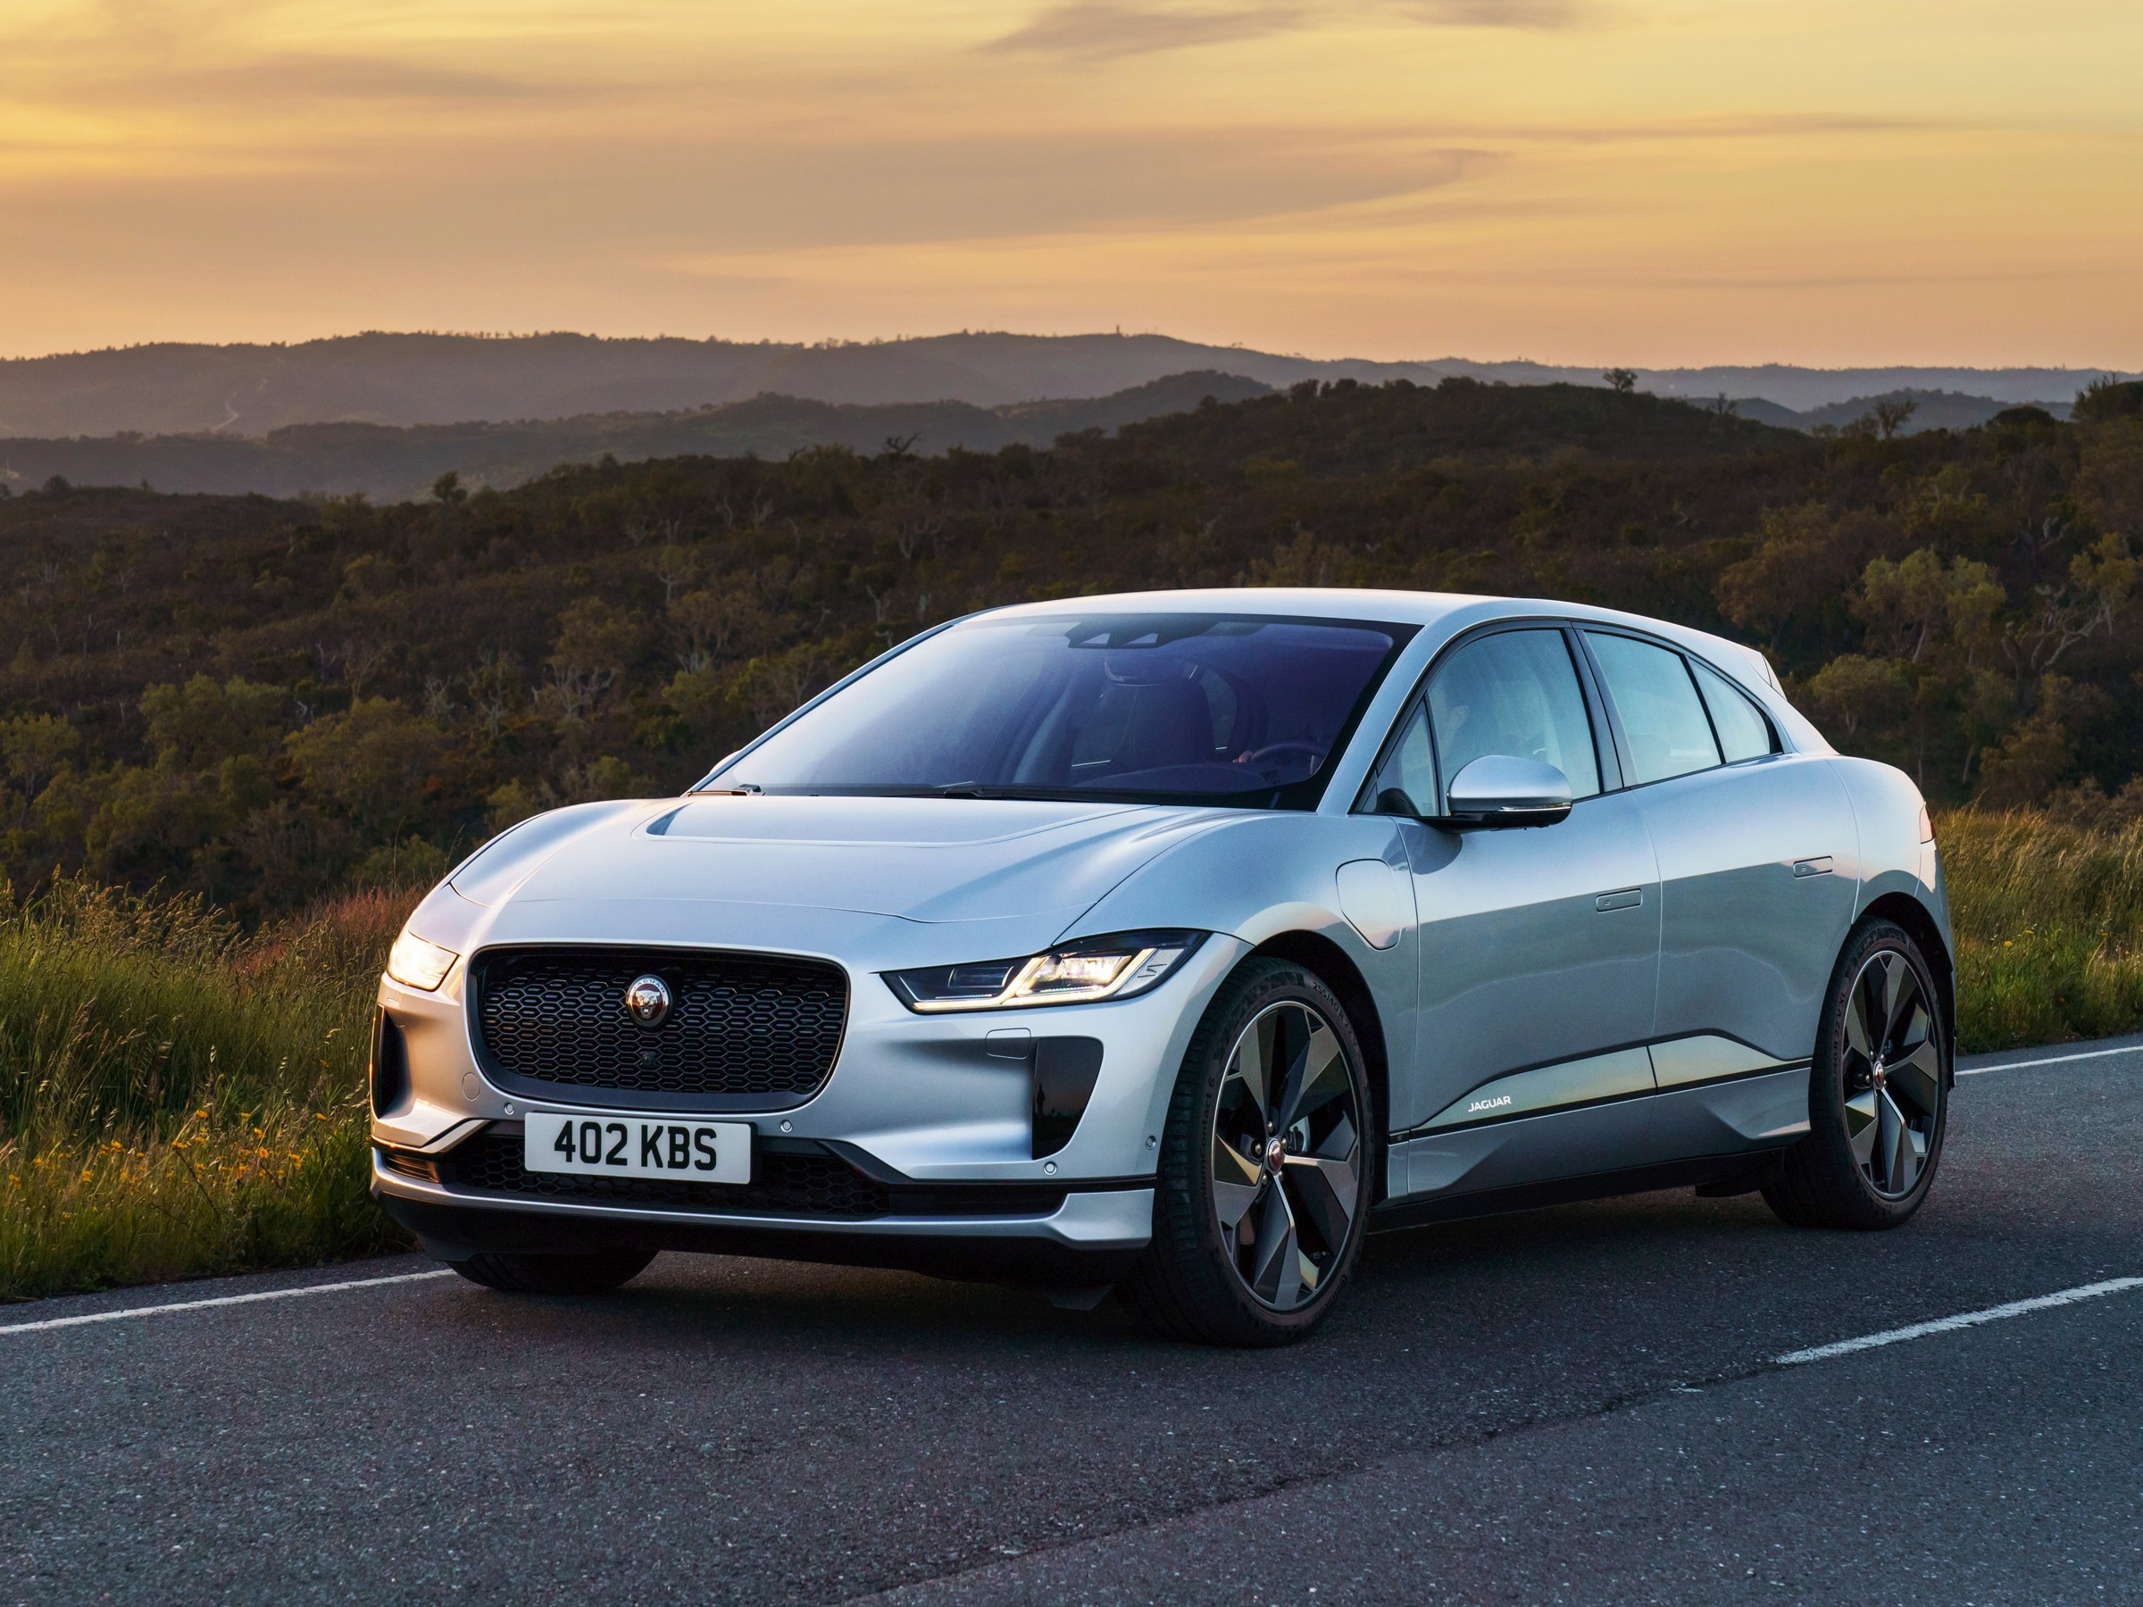
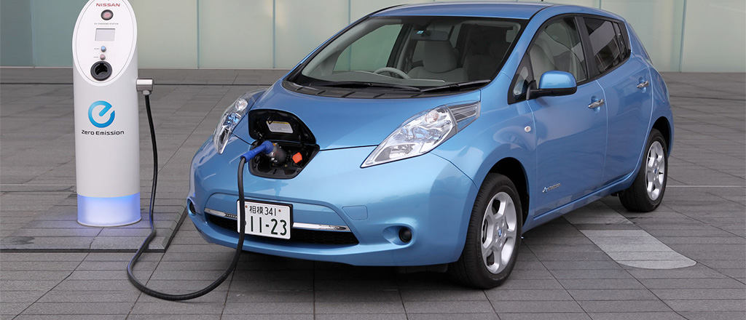
Figure 2. Walking (Shutterstock, 2017).
Figure 3. Carriage (Reza, 2014).
Figure 4. First Car (Adler, 2015).
Figure 5. Jaguar (Jaguar, 2018).
Figure 6. Nissan Leaf (UPenn Wharton, 2017).

Slide 3
Broad Overview of Electric Cars
In 1884, Thomas Parker created the first electric car in London.
Resurgence of electric cars came in 1997 with the Prius and 2006 with Tesla (“The History of The Electric Car”, n.d.).
Electric vehicles (EV’s) run at least partially on electricity from power cells or batteries, unlike conventional cars that run on gasoline or diesel (Union of Concerned Scientists, n.d.).
There are two kinds of EV’s (Electric Vehicle Basics, n.d).
  AEVs (all-electric vehicles) are powered by one or more electric motors by electricity by plugging into the grid and from batteries.
  PHEVs (plug-in hybrid electric vehicles) use batteries to power an electric motor, plug into the electric grid to charge, also have an internal combustion engine that runs on petroleum or alternative fuels.

Slide 4
Are electric cars the wave of the future?
With electric cars’ resurgence, they have been gaining popularity as a new option compared to conventional cars, but

Slide 5
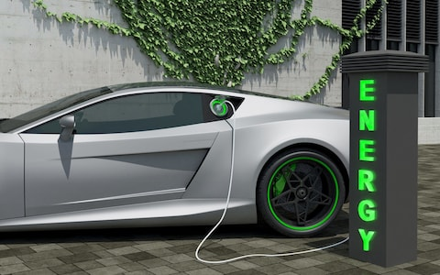
Viewpoint 1: Electric Cars Should Replace Conventional Cars
Figure 7. Electric Car Charging (FirstSignal, 2017).

Slide 6
Science Perspective
Decreased Greenhouse Gas Emissions
AEVs produce zero direct emissions [no smog-forming pollutants like nitrogen oxides] (“Electric Vehicle Benefits”, n.d.).
Most PHEVs are more efficient than comparable conventional vehicles. They produce fewer tailpipe emissions even when relying on gasoline. (“Electric Vehicle Benefits”, n.d.).
EVs produce fewer life cycle emissions, which is all emissions related to fuel and vehicle production, distribution, use, and disposal (“Reducing Pollution With Electric Vehicles”, n.d.).
  AEVs do not have the emissions from the extraction of petroleum, refining to gasoline, distributing to stations, and burning in vehicles
  EV drivers can further minimize their life cycle emissions by using electricity generated by non-polluting renewable sources like solar and wind.

Slide 7
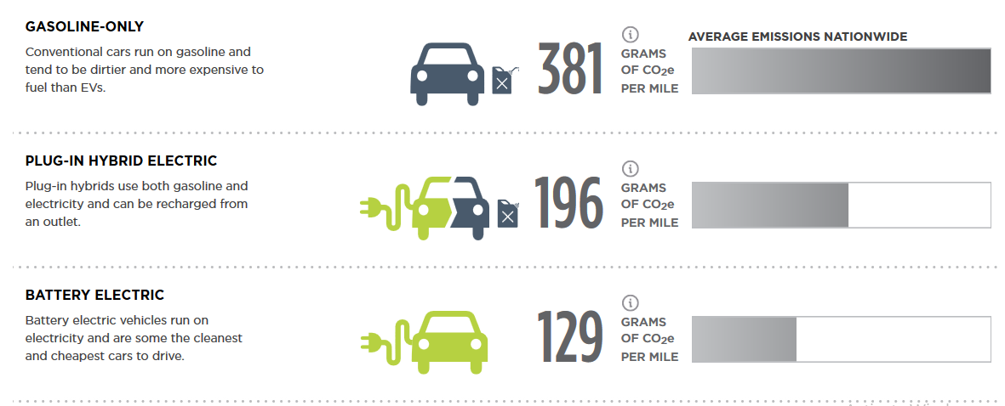
Note. Adapted from “How Clean is Your Electric Vehicle?”, n.d., Union of Concerned Scientists, Retrieved from: https://www.ucsusa.org/clean-vehicles/electric-vehicles/ev-emissions-tool#.XADPheJRfIV

Slide 8
Science Perspective
EV Batteries are Reliable
Failure rate of the battery power unit is less than 0.01% (Green Car Progress, 2015)
  Analysis by independent British insurance specialist, Warranty Direct, indicates that 0.255% of vehicles on its books had experienced an issue that led to a failure of the engine.
  Nissan stated in 2015 that thus far only 0.01 percent of batteries had to be replaced because of failures or problems, and then only because of externally inflicted damage.
Lots of Lithium Reserves
  35 million tons of extractable lithium are estimated worldwide, which is enough to power over 4 billion electric cars (ElectroVelocity, n.d.).
  Lithium is common and exists in igneous rock, which makes up close to 95% of the Earths upper crust.

Slide 9
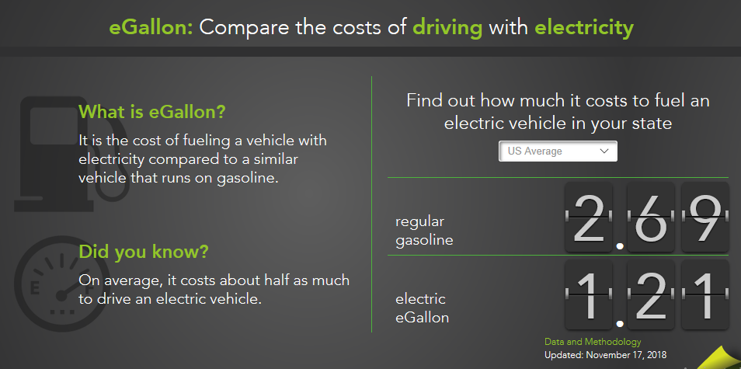
Economic Perspective
Cheaper to Run
The cost to charge an EV is half as much per kilometre to buy petroleum for the same vehicle (“Saving Fuel and Vehicle Costs”, n.d.).
Electricity prices are also generally much more stable than gasoline prices (“Saving Fuel and Vehicle Costs”, n.d.).
Note. Adapted from “Saving on Fuel and Vehicle Costs” by Office of Energy Efficiency & Renewable Energy, n.d., Department of Energy, Retrieved from: https://www.energy.gov/eere/electricvehicles/saving-fuel-and-vehicle-costs

Slide 10
Economic Perspective
Cheaper to Maintain
A battery electric vehicle has less moving parts than a conventional car. There is no exhaust systems, starter motors, fuel injection systems, or radiators, so there is no money needed for maintenance of those parts (Ergon Energy Network, n.d.).
EV Prices Are Projected to Decrease
As production increases and battery technology matures, prices are likely to decrease (US Department of Energy, n.d.).

Slide 11
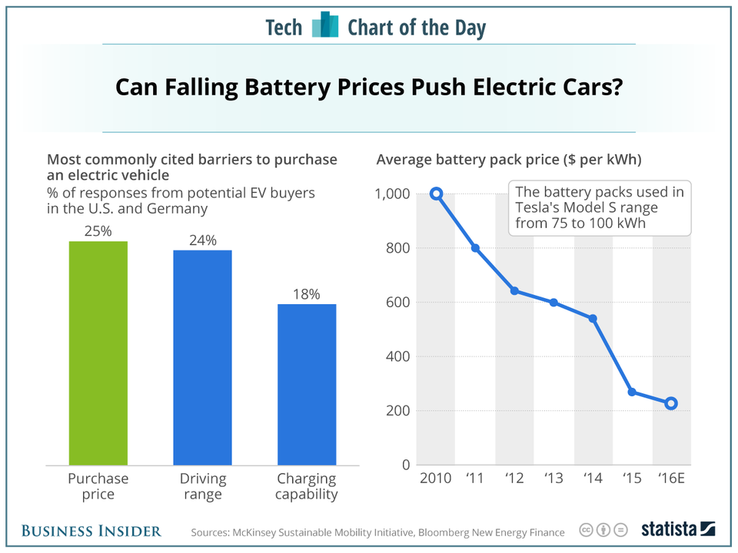
Note. Adapted from “Batteries for Tesla and other electric car makers are getting cheaper” by Jeff Dun, 2017, Business Insider, Retrieved from: https://www.businessinsider.com/tesla-electric-car-vehicle-battery-cost-chart-2017-1

Slide 12
Economic Perspective
Incentives to Buy EVs
The cost of an EV can be offset by federal tax credit and state incentives (US Department of Energy, n.d).
  According to the Alternative Fuels Data Center from the US Department of Energy, The Qualified Plug-In Electric-Drive Motor Vehicle Tax Credit provides a tax credit of $2,500 to $7,500 for new purchases (n.d.).

Slide 13
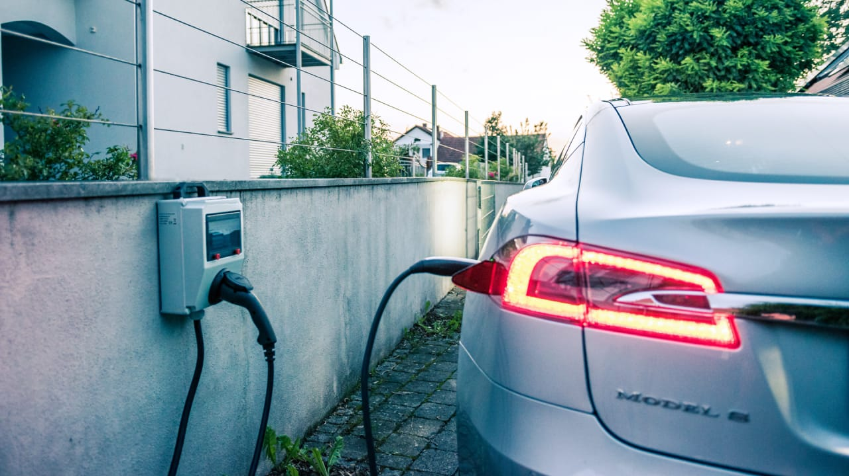
Viewpoint 2: Electric Cars Shouldn’t Replace Conventional Cars
Figure 8. Charging Station (Härter, 2018).

Slide 14
Science Perspective
Greenhouse Gas Emissions Based on Location of Electricity Production
How green EVs are depend on where the electricity is produced. This can range from non-renewable energy like coal to renewable energy like solar (Lewis, 2017).
Coal, which is dirtier than gasoline, makes up about 30% of electricity production in the US and is used to produce electricity for some EVs (Lewis, 2017).
Long range EVs, like Tesla, have manufacturing emissions 68% higher than for conventional cars (Calder, 2016).
A report by IVL Swedish Environmental Research Institute found that “battery production produces 150-200kg of carbon dioxide equivalent per kilowatt hour (kWh) of produced battery” (RAC Motoring Services, 2017).

Slide 15
Science Perspective
Hard to Recycle Batteries
More than 90% of batteries used in conventional cars are recycled (RAC Motoring Services, 2017).
Less than 5% of lithium-ion batteries are recycled, leaving the remaining as waste (RAC Motoring Services, 2017).
Don’t Travel As Far as Conventional Cars
AEVs have a range of between 60-120 miles (City of New York, n.d.).
Conventional cars can travel 300-500 miles on a tank of gas (City of New York, n.d).
Metals Batteries Are Made of Are Toxic
Nickel is a component of the lithium-ion batteries and is toxic to extract from the ground (Brueckner, 2018).

Slide 16
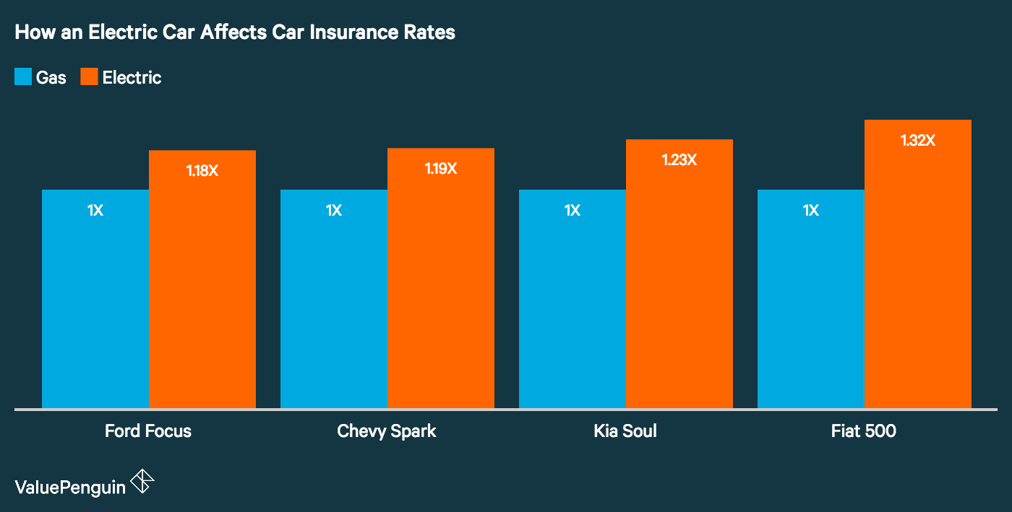
Economic Perspective
More Expensive than Conventional Cars
$30,000 : 2018 EV Nissan Leaf (Schiller, 2018).
Less than $19,000 : 2018 Honda Civic (conventional car)
(Schiller, 2018)
Insurance for EVs are more expensive (Value Penguin, n.d.).
Added Cost of Charging Stations
Two kinds of charging stations: Level 1 & Level 2
  Level 1 recovers 4-5 miles of range per hour and Level 2 recovers 25-30 miles of range per hour
Cost of Level 1 station ranges from $300-$600 while Level 2 ranges from $500-$700 (Ference, 2017).
Cost of parts and labor for Level 1 ranges from $1,000 to $1,700, and $1,200-$2,000 for Level 2 according to HomeAdvisor (Ference, 2017).
Certain states require permits when installing charging stations that range from $50 to $200 (Ference, 2017).
Note. Adapted from “How Having an Electric Car Affects Your Auto Insurance Rates”, n.d., Value Penguin, Retrieved from: https://www.valuepenguin.com/how-having-electric-car-affects-your-auto-insurance-rates

Slide 17
Economic Perspective
Expensive Battery Replacements
Nissan charges $5,499 for a replacement battery if the old battery was turned in. There is also an installation fee for the new battery (Durbin, 2018).
EV Value Decreases Quickly
Each year owned, EVs lose $5,704 in value, compared to $2,114 for small cars (Durbin, 2018).

Slide 18
Conclusion
We think EVs should be the car of the future, being bought more than conventional cars.
This is because the average US household spends almost one-fifth of its total expenditures on transportation and reducing this cost would be helpful (“Saving Fuel and Vehicle Costs”, n.d.).
  The electric eGallon being cheaper than gasoline, reducing the cost.
  EVs are more expensive to buy up front currently but battery prices have reduced over time, making them less expensive every year.
  Government incentives reduce the cost of buying EVs.
  If more people buy EVs and they are produced more, prices should go down.
  Since EVs have only resurged less than thirty years ago and technology is still maturing, which will also decrease prices.
EVs can slow down climate change.
  There are no direct emissions that contribute to climate change from EVs compared to conventional cars that have direct and life cycle emissions.

Slide 19
Summary
Are Electric Vehicles the wave of the future?
PRO-EV SCIENCE PERSPECTIVE | ANTI-EV SCIENCE PERSPECTIVE
Decreased Greenhouse Gas Emissions | Some EVs have GHG emissions based on where the electricity is produced
Lots of Lithium Reserves | Hard to Recycle Batteries
Batteries Are Reliable | Metal in Batteries are Toxic
 | Don’t Travel As Far
PRO-EV ECONOMIC PERSPECTIVE | ANTI-EV ECONOMIC PERSPECTIVE
Cheaper to Run | More Expensive
Cheaper to Maintain | Charging Station Costs
EV Price Projected to Decrease | Expensive Battery Replacements
Incentive to Buy EVs | Value Decreases Quickly

Slide 20
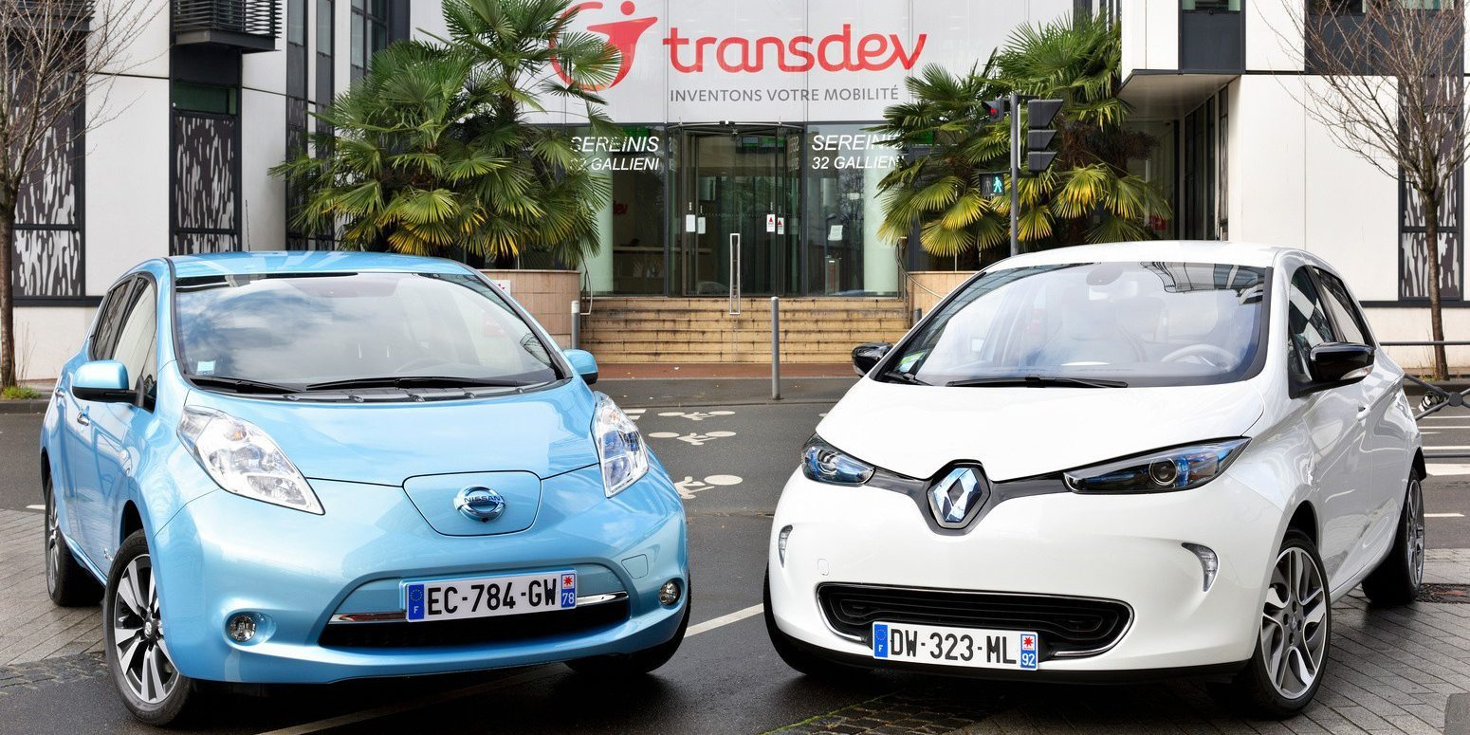
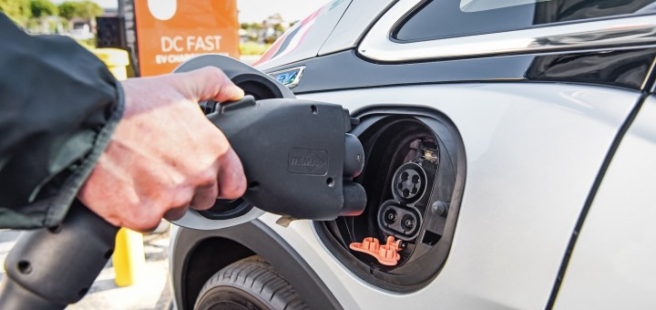
Summary
In a world where transportation is a necessity, the goal should be to find a cheaper way to transport ourselves while also protecting the environment we live in.
Electric cars could be the answer to this.
Figure 9. Matching Cars (Lambert, 2017).
Figure 10. Chevrolet Bolt Charging (Szymkowski, 2018).

Slide 21
Works Cited
Adler, Dennis. (2015, 12 October). Carl-Benz-at-the-tiller-of-the-improved-1887-Benz-Patent-
Motorwagen.jpg [Image File]. Retrieved from https://heacockclassic.com/wp-content/uploads/Carl-Benz-at-the-tiller-of-the-improved-1887-Benz-Patent-Motorwagen.jpg
Brueckner, Martin. (2018, 17 April). Why the electric vehicle revolution will bring problems of its own.
Retrieved November 30, 2018, from https://phys.org/news/2018-04-electric-vehicle-revolution-problems.html
Calder, V. B. (2016, August 03). How Uncle Sam Underwrites Coal-Powered Automobiles. Retrieved
November 30, 2018, from https://www.nationalreview.com/2016/08/electric-cars-environmental-impact/
City of New York (n.d.). What Is An “Electric Car”? Retrieved November 30, 2018, from
http://www.nyc.gov/html/ev/html/you/electric-car.shtml
Durbin, D. (2018, February 07). Electric cars have benefits, but likely won't save you money. Retrieved
November 30, 2018, from https://phys.org/news/2018-02-electric-cars-benefits-wont-money.amp
ElectroVelocity. (n.d.). Learn About Lithium – In 10 Bullet Points. Retrieved November 30, 2018, from
http://electrovelocity.com/2010/12/13/learn-about-lithium-in-10-bullet-points/
Ergon Energy Network (n.d.). Benefits Of Electric Cars. Retrieved November 30, 2018, from
https://www.ergon.com.au/network/smarter-energy/electric-vehicles/benefits-of-electric-vehicles
Ference, A. (2017, November 02). Electric Car Charger Installation in Your Home: True Costs-and What
You Need to Know. Retrieved November 30, 2018, from https://www.realtor.com/advice/home-improvement/installing-electric-vehicle-charger/
FirstSignal. (2017, 29 July). electric-car-
charging_trans_NvBQzQNjv4Bqeo_i_u9APj8RuoebjoAHt0k9u7HhRJvuo-ZLenGRumA.jpg [Image File]. Retrieved from https://www.telegraph.co.uk/content/dam/business/spark/e-on-energy-efficiency/electric-car-charging_trans_NvBQzQNjv4Bqeo_i_u9APj8RuoebjoAHt0k9u7HhRJvuo-ZLenGRumA.jpg?imwidth=1400

Slide 22
Works Cited
Lewis, Paul. (2017, July 18). Electric Cars Won't Save the Environment. Retrieved November 30, 2018,
from https://www.usnews.com/opinion/economic-intelligence/articles/2017-07-18/3-reasons-electric-vehicles-arent-enough-to-save-the-environment
Magill, Bobby. (2014, December 15). Electric Cars a Mixed Bag For Health, Climate. Retrieved November
30, 2018, from http://www.climatecentral.org/news/electric-cars-mixed-bag-for-climate-18447
Office of Energy Efficiency & Renewable Energy. (n.d.). Electric Vehicle Basics. Retrieved November 30,
2018, from https://www.energy.gov/eere/electricvehicles/electric-vehicle-basics
Office of Energy Efficiency & Renewable Energy. (n.d.). Electric Vehicle Benefits. Retrieved November 30,
2018, from https://www.energy.gov/eere/electricvehicles/electric-vehicle-benefits
Office of Energy Efficiency & Renewable Energy. (n.d.). The History of the Electric Car. Retrieved
November 30, 2018, from https://www.energy.gov/articles/history-electric-car
Office of Energy Efficiency & Renewable Energy. (n.d.). Reducing Pollution with Electric Vehicles.
Retrieved November 30, 2018, from https://www.energy.gov/eere/electricvehicles/reducing-pollution-electric-vehicles
Office of Energy Efficiency & Renewable Energy. (n.d.). Saving on Fuel and Vehicle Costs. Retrieved
November 30, 2018, from https://www.energy.gov/eere/electricvehicles/saving-fuel-and-vehicle-costs
Paul, Rik. (2017). electric-vehicle-2x1-lowres-5037.jpg [Image File]. Retrieved from
https://cdn.thewirecutter.com/wp-content/uploads/2017/10/electric-vehicle-2x1-lowres-5037.jpg
Green Car Progress. (2015, March 23). Nissan reports failure rate of LEAF battery pack in Europe of less
than 0.01%. Retrieved November 30, 2018, from https://www.greencarcongress.com/2015/03/20150323-nissan.html
Härter, Jakob. (2017, 13 August). p-1a-owning-an-electric-car-is-two-times-cheaper-than-a-gas-
vehicle.jpg [Image File]. Retrieved from https://images.fastcompany.net/image/upload/w_937,ar_16:9,c_fill,g_auto,f_auto,q_auto,fl_lossy/wp-cms/uploads/2018/01/p-1a-owning-an-electric-car-is-two-times-cheaper-than-a-gas-vehicle.jpg

Slide 23
Works Cited
Jaguar. (2017, 29 July). Jaguar_I-PACE_S_Indus-Silver_065.jpg [Image File]. Retrieved from
https://media.wired.com/photos/5b86fce8900cb57bbfd1e7ee/master/w_582,c_limit/Jaguar_I-PACE_S_Indus-Silver_065.jpg
Lambert, Fred. (2017, 15 November). alliance_87744_global_en-e1488220589290.jpg [Image File].
Retrieved from https://i1.wp.com/electrek.co/wp-content/uploads/sites/3/2017/02/alliance_87744_global_en-e1488220589290.jpg?resize=1500%2C0&quality=82&strip=all&ssl=1
RAC Motoring Services (2017, December 22). Are electric cars actually worse for the environment?
Retrieved November 30, 2018, from https://www.rac.co.uk/drive/advice/emissions/are-electric-cars-actually-worse-for-the-environment/
Reza, James. (2014, 1 May). Carriage.jpg [Image File]. Retrieved from
http://dtlv.com/files/2014/05/Carriage.jpg
Schiller, B. (2018, January 19). Owning An Electric Car Is Twice As Cheap As Owning A Gas Vehicle.
Retrieved November 30, 2018, from https://www.fastcompany.com/40517133/owning-an-electric-car-is-twice-as-cheap-as-owning-a-gas-vehicle
Shutterstock. (n.d.). iswalkingsuf.jpg [Image File]. Retrieved from
https://3c1703fe8d.site.internapcdn.net/newman/gfx/news/hires/2017/iswalkingsuf.jpg
Szymkowski, Sean. (2018, 15 March). 2017-Chevrolet-Bolt-EV-Exterior-023-plugging-in-charger-
720x340.jpg [Image File]. Retrieved from http://gmauthority.com/blog/wp-content/uploads/2018/01/2017-Chevrolet-Bolt-EV-Exterior-023-plugging-in-charger-720x340.jpg
US Department of Energy. (n.d.). Electric Vehicle Benefits and Considerations. Retrieved November 30,
2018, from https://afdc.energy.gov/fuels/electricity_benefits.html
Union of Concerned Scientists. (n.d.). What Are Electric Cars? Retrieved November 30, 2018, from
https://www.ucsusa.org/clean-vehicles/electric-vehicles/what-are-electric-cars
University of Pennsylvania Wharton. (2017, 6 January). Nissan-Leaf.jpeg [Image File]. Retrieved from
http://knowledge.wharton.upenn.edu/wp-content/uploads/2017/01/Nissan-Leaf.jpeg
Value Penguin. (n.d.). How Having an Electric Car Affects Your Auto Insurance Rates. Retrieved November 30, 2018, from
https://www.valuepenguin.com/how-having-electric-car-affects-your-auto-insurance-rates

