Slide 1
Energy Controversy Project
What is the best way to dispose of coal ash?
Group 12 - Gabriel Arauz Ramos, Jennah Best, Molly Maley, Laura Singleton

Slide 2
Introduction
In the past, coal was the primary source of energy for millions of people due to the lack of energy resources available. There have been controversial debates about coal due to their risks and potential dangers. The ash that is leftover from the burning of coal is a major issue. Coal ash is the second largest industrial waste producing approximately 180 millions of tons per year. Compared to the rest of the world, the United States produces the most coal with 28%.

Slide 3
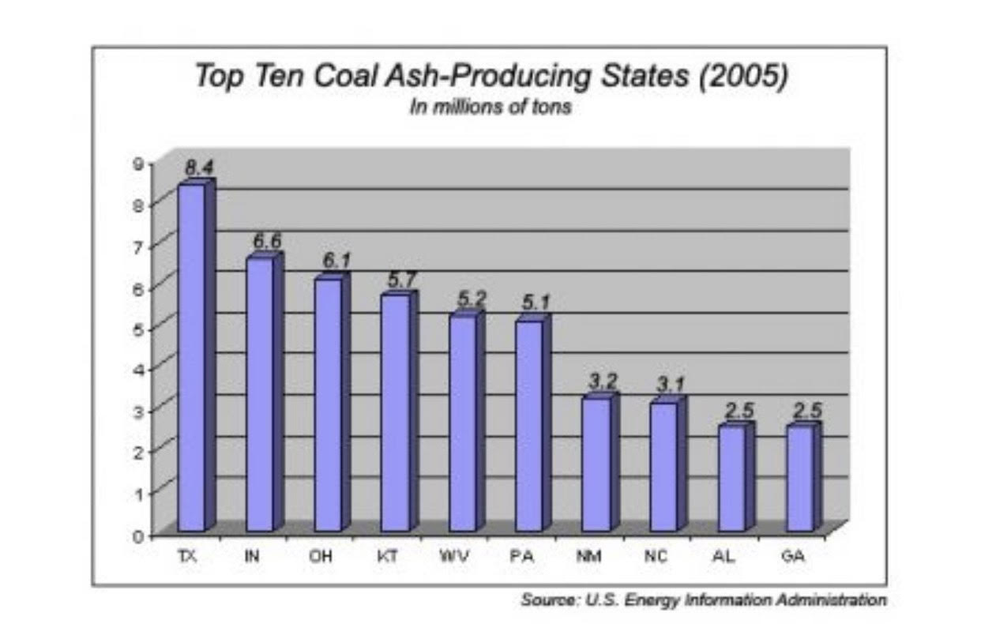
The chart to the right displays the top 10 states in the U.S. that produces the most coal ash

Slide 4
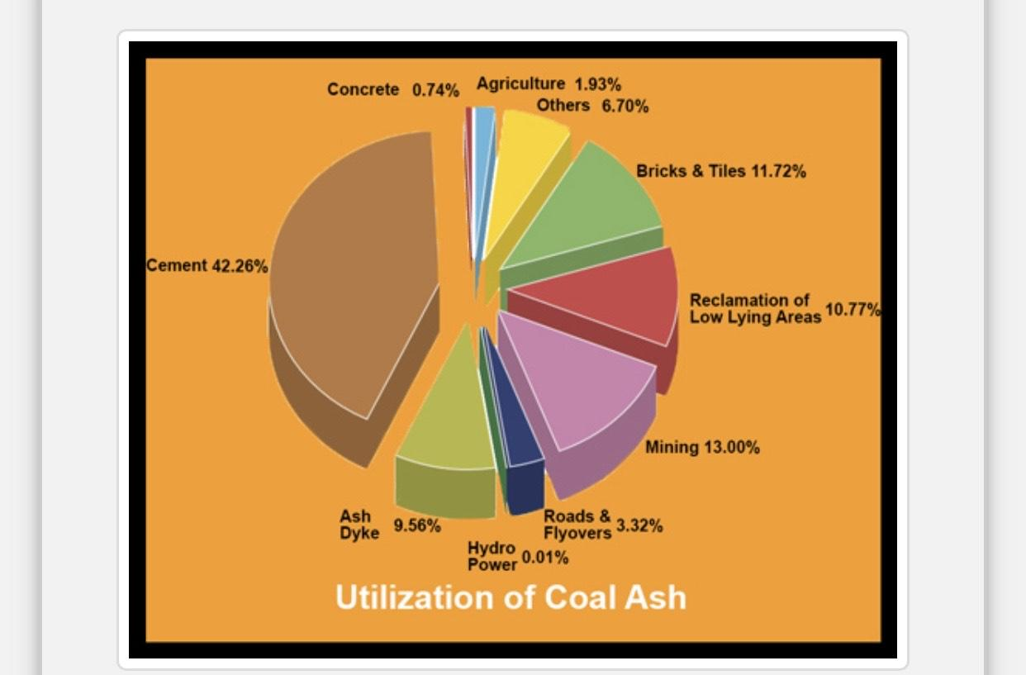
The pie chart to the left shows the different ways coal ash is used. Also shown is the amount of ash used in each of the different benefits to recycling and reusing coal ash.
http://www.coalashinstituteofindia.org/utilization.php

Slide 5
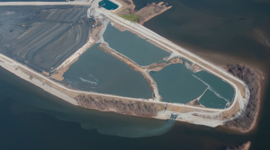
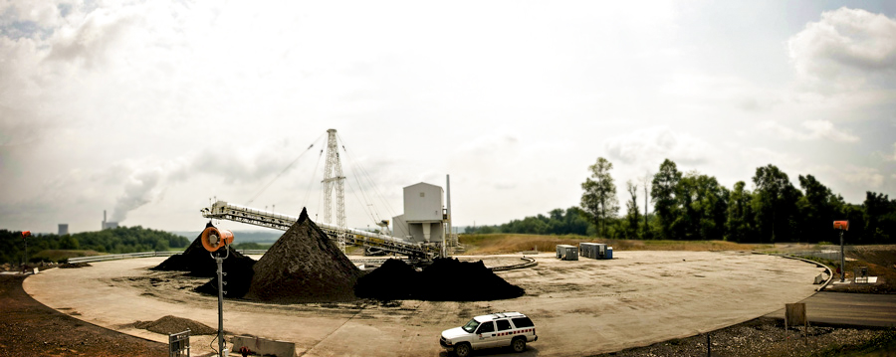
Energy Controversy
Wet Disposal
The controversy that will be discussed is:
What is the better way to dispose of coal ash?
Two opposing methods: Wet coal ash disposal & dry coal ash disposal
Dry Disposal

Slide 6
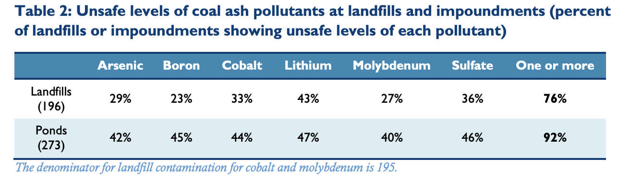
This covers the pollutants found in landfills and water located near where coal ash is being disposed of.
www.environmentalintegrity.org/wp-content/uploads/2019/04/National-Coal-Ash-Report-4.30.2019.pdf.

Slide 7
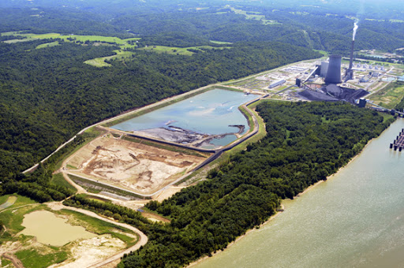
Wet Coal Ash Disposal
Through the process of wet coal ash disposal, fly and bottom ash is piped, from power plants, in the form of slurry that lead to lagoons - ash is then mixed with water (Cooper)
Ponds and lagoons both function as a larger sedimentation basin (Gai Consultants, 1979)
The ash in those disposal areas then leaves a heavy material that floats overtop the sediment in the lagoon

Slide 8
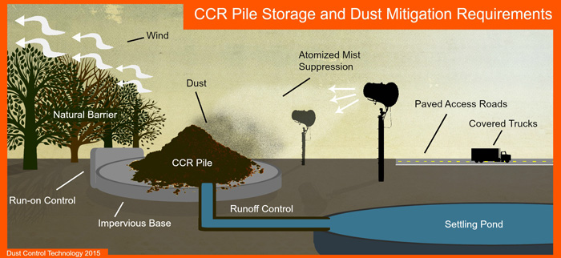
Wet Coal Ash Disposal
Dangerous substances from the coal ash include arsenic and selenium
According to the EPA, there are 735 active on-site surface impoundments used to dispose of wet coal ash across the United States

Slide 9
Wet Coal Ash & Politics
Wet coal ash cleanup is less harmful to the environment than wet coal ash itself
Some questions arise: Who will be responsible for the cost of cleaning up the wet coal ash? Will the company who is creating the ash clean it up? Will the state the ash is being produced in be responsible for the cost of cleanup? Will the federal government or a federal agency such as the EPA be responsible?
Evidence includes the case of Duke Energy in North Carolina because it is still unknown as to who will be responsible for the cleanup of ash produced
Duke Energy is blamed for knowing that the coal produced was toxic for years, and the company failed to act responsibly

Slide 10
Wet Coal Ash & Politics
Many citizens of North Carolina believe that since the company failed to act ethically on the issue of toxic chemicals of the coal ash in the environment, they should not have to pay for the company’s mistake
Decision: The State Attorney General is appealing a ruling to the Supreme Court after a lower court ruled that Duke Energy could charge its customers for the cleanup cost (What Are the Costs of Coal Ash Cleanup?)
The debate continues on whether or not those who live around coal ash sites should be paying for a company’s mishaps and faults

Slide 11
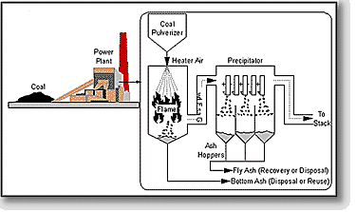
This graph goes over the steps of coal combustion that produces coal ash.
https://www.fhwa.dot.gov/publications/research/infrastructure/structures/97148/cfa51.cfm

Slide 12
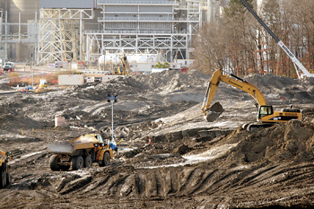
Dry Coal Ash Disposal
This method of coal ash disposal is used the least - due to the amount of regulations & drawbacks along with it
Through the process of dry coal ash disposal, the dry ash is moved to landfills along with a large amount of water to use for the placement of the coal ash
This helps to prevent the ash from rising up in the air and causing harm to the environment

Slide 13
Dry Coal Ash Disposal
This method is said to be much easier than wet coal ash disposal
Harmful to underground and surface water bodies because of the fly ash permeability
The stormwater can wash the fly ash ending up in rivers
The main disadvantage - harming human health
Toxins in the dry ash can be exposed in the air and end up in people’s lungs
In the United States, there are over 310 active on-site landfills used to dispose of wet coal ash

Slide 14
Dry Coal Ash Disposal & Politics
There is more evidence showing that areas of dry coal ash need to be regulated and cleaned up to prevent more toxic chemicals in the air
Trump’s administration is not going forward with any plans for cleanup and/or regulation
The reason being is that their full support is with “coal-fired power”
There is desperate need for aid in cleanup around dry coal ash disposal sites
Negative effects include toxic chemicals in the air & harming the environment around the area

Slide 15
Dry Coal Ash & Science
Dry coal ash can be added back into abandoned mines or recycled to other materials
43% of fly ash is recycled which leads to greenhouse gas emissions reducing as well
Flying ash reduces the use of materials that play a major part in greenhouse gases such as concrete and brick
Economic Benefit
Costs of disposal are reduced
Sales revenue increases
There are still debates on whether or not fly ash should be recycled because some experts say that it helps the environment, but others say that it is a worry with the chemicals in the air

Slide 16
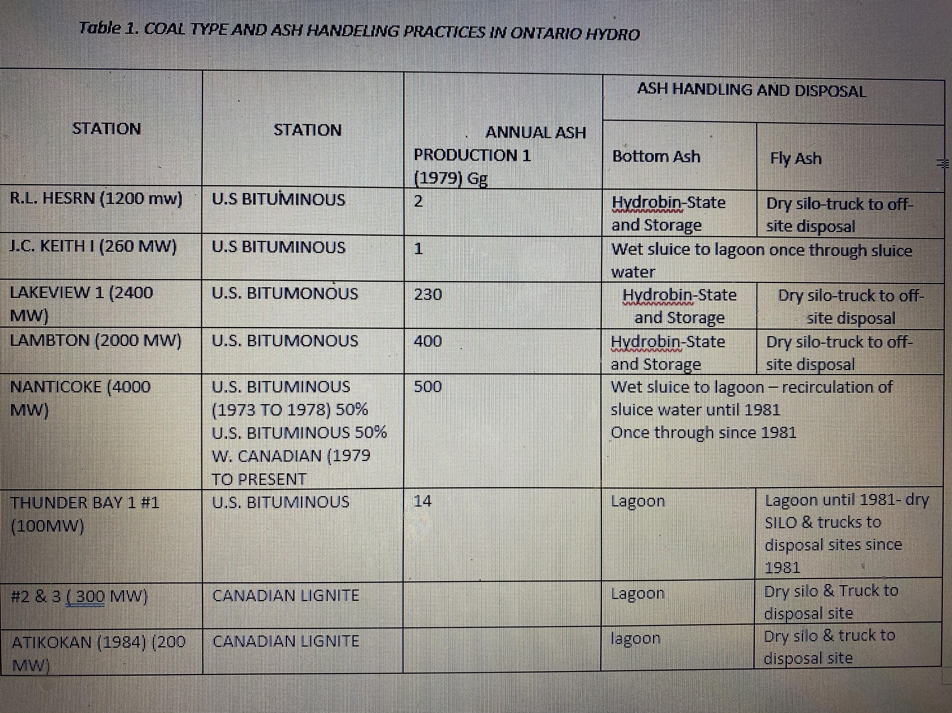
The graph shows the practices used by ONTARIO HYDRO in getting rid of coal ash.

Slide 17
Conclusion
The controversy between the dry storage and wet storage of coal ash comes down to the lesser of two evils - dry being the lesser
The implementation of wet systems is being replaced at this very moment
Science and society has deemed wet systems to be far inferior to dry systems, albeit it’s hazardous tendencies

Slide 18
Works Cited
Afework, Bethel, et al. “Coal Ash.” Coal Ash - Energy Education, University of Calgary, 3 Sept. 2018, energyeducation.ca/encyclopedia/Coal_ash.
Gai Consultants, Inc. Coal Ash Disposal Manual, OSTI.GOV, 1 Dec. 1979, www.osti.gov/servlets/purl/5310803.
Russ, Abel, and Courtney Bernhardt. “Coal's Poisonous Legacy.” Environmental Integrity, Environmental Integrity Project, 30 Apr. 2019, www.environmentalintegrity.org/wp-content/uploads/2019/04/National-Coal-Ash-Report-4.30.2019.pdf.
Southern Alliance for Clean Energy. (2020) “Coal Ash Storage.” Southeast Coal Ash, www.southeastcoalash.org/about-coal-ash/coal-ash-storage/.
“Wet vs Dry Bottom Ash Handling Compared: One Plant's Experience.” www.modernpowersystems.com, 1 June 2007, www.modernpowersystems.com/features/featurewet-vs-dry-bottom-ash-handling-compared-one-plant-s-experience/.

