Slide 1
What is the Best Way to Dispose of Coal Ash?
Nick Troutman, Conrad Middleton, Sreyneat Chan

Slide 2
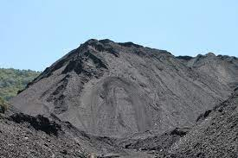
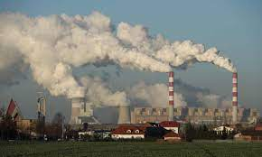
What is Coal Ash?
Coal Ash is a term for any of the by-products that are produced from the burning of coal for power plants that use coal.
It is one of the largest industrial wastes generated in the United States
Coal Ash is a harmful and if not disposed of properly can be catastrophic.
Extremely Dangerous if not handled properly.
Coal ash will be a problem as long as coal is used as an energy source

Slide 3
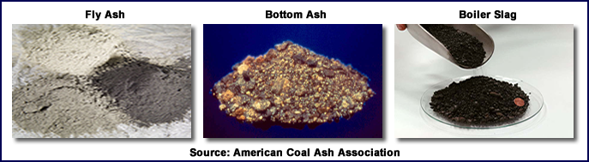
Forms of Coal Ash
Fly Ash Bottom Ash Boiler Slag
Fly Ash is a fine powdery ash that would often just be released into the air through smoke stacks
Bottom Ash heavier ash that is produced and would be found at the bottom of the furnace.
Boiler Slag are the parts of coal ash that melt and turn into glass-like pellets

Slide 4
Coal Ash Controversy
Coal Ash has become a controversial topic as of recently with the dangers it poses to the environment and human safety.
As a result of being harmful, there have regulations in recent years on proper ways of disposing and storing coal ash.
In 2015 regulations were set in place by the Obama administration but during the Trump administration they have been amended fueling much controversy
The regulations did however not define clear but give a framework for how to dispose of coal ash.
Since the Trump Administration has amended the regulations he has become more lenient, angering many environmentalists.

Slide 5
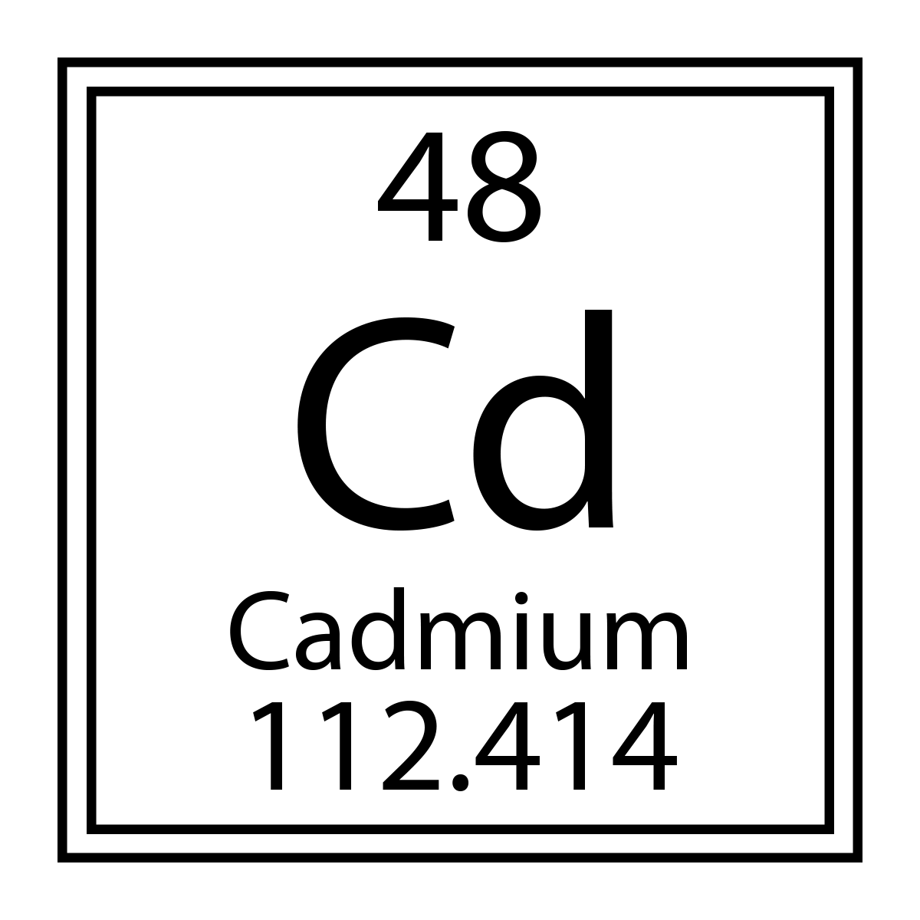
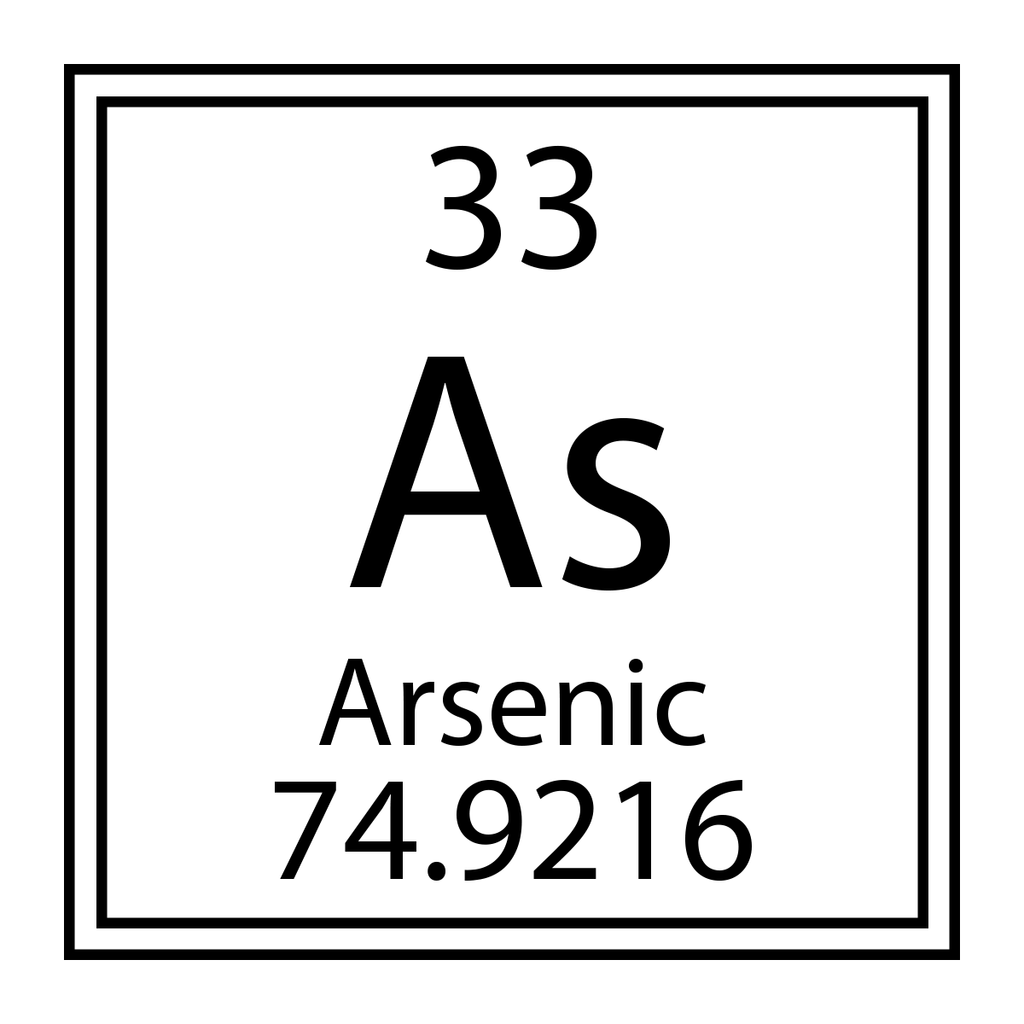
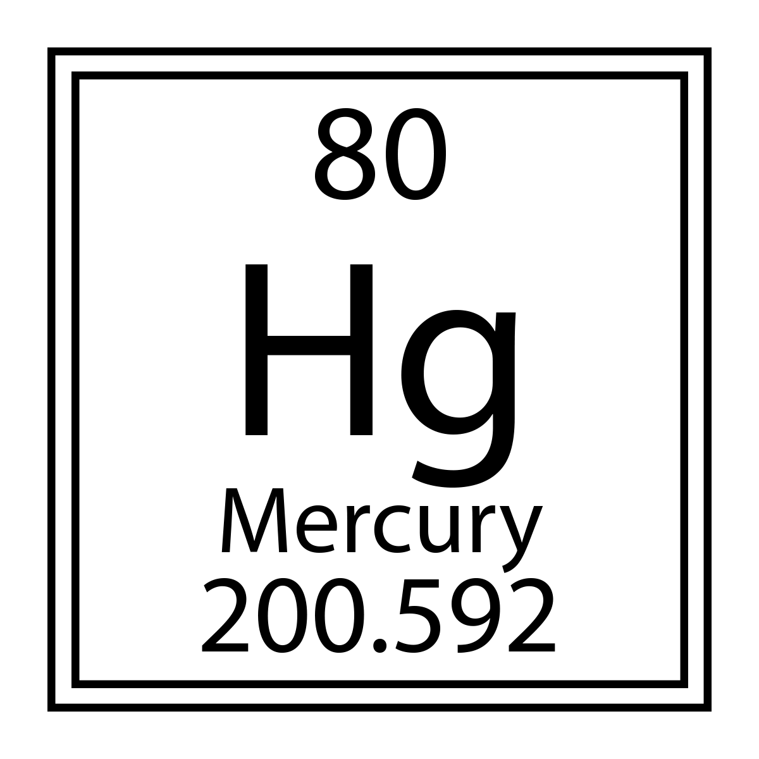
The Impact of Coal Ash Contamination
Coal ash contains several contaminants that impact the environment and us in general (EPA):
Mercury
Cadmium
Arsenic

Slide 6
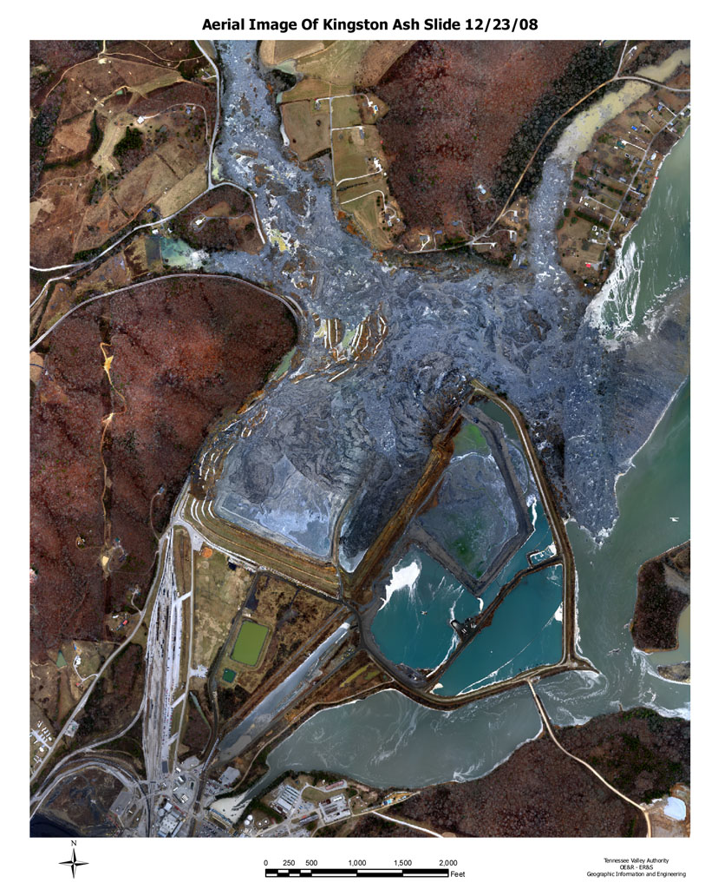
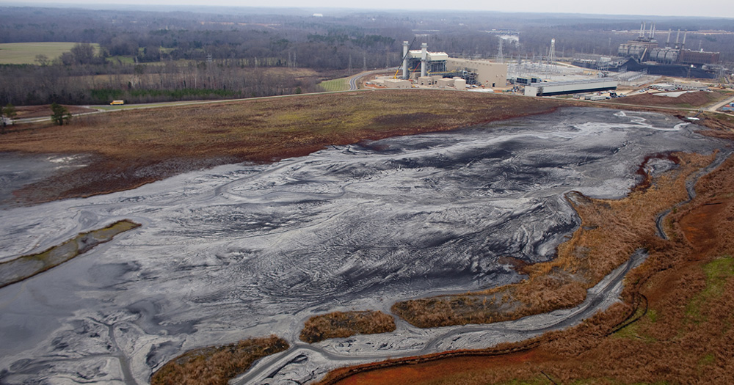
The Impact of Coal Ash Contamination (Cont.)
When coal ash is not properly managed, these materials can make their way into nearby water sources, as well as the air (EPA).
This proves to be very harmful to not only the environment, but also on the lives of wildlife and humans (Pennsylvania and Coal Ash, 1-2).

Slide 7
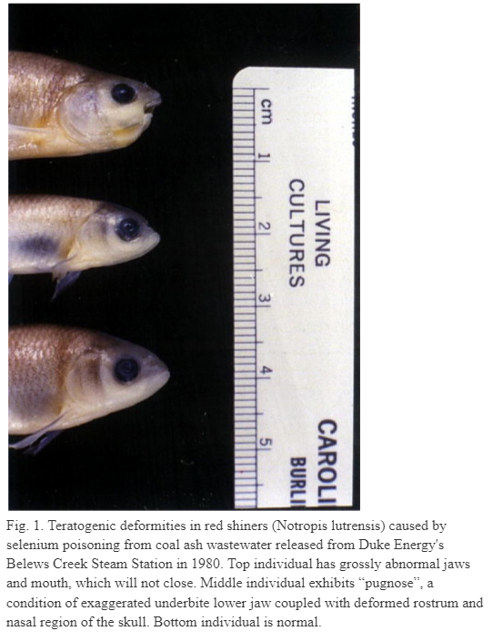
The Impact of Coal Ash Contamination (Cont.)
Contaminated water exceed the federal drinking water standards over thirty six times over in both groundwater and surface water. Exposure to these materials may result in:
Selenium poisoning (Lemley, An urgent need)
Heart damage (PSR, Coal Ash)
Lung damage (PSR, Coal Ash)
Respiratory distress (PSR, Coal Ash)
Kidney disease (PSR, Coal Ash)
Reproductive problems (PSR, Coal Ash)
Gastrointestinal illness (PSR, Coal Ash)
Birth defects (PSR, Coal Ash)

Slide 8
The Impact of Coal Ash Contamination (Cont.)
Outside of causing damage to wildlife and humans, it also causes damage to various other important issues such as:
The environment
  There is already an estimated two billion dollars worth of damage already done by coal ash on the environment, and that is only taking into account the documented cases (Lemley, An urgent need).
The economy
  Certain industries are severely affected by coal ash contamination, such as the fishery industry, which suffers losses around $US 8.6 million annually due to coal ash (Lemley, An urgent need).

Slide 9
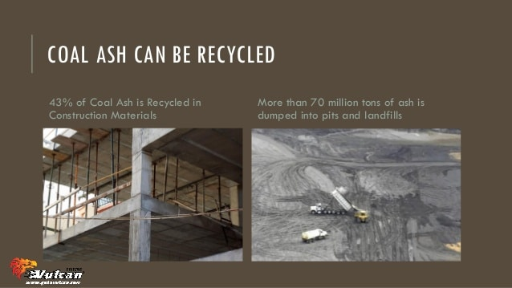
Why is Coal Ash reused?
Reusing coal ash can create many environmental, economic, and product benefits including:
Environmental benefits such as reduced greenhouse gas emissions, reduced need for disposing in landfills, and reduced use of other materials.
Economic benefits such as reduced costs associated with coal ash disposal, increased revenue from the sale of coal ash, and savings from using coal ash in place of other, more costly materials.
Product benefits such as improved strength, durability, and workability of materials.

Slide 10
Ways to Dispose Coal Ash
How to dispose of coal ashes
  Method1: Dispose of it with the rest of your garbage
    Throwing coal in the garbage
    Wrap them in plastic or put them in a small metal box and dispose of them in an outdoor garbage bin
  Method 2: Make fertilizer/compost
    Potassium carbonate is abundant in ash from ingredient-wood charcoal, which offers nutrients to plants
    As a fertilizer, you can only use ingredient-wood charcoal
  Method 3: Use it to deter pests
    To keep bugs at bay, shake it up and spray it around your food garden and plants
    It can help keep away mites and lice from outdoor bird cages and chicken coops

Slide 11
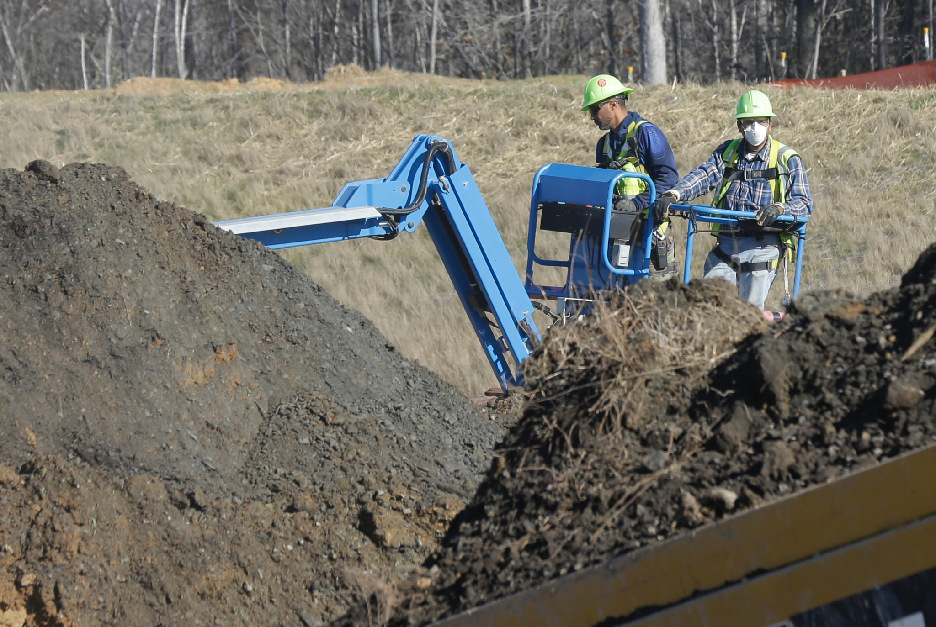
Ways to Dispose Coal Ash (Cont.)
  Method 4: use it as a cleaner or odor remover
    You can use it to make a cleaner like lye soap. The wood charcoal ash can be used to polish silver
    Moreover, you can use coal ash to remove odor from your pet
    Using wood ash rubbed through the fur will make the smell fade faster.
  Method 5: use it to slow algae growth outdoors
    To limit algae development and enhance other pond plants, simply mix one tablespoon of coal ash into a thousand gallons of pond water

Slide 12
References
Arlene Karidis | Aug. “2015 Coal Ash Rule Continues to Spark Controversy and Change.” Waste360, 20 Aug. 2019, https://www.waste360.com/legislation-regulation/2015-coal-ash-rule-continues-spark-controversy-and-change.
“Coal Ash Basics.” EPA, Environmental Protection Agency, https://www.epa.gov/coalash/ coal-ash-basics.
“Coal Ash: Hazardous to Human Health.” Physicians for Social Responsibility, International Physicians for the Prevention of Nuclear War, https://www.psr.org/wp-conten t/uploads/2018/05/coal-ash-hazardous-to-human-health.pdf.
“Eden NC Coal Ash Spill”. https://response.epa.gov/site/site_profile.aspx?site_id=9065
Lemly, A. Dennis. “An Urgent Need for an EPA Standard for Disposal of Coal Ash.” Environmental Pollution, vol. 191, 14 May 2014, pp. 253–255., https://doi.org/10.1016/j.envpol.2014.04.029.
“Pennsylvania and Coal Ash Disposal in Ponds and Landfills .” Earthjustice, https://earthjustice.org/sites/default/files/files/Pennsylvania-Fact-Sheet-2014-12.pdf.
Ruelas, Goliard. “How to Dispose of Coal.” How to Dispose, 21 Sep. 2021, https://howtodispose.info/dispose-coal/.
Turrentine, Jeff. “Coal Ash Is Hazardous. Coal Ash Is Waste.” NRDC, 6 Aug. 2021, https://www.nrdc.org/onearth/coal-ash-hazardous-coal-ash-waste-according-epa-coal-ash-not-hazardous-waste.

