Slide 1

Is climate change the cause of the wildfires in California
By: Ryder Egner Faustner

Slide 2
WHAT IS CLIMATE CHANGE
- Climate change is an overall change in the global temperatures
- Generally related to high temperatures
- It is caused by C02 and other greenhouse gases being released into the air
- These Greenhouse Gas help trap heat from the sun on Earth
- It is an event that happens around the globe and is not caused by one singular country

Slide 3
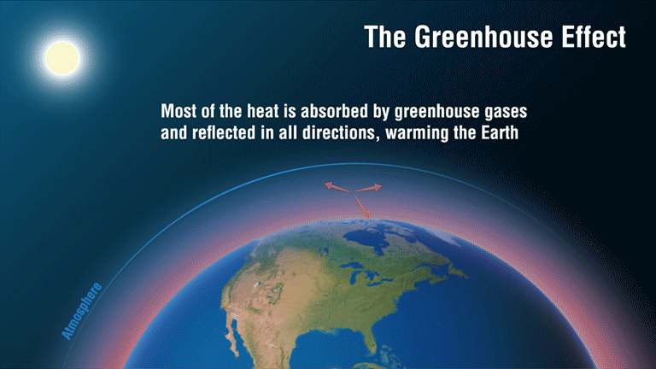

Slide 4
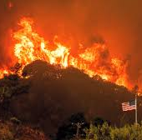
What is happening in California
-Recently massive fires have broken out all over California
- This is the worse wildfire season California has experienced in years
- The fires have destroyed entire towns such as Paradise and claimed at least 88 lives
- More than 19,000 structures, mostly homes have been destroyed
- Firefighters and others have been struggling to put it out as the fire grows bigger

Slide 5
Yes, Climate change is the cause
Climate change has increased the temperatures around the globe, causing more droughts in very warm areas such as California
- These droughts dry out the fire fuels: organic debris, plant material and more
-Once these materials dry, they can easily catch fire and burn other material around
The current fires in California are caused by several factors
- Climate change is just factor that makes the fires happen more often
- It also makes them generally harder to put out and more dangerous

Slide 6
Yes, Climate change is the cause. Con.
-Wildfires in California are a normal occurrence bring benefits to many ecosystems
- Fire Dependent and Fire Adaptive ecosystems are very common
- The fires burn away undergrowth, give the nutrients and can kill diseases and bugs
-The current Wildfires are much worse than previous
- Burning hotter, more land is being consumed and they are harder to put out
From January 1st, 2019 to November 8th, 2019, 252,673 acres of land was destroyed by wildfire
From January 1st, 2020 to November 8th, 2020, 1,490,872 acres of land was destroyed by wildfires
These numbers are subject to change depending on false alarms

Slide 7
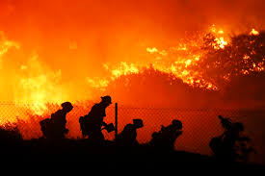
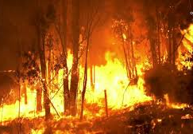
The Fires

Slide 8
No, Climate change is Not the cause
-Some believe the fires are not caused by Climate change but rather California’s poor handling of their forest
- For years California has had policies that make clearing undergrowth difficult
- Policies regarding lumbering as made tree removal difficult as well
-These two policies have allowed for the fires to burn longer and more as there is more material to burn
- More material to burn creates larger, warmer fires that are harder to put out

Slide 9
No, Climate change is Not the cause. Con.
- California is region that has normal wet and dry seasons, connected by some scientist to the sun
- From November to March, is the wet season. Everything else is dry
-Wildfires are a natural occurrence in California as many ecosystems require them
- It is the belief that the natural cycle of fires is not affected by climate change but rather the policies preventing undergrowth removal has made these cycles worse

Slide 10
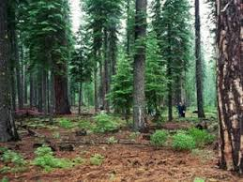
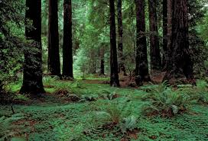
Undergrowth

Slide 11
Where do I stand
I stand in the middle, both viewpoints could be considered right at the same time
- Scientifically the increased temperatures from global warming could dry undergrowth, causing fire to grow out of control quicker
- The poor policies preventing the removal of undergrowth mixed with the normal wildfire cycle and warmer temperatures could create fires that are drastically bigger than before
- Evidence from both sides can be put together and make sense, therefore I believe neither side is enterally wrong

Slide 12
Conclusion
Neither side in this argument is wrong
- Facts backed by science or political policies or both can prove either standpoint to be factual
- If you have undergrowth from a lack of removal and warmer temperatures from climate change that dries that undergrowth, that could create a worse than usually fire.
-Mixing evidence from both viewpoints to create the fires burning in California

Slide 13
The End
Any Questions?

