Slide 1
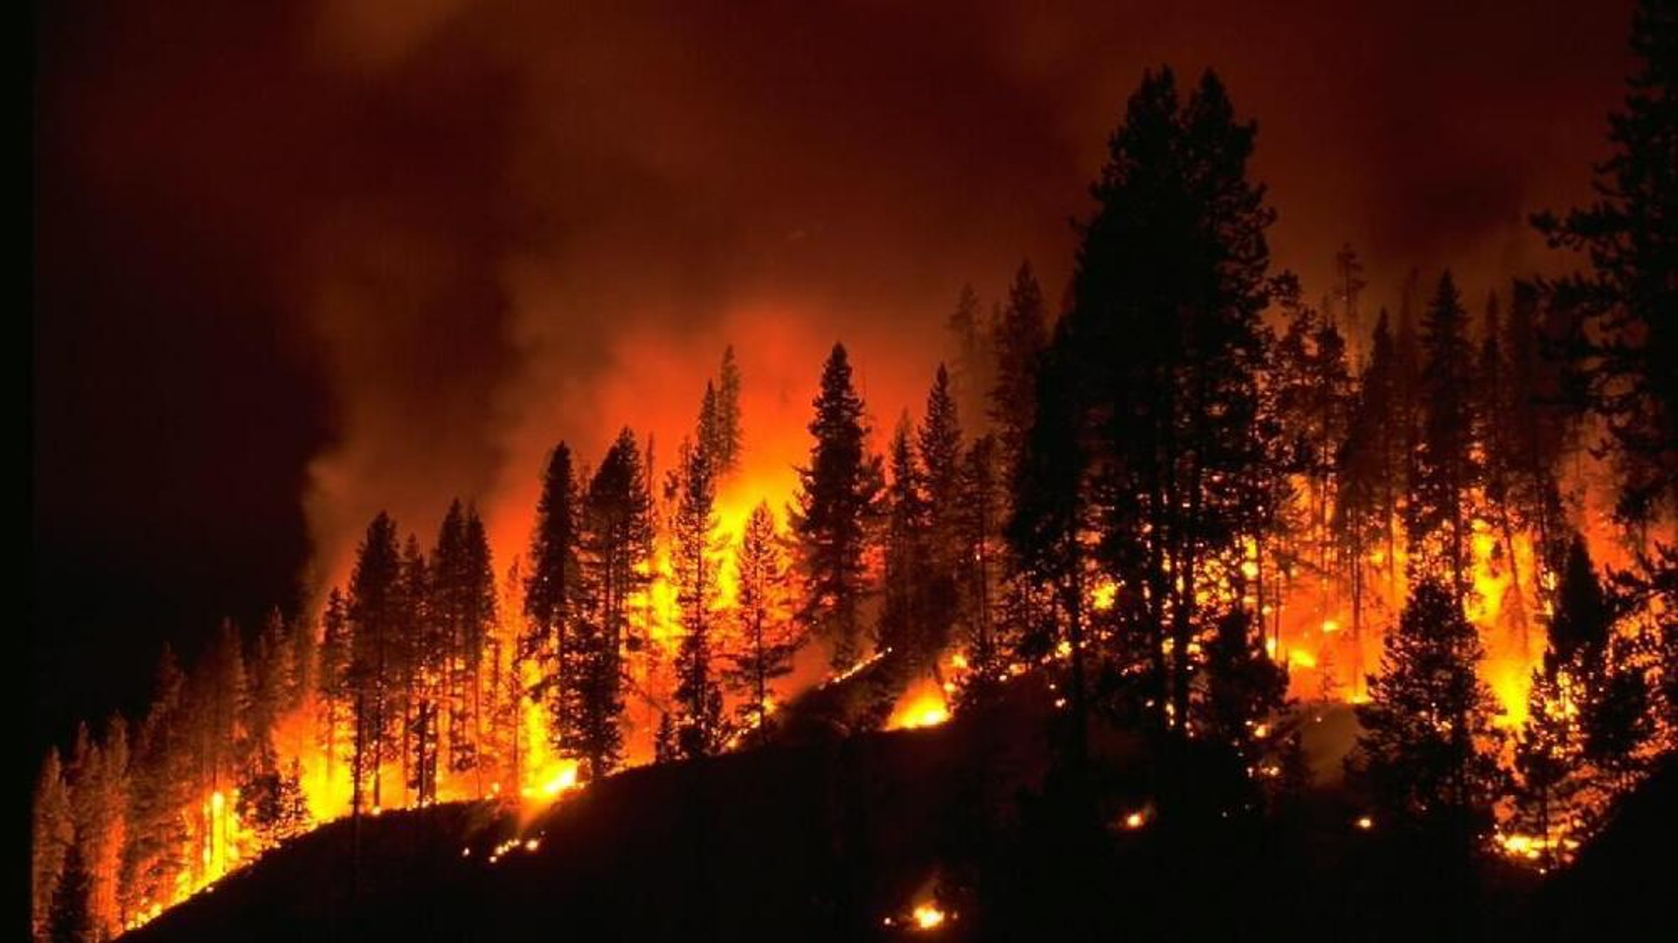
Are Wildfires a Result of Climate Change?
By: Elizabeth Frederick, McKenna Melton, Shawn Stone, and Hannah Boyd

Slide 2
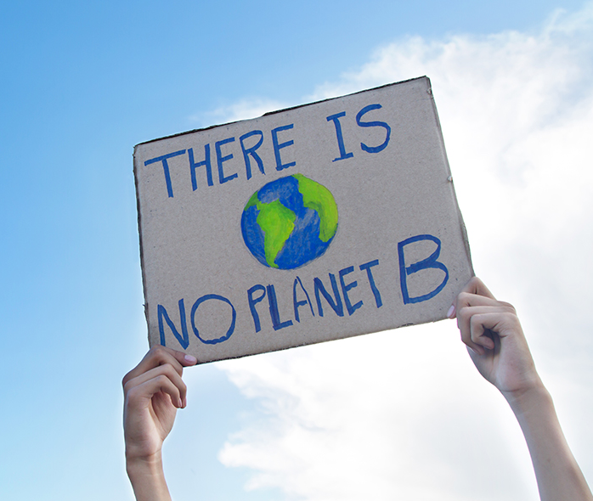
What is Climate Change?
Climate Change is the change in Earth’s usual climate that occurs over millions of years.
Causes of Climate Change:
Rising maximum temperatures
Rising sea levels
Higher ocean temperatures
Melting glaciers
Increase in precipitation
Rising minimum temperatures
Effects of Climate Change:
Intense droughts
Hurricanes
Floods
Loss of Species
Lack of food
Hotter temperatures
Increase/more severe storms

Slide 3
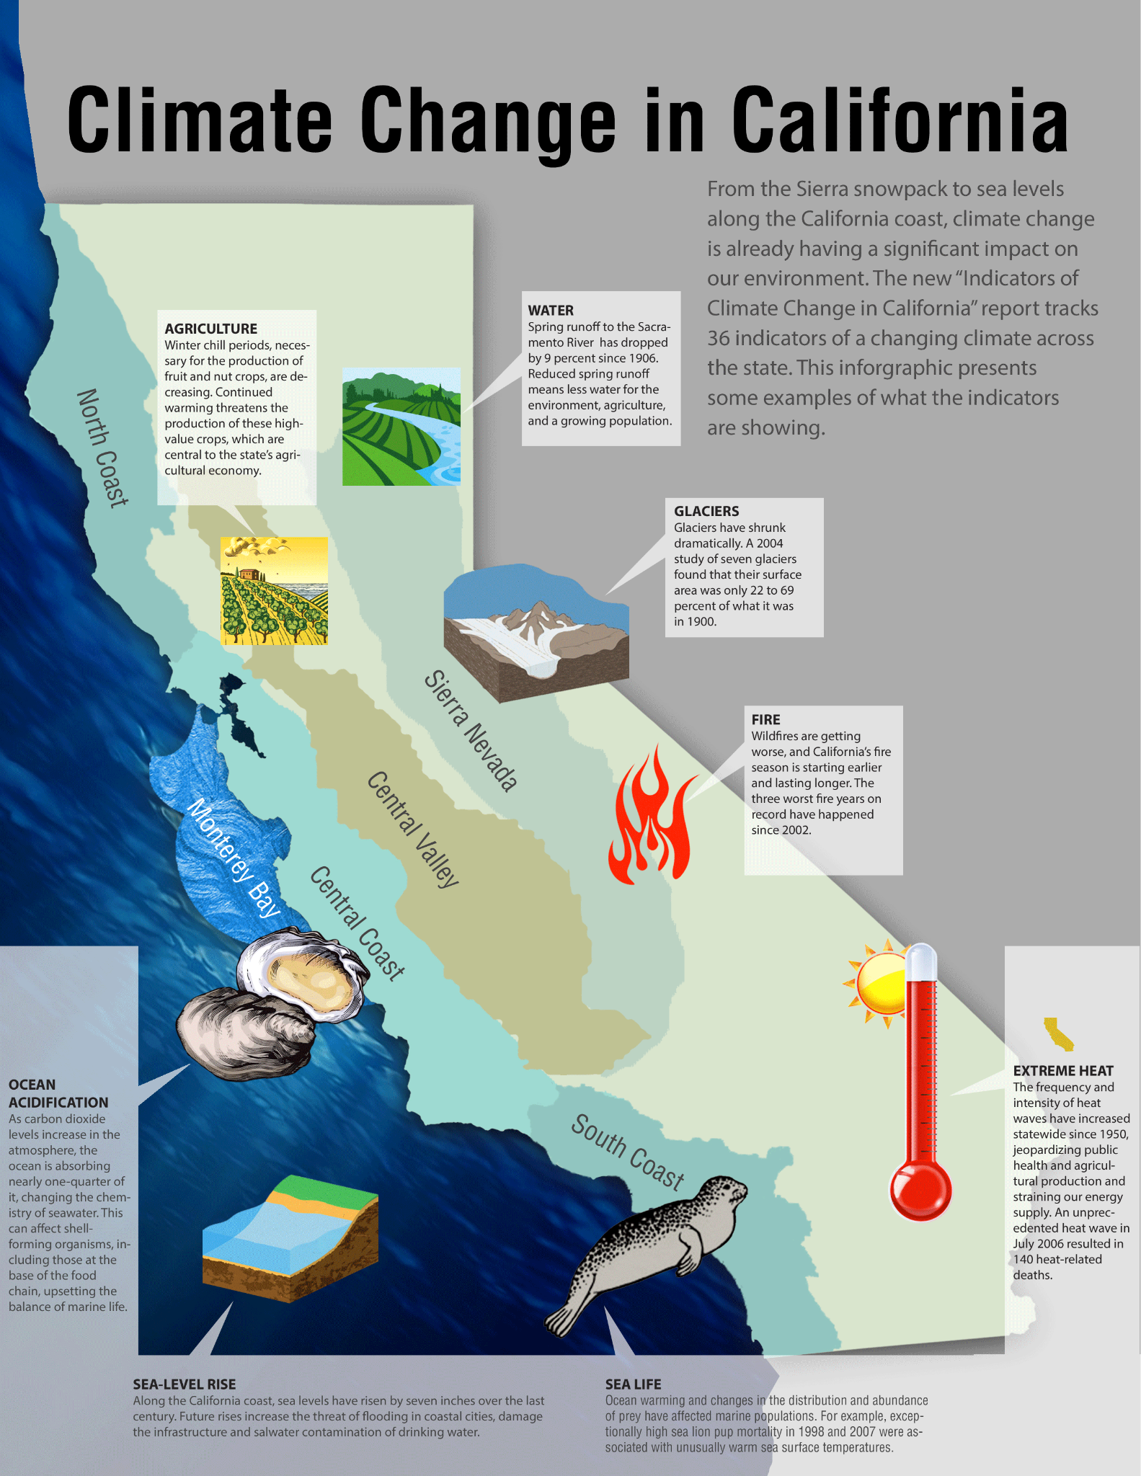
Climate Change in California
California has been in a severe drought since 2000 and is still in a drought to this day.
California’s average state temperature has also risen approximately 3 degrees fahrenheit (1.8 degrees celsius).
The sea level of the coast surrounding California has risen 6 inches since 1950 and is rising 1 inch every 10 years.
https://thesource.metro.net/2013/08/12/climate-change-in-california-state-summarizes-the-ongoing-impacts/

Slide 4
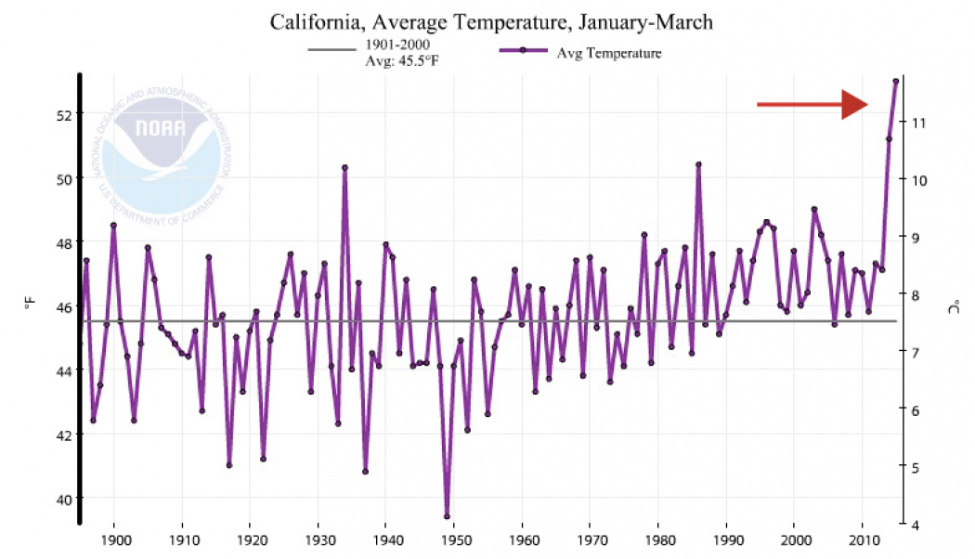
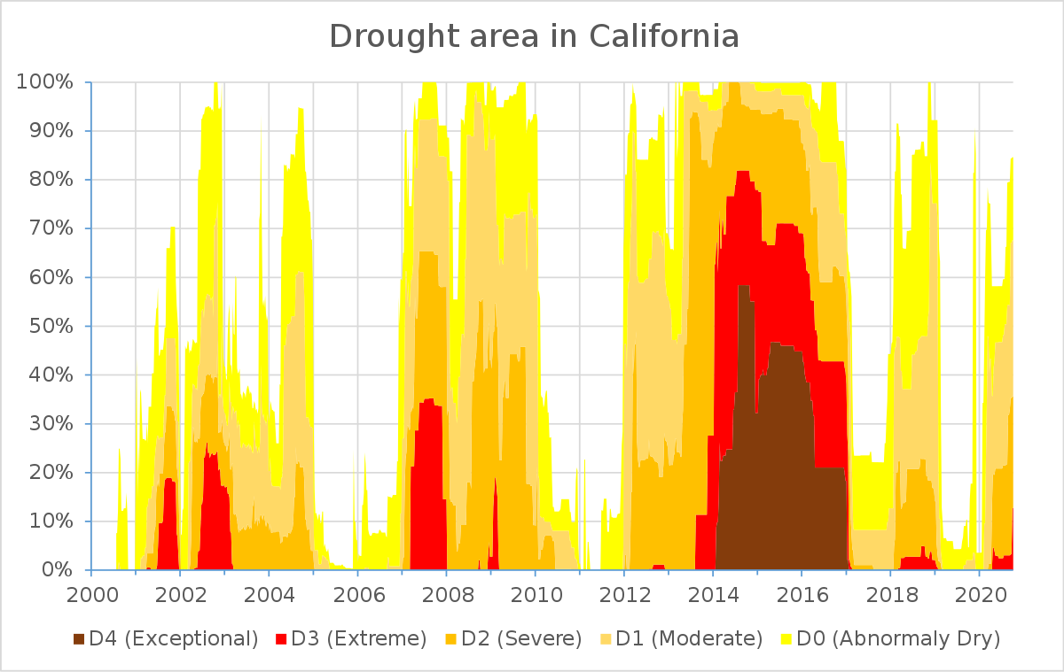
Climate Change in California
Rising Temperatures
Drought Severity
https://www.climatecentral.org/news/california-shattering-temperature-records-18871
https://landsat.visibleearth.nasa.gov/view.php?id=89110

Slide 5
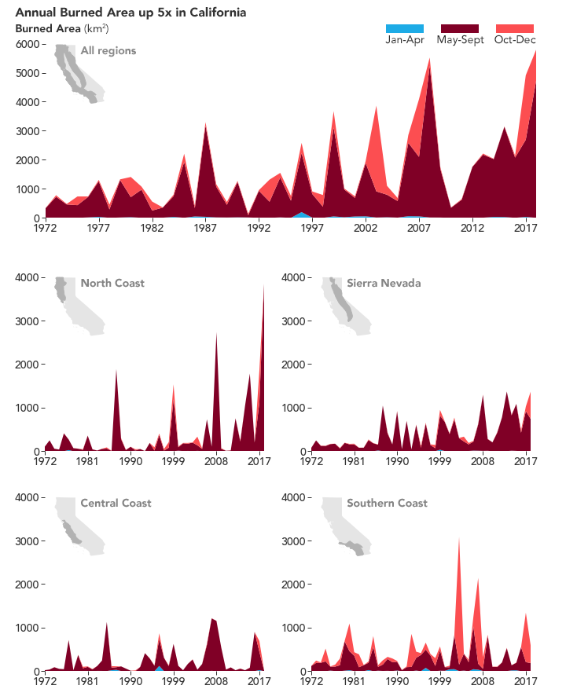
Wildfires in California
The amount of wildfires in California has grown since 1972.
Since 2016 to present day over 39,372 wildfires have occurred burning over 6,119,158 acres burned.
https://earthobservatory.nasa.gov/images/145534/rising-global-temperatures-influence-californias-fire-season

Slide 6
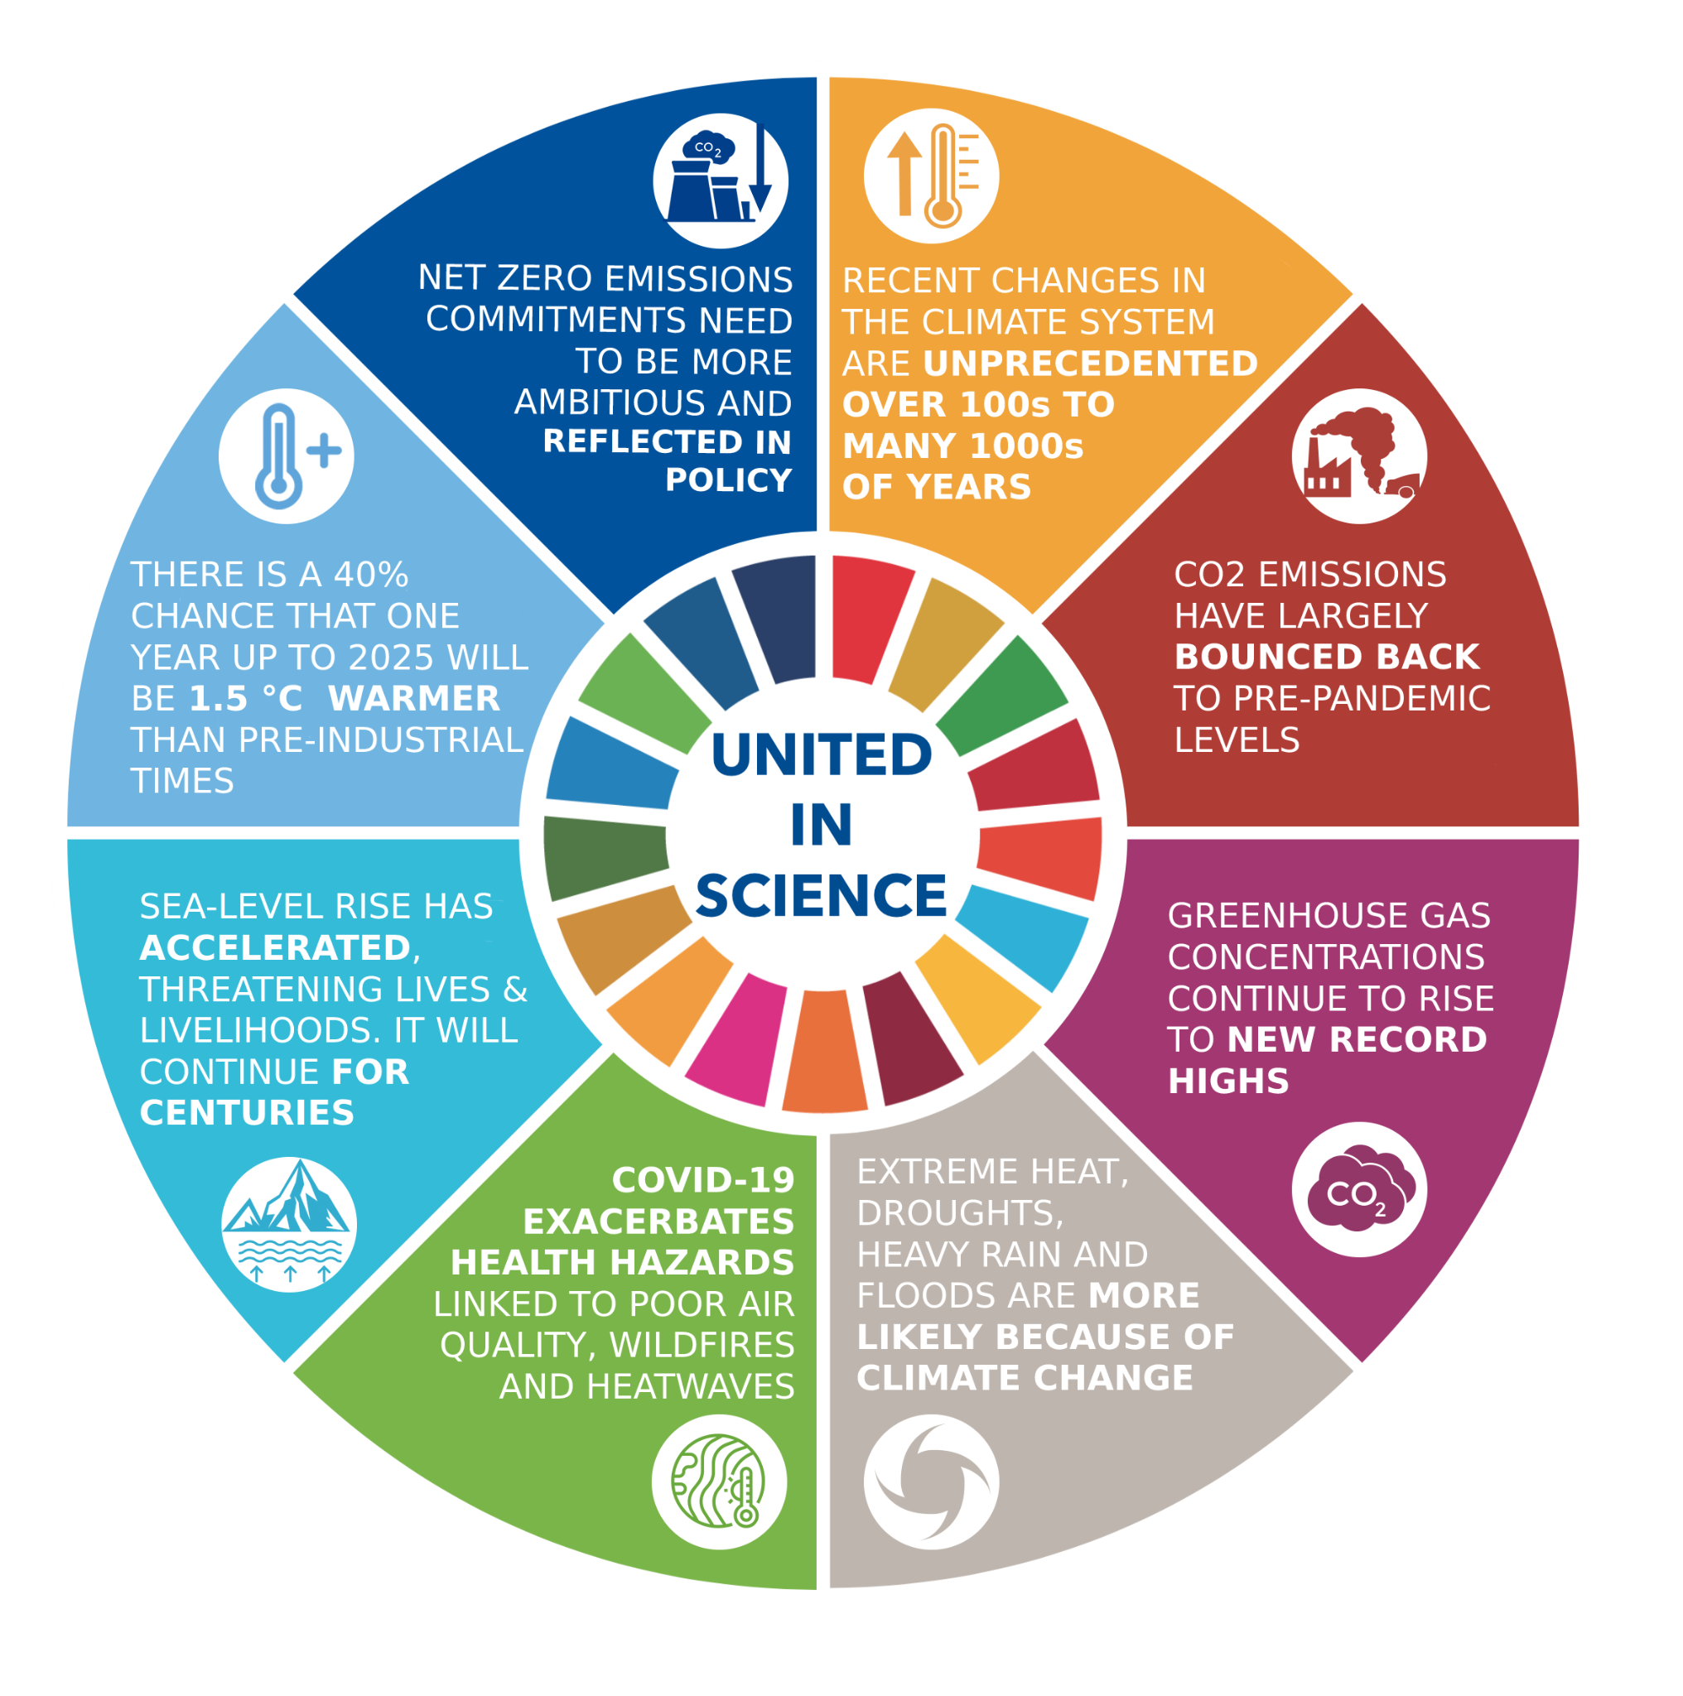
Scientific Evidence on Climate Change
Greenhouse gases are essential to life on earth despite the fact that they contribute to global warming.
Carbon dioxide, a greenhouse gas, is necessary for plant survival, and other greenhouse gases help to maintain the earth’s surface and oceans at temperatures that enable life to flourish on our planet.
As greenhouse gases accumulate beyond their historic levels, they prevent more and more of the energy reaching the earth from going back into space.
The scientist John Tyndall found that CO2 absorbed heat more readily than other atmospheric gases, like oxygen and nitrogen, which have simpler molecular structures relative to CO2 . He also speculated that gases such as carbon dioxide would produce negative effects corresponding to the climate.

Slide 7
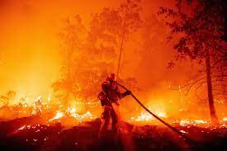
Scientific Evidence on Climate Change and Wildfires
In the last 100 years,the planet’s average surface temperature has risen about 1.1°C (2.0°F). The current rate of warming is roughly ten times faster than the average rate of warming after ice ages of the past million years.
With the increase of carbon dioxide and other greenhouse gases in the atmosphere, we see significant changes in the weather such as rising maximum temperatures, increase in precipitation, higher ocean temperature, rising minimum temperatures, and more.
In California, the rise of temperatures as well as intense periods of drought have created hotter summers and winters, making the forest dry, and increasing the chances of forest fires.

Slide 8
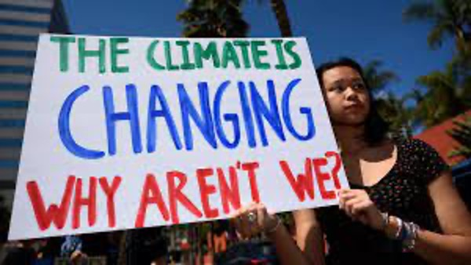

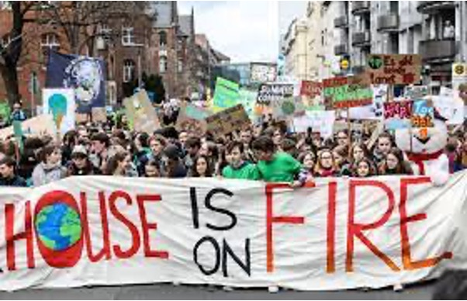
Republican View of Climate Change
Republicans are less likely than Democrats to support climate change adaptation measures.
Donald Trump blamed forest mismanagement and water shortages for the California wildfires.
Republicans tend to accept other factors before accepting climate change as a problem in disasters.

Slide 9
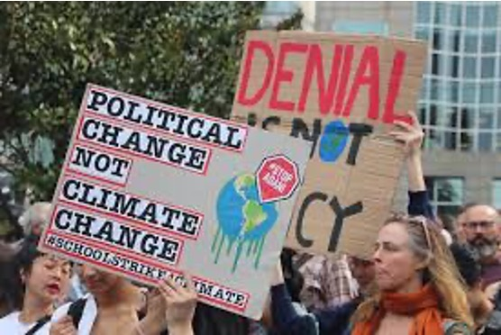
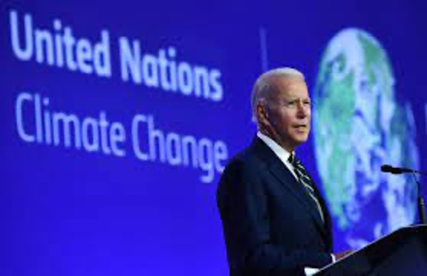

Democratic View of Climate Change
Democrats are concerned with addressing this climate crisis.
Joe Biden discussed a $2tn plan for net-zero emissions by 2050 to demonstrate leadership of the United States in the climate crisis.
The democratic view supports the idea of climate change being a factor in the California wildfires.

Slide 10
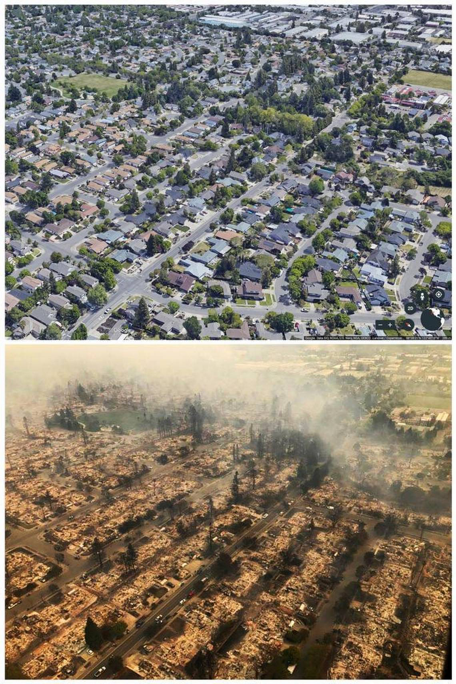
Conclusion
There are other possible factors that may be involved with the wildfires.
Donald Trump blames “forest mismanagement” and “water shortages” for the fires in California, and Joe Biden discussed proposing a plan for net zero emissions by 2050 to show leadership in the climate change crisis.
California’s summers and winters are now hotter than ever, increasing the dryness of the brush and wildlife.

Slide 11
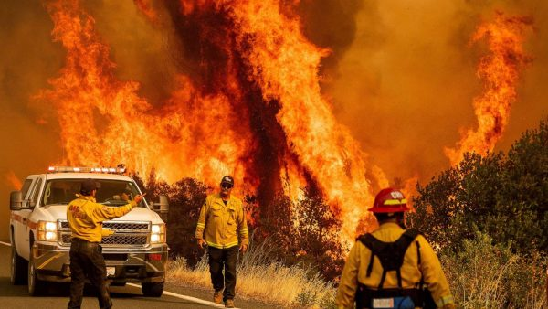
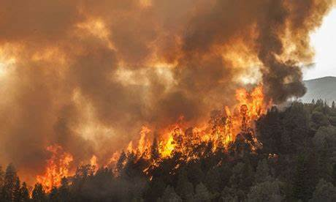
Conclusion
Climate change is a factor in the California wildfires.
In our opinion, the main reasons for the increase in wildfire intensity, and the number of wildfires are due to the decrease in rain and increased heat and dry weather in California.
There is significant evidence that climate change is a factor in the California wildfires, and we, as a group, believe that it is a huge factor, and something needs to be done about it.

Slide 12
Sources
Amanpour, Christiane, and Michel Martin. “Wildfires Continues in California, Oregon and Washington; Democrats Accuses Trump for Denying Climate Science and Safety Investigations on Coronavirus; Senator Tammy Duckworth (D-IL), Is Interviewed About Climate Change, Coronavirus and Trump; Devastation of the West Coast Wildfires; Kent Nishimura. Photojournalist, Los Angeles Times, Is Interviewed About the West Coast Wildfires; Eradicating Police Brutality; ‘Policing the Police," a New Documentary; Jelani Cobb, Correspondent, FRONTLINE's ‘Policing the Police 2020," Is Interviewed About Police Brutality. Aired 2- 3p ET.” Amanpour, CQ Roll Call, New York, 14 Sept. 2020. ProQuest Central, https://wilkes.idm.oclc.org/login?url=https://www.proquest.com/other-sources/wildfires-continues-california-oregon-washington/docview/2442689165/se-2?accountid=62703.
Armstrong, Anne K., et al. “CLIMATE CHANGE SCIENCE: The Facts.” Communicating Climate Change: A Guide for Educators, Cornell University Press, 2018, pp. 7–20, http://www.jstor.org/stable/10.7591/j.ctv941wjn.5.
Gordon, Kylie. “California Wildfires Shrink Partisan Differences about Climate Change.” Stanford News, Stanford University, 24 Sept. 2020, https://news.stanford.edu/2020/09/25/california-wildfires-shrink-partisan-differences-climate-change/.
Nilsen, Ella. “Biden's Spending Bill Could Be Democrats' Last Hope of Achieving Meaningful Climate Action as Crisis Worsens.” CNN Wire Service, 14 Sept. 2021. ProQuest Central, https://wilkes.idm.oclc.org/login?url=https://www.proquest.com/wire-feeds/bidens-spending-bill-could-be-democrats-last-hope/docview/2572237094/se-2?accountid=62703.
“Trump Administration Climate Report Warns of ‘Intensifying’ Disasters Due to Global Warming: The Congressionally Mandated Report Contradicts Trump, Directly Linking Recent Catastrophes like the California Wildfires to Climate Change.” The Daily Beast, 23 Nov. 2018, https://wilkes.idm.oclc.org/login?url=https://www.proquest.com/blogs-podcasts-websites/trump-administration-climate-report-warns/docview/2137060798/se-2?accountid=62703.
Whitfield, Kate. “California Fires: What Caused the California Wildfires? Is Climate Change to Blame?” Express (Online), 15 Aug. 2018. ProQuest Central, https://wilkes.idm.oclc.org/login?url=https://www.proquest.com/newspapers/california-fires-what-caused-wildfires-is-climate/docview/2088503047/se-2?accountid=62703.
Virgilio, Giovanni Di, et al. “Climate Change Increases the Potential for Extreme Wildfires.” AGU Journals, John Wiley &amp; Sons, Ltd, 29 July 2019, https://agupubs.onlinelibrary.wiley.com/doi/full/10.1029/2019GL083699.
Dunbar, Brian. “What Is Climate Change?” NASA, NASA, 13 May 2015, https://www.nasa.gov/audience/forstudents/k-4/stories/nasa-knows/what-is-climate-change-k4.html.
“Climate Change Impacts in California.” State of California - Department of Justice - Office of the Attorney General, 20 July 2017, https://oag.ca.gov/environment/impact.
California Department of Forestry and Fire Protection (CAL FIRE). “2020 Incident Archive.” Cal Fire Department of Forestry and Fire Protection, https://www.fire.ca.gov/incidents/2020/.

