Slide 1
Biofuels vs. Gasoline
By: Hope Williams, Lucas Snedeker, Rudy Urenovich, James Shaw

Slide 2
What are Biofuels?
Biofuels- are renewable, liquid fuels made from biomass
Main use for Biofuels in Transportation
Two main types of Biofuels:
Ethanol: Is a biofuel made from plant matter. Often mixed with Gasoline to increase Octane and decrease Carbon monoxide and other harmful admissions.
Biodiesel: Is made from clean and used vegetable oil and animal fats. Often used as healthier alternative to Petroleum

Slide 3
Pros of Biofuels: Environmental
Can replace fossil fuels for energy
Burning and consumption are considered “clean energy”
-No Harmful greenhouse gases are emitted
-Methane, CO2, Sulfur limited to the atmosphere
Do not contribute to global warming.
-Release previously emitted carbon dioxide- no influx into atmosphere

Slide 4
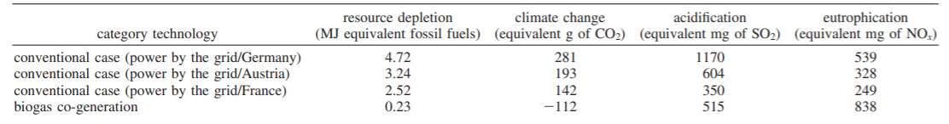
Pros of Biofuels: Environmental
This table shows common conventional fossil fuel combustion in industrialized countries and the equivalent environmental impacts of each and compares it to that of biofuels

Slide 5
Pros of Biofuels: Socio-Economical
Biofuels come in multiple different ways, which makes the supply more common.
-More options to produce, sell, and boost economy
Will help create jobs and boost the economy; family farms can have an extra boost of income
Reduces dependency on foreign sources for oil.
-Reduces overall exportation

Slide 6
Pros of Biofuels: Economical AND Environmental
Common Wastes can be reused as biofuels, limits landfills and incineration
Technology is improving at a increasing rate
-Production can increase drastically
Biomass cultivation can boost severely damaged land to better health

Slide 7
Cons of Biofuels- Economical
Very expensive to produce in comparison to fossil fuels.
-Hard to keep a steady supply
-Lower Yield
Production of biofuels can cause a drastic increase of food products being used for biofuels rather than a food source.
-Farmers increasingly putting crop yield to biofuels rather than food supply

Slide 8

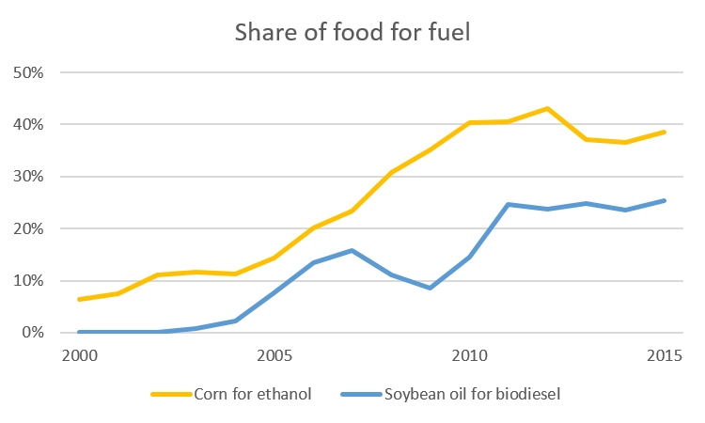
Cons of Biofuels- Impact on Food supply
The table shows the steady increase of basic crops such as corn and soybean yields being used for biofuel instead of food supply from 2000-2015

Slide 9
Cons of Biofuels- Environmental
Would cause some destruction in agricultural areas
-plants and organic material would diminish
May cause different pollution than that of traditional gas
-Nitrous Oxides

Slide 10
So, Are Biofuels Better For The Environment?
As a group, we decided that yes, in the end, biofuels are better for the environment than gasoline.
With a new Presidential administration, we will see what choices they make in regards to energy sources.

Slide 11
References
Works cited
“Biofuels Basics.” Energy.gov, www.energy.gov/eere/bioenergy/biofuels-basics.
Martin, J. (2016, June 23). Everything You Ever Wanted to Know About Biodiesel. Retrieved November 11, 2020, from https://blog.ucsusa.org/jeremy-martin/all-about-biodiesel
Petrou, Evangelos C., and Costas P. Pappis. "Biofuels: a survey on pros and cons." Energy & Fuels 23.2 (2009): 1055-1066.
Puppan, Daniel. "Environmental evaluation of biofuels." Periodica polytechnica social and management sciences 10.1 (2002): 95-116.
Shinde, R. A. "Biofuels: pros and cons." Cooperative Sugar 41.8 (2010): 31-33.

