Slide 1
Are Biofuels Better or Worse for Climate Change than Gasoline?
Present by:
Kossivi Essiomle, Abigail Machay, and Tatiana Mancera

Slide 2
Introduction
Today, we will be discussing the controversy between biofuels and gasoline. Gasoline has been around since the 19th century to power sources of transportation, and since then, there have been ways to reduce its emission of pollution. Therefore, there are constantly new alternatives being created in exchange of gasoline that will actually remove carbon from the air, such as biofuel. However, although biofuel was created as a new and better resource for the environment, in recent studies there have been some disadvantages that have halted its use and eﬀectiveness; it in fact has been discovered to not actually be carbon free and not be any better than gasoline.

Slide 3

Biofuel

Slide 4

Deﬁnition of Biofuel
Biofuel is a fuel that is produced through contemporary processes from biomass
Biofuel is manufactured from natural biological sources
  Including: crop waste, agricultural food crops, animal waste, and other bioproduct
Non- toxic and essentially environment- friendly

Slide 5
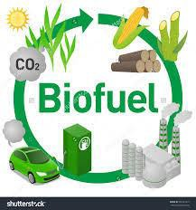
Advantages
Low Cost
Less expenses than gasoline and other fossil fuels
Energy security
Renewable energy source
Burns more cleanly
Biofuel spill are more easily degraded

Slide 6
Disadvantages
Not as eﬃcient as petroleum
  Biofuel has less energy than petroleum
High cost
Rise food price
Can cause food shortage
  Massive food used for fuel production can lead to food shortage
Water waste
  Important quantity of water are required for irrigation

Slide 7
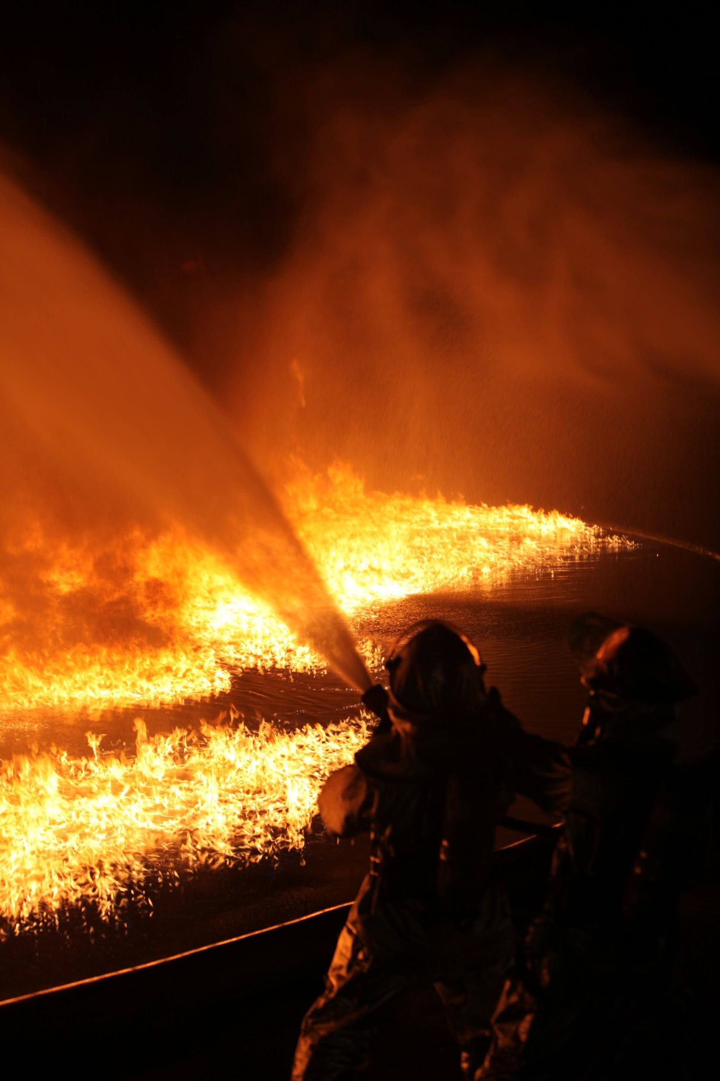
Gasoline

Slide 8
Deﬁnition of Gasoline
a volatile, ﬂammable, liquid, hydrocarbon mixture used as a fuel, especially for internal combustion engines, and usually blended from several products of natural gas and petroleum

Slide 9
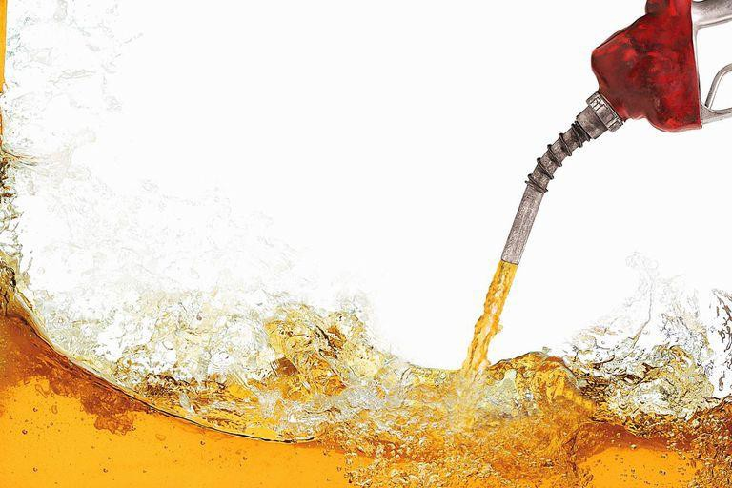
Advantages
Easy to obtain large consumptions at a time
  The United States used about 392 million gallons of ﬁnished motor gasoline per day in 2018
Used to power multiple types of motors
  Cars, light trucks, motorcycles, lawn mowers, small aircraft, boats and other watercraft, and landscaping and construction equipment
Gasoline is relatively inexpensive
Gasoline is widely available

Slide 10
Disadvantages
Toxic and highly ﬂammable
Evaporation and burning gasoline contribute to air pollution
Produces carbon dioxide
  Greenhouse Gas - a gas that contributes to the greenhouse eﬀect by absorbing infrared radiation (heat)
  Greenhouse Eﬀect - process that occurs when gases in Earth's atmosphere trap the Sun's heat
    Results in global warming and climate change
  22% of total U.S. energy-related carbon dioxide emissions from gasoline in 2018
●

Slide 11
Our Opinion

Slide 12
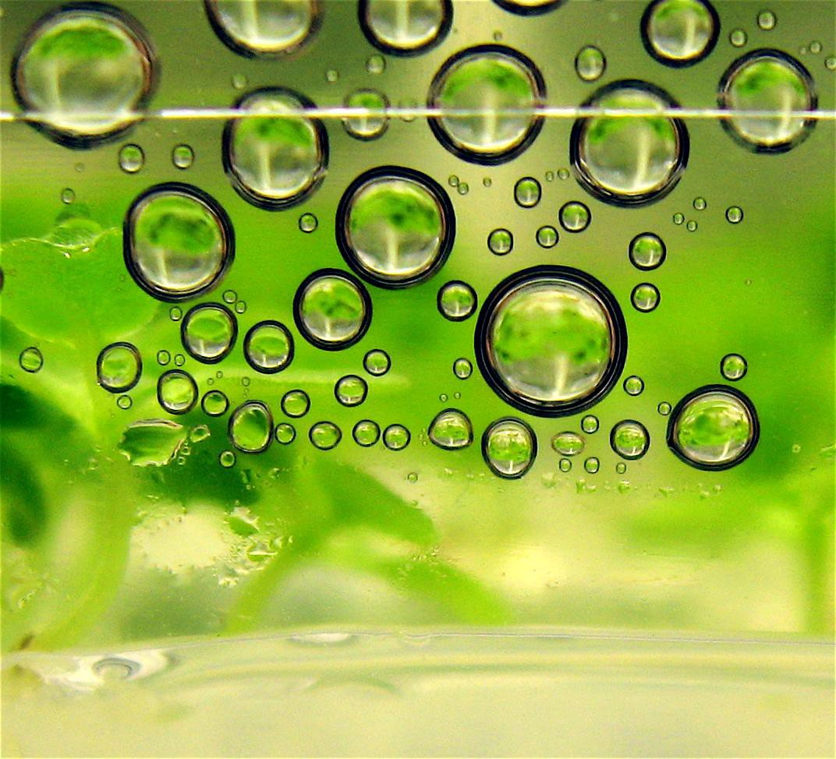
Our Opinion
All in all, we believe that biofuels are in fact worse for the environment than gasoline.
Although biofuels were thought to be more environmentally friendly because they are renewable alternatives to fossil fuels, recent studies have shown otherwise. Biofuels, in fact, have been found to increase the amount of greenhouse gas in the air because they are only absorbing 37 percent of CO2 that is later released into the atmosphere when the plants are burned. They dangerously compete with arable land for food production during a time when the global population will increase to 9.6 billion by 2050. Therefore, biofuels are in fact worse for climate change than gasoline because they are not doing anything.

Slide 13
References
Biofuel. (2019, November 18). Retrieved from https://en.wikipedia.org/wiki/Biofuel.
Gasoline. (n.d.). Retrieved from https://www.merriam-webster.com/dictionary/gasoline.
U.S. Energy Information Administration - EIA - Independent Statistics and Analysis. (n.d.). Retrieved from https://www.eia.gov/energyexplained/gasoline/gasoline-and-the-environment.php.
U.S. Energy Information Administration - EIA - Independent Statistics and Analysis. (n.d.). Retrieved from https://www.eia.gov/energyexplained/energy-and-the-environment/greenhouse-gases.php.
(n.d.). Retrieved from https://www.nature.com/scitable/blog/eyes-on-environment/the_biofuel_controversy/.

