Slide 1
Algae as a Energy Source
Group 5: Cory Berrien, Julia Mazur, Mikayla Faatz, Deven Schwartz

Slide 2
Introduction
Algae has the potential to be one of the major energy sources of the future, given its abundance and the new technologies that allow the extraction of its oil. Do the benefits of algae oil outweigh the negatives associated with it? Will the negatives costs that come along with the use of algae oil be to great for the positives that algae oil may provide? These questions and more may only be answered as the research into algae and its uses continues on.

Slide 3
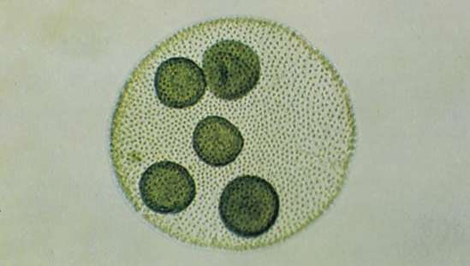
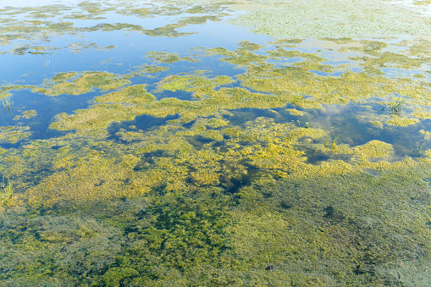
What is algae?
Algae is photosynthetic aquatic organism
Algae is classified by color
  Large range in living environments, life cycles, and sizes
It is the primary base of food chain for most aquatic life
  Almost all aquatic organism are reliant on algae as the base of their food chain
Large oxygen producer as a result of photosynthesis
  An estimated 30% to 50% of the world oxygen is a result from algae
Notes:
https://www.britannica.com/science/algae/Physical-and-ecological-features-of-algae

Slide 4
Uses of Algae
Algae is a supplemental food source
  Has a high protein content (up to 65%)
  Has been eaten around the world by many different cultures
Fossil fuels, specifically petroleum, is a result of ancient algae
Algae can be grown to extract crude oil as an alternative energy source
Notes:
Source of crude oil

Slide 5
How is Crude Oil Produced from Algae?
Algae must first be cultivated and collected to begin the process of oil extraction
To begin the extraction process the algae must undergo some type of chemical reaction to separate the oil from the rest of the material
  Heat, pressure, and or chemical additives are the common way to accomplish this
Once the reaction is complete, the algae will have separated into crude oil and waste water
  Depending on the process, as high as 70+% of algae carbon has been transformed into energy as oil

Slide 6
Algae Oil Production Continued
Once the crude oil has been produced it can be further refined into usable forms like diesel and ethanol
Waste water uses
  Can be further refined to yield other natural resources that are left over
  Reused as growing water to produce more algae
Lipids in the algae have a low presence, so companies are experimenting with selective breeding, genetic modification and fermentation processes to increase the yield

Slide 7
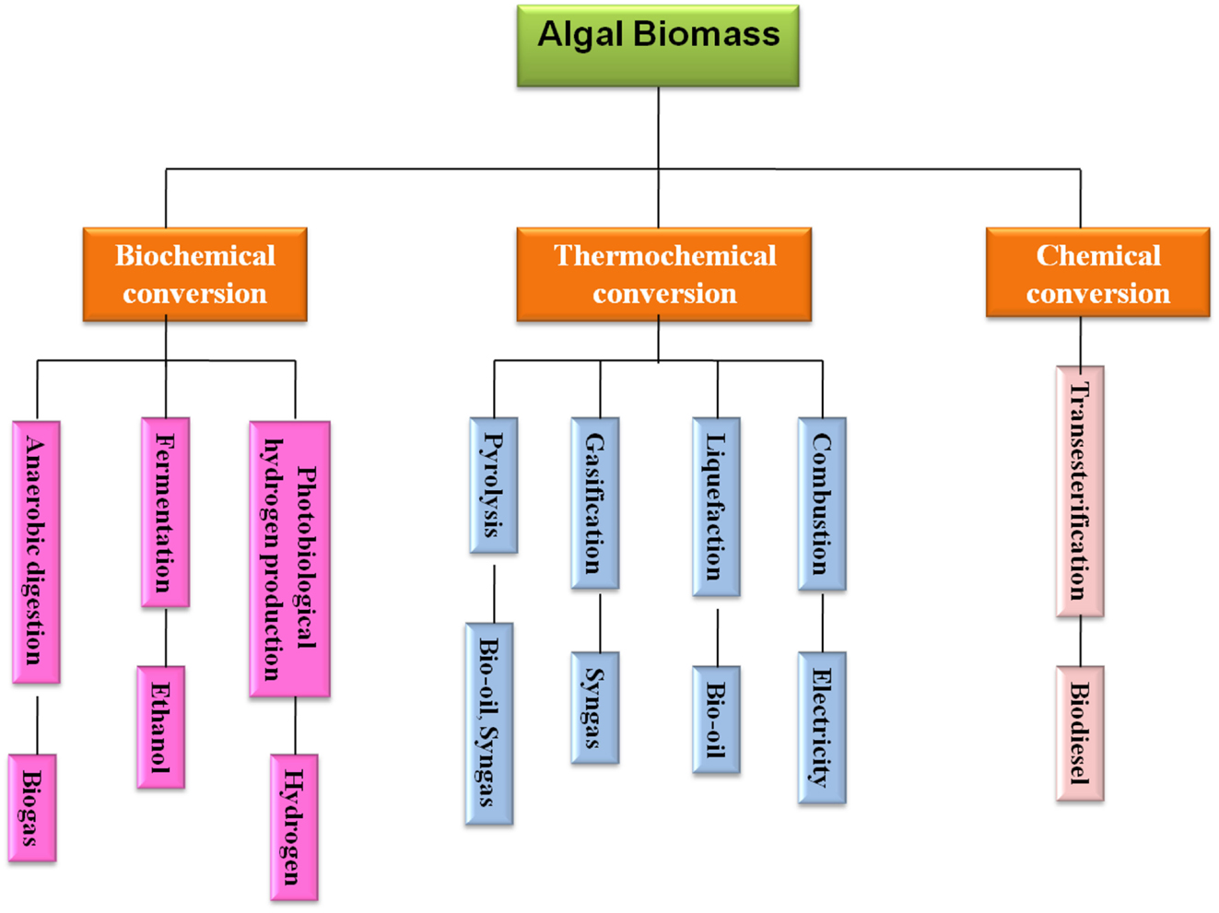
Algae Conversion Chart

Slide 8
Positives of Algae Energy
Notes:
https://springpowerandgas.us/pros-and-cons-of-algae-in-biofuel/
https://www.frontiersin.org/articles/10.3389/fbioe.2014.00090/full
https://corporate.exxonmobil.com/Climate-solutions/Advanced-biofuels/Advanced-biofuels-and-algae-research#Biofuelsresearchportfolio

Slide 9
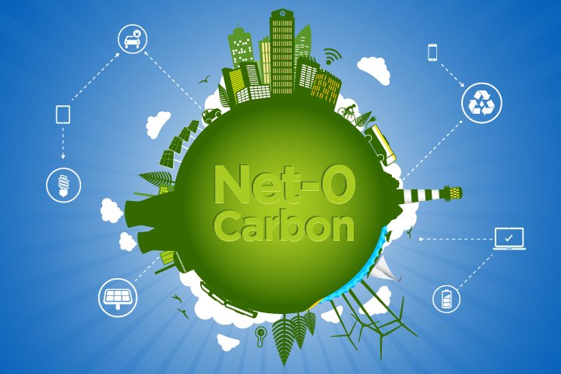
Carbon Net Zero Emissions
During the growth stage of algae carbon is captured from the environment
This carbon, when the algae oil is consumed, is released back into the environment
In the life cycle of the product no new carbon would be released into the environment
A big advantage is that algae feeds on the toxins produced in manufacturing
  This means that with this new fuel source mankind can both reduce the amount of toxicity in the environment while also helping clean up toxins already present

Slide 10
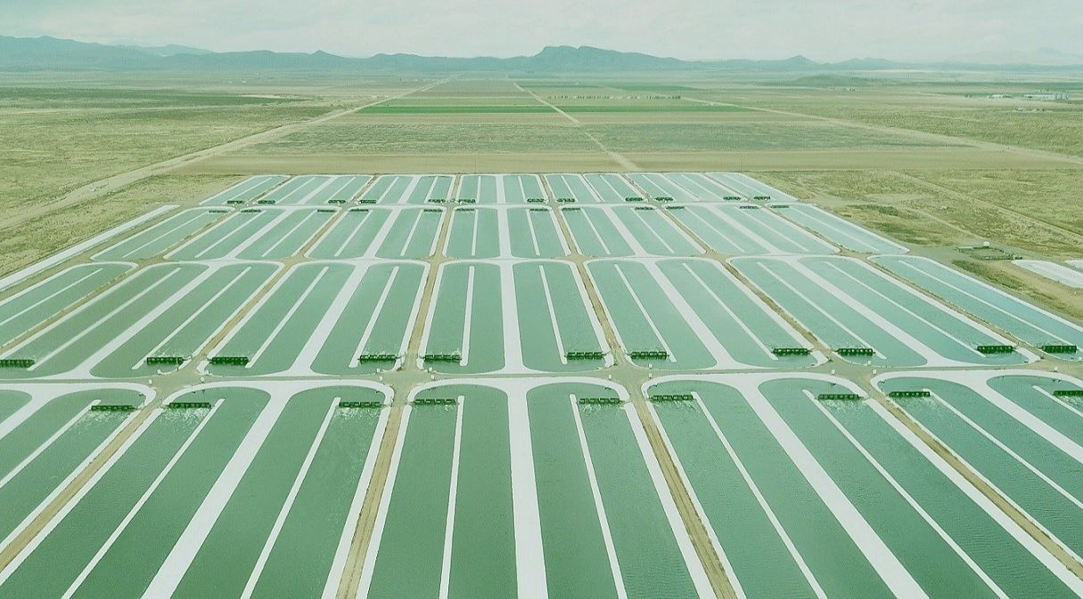
High Biofuel Yield and Easy to Cultivate
Compared to other biofuels the net yield of oil is very high
Per acre yield is 1500 gallons of fuel/year, significantly more than other conventional biofuel sources
Can be grown year round, increasing output per year
Different species of algae have large ranges of growth environments
  Allows for year round production almost everywhere
Tolerant to large range of conditions
  Land unable to grow other crops could be used
to produce algae
*Algae cultivation farm

Slide 11
Byproducts Produced
Several byproducts can be produced in the making of algae oil
  Fertilizers
  Phosphorus and nitrogen in wastewater
  Cleaning products
  Excess algae produced could be converted to food

Slide 12
An Alternative to Fossil Fuels
Provides an alternative, renewable source of fuel
Algae can be converted into many forms of fossil fuels that are currently being used
These biofuels are able to supplement fossil fuels at a net zero carbon footprint

Slide 13
Negatives of Algae Energy

Slide 14
High Cost
Final product is costly to produce
Extraction technology is expensive
Direct harvesting and gathering of algae is costly
Cost per barrel of algae oil is higher than normal oil
  > $300/barrel
  Can be significantly reduced with selling off byproducts but still greater than normal oil

Slide 15
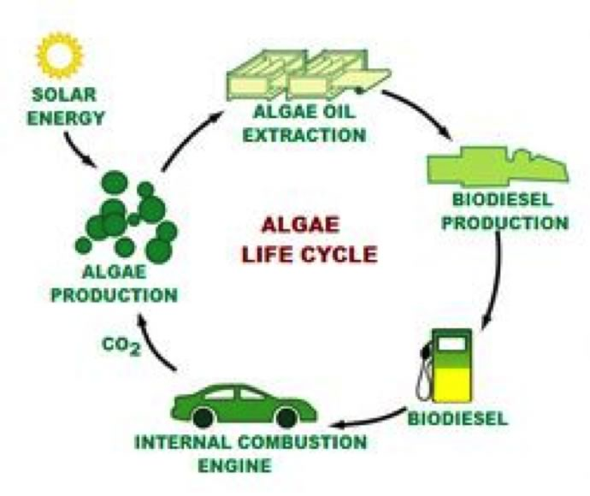
Loss of Energy
In the collection algae and the production of oil there is a large cost of energy
The loss of potential energy is as high as 30% of the total energy available
The large loss of energy leaves at worst only 70% of the energy remaining for other uses

Slide 16

Many Types of Algae Issue
Many different variations of algae
Large variation in efficiency of there production depending on what type it is
Specific types lack the ability to be cultivated in regions and would not be able to be used in production

Slide 17
Large Resource Strain
Requires many resources that could be used elsewhere
Large amount of water required to produce
  High temperature for best growth cause more evaporation
Fertilizer required for maximizing growth, taking it away from being used in other crops that may be for food
  Fertilizer production requires energy, taking away more from the potential energy that can be created

Slide 18
Complicated Production Process
Many steps involved in process
Growing conditions must be controlled to maximize the potential energy produced
Extraction of crude oil from algae takes time
Once oil is extracted it still needs to be refined further to be usable
Still lacking knowledge on best algae to use and when

Slide 19
Conclusion
The drawbacks to algae, like the high cost of production, make the current usability of algae oil as a sustainable source of energy difficult and impractical. However, with continued research into determining the best type of algae to use and lowering the cost associated with the production of the oil, algae has the potential to be a serious contributor to the world wide energy usage.

Slide 20
Resource Links
https://www.britannica.com/science/algae
https://www.pnnl.gov/news/release.aspx?id=1029
https://springpowerandgas.us/pros-and-cons-of-algae-in-biofuel/
https://www.frontiersin.org/articles/10.3389/fbioe.2014.00090/full
https://corporate.exxonmobil.com/Climate-solutions/Advanced-biofuels/Advanced-biofuels-and-algae-research#Biofuelsresearchportfolio
https://cla.auburn.edu/ces/energy/algae-as-energy-a-look-to-the-future/

