Slide 1
Does Algae Hold Much Promise as an Energy Source?
Paul Cimilluca, Samantha Moses, Taylor Dillon

Slide 2
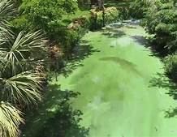
What Is Algae?
Algae is a simple, nonflowering, typically aquatic plant.
Most commonly recognized algae is seaweed, however there are many different forms of algae mainly single-celled organisms.
Algae contain chlorophyll but do not have stems, roots, leaves, and vascular tissue.

Slide 3
The Importance of Algae
Algae servers many roles in our environment, arguably the most important in these roles is the generation of oxygen through photosynthesis.
Algae is indispensable because algae produces around half of the Oxygen in Earth’s atmosphere.
We have also found that petroleum is partially derived from ancient algae deposits.
Knowing this Scientist who have been trying to eliminate fossil fuels have turned to Algae as a possible answer.

Slide 4
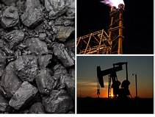
Fossil Fuels
Most common fossil fuels consumed daily are coal oil and natural gas.
Fossil fuels are known to give off harmful toxins
Fossil fuels are depleting at a rate so rapidly that scientist are rushing to find safer and cleaner alternatives

Slide 5
Why Algae
When researched scientist found that one can extract oils from algae to use for fuel.
Algae can be grown in vast array of places, one argument we came across when researching was to grow algae next to nuclear plants because algae needs CO2
Algae is fast growing, some algae can double in numbers in just a few short hours.
Algae can have high biofuel yields, algae store energy in the form of oils and carbohydrates. When studied the research shows that one acre of algae fields can produce between 2,000 to 5,000 gallons of biofuel per year.

Slide 6
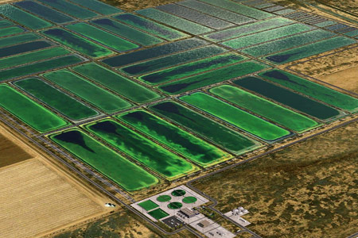
Why Algae Continued
Another positive is algae does not compete with agriculture, algae grows in areas that are unsuitable for other agriculture and it also grows in water sources that are not usable for other crops, like wastewater.
Another positive from algae is it can also purify waste water
The strongest argument for turning to algae as a fuel is it can be grown in a vast number of places there is no limit.

Slide 7
The Algae Industry
Over the past years the Algae industry has grown rapidly and it seems that more and more companies are starting to see algae as a viable alternative to fossil fuels
Many companies are transitioning to start or investing more heavily in the feild of algae.
Some of the leaders in this industry are Algenol Biofuels, Solix Biofuels, Sapphire Energy, Solazyme and Seambiotic.
One of the most notably large energy firms that have started to do more investment in the Algae field is Exxon Mobil.

Slide 8
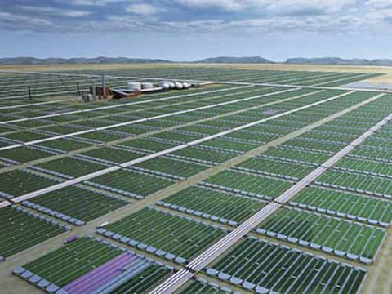
Algae Farms
Algae farms are usually large spanding many acres, so the key question that comes up is where to put these algae fields.
We have to sacrifice other resources in order to grow algae.

Slide 9
The Cost of Algae Biofuels
As of right now the cost of growing and converting algae into biofuels can be expensive but many of the companies say that as they do more research and refine the process it is getting less and less expensive.
One company Solix says that as of today it cost them $33 per gallon to produce the biofuel but estimates that in the near future with more and more research that price could be cut by 90%.
They would do this by exploiting waste heat at adjacent facilities and by selling the proteins and other byproducts from the algae for use in pet foods.

Slide 10
References
https://www.greentechmedia.com/articles/read/algae-biodiesel-its-33-a-gallon-5652
https://www.azocleantech.com/article.aspx?ArticleID=448
https://www.popularmechanics.com/science/energy/a4677/4333722/
http://allaboutalgae.com/benefits/#:~:text=Here%20are%2010%20reasons%20why%20algae%20are%20a,crops.%202%29%20Algae%20Can%20Have%20High%20Biofuel%20Yields
https://www.livescience.com/54979-what-are-algae.html

