Slide 1
Algae Fuels
Jennie Snyder, John Walter, Natalie Dowd, Joey Gayton

Slide 2
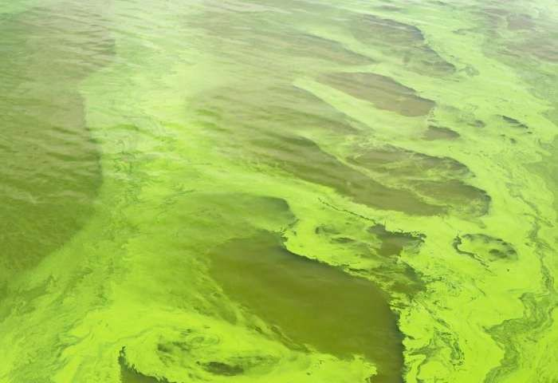
Algae Overview
Algae are tiny biological factories that use photosynthesis to convert CO2 and sunlight into energy-rich chemicals
Algae can live just about anywhere on Earth including seas, rivers, lakes, ponds, and trees
Algae can live anywhere there is sunlight for photosynthesis and water for reproduction
Algae are known for thriving in brackish water and wastewater

Slide 3
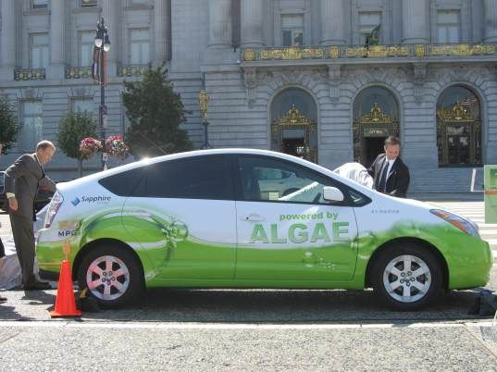
Algae Overview
There are more than 30,000 freshwater and saltwater species of algae
Nearly 1,000 algae species that have been studied so far exhibit the potential for producing biofuel
Of these species of algae, some store energy in the form of natural oils, and under the right conditions can make large amounts of oils
The large amounts of oil can be extracted and converted into biodiesel
The extracted oil can be used to create fuels for: cars, trucks, trains, and planes
https://inhabitat.com/first-algae-powered-car-attempts-to-cross-us-on-25-gallons/

Slide 4
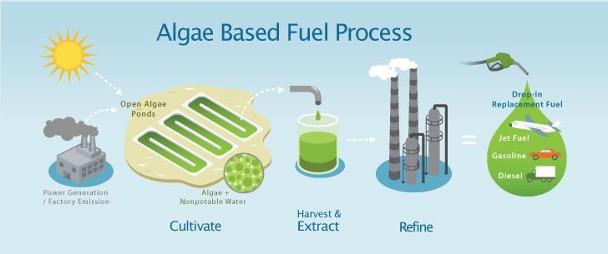
Algae Overview
Algae is cultivated at algae farms in large open ponds
The algae is harvested and the oil is extracted from the algae by breaking down the cell structure of the algae to release oil
After the oil is extracted, it is further processed at an integrated bioreﬁnery and then is ready to be used as fuel
In the future, anything that runs on gasoline or biodiesel will hopefully run on algae fuels
https://couldthishappen.com/2015/10/algae-power-could-soylent-green-be-the-future/

Slide 5
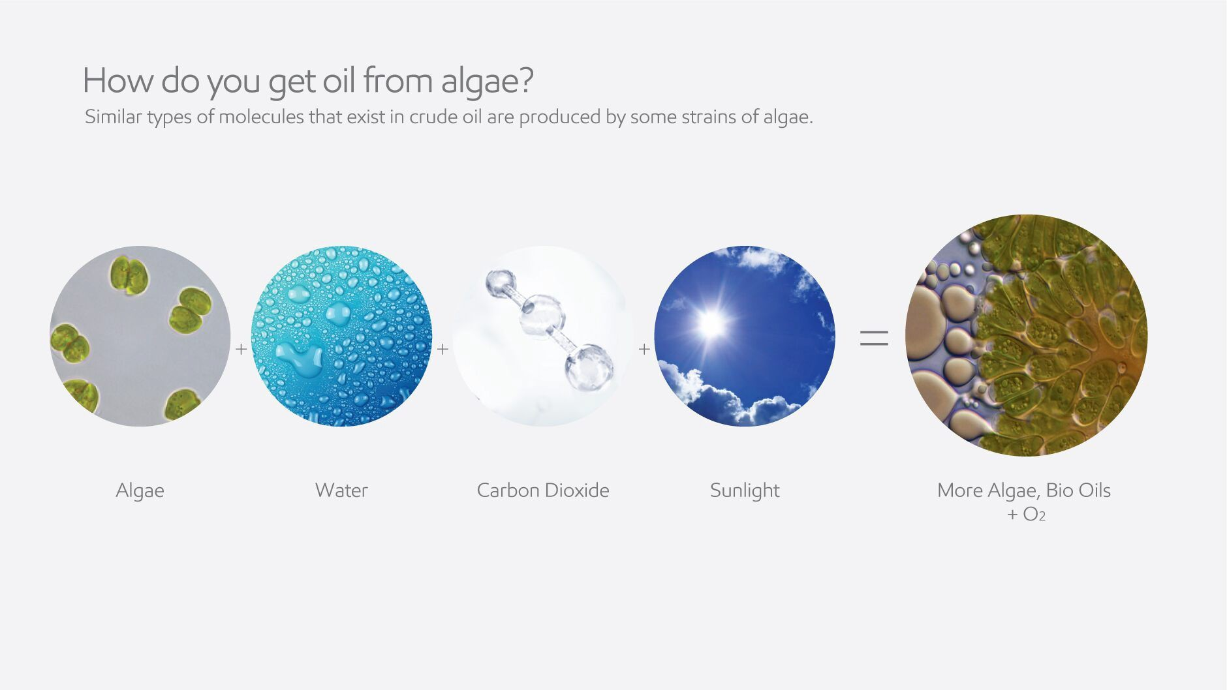
Algae Overview
https://corporate.exxonmobil.com/Research-and-innovation/Advanced-biofuels/Advanced-biofuels-and-algae-research#algaeForBiofuelsProduction

Slide 6

Perspective 1

Slide 7
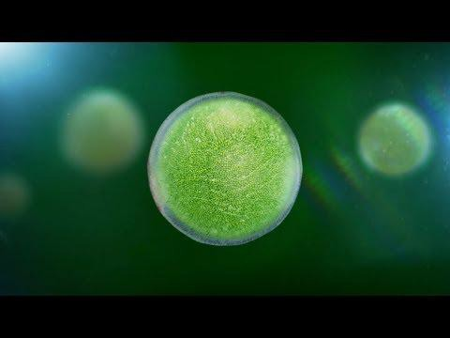
ExxonMobil Algae Fuel Commercial

Slide 8
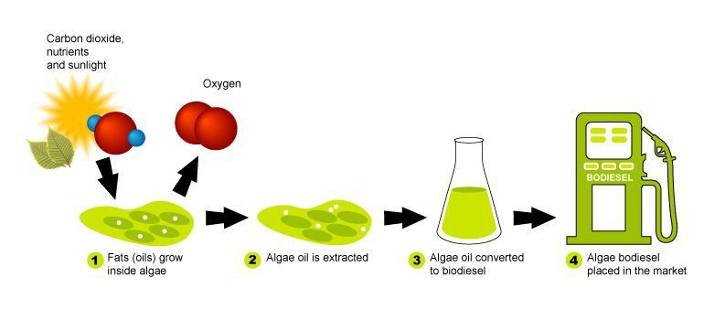
Algae
Fuel
https://lawofalgae.wiki.zoho.com/Chapter-1----Introduction-to-Algae-Biofuels.html

Slide 9
Beneﬁts of Algae Fuels
Algae can be produced in brackish water (including seawater) its production will not
strain freshwater resources
Algae consumes CO2
  On a life-cycle basis have a much lower emissions proﬁle than corn ethanol given energy used to make fertilizer, distill ethanol and farm/transport the latter
Algae can yield more biofuel per acre than -plant based biofuels – currently about 1,500 gallons of fuel per acre, per year
  almost ﬁve times more fuel per acre than from sugar cane or corn

Slide 10
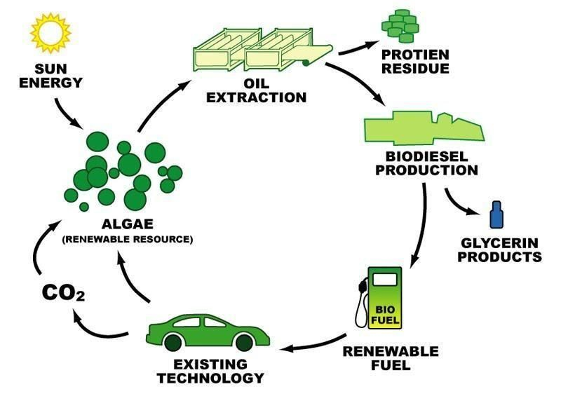
Algae: Low-Emission Fuel of Tomorrow
Algae Consumes CO2:
  Production sites can also act as carbon capture projects in addition to producing algae
Low-Emission Fuel:
  On a life-cycle basis, algae biofuels will emit about half as much greenhouse gas as
petroleum-derived fuels
High Yield:
  Each acre of algae yields more than 2,000 gallons of fuel compared to 650 gallons per acre of palm oil and
50 gallons an acre of soybean oil
https://www.google.com/url?sa=i&source=images&cd=&ved=2ahUKEwjz7-S9ipjmAhXkYt8KHbc1BRIQjRx6BAgBEAQ
url=https%3A%2F%2Fwww.researchgate.net%2Fﬁgure%2FCarbon-dioxide-close-cycle-for-biofuels-wwwknolgoogleco ﬁg1_303403359&psig=AOvVaw2fA8ZulMtlTPRzpw5hoXNw&ust=1575414347132212

Slide 11
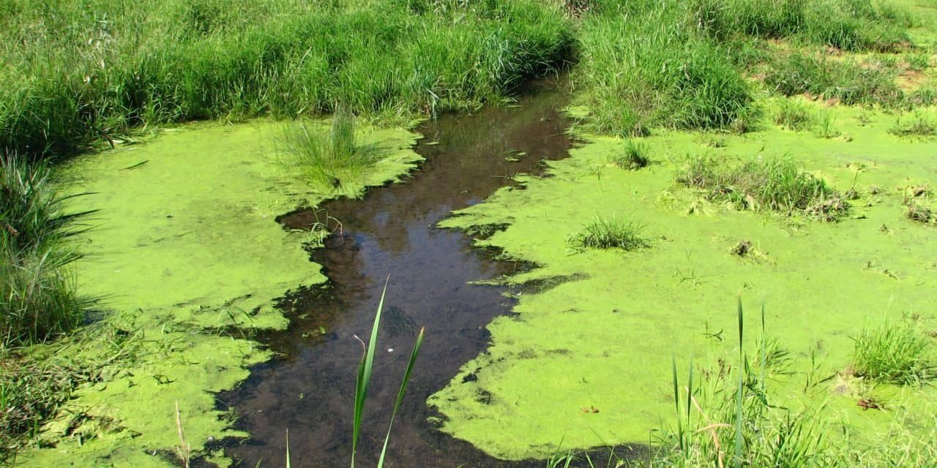
Algae: Low-Emission Fuel of Tomorrow
Year-Round Harvest:
  Harvested repeatedly throughout the year unlike other feedstocks; such as corn.
Food Production:
  Algae can be cultivated on unsuitable land with water that cannot be used for food production
Water Puriﬁer:
  Algae can be grown in wastewater or industrial effluent (sewage discharged into a river or sea) and can purify polluted water while producing energy-rich biofuel

Slide 12

How Algae can beneﬁt consumers???
Engine Ready:
  Algae-derived diesel can be pumped into existing diesel automobiles without making major changes to car engines or the infrastructure
Producing algae does not compete with
sources of food, rendering the
food-vs.-fuel quandary a moot point
(unlike ethanol or biodiesel)

Slide 13
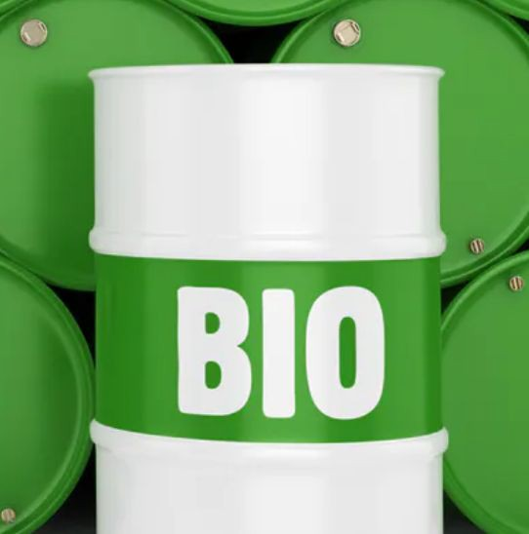
Perspective 2
Environmental Damage

Slide 14
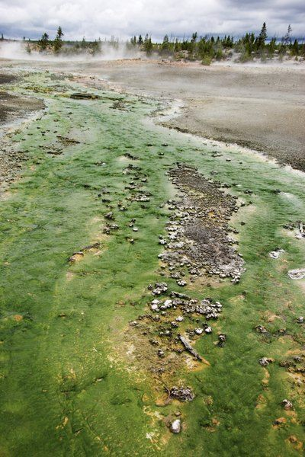
Explanation
Production of algal biofuels is neither commercially nor environmentally sustainable
Attainable production levels are a fraction of those that were claimed
Amount of biofuel produced from prolonged culture of algae in pilot-scale systems is actually not too dissimilar from those of terrestrial plant
  around 5,000 to 10,000 litres per hectare per year

Slide 15
Two Perspectives for Viewpoint #2
(scientiﬁc perspective) The production of algae has negative eﬀects for the environment
Too much Algae can harm an aquatic ecosystem
Algae production consumes more energy, higher greenhouse gas emissions, uses more water than other biofuel sources
(Economic perspective) Cost associated with reversing the negative eﬀects from Algae production would be high and unnecessary compared to alternatives sources (corn)

Slide 17
Explanation
According to the charts algae fuels are expected to release more Carbon Dioxide per MJ then diesel fuel. (~0.07 MJ for diesel, while ~0.1 MJ for algae fuel)
The energy yielded for algae fuel is almost similar for energy used to produce it. This ends up having a small net yield and may not be sustainable.

Slide 18
Do we agree?
Based on the research and available data, we believe that algae fuel would be a good source of renewable energy.
However, we also believe that there needs to be a better more eﬃcient way to be able to manufacture/ produce usable algae.
With oil and fossil fuels being pumped out, having this source of energy will greatly help out the future generations.

Slide 19
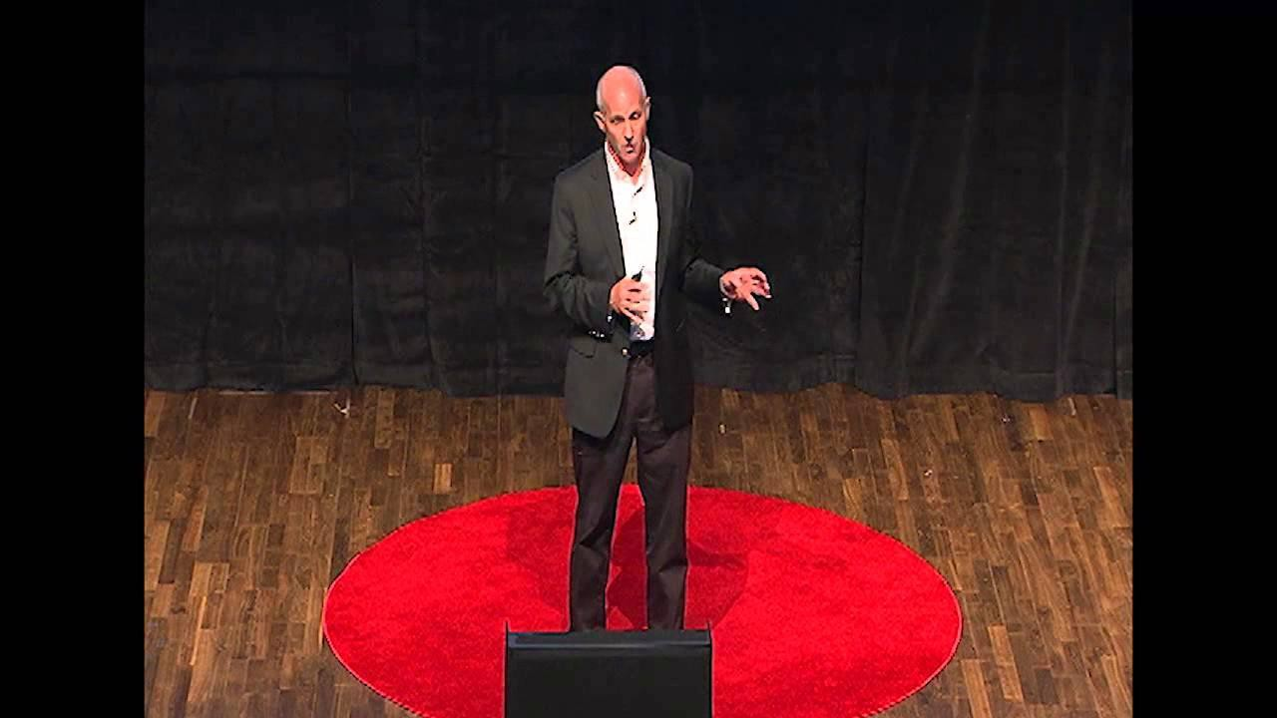
Conclusion
Research and development could improve a lot in this ﬁeld and could have potential of become the biofuel of the future.
Having already discovered about 1000 species of algae that have a chance to be fuel, who knows how many other types can be discovered.
Having so many species discovered, may lead to having more energy extracted out of these organisms.
https://www.youtube.com/watch?v=eWMQysrBGDk&t=359s

Slide 20
References
2014, Will SoutterSep 16. “What Is Algal Fuel?” AZoCleantech.com, 17 Apr. 2019, www.azocleantech.com/article.aspx?ArticleID=406.
“Algae Power: Could Soylent Green Be the Future?” Could This Happen?, 21 Oct. 2015, https://couldthishappen.com/2015/10/algae-power-could-soylent-green-be-the-future/.
Chapter 1 - Introduction to Algae Biofuels - Selecting Algae Species, Algae Production Issues, Harvesting Algae and Extracting Oil, and Converting Algae Oil to Biofuels, https://lawofalgae.wiki.zoho.com/Chapter-1----Introduction-to-Algae-Biofuels.html.
Chino, Mike. “First Algae-Powered Car Attempts to Cross US on 25 Gallons.” Inhabitat Green Design Innovation Architecture Green Building, Inhabitat, 9 Sept. 2009, https://inhabitat.com/ﬁrst-algae-powered-car-attempts-to-cross-us-on-25-gallons/.
Guiry , Michael. “Algae.” EOL, https://eol.org/docs/discover/algae.
Keane, Eamon. “Algae Biofuels - Not Sustainable.” Seeking Alpha, Seeking Alpha, 28 Jan. 2010, https://seekingalpha.com/article/185070-algae-biofuels-not-sustainable.
“The Power of Algae.” Energy Factor, 9 June 2017, https://energyfactor.exxonmobil.com/science-technology/power-of-algae/.
Smith, Colin. “Imperial Academic Discusses His Work on Algae Fuel Factories.” Phys.org, Phys.org, 4 July 2017, phys.org/news/2017-07-imperial-academic-discusses-algae-fuel.html.
Swarup, Vijay. “Advanced Biofuels and Algae Research.” ExxonMobil, 17 Sept. 2018,
https://corporate.exxonmobil.com/Research-and-innovation/Advanced-biofuels/Advanced-biofuels-and-algae-research#biofuelsResearchPortfolio
.
WalkerJan, Kris. “Turning Algae into Oil.” AZoCleantech.com, 17 Apr. 2019, https://www.azocleantech.com/article.aspx?ArticleID=345.

