Slide 1
Should the Alaska National Wildlife Refuge (ANWR) be opened for oil and gas development?
Robert Bruce, Bridget Hannon, Regan Metz, Jawun Tabb
Department of Biology at Wilkes University BIO 105: Energy in our World

Slide 2
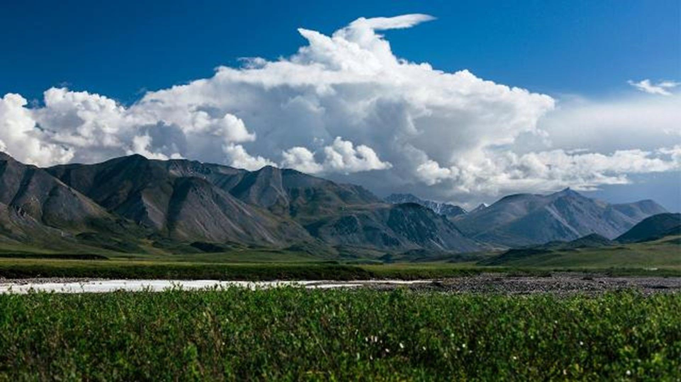
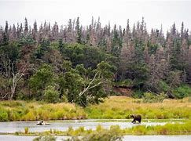
The Alaska National Wildlife Refuge (ANWR)
North-Eastern part to the state
President Theodore Roosevelt
The Public Land Order (PLO) 2214
December 6, 1960
Created because the wildlife in the area and the land itself

Slide 3
The Political Lens
As the semester progressed, I learned more about the political implications of our topic, "ANWR oil and gas development." For those unfamiliar with the term, political impact is defined as: an of or pertaining to civil government, as opposed to military government; b of, involved in, or connected with government
policy-making; c of, involved in, or connected with government policy-making; d of, involved in, or connected with government policy-making; d of, involved in, or connected with government policy-making; d of, involved in, or connected with government policy-making; d of, involved in, Tax policy, labor law, and trade restrictions are some examples of themes that have a significant political impact.

Slide 4
Tax Policy
Tax Policy- A government's choice of what taxes to charge, in what amounts, and on whom is known as tax policy. It is microeconomic as well as macroeconomic in nature. The purpose of tax policy is to produce income for government purposes rather than to affect company and personal decisions. Growth and efficiency in the economy The tax system should not obstruct or impair the economy's productive capabilities. Also, if you notice there are 3 different types of three types of taxation: regressive, proportional, and progressive. Two of these schemes have differing effects on high- and low-income earners. Lower-income people are more affected by regressive taxation than the wealthy.Low-, middle-, and high-income earners are all affected equally under proportional taxation, commonly known as a flat tax. Regardless of income, they all pay the same tax rate. A progressive tax has a greater financial impact on higher-income people than it does on lower-income people.

Slide 5
Labor Law
Labor Law-Is legislation specifying responsibilities and rights in employment, particularly the responsibilities of the employer and the rights of the employee. Laws differ among jurisdictions; this definition pertains to labor law within the United States.The purpose of Labor Law is to equalize the bargaining power between employers and employees. The laws primarily deal with the relationship between employers and unions. Not to mention, the wage and hour division of the United States Department of Labor administers and enforces some of the country's most comprehensive labor regulations. The Fair Labor Standards Act is one of them. These rules apply to everyone though. These are 3 of them minimum wage,overtime and misclassification.

Slide 6
3 Types Of Labor Laws
Minimum Wage - A minimum wage is the lowest salary that businesses are legally permitted to pay their employees—the price floor below which employees are prohibited from selling their labor. By the end of the twentieth century, most countries had enacted minimum wage legislation.
Overtime - Overtime work is required or permitted by an employer. Workers who work more than 40 hours per week are entitled to overtime pay under the Fair Labor Standards Act. This rule has only a few exceptions.
Misclassification - A worker is described as an independent contractor by an employer. According to the legislation, the worker is an employee. This is a case of misclassification, which can lead to:
Affect a worker's pay, perks, and safeguards
Both firms and employees will face tax concerns as a result of this.
Contact your state labor office or register a complaint with the Department of Labor if you believe you have been misclassified.

Slide 7
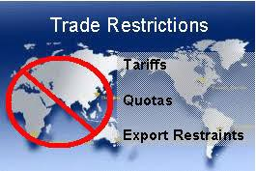
Trade Restriction
A trade restriction is a restriction on the exchange of products and/or services between two or more countries that is imposed artificially. It's a side effect of protectionism. An Example of a trade restriction is? A Trade Barrier
Trade Barrier - When a government erect hurdles
to free commerce between national economies, which are referred to as trade barriers. As a result, trade barriers are essentially interventions in markets that function on a global scale. Tariffs (taxes) on imports (and occasionally exports) are one type of trade barrier, as are non-tariff obstacles such as import quotas, domestic industry subsidies, trade embargoes (typically for geopolitical reasons), and licenses to import goods into the economy.

Slide 8
Environmental Impacts
Oil Drilling is well known for its negative effect on the environment.
This is why ANWR oil drilling was stopped. To try to put an end to the pollution it was creating.
Oil drilling pollutes the ocean, arctic ice, and kills animals

Slide 9
Environment Continued
Thousands of barrels of crude oil gets spilled into the oceans
Even a small oil spill can take decades to clean up
The oil rigs themselves use dangerous chemicals that leak into the ocean

Slide 10
Environment Continued
The oil that went into the ocean kill the fish and other sea life, by suffocating them
Other animals are affected like the animals that eat fish. For example birds and reptiles
People worry that if the drilling gets started in the Arctic the native species will get harmed
This includes endangered species such as polar bears and seals

Slide 11
Environment Continued
Oil spills are also very difficult to clean up
In the open ocean many boats are used to clear it up, but in the Arctic the sheets of ice make things harder
Breaking up the ice also harms the habitat
Overall ANWR drilling does horrible damage to the environment that will take decades to repair

Slide 12
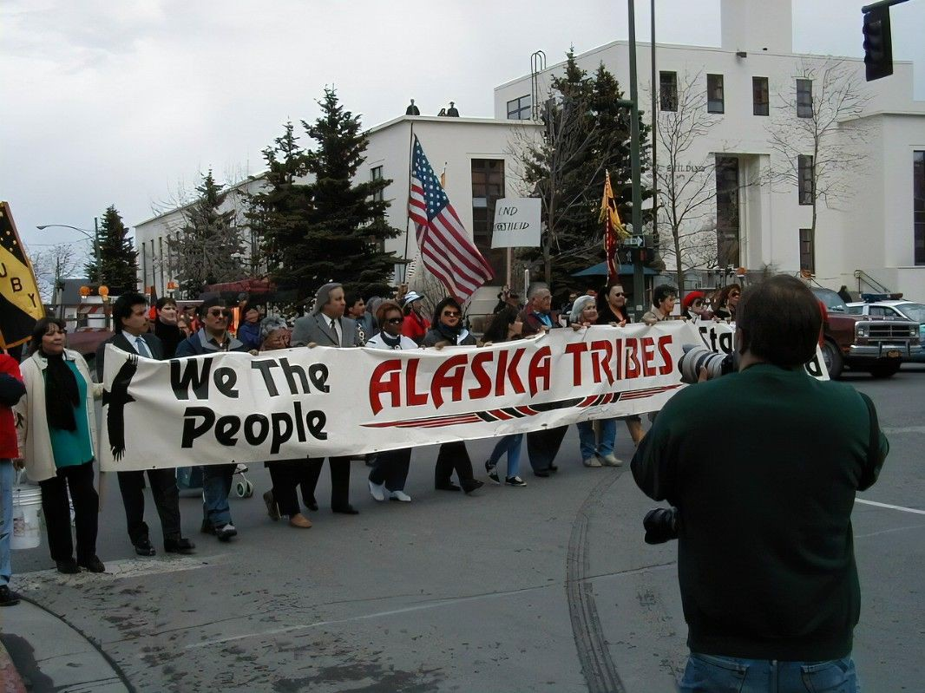
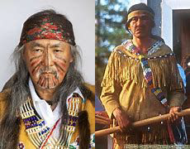
Social Lens
These are the people of the Gwich’in tribe.
The tribe lived in the area prior to the creation of the Refuge and was authorized to keep living their by the government.
Drilling there would be talking away their land that the government said they could keep
It would just be another broken promise to the native community.

Slide 13
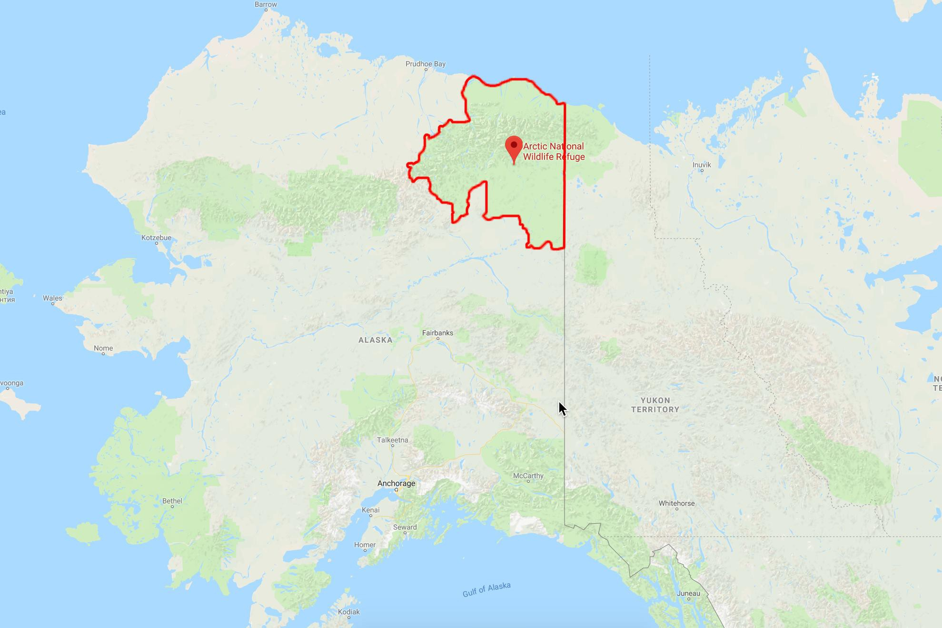
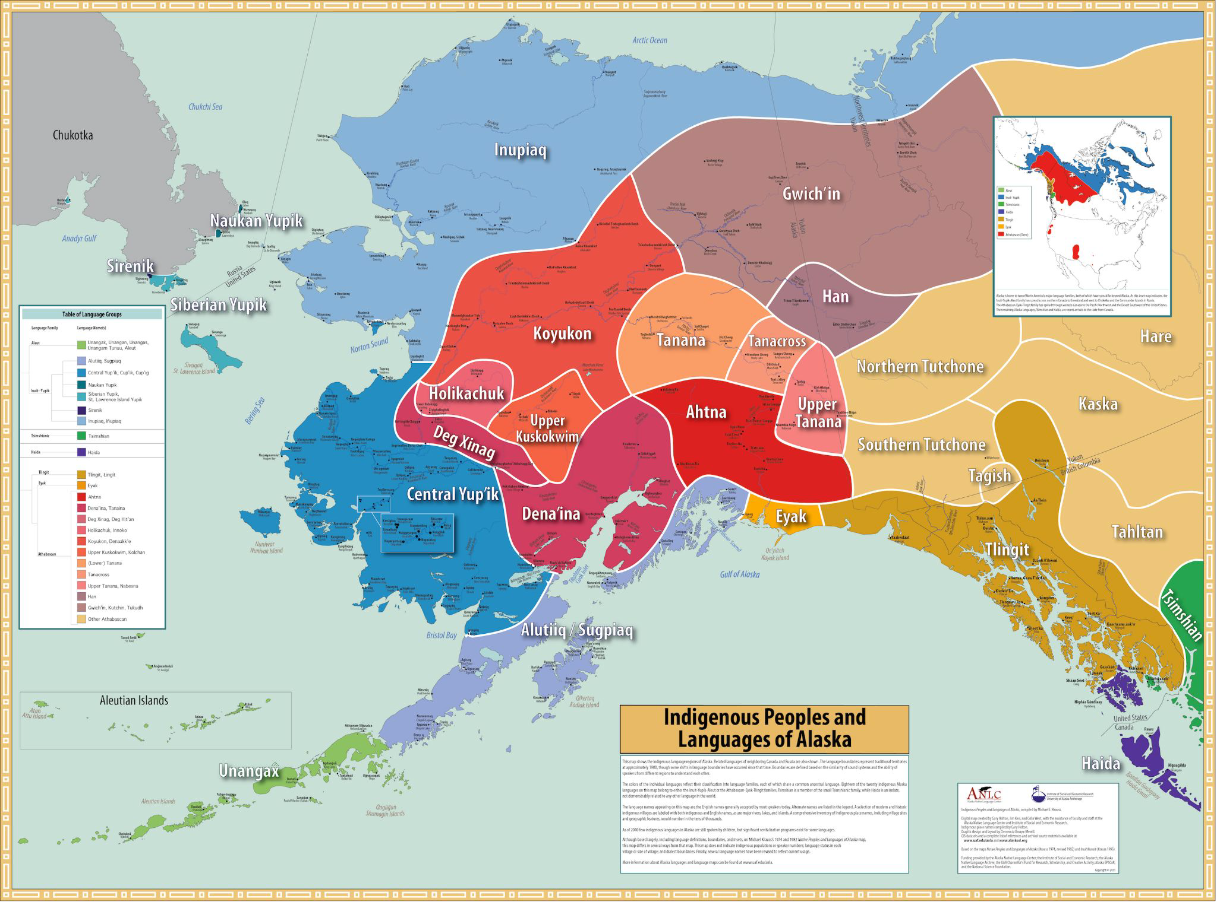
Location of Territory
The Gwich’in tribe lives in the majority of the proposed drilling area along with the Inupiaq tribe

Slide 14
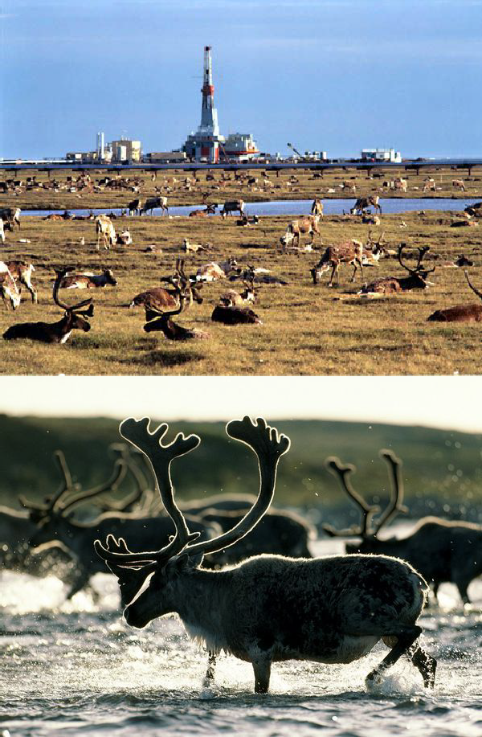
Caribou
The development of the drilling area would drive the carabo away due to habitat loss.
Caribou are spiritually connected with the people and are a main source of their food and supplies.

Slide 15
Economic Impact
Though there is so much hate on fossil fuels, they are essential to our economy
Sources say that Alaska has the potential to become the nation's largest oil producing state, sepacing Texas.
10.4 billion barrels of oil is said to be within the area of potential drilling.
With everything running properly, an estimated 1.45 million barrels of oil per day could be produced.
For Reference: that is more than the U.S. imports from Saudi Arabia every day.

Slide 16
Economics Continued
Countries like Mexico, Angola, Azerbaijan, Norway, India, Indonesia, Malaysia, Egypt, Australia and New Zealand, Turkmenistan, and Uzbekistan would become irrelevant when it comes to oil imports.
A major increase in the likelihood of energy independence which equals saving more money.
Could generate approximately $150 billion to $296 billion in new federal revenue. 55,000 to 130,000 jobs will be created

Slide 17
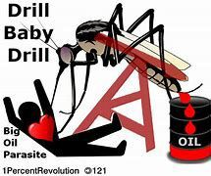
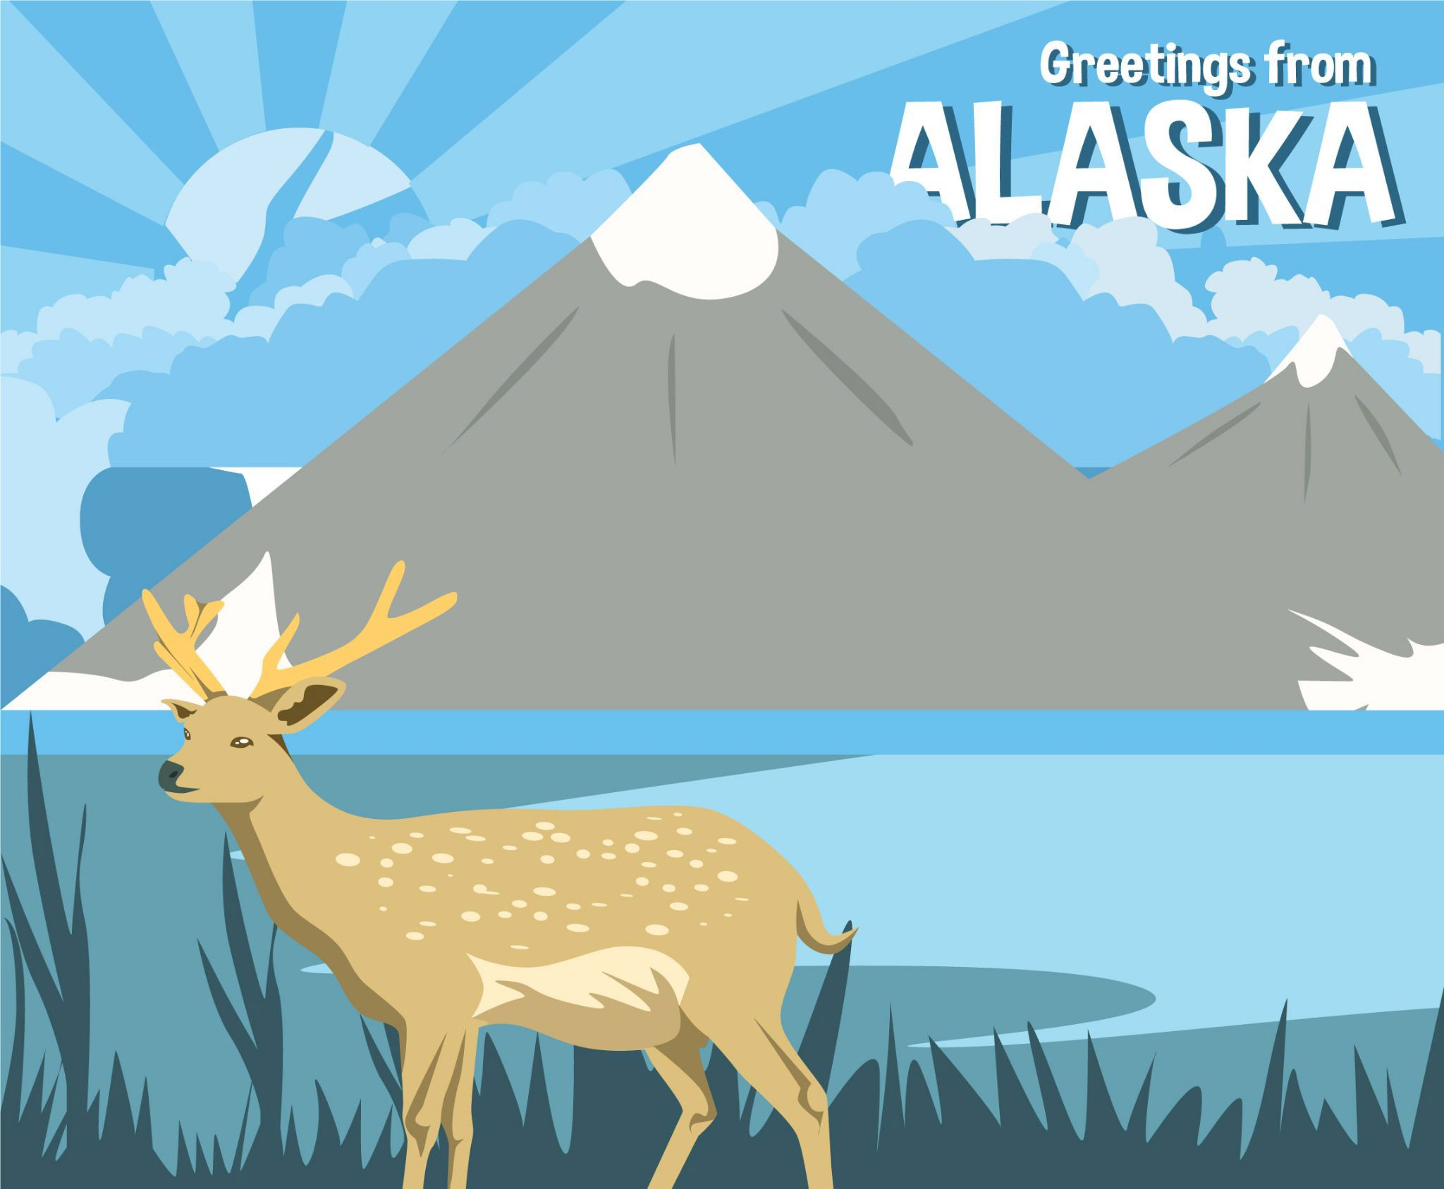
Final Statements
Those in Favor: Economics
Those Opposed: Environmental
Social Political
Our results are consistent with the current national atmosphere.
Don Young introduced the America Needs Worthwhile Resources (ANWR) Act

Slide 18
Works Cited
Alaska Wild Organization. (2021). People of the Arctic National Wildlife Refuge. Alaska Wild Organization. Retrieved November 22, 2021, from
https://www.alaskawild.org/wp-content/uploads/2014/10/People-of-the-Arctic-National-Wildlife-Refuge.pdf
Another big reason to open ANWR for safe development. Energy API. (n.d.). Retrieved December 3, 2021, from https://www.api.org/news-policy-and-issues/blog/2018/06/15/another-big-reason-to-open-anwr-for-safe-development.
ANWR: Producing American Energy and creating American Jobs. Committee on Natural Resources Republican Office. (n.d.). Retrieved December 3, 2021, from https://republicans-naturalresources.house.gov/anwr/.
Don Young Staff. (2021, March 19). Congressman Don Young introduces the ANWR Act to prohibit executive actions harmful to responsible energy development. Don Young: Congressman for All Alaska.
Retrieved December 1, 2021, from https://donyoung.house.gov/news/documentsingle.aspx?DocumentID=401903
Indigenous Religious Traditions (Ed.). (2021). Arctic National Wildlife Refuge. Indigenous Religious Traditions. Retrieved November 22, 2021, from
http://sites.coloradocollege.edu/indigenoustraditions/sacred-lands/arctic-national-wildlife-refuge/#:~:text=Arctic%20National%20Wildlife%20Refuge%20The%20arctic%20tundra%20of,animal%20speci es%20including%20wolves%2C%20muskox%2C%20bears%2C%20and%20caribou.
Jans, N. (2005, Apr 27). Why are we talking about just ANWR? ; the wildlife refuge has been a lightning rod for years, but the truth is that 95% of alaska's arctic coastal plain is open to gas and oil leasing. pro-development interests certainly know the lay of the land. most americans, though, don't.: [FINAL edition]. Usa Today Retrieved from https://wilkes.idm.oclc.org/login?url=https://www.proquest.com/newspapers/why-are-we-talking-about-just-anwr-wildlife/docview/408950684/se-2?accountid=62703
NOAA (2020, August 1). Oil Spills from https://www.noaa.gov/education/resource-collections/ocean-coasts/oil-spills
U.S. Fish & Wildlife Service. (2020, October 9). Alaska national wildlife refuges. Alaska Region:Conserving the Nature of America. Retrieved November 16, 2021, from https://www.fws.gov/alaska/pages/national-wildlife-refuges
Zentner, E., Kecinski, M., Letourneau, A., & Davidson, D. (2019). Ignoring indigenous peoples—climate change, oil development and indigenous rights clash in the arctic national wildlife refuge. Climatic Change, 155(4), 533-544. doi:http://dx.doi.org/10.1007/s10584-019-02489-4

