Slide 1
Alaska National Wildlife Refuge
Kacee Diehl, Sheena Patel, Greg Steo

Slide 2
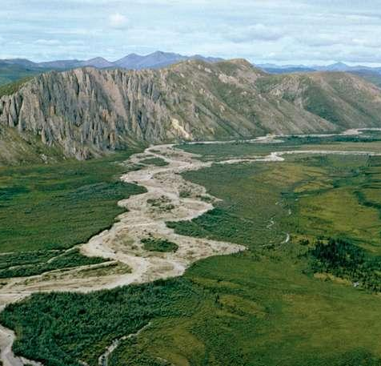
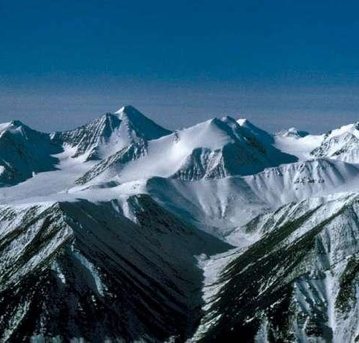
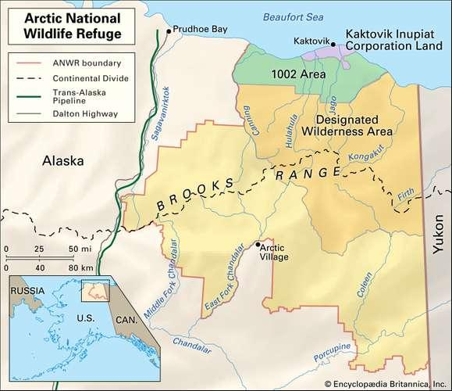
A.N.W.R
Established in 1960 as Arctic National Wildlife Range with an area of approximately 13,900 square miles.
Renamed Arctic National Wildlife Refuge in 1980, acquired more land throughout the 80’s.
Refuge’s current land mass is about 30,500 square miles.
SOURCE: “Arctic National Wildlife Refuge”,Kenneth Pletcher, Encyclopædia Britannica(2017)

Slide 3
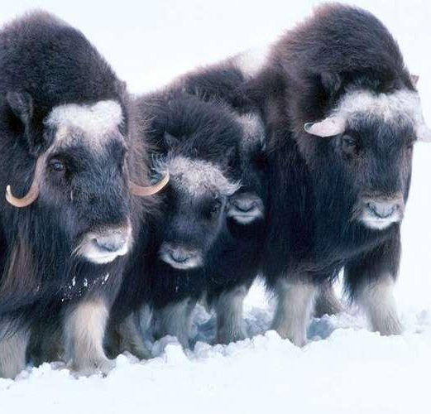
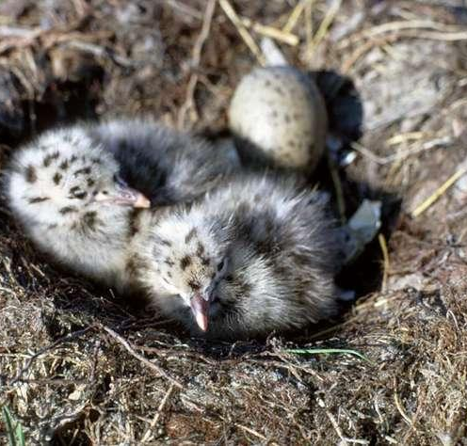
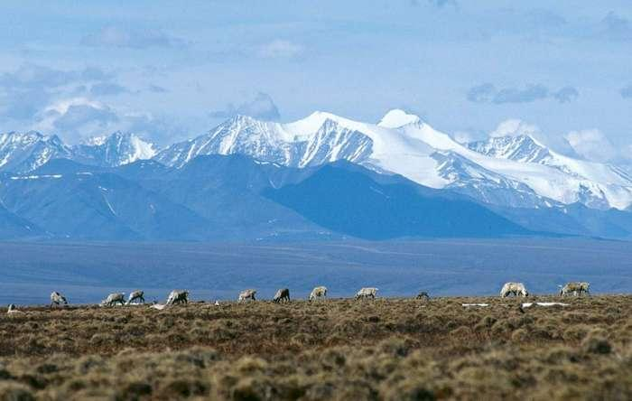
A.N.W.R(cont.)
4. Arctic National Wildlife Refuge protects several ecological zones:
- Alpine tundras
-Boreal forests
-Arctic tundra zone: the landscape is underlain by permafrost
5.Home to nearly four dozen mammal species and some 200 species of birds. Mammal species include musk oxen, moose, gray wolves, red and Arctic foxes, black and brown bears, and more.
SOURCE: “Arctic National Wildlife Refuge”,Kenneth Pletcher, Encyclopædia Britannica(2017)

Slide 4
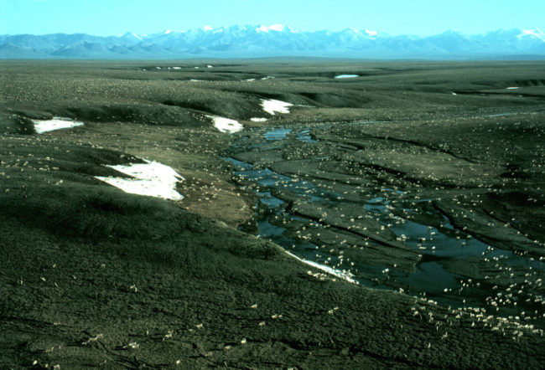
Oil Discovery in ANWR
Resource assessment done in 1998
  The United States Geological Survey (USGS) estimated there is a 95% chance for there to be more than 5.7 billion barrels of recoverable crude oil and a 5% chance of 16 billion barrels
  Estimates based on:
    Oil productivity in neighboring lands in Alaska as of 1998
    Two-dimensional seismic data that was collected in 1984-1985
      A lot of uncertainty remains regarding size and oil quality
IMAGE: U.S. Fish and Wildlife Service
SOURCE: https://www.eia.gov/outlooks/aeo/anwr.php

Slide 5
The Political Journey
1977: Capitol Hill was debating what land areas in Alaska should be developed and what should be reserved
For a while, ANWR was in limbo
  Interior Department was asked to research the area for possible oil production
1987: during Reagan’s presidency, the Interior Department recommended drilling in the ANWR
  Was announced as being the best way to increase domestic oil production, but would be harmful to wildlife
March 1989: Senate committee approved leasing
  10 days later: Exxon Valdez oil spill
It was a struggle to get it passed in the Senate
It continues to be a battle as of present day

Slide 6


Different Political POVs
Trump
Attempting to “lock in drilling rights” before Biden has an opportunity to stop it
Asking oil and gas companies to take spots within the refuge
Energy Independence
Important for nation’s energy security
SOURCE: https://www.washingtonpost.com/climate-environment/2020/11/16/arctic-refuge-drilling-trump/
Biden
Agrees we needs to lessen foreign sources of energy
Thinks opening the ANWR is a short-sighted solution
May have devastating long-term effects
Stresses priority of preserving Alaska’s wilderness
SOURCE: https://justfacts.votesmart.org/public-statement/84921/statement-by-senator-biden-on-senate-approval-to-drill-in-arctic-national-wildlife-refuge

Slide 7
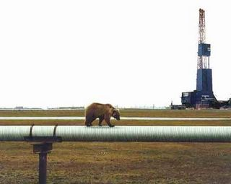
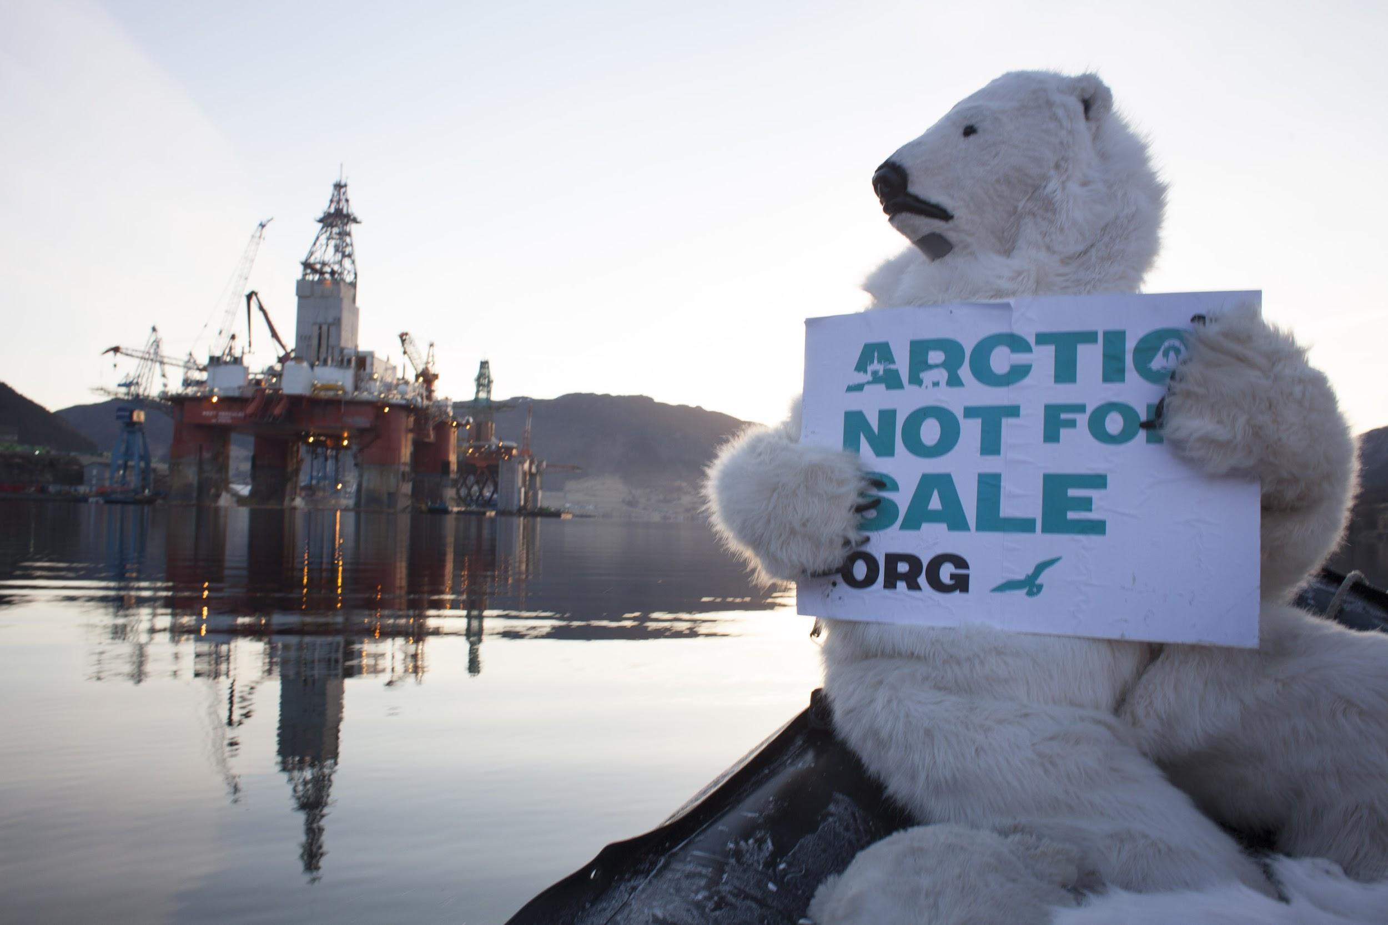
OIL CONTROVERSY IN ANWR
IMG:ILLINOIS REVIEW
IMG:NICK COBBING

Slide 8
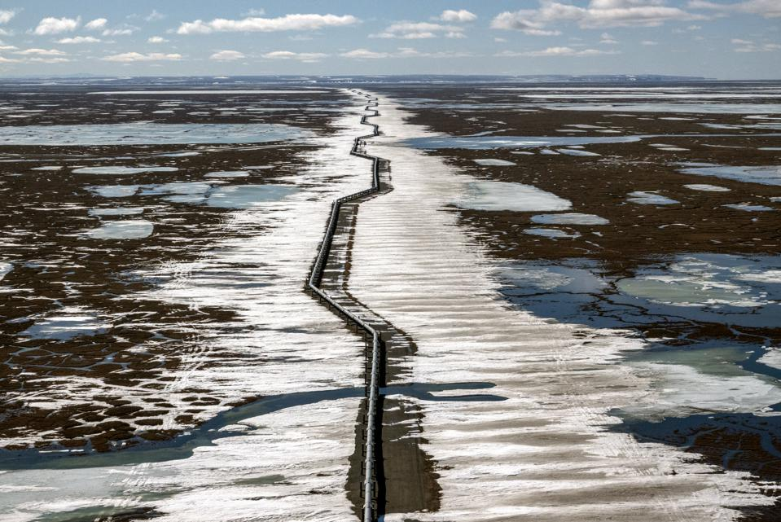
Controversy: Should ANWR Be Drilled?
SUMMARY OF THE CONTROVERSY
In 1998, a report by the U.S. Geological Survey estimated there was 5.7-16.0 billion barrels of recoverable oil in the ANWR
Big Controversy:
  Drilling and extracting oil in one of the largest and most pristine regions in North America
  Is it worth opening up a protected refuge to extract oil from what could be the largest reserve in the country?
  There are strong points that support both sides of the argument
Getty Images
SOURCE: “Arctic Refuge Drilling Controversy.” Wikipedia, Wikimedia Foundation, 5 Oct. 2020, en.wikipedia.org/wiki/Arctic_Refuge_drilling_controversy.

Slide 9
Pro-Drilling
ANWR may contain enough oil to replace all other oil imports to U.S. (Dominance)
U.S. GDP may increase
Oil is non-renewable, therefore it is beneficial to create more supply by opening the land for extraction
Oil is still being heavily used in U.S. and other parts of the world - there is still a need
  Oil is used for more than operating vehicles
It is estimated to hold more than 10 billion barrels of oil
The damage to the wildlife can be mitigated and it will only affect a very small portion of the refuge
Many new jobs will be available
Information in support of drilling

Slide 10
Anti-Drilling
There is no guarantee that the reserve will hold a lot of oil
  past tests to estimate oil reserve are outdated
The increase in alternative energy sources makes it unnecessary to drill for more oil
The project can do much harm to the wildlife the refuge is trying to protect
It could pose a threat to indigenous tribes and their way of life
Increased risk of oil spills
Production activities negatively affect the environment
Information in support of ANWR
conservation

Slide 11
Our Conclusion
If Congress and the president open the refuge to drilling, the changes would be felt right away. It could take a decade or greater for Alaska to workout leasing information with involved oil groups. After that, it can take a few more years to set up the necessary infrastructure for drilling. Drill rigs no longer belong within the Arctic National Wildlife Refuge. And regulation pushing drill rigs into the Arctic Refuge does not belong everywhere in Congress, not to mention as an environmental rider to a bill that would provide tax cuts for corporations and the rich. The safe haven need to stay as it's far: an unbroken landscape this is included for all Americans and for all time.
Notes:
Collectively, our group believes that both sides present strong arguments
We believe that the ANWR should be open for oil and natural gas exploration and extraction
The oil reserve is a mystery, and it holds something incredibly valuable to our world right now
If there was more evidence that supported minimal impacts to the wildlife and environment, then we support the idea that the ANWR should be opened
If there were detrimental consequences to the wildlife, then it might not be worth opening the land

Slide 12
Works Cited
https://www.fws.gov/alaska/pages/national-wildlife-refuges
https://www.npr.org/templates/story/story.php?storyId=5007819
https://www.google.com/amp/s/www.pewresearch.org/fact-tank/2020/08/17/fast-facts-about-u-s-views-on-oil-and-gas-production-as-white-house-moves-to-open-alaska-refuge-to-drilling/%3famp=1
https://www.google.com/amp/s/theconversation.com/amp/trump-greenlights-drilling-in-the-arctic-national-wildlife-refuge-but-will-oil-companies-show-up-144715
https://connectusfund.org/17-anwr-oil-drilling-pros-and-cons

