Slide 1
Should The Alaska National Wildlife Refuge be Open to Oil Mining
Michael Renard, Luke Modrovsky, Ian Dewar, Rashonda Montgomery

Slide 2
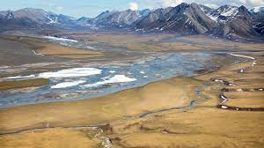
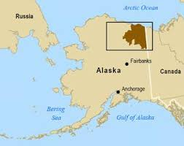
What is the Alaska National Wildlife Refuge
Over 19 million acres of pristine Wildlife Habitat
First set aside by President Eisenhower in 1960
1980 expanded to include the Arctic National Wildlife Refuge
Home to a diverse amount of plants and animals

Slide 3
What are the Two Sides?
Side 1 - Open the Alaska National Wildlife Refuge to oil and gas mining
Side 2 - Keep the Alaska National Wildlife Refuge closed to oil mining

Slide 4
Side One
Open the Alaska National Wildlife Refuge to oil mining

Slide 5
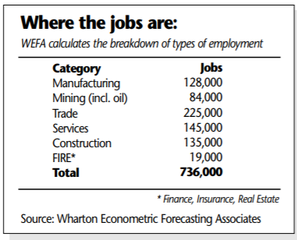
Side One from an Economic View
Amount of Oil
  Drilling is a risky endeavor that would cause widespread and permanent damage to the coastal plain and jeopardize its wildlife and ecosystem
Potential Monetary Value
  Estimated $600 Billion in revenue
Potential Jobs
  Over 700 thousands jobs

Slide 6
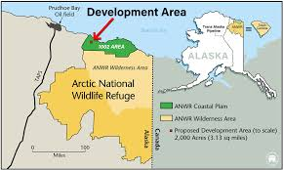
Side one from a Political View
Republic Tax Reform Bill
  Opened a portion of the land for drilling
  Area 1002

Slide 7
Side Two
Keep the Alaska National Wildlife Refuge closed to oil and gas mining

Slide 8
Side Two from a Scientific View
Habitat Deforestation
  Drilling is a risky endeavor that would cause widespread and permanent damage to the coastal plain and jeopardize its wildlife and ecosystem
Geological Screw ups
  Oil spills
    damage waterways, marine life, plants and animals on the land.
Water disruption
  Imperil drinking water
  Oil can contain toxic properties and produce harmful physical effects

Slide 9
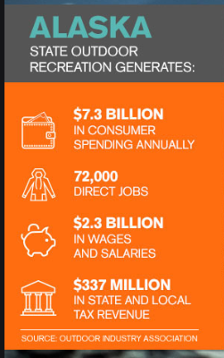
Side Two from a Social-Cultural View
Indigenous People
  They fear that drilling in this area will have an adverse effect on the herd, disrupting their annual migration and calving
Financial benefits of outdoor recreation
  Outdoor recreation brings $887 million in consumer spending per year nationally
  It exist in several states that reap economic benefit from public land use and the jobs it creates.

Slide 10
Stance on the Issue - Keep It Closed!
We ultimately believe in saving the wildlife refuge from being open to oil and gas mining.
Although one of us thinks there is a great amount of money to be made regardless of the sacrifices, the rest of us have decided that the sacrifices are too great to ignore.

Slide 11
Citations
ANWR: Producing American Energy and Creating American Jobs. (2013, March 11). Retrieved November 22, 2019, from https://republicans-naturalresources.house.gov/anwr/.
Arctic Refuge drilling controversy. (2019, October 22). Retrieved November 20, 2019, from https://en.wikipedia.org/wiki/Arctic_Refuge_drilling_controversy#/media/File:2_USGA_ANWR_Oil.png.
Collins, M. (2017, November 19). Congress moves to 'drill, baby, drill' in Alaska's ANWR. Here's what you should know. Retrieved November 22, 2019, from https://www.usatoday.com/story/news/politics/2017/11/19/congress-moves-drill-baby-drill-alaska-anwr-refuge-heres-what-you-should-know/874187001/.
Collins, M. (2017, November 19). Congress moves to 'drill, baby, drill' in Alaska's ANWR. Here's what you should know. Retrieved November 19, 2019, from https://www.usatoday.com/story/news/politics/2017/11/19/congress-moves-drill-baby-drill-alaska-anwr-refuge-heres-what-you-should-know/874187001/.
Economic Benefits of the Oil Industry: The Perryman Group. (2014, August 22). Retrieved November 21, 2019, from https://www.perrymangroup.com/publications/column/2014/08/22/economic-benefits-of-the-oil-industry/.
Overholt, M. (2017, October 23). Exceptional Benefits of Oil Drilling. Retrieved November 22, 2019, from https://www.tigergeneral.com/exceptional-benefits-oil-drilling/.

