Slide 1

“What is the affordable clean energy rule and should it be replaced?”
Katie Hestor
Daniel Lopez
Connor Creamer

Slide 2
Outline
Daniel Lopez - Background
Connor Creamer - Viewpoint #1 → Pro perspective
Katie Hestor - Viewpoint #2 → Critics perspective

Slide 3
Vocabulary
EPA : Environmental Protection Agency
CPP : Clean Power Plant
ACE : Affordable Clean Energy
BSER : Best Technology or Other Measure

Slide 4
Background/Introduction
On June 19, 2019, EPA issued the final Affordable Clean Energy rule (ACE)
replacing the prior administration’s overreaching Clean Power Plan with a rule that restores rule of law, empowers states, and supports energy diversity
The ACE rule establishes emission guidelines for states to use when developing plans to limit carbon dioxide (CO2) at their coal-fired electric generating units (EGUs)
In this notice, EPA also repealed the CPP, and issued new implementing regulations for ACE
significantly less effective and environmentally protective than its predecessor.
During President Trump's term

Slide 5
BSER = Heat Rate Improvement (HRI)
Candidate Technologies
Neural Network/Intelligent Sootblowers
Boiler Feed Pumps
Air Heater and Duct Leakage Control
Variable Frequency Drives
Blade Path Upgrade (Steam Turbine)
Redesign/Replace Economizer

Slide 6

Steps in ACE
Environmental Protection Agency determines BSTR
States are tasked with developing an implementation plan
Regulated entities take measures to comply

Slide 7
Pro-Affordable Clean Energy Rule
Gives Americans cleaner, and more affordable energy
Will provide a dependable and diverse energy
Reduces CO2 Emissions
  Expected to go down as much as 35% below 2005 levels in 2030
Will get rid of other pollutants such as mercury, precursors to fine particulate matter and ground level Ozone
EPA projects that ACE will result in annual benefits of $120 million to $730 million including costs, domestic climate benefits, health co-benefits

Slide 8
Critics of the Affordable Clean Energy Rule
Highly Stringent
Natural gas
Prohibited averaging emissions between units
Effectiveness

Slide 9
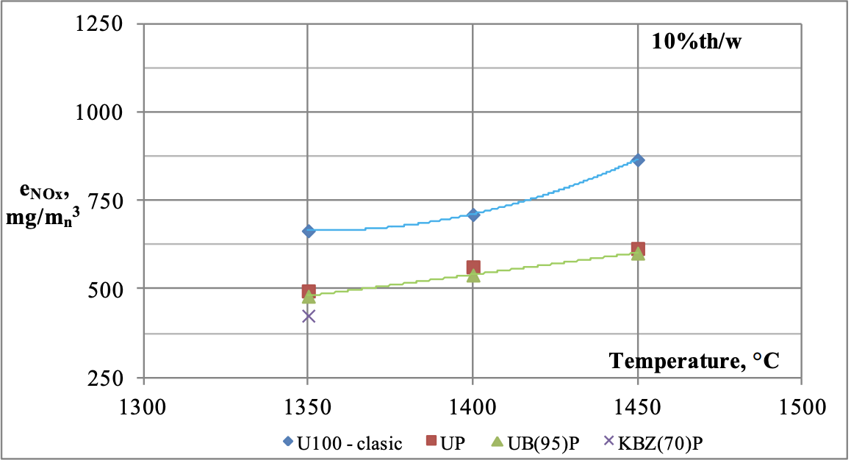
Natural Gas
Natural gas is excluded from BSER
EPA deems natural gas not generally available
75% of coal firing plant could cofire with Natural Gas
  60% could convert completely
Entities will use at-the-source-methods to comply
  Natural gas co-firing

Slide 10
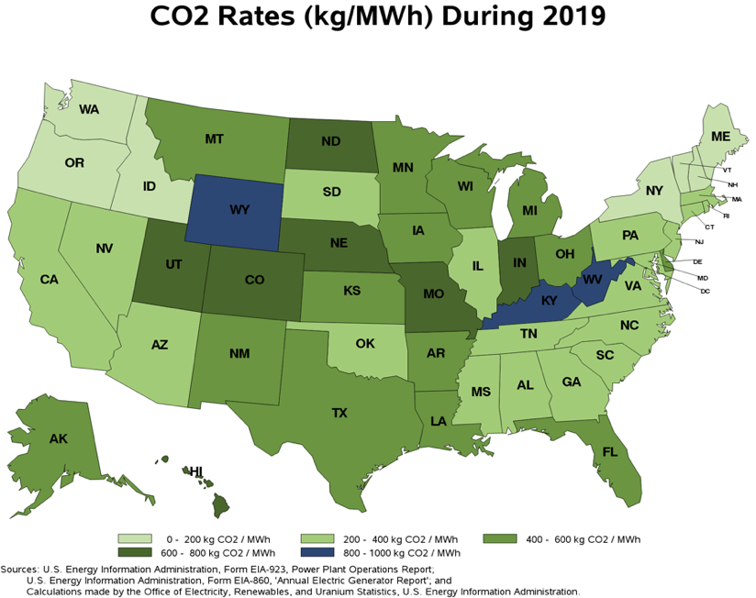
2. Prohibited Averaging Emissions Between Units
EPA does not allow plants to average emissions from multiple units in the same facility
EPA was granted this authority under the Clean Air Act
Increased administrative task - state level

Slide 11
3. Effectiveness
18% of coal plants will experience increased emissions
Increase of pollutant emissions in 20+ states
Rebound effect
a phenomenon in which heat rate improvements allow plants to operate more efficiently and thus encourage them to operate more

Slide 12
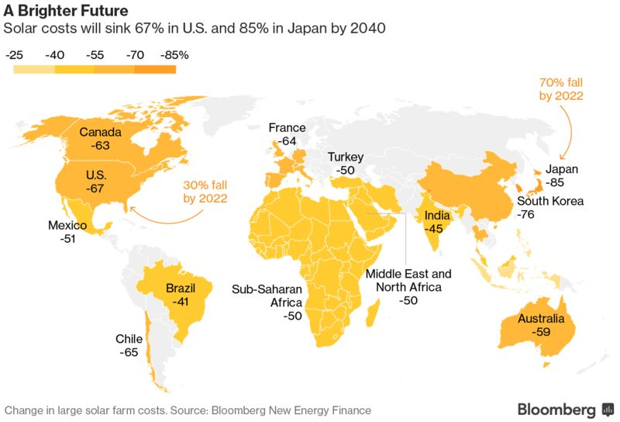
Conclusion
Do not support ACE rule
Not enough of an environmental impact
Greater emphasis should be placed on renewable energy sources
Trend of decreased cost for “new energy” methods
Long-term result in saved money and a more progressive nation

