Slide 1
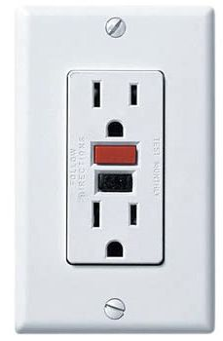
Introduction to Electricity
EGY 105 – Energy in Our World
Kenneth M. Klemow, Ph.D. – Wilkes University

Slide 2

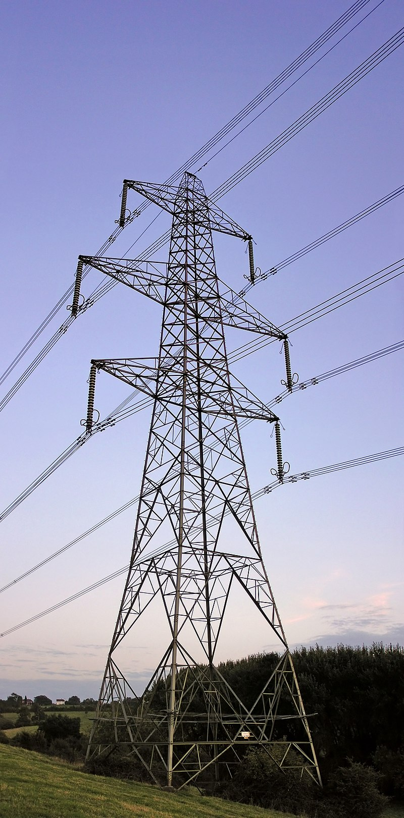
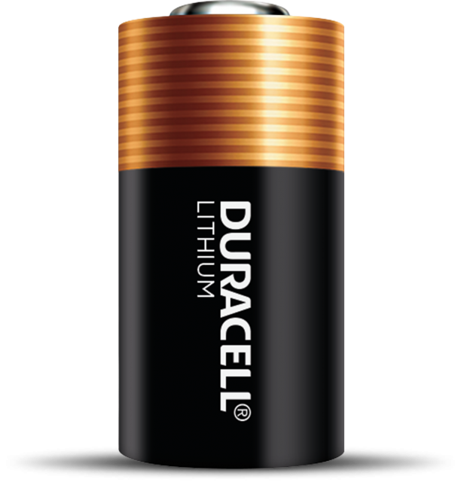
Electricity is a Familiar Concept
Power everyday devices
Carried by wires
Stored in batteries

Slide 3
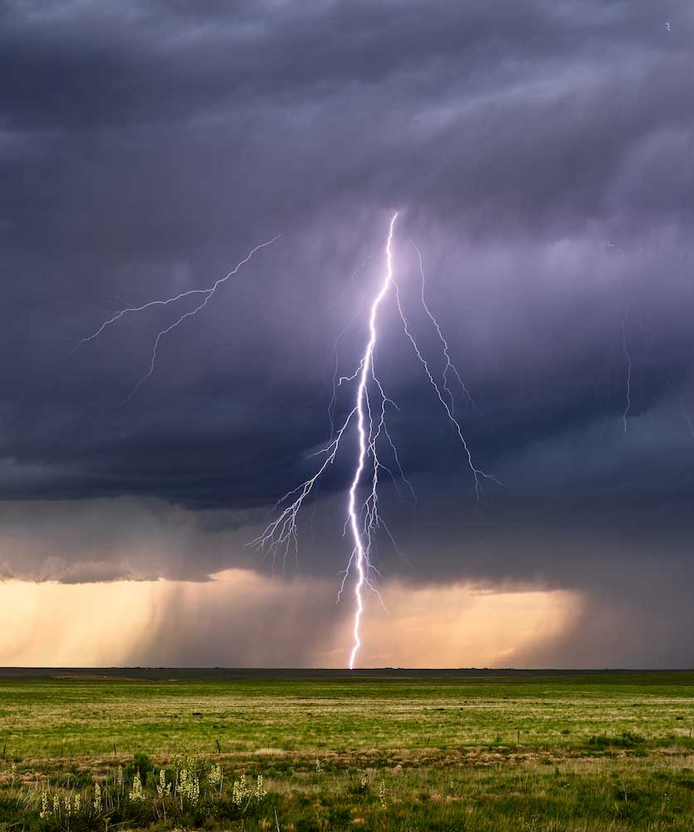
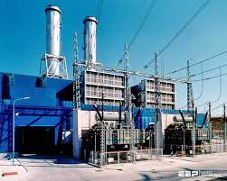

We also know that:
Natural Phenomenon
Generated by power plants
Can be hazardous

Slide 4
Points to be covered:
What is electricity?
  Atomic level
Conductors vs non-conductors
Electrical circuits
Voltage, Amperes, and Ohms
How generated?
  Role of spinning magnets
  Photoelectric effect
Electricity generation in US

Slide 5
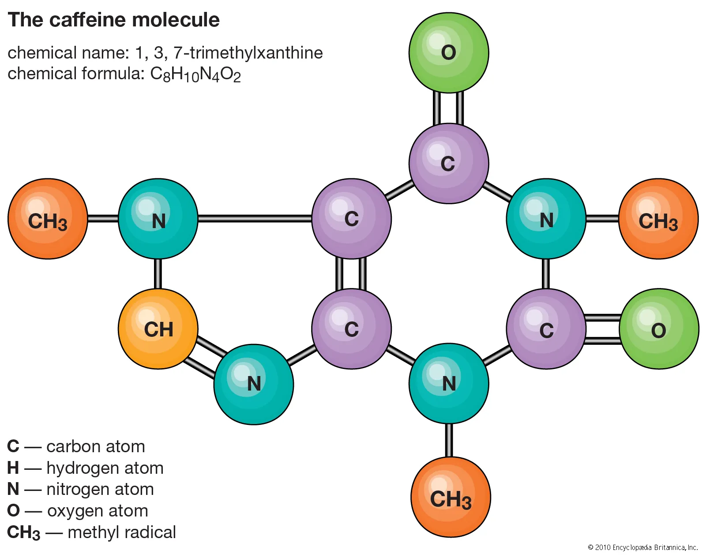
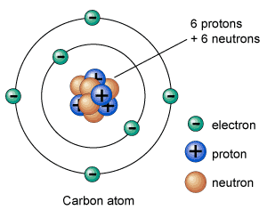
What is Electricity?
All matter made up of molecules and atoms
Atoms have three categories of particles
  Protons (In nucleus, positively charged)
  Neutrons (In nucleus, no charge)
  Electrons (Outside of nucleus, negatively charged)

Slide 6
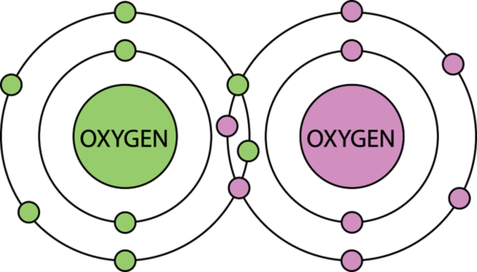
Stationary vs mobile electrons
In some atoms, electrons adhere to the nucleus
  Often shared between adjoining nuclei forming a bond

Slide 7
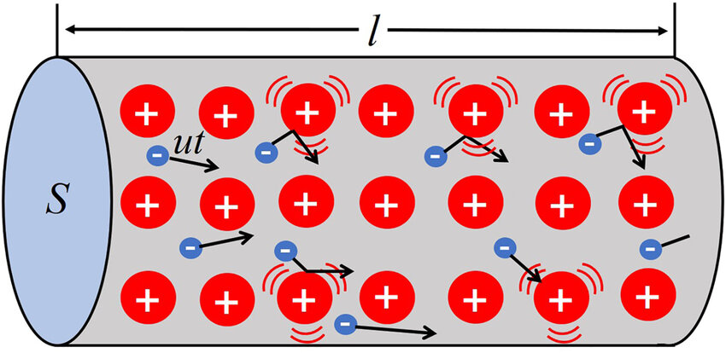
Stationary vs mobile electrons
In other atoms, electrons move from nucleus to nucleus
Note nuclei are positively charged

Slide 8
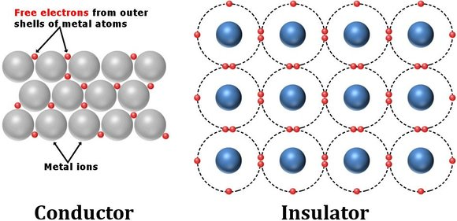
Conductors vs Insulators
https://www.themusictelegraph.com/146

Slide 9
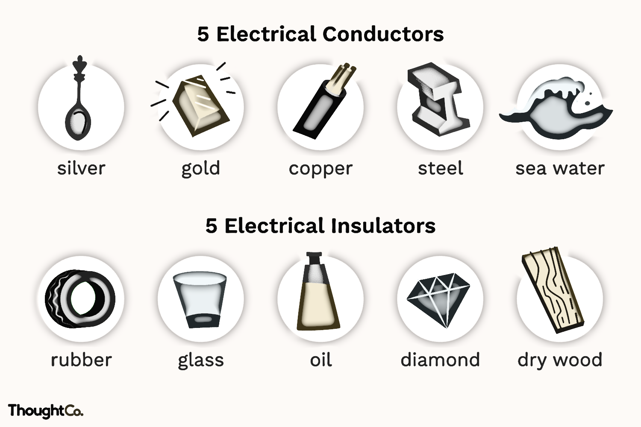
Conductors vs insulators

Slide 10
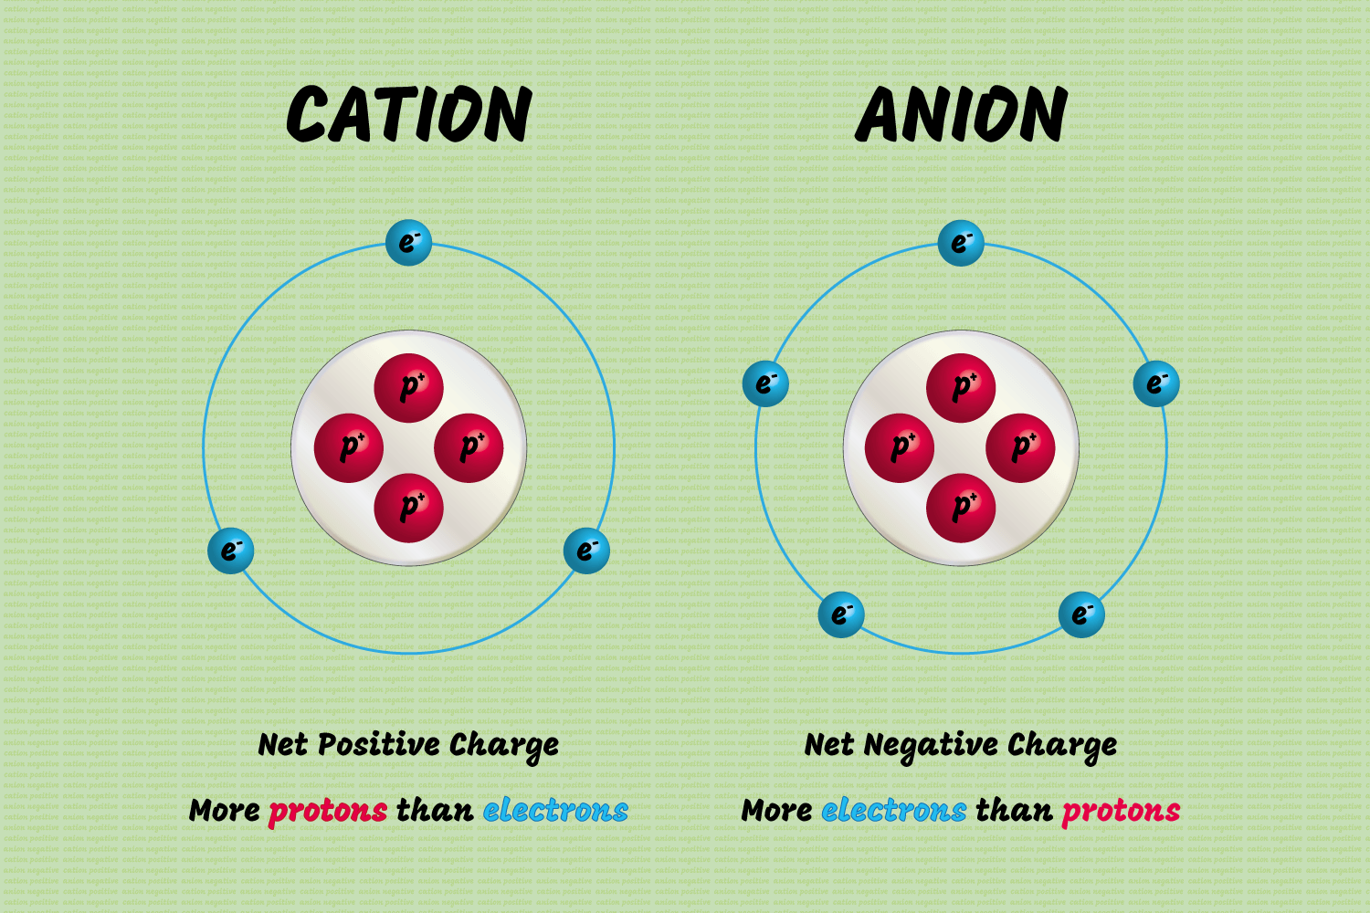
CATions vs ANions

Slide 11
Electrodes, Anodes, and cathodes
Electrode - a substance that helps in the conduction of electricity
The anode is the electrode where electricity moves into. | The cathode is the electrode where electricity is given out or flows out.
The anode is usually the positive side. | A cathode is a negative side.
It acts as an electron donor. | It acts as an electron acceptor.
https://byjus.com/chemistry/cathode-and-anode/

Slide 12
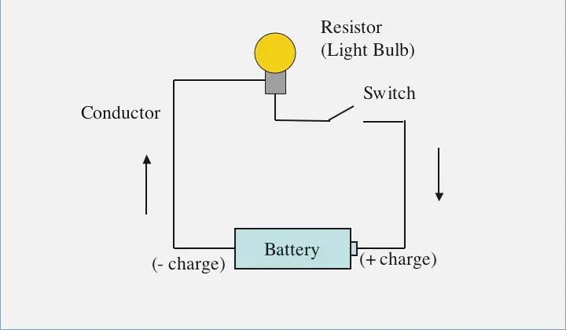
Circuits

Slide 13
Voltage, amperage, and Resistance
Voltage - the pressure from an electrical circuit's power source that pushes charged electrons (current) through a conducting loop.
  The amount of voltage is indicated by a unit known as the volt (V), and higher voltages cause more electricity to flow to an electronic device.

Slide 14
Voltage, amperage, and Resistance
Voltage - the pressure from an electrical circuit's power source that pushes charged electrons (current) through a conducting loop.
  The amount of voltage is indicated by a unit known as the volt (V), and higher voltages cause more electricity to flow to an electronic device.
Amperage - An ampere is the unit used to measure electric current.
  Current is a count of the number of electrons flowing through a circuit.
  One amp is the amount of current produced by a force of one volt acting through the resistance of one ohm.

Slide 15
Voltage, amperage, and Resistance
Voltage - the pressure from an electrical circuit's power source that pushes charged electrons (current) through a conducting loop.
  The amount of voltage is indicated by a unit known as the volt (V), and higher voltages cause more electricity to flow to an electronic device.
Amperage - An ampere is the unit used to measure electric current.
  Current is a count of the number of electrons flowing through a circuit.
  One amp is the amount of current produced by a force of one volt acting through the resistance of one ohm.
Resistance - a measure of the opposition to current flow in an electrical circuit
  An ohm is the resistance in a circuit transmitting a current of one ampere when subjected to a potential difference of one volt.

Slide 16
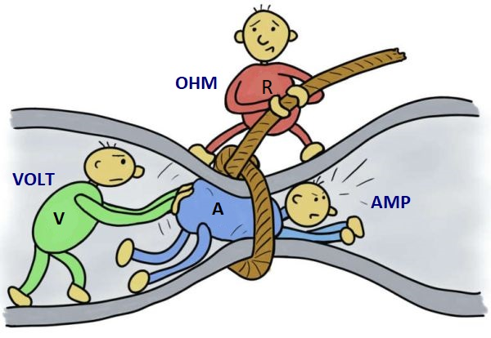
Amps, Volts, and Ohms explained

Slide 17
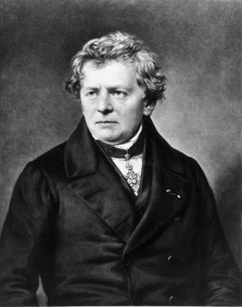
Ohm’s Law
V = IR
  V = Voltage
  I = Current (amps)
  R = Resistance (ohms)
R = V/I
I = V/R
Georg Ohm (1789 – 1854)

Slide 18
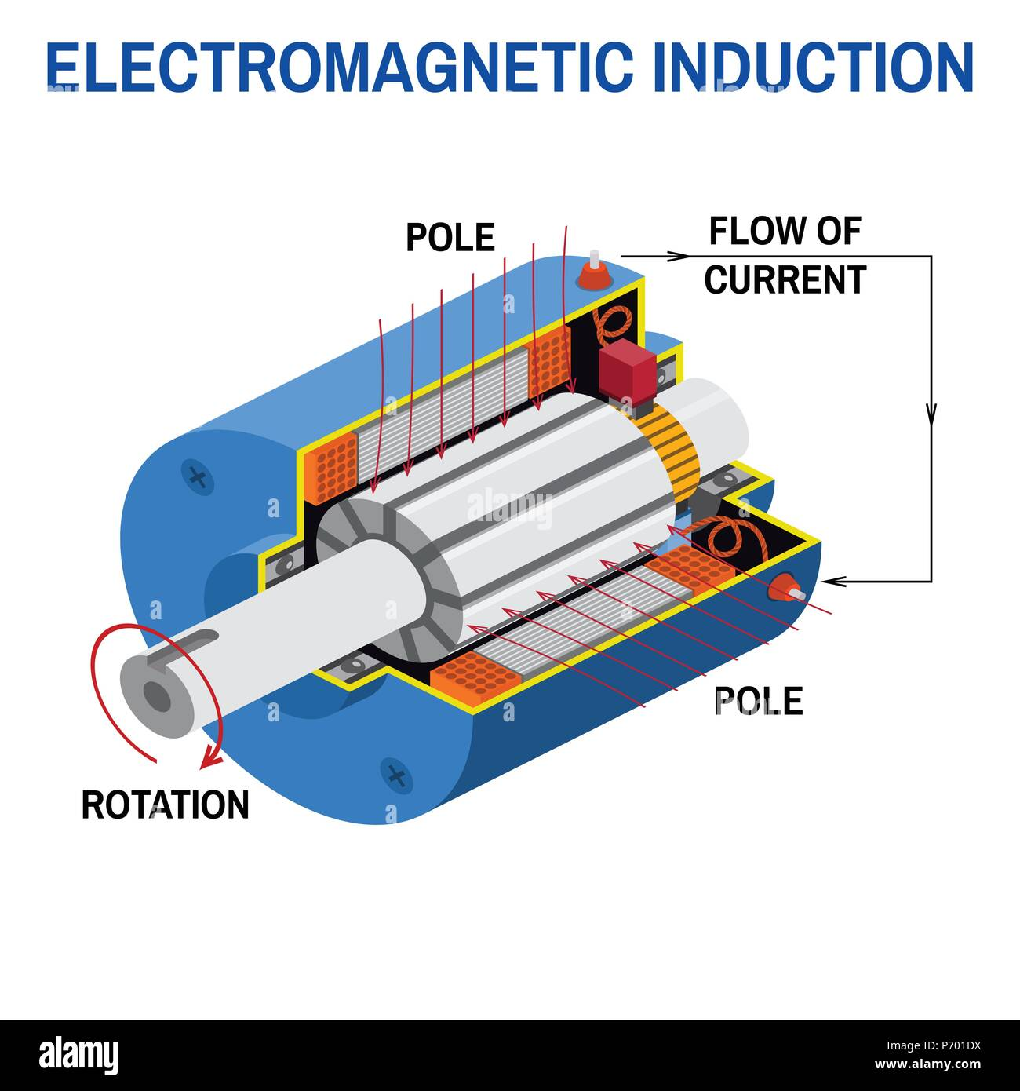
Generating electricity with magnets and wires
Spinning a magnet in the presence of wires, or spinning wires in the presence of a magnetic field generates electricity.
Principle behind most electrical generation involving steam, wind, or water.

Slide 19
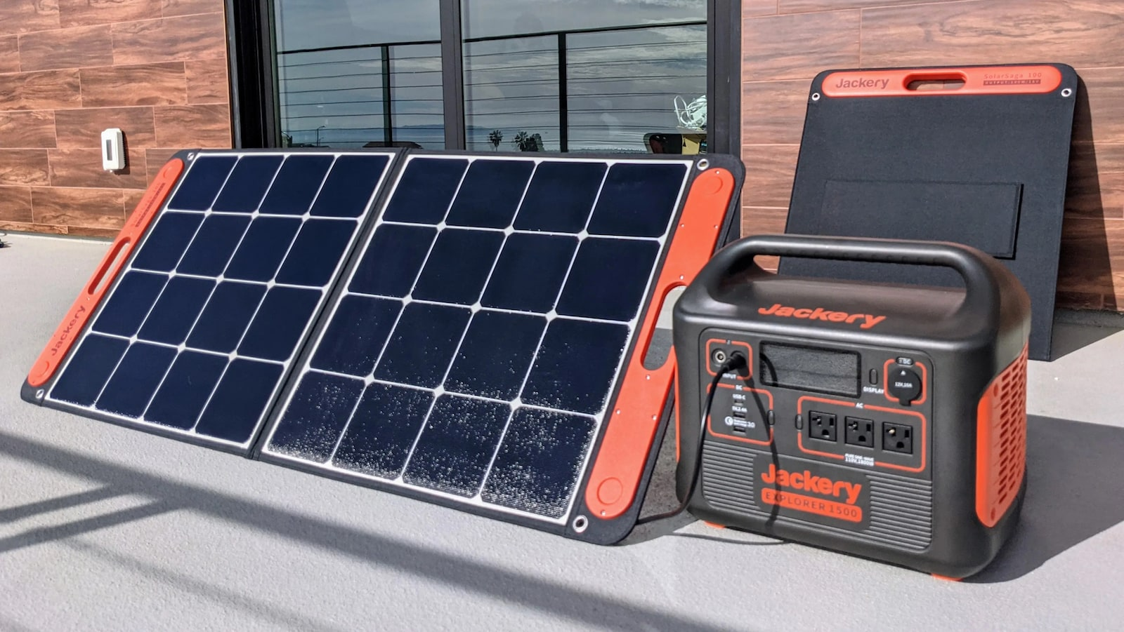
Generating electricity with Light
Photoelectric effect.

Slide 20
Generating electricity with Light
Photoelectric effect.
Will discuss in more detail in presentation on solar power.

Slide 21
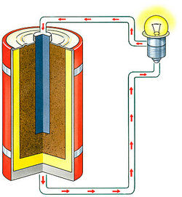
BATTERIES
Devices that are able to convert chemical energy to electrical energy.

Slide 22
BATTERIES
Devices that are able to convert chemical energy to electrical energy.
Consist of one or more electrochemical cell that are made up of two electrodes separated by an electrolyte.

Slide 23
BATTERIES
Devices that are able to convert chemical energy to electrical energy.
Consist of one or more electrochemical cell that are made up of two electrodes separated by an electrolyte.
Some single use, others rechargeable.

Slide 24
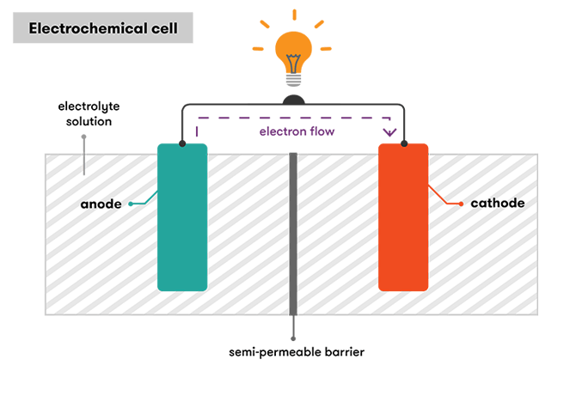
BATTERy Structure

Slide 25
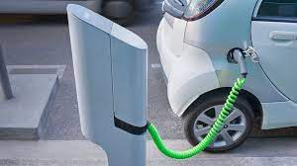
Future BATTERY Needs
Much research is needed to produce lighter, safer, more efficient renewable batteries to power transportation and store electrical energy when production exceeds demand.

Slide 26
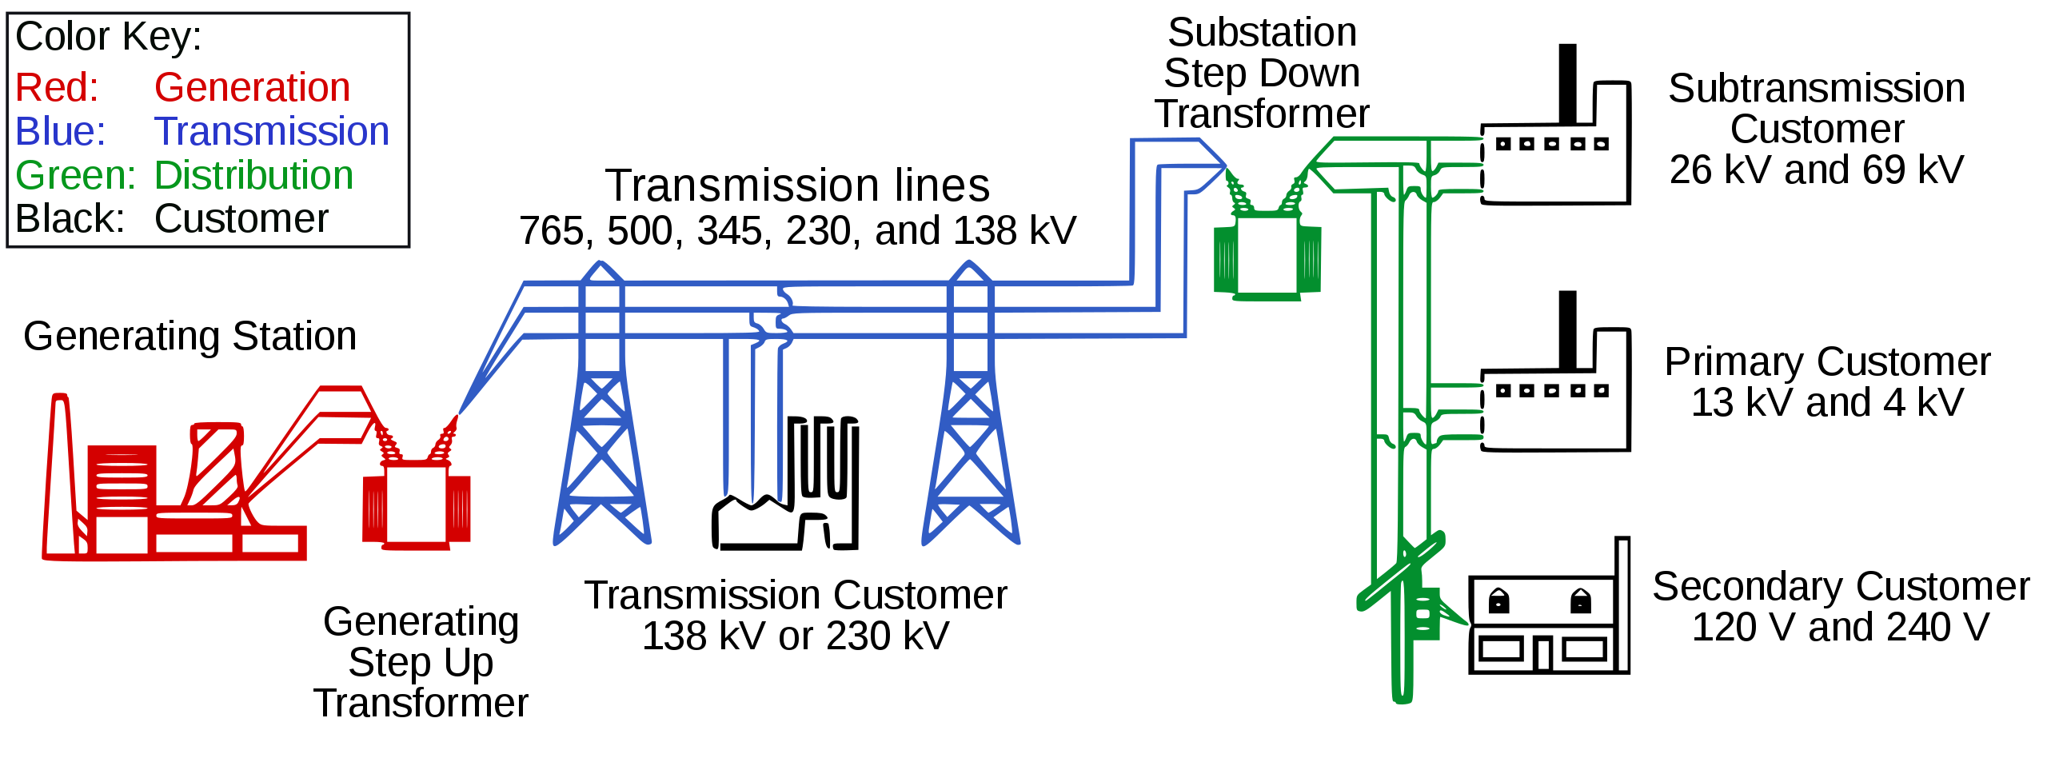
Electricity Distribution

Slide 27
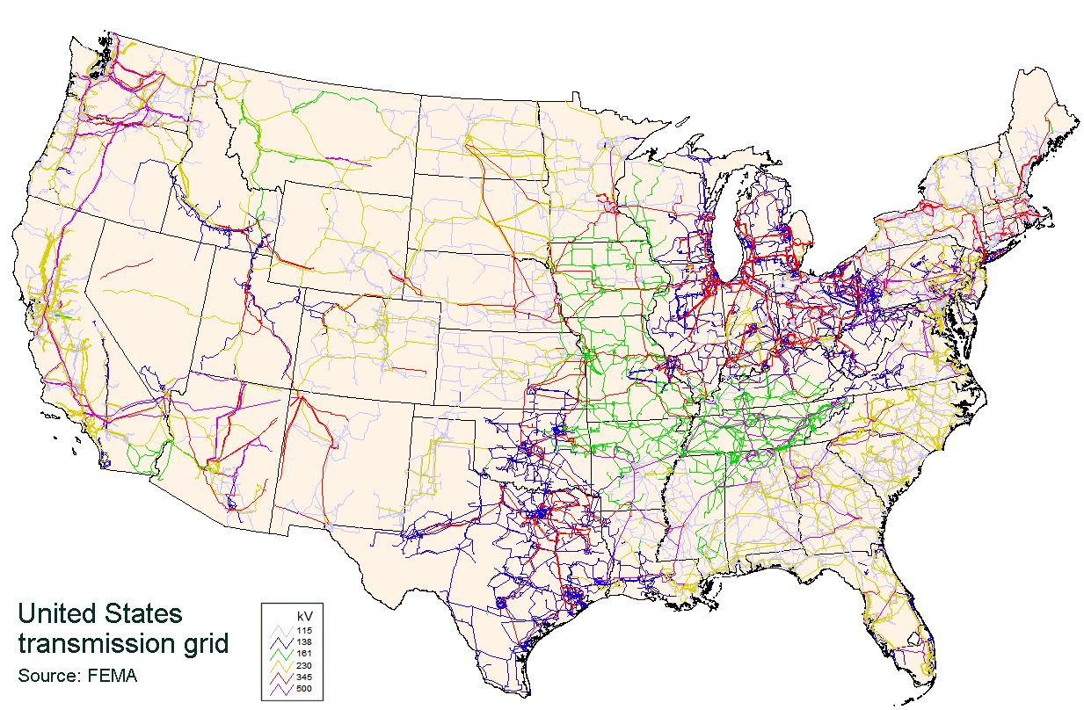
US Electrical Power Grid

Slide 28
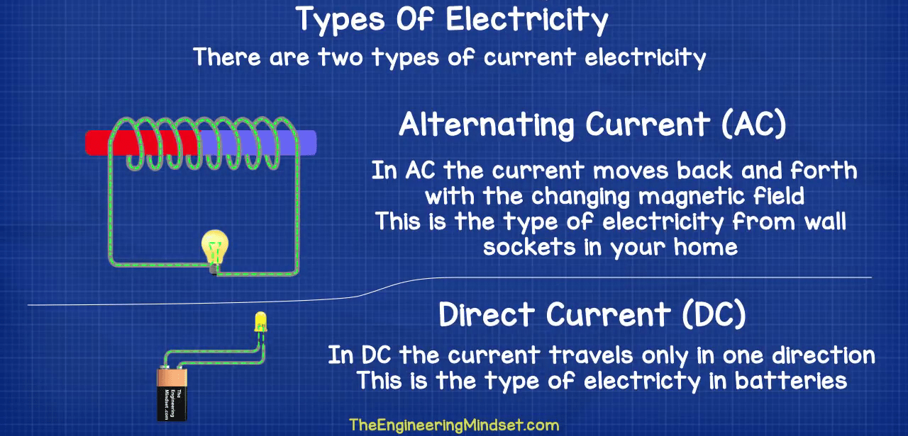
Alternating vs. Direct current

Slide 29
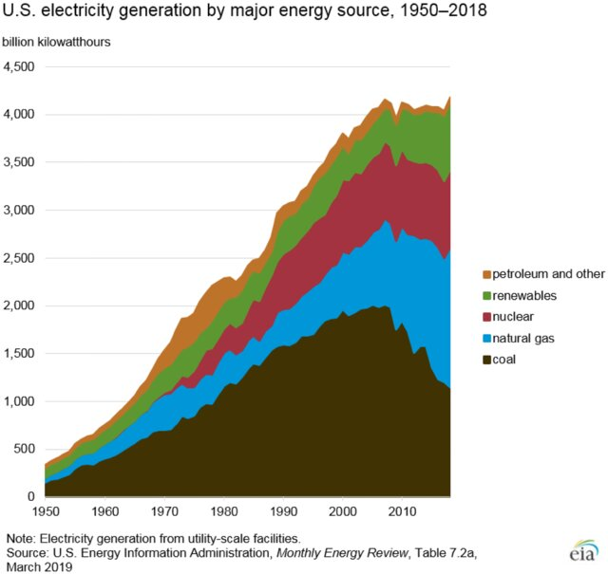

Slide 30

So much more to know regarding electricity

